Slide 1
ARTIFICIAL INTELLIGENCE
PHASE - III

Slide 2
DEVELOPMENT PART
PRESENTED BY
TEAM LEADER : KAVIBHARATHI G
TEAM MEMBERS : RAVIKUMAR M
BOOPATHI C
DHAYALAN R
BHUVANESWARAN M

Slide 3
LOAD
Nltk:
It sounds like you're interested in working with NLTK (Natural Language Toolkit) for building a chatbot. NLTK is a powerful library for working with human language data, but it doesn't inherently have a "loading" function specifically for chatbots. However, I can help guide you on how you might approach building a basic chatbot using NLTK in Python.

Slide 4
TXT (Text file):
# Assuming each line of your text file contains a separate conversation or dialog
with open('chatbot_data.txt', 'r') as file:
data = file.readlines ()
Custom Data Formats:
If your data is in a custom format, you might need to write a custom parser to load it.
This would depend on the specifics of your data format.

Slide 5
Necessary Steps
Import Libraries
Load the dataset
Exploratory Data Analytics(EDA)
Split the Data
Feature Scaling

Slide 6
Program:
import nltk
from nltk.chat.util import Chat, reflections
reflections = {
"i am" : "you are",
"i was" : "you were",
"i" : "you",
"i'm" : "you are",
"i'd" : "you would",
"i've" : "you have",
"i'll" : "you will",
"my" : "your",
"you are" : "I am",
"you were" : "I was",
"you've" : "I have",
"you'll" : "I will",
"your" : "my",
"yours" : "mine",
"you" : "me",
"me" : "you"
}

Slide 7
pairs=[
["hi",["Hi!,I'm chatbot, how can i help you?"]],
["need help",["how can i help you?"]],
["tourist place in India",["1.Tamilnadu 2.Delhi 3.kerala 4.karanataka 5.Mumbai"]],
["tourist place in Delhi",["1. Qutub Minar · 2. Swaminarayan Akshardham · 3. Humayun's Tomb · 4. Gurudwara Bangla Sahib · 5. Lodhi Garden · 6. India Gate. 7.Tajmahal "]],
["tourist place in Kerala",[" 1.Munnar · 2.Thekkady · 3.Kovalam · 4.Bekal · 5.Kozhikode · 6.Alleppey · 7.Vagamon · 8.Trivandrum."]],
["tourist place in Tamilnadu",["1.Ooty, 2.Kodaikanal, 3.Yercaud, 4.Yelagiri, 5.Madurai, 6.Rameshwaram, 7.Kanyakumari, 8.Thanjavur, 9.Kanchipurm."]],
["tourist place in karnataka",["1. Bangalore · 2. Coorg · 3. Hampi – One of the recommended places to visit in Karnataka · 4. Badami, Aihole and Pattadakal · 5. Kabini · 6. Jog Falls · 7. Mangalore."]],
["munnar",["1. Tea Gardens · 2. Kalari Kshethra · 3. Top Station · 4. Munnar Hiking Trails · 5. Rajamalai (Eravikulam) National Park · 6. Kundala Dam ."]],
["Qutub Minar",["1. Jagannath Temple · 2. Iron Pillar of Delhi · 3. Jamali Kamali Tomb and Mosque · 4. Iltutmish's Tomb · 5. Alai Minar."]],
["Ooty",["1. Avalanche Lake · 2. Ooty Lake · 3. Emerald Lake · 4. Ooty Botanical Gardens · 5. Deer Park"]],
["Coorg",["1. Mercara Gold Estate Coffee Plantation & Museum · 2. Mandalpatti Peak · 3. Abbey Falls · 4. Raja's Seat · 5. Dubare Elephant "]],
["Swaminarayan Akshardham",["1. Exhibitions · 2. Sahajanand Darshan - The Hall of Values · 3. Neelkanth Darshan - · 4. Sanskruti Darshan - Cultural Boat Ride · 5. Musical Fountain "]],
["Humayun's Tomb",["1. Tomb and mosque of Isa Khan: · 2. Bu Halima's tomb and garden: · 3. Afsarwala tomb and mosque: · 4. Arab Sarai: · 5. Nila Gumbad:"]],
["Thekkady",["1. Yodha Cultural Village Thekkady · 2. Green Park Spices Thekkady · 3. Periyar Lake · 4. Periyar National Park · 5. Elephant Junction."]],

Slide 8
["Kozhikode",["1. Kappad Beach · 2. Kozhikode Beach · 3. Tali Temple · 4. Kariyathumpara · 5. Sargaalaya · 6. Beypore Beach · 7. S.M. Street"]],
["Kovalam",["1. The Three Crescent Beaches · 2. Samudra Beach · 3. Vizhinjam Village · 4. Chowara · 5. Valiyathura Pier · 6. Thiruvallam · 7. Vellayani"]],
["Kodaikanal", ["1. Coakers Walk · 2. Kodaikanal Lake · 3. Berijam Lake · 4. Poombarai Village View · 5. Mannavanur Lake · 6. Pillar Rocks · 7. Pine "]],
["Rameshwaram",["1. Arulmigu Ramanatha Swamy Temple · 2. Dhanushkodi Beach Point · 3. Pamban bridge · 4. Dr. A.P.J. Abdul Kalam Memorial · 5. Annai Indira Gandhi Road Bridge"]],
["what is chatbot?",["chatbot is python program to help you."]],
["Hello! I'm really excited to explore Delhi today,There's so much history and culture here.",["Welcome to Delhi! I'm glad you're excited. We have a rich tapestry of history and culture waiting for you."]],
["I'm particularly interested in the Mughal period. I'd love to visit places like the Red Fort and Humayun's Tomb.",["Great choice! We'll start with the Red Fort. It's an iconic Mughal monument and a UNESCO World Heritage Site. You'll be amazed by its stunning architecture and the history behind it."]],
["That sounds fantastic. What's the story behind the Red Fort?",["The Red Fort, also known as Lal Qila, was built by the Mughal Emperor Shah Jahan in the 17th century. It served as the main residence of the Mughal emperors for nearly 200 years. The fort is a blend of Persian, Islamic, and Indian architecture and is a symbol of India's rich heritage."]],
["It sounds like a fascinating place. After that, I'd love to see Humayun's Tomb. I've heard it's a precursor to the Taj Mahal.",["It sounds like a fascinating place. After that, I'd love to see Humayun's Tomb. I've heard it's a precursor to the Taj Mahal."]],
["That's exactly what I'm looking for. What else would you recommend in Delhi?",["There are plenty of other places to explore in Delhi. If you're interested in more Mughal history, we can visit the Qutub Minar complex, which also houses the Iron Pillar and the Quwwat-ul-Islam Mosque. Additionally, you might want to experience the spiritual side of Delhi by visiting places like the Lotus Temple and Akshardham Temple."]],
["Those all sound like wonderful options. I'd also love to try some local cuisine. Where would you recommend for authentic Delhi street food?",["For authentic street food, you must visit Chandni Chowk. It's one of the oldest and busiest markets in Delhi, and it's known for its delicious street food. You can try specialties like chaat, chole bhature, and parathas at places like Paranthe Wali Gali and Karim's."]],

Slide 9
[" If you have any questions while we're going along, please don't hesitate to ask.",[" I have a question actually."]],
[" Hey I am your guide whose gonna help you to explore Delhi today.",["Yeah sure."]],
["This is the heart of Delhi which is also known as CP,Could you please tell me the full form of CP?",["Connaught Place."]],
["What’s so special about this place?",[" It’s the best place to hang out. A place where you can get almost everything. It’s not only a commercial hub but a transportation hub as well."]],
["Is this place good for shopping also?",[" Yes! Here you can get all the trendy and branded items of every range."]],
["Is there any shop famous for clothes?",["Yes. Shop no. 36 near west block is very famous for clothes."]],
["What kind of clothes will I get there?",["Ethnic as well as western clothes. Both the options are available there."]],
["Is there any place where I can click a lot of awesome pictures?",["Yup! The Inner circle of CP is best for photo-shoot."]],
["What kind of environment is there?",["It offers absolutely lively environment. There is also a central park where you can sit for hours and relax. And you can also take pictures of our nation flag which is right in the middle of that park."]],
["That’s marvelous. Could you please guide me there?",["Yeah sure."]],]

Slide 10
print("Hi! I am a chatbot created by JKKM COLLEGE OF TECHNOLOGY")
print("Welcome to the Virtual Travel Guide Chatbot!")
while True:
chatbot = Chat(pairs, reflections)
pairs = input("YOU:")
if pairs.lower() == 'quit':
break
reflections = chatbot.respond(pairs)
print(f"BOT:{ reflections}")
chatbot.converse()

Slide 11
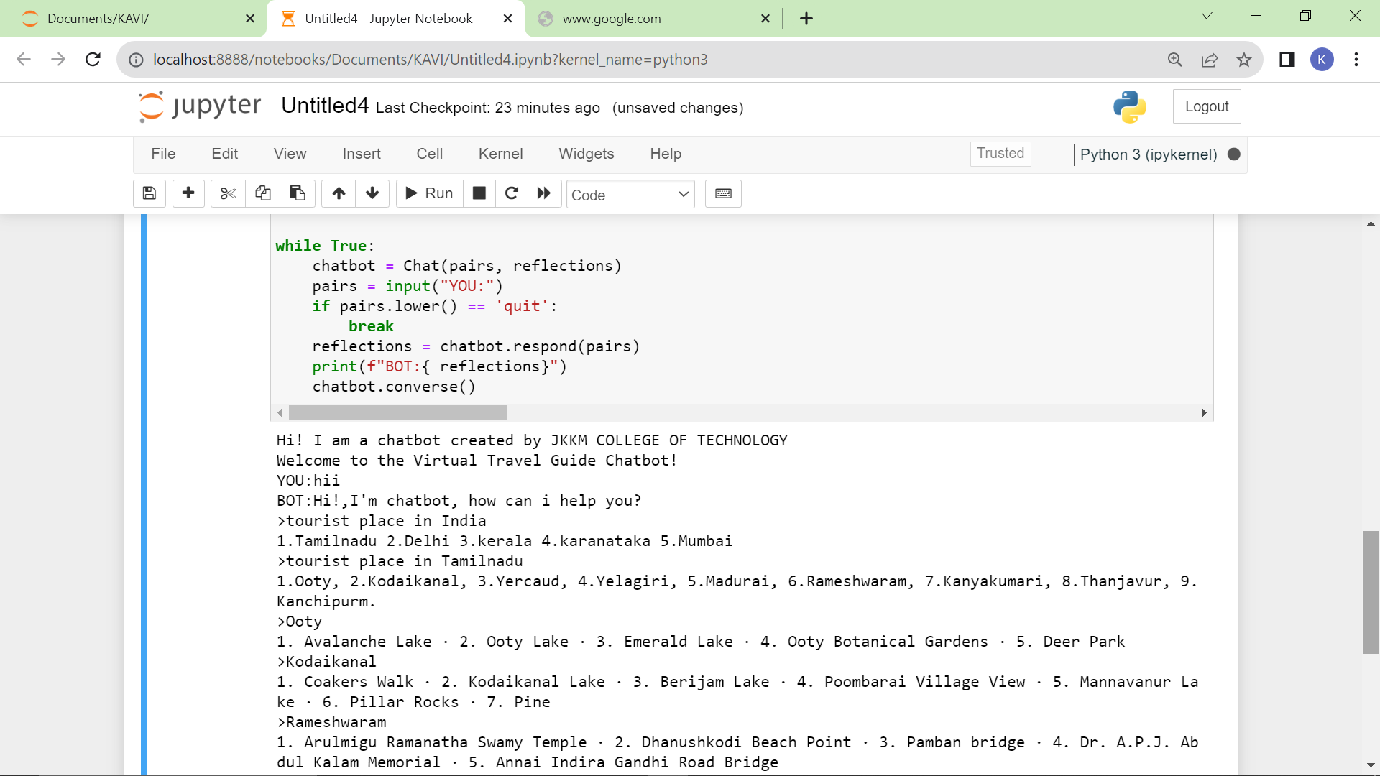
Output:

Slide 12
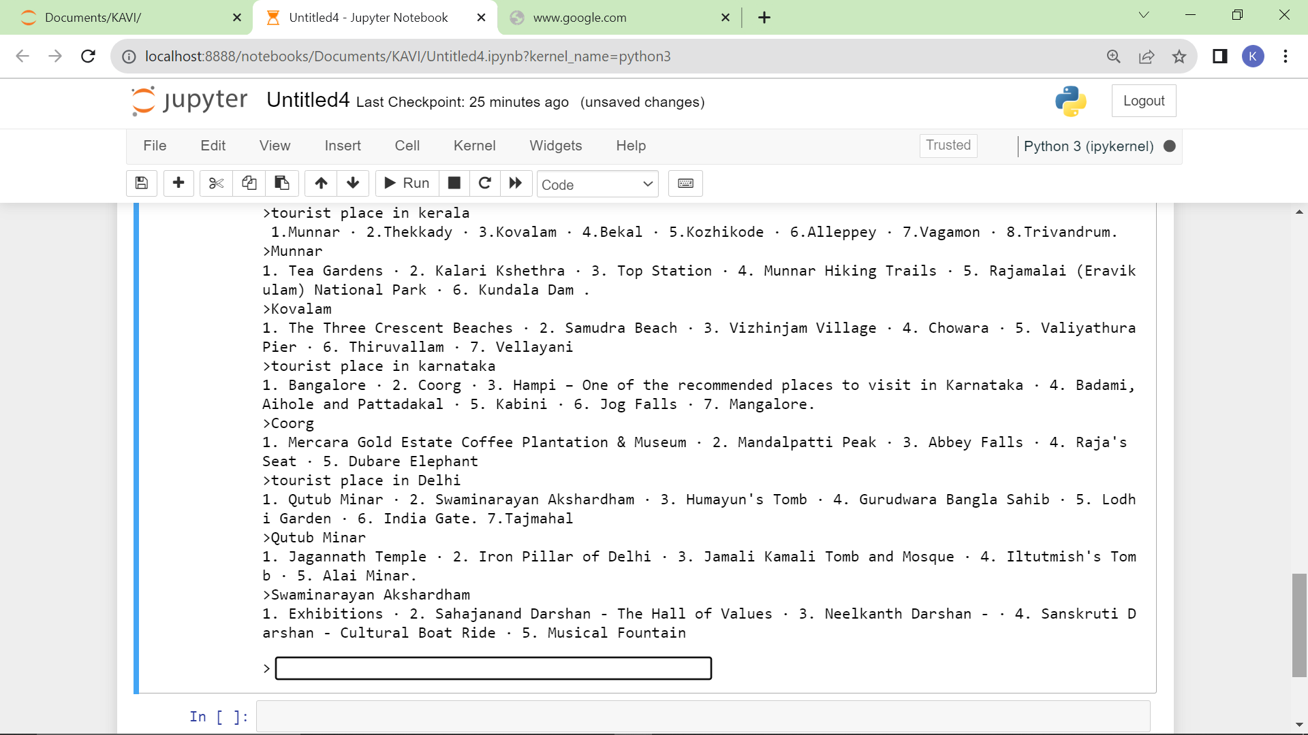

Slide 13
PREPROCESSING
1.Data Cleaning
2. Data Transforming
3. Data Integration

Slide 14
Data Cleaning:
This involves identifying and correcting errors and inconsistencies in the data.
For example, this may involve removing duplicate records, correcting typos, and filling in missing values.

Slide 15
Data Transforming:
This involves combining data from multiple sources into a single dataset.
This may invove resolving inconsistencies in the dataset , such as different data formats or different variable names.

Slide 16
Data Integration:
This involves converting the data into a format that is suitable for the analysis task.
For example, this may involve converting categorical data to numerical data, or scaling the data to a suitable range.

Slide 17
Training data generator
To quickly get more training data for NLU task, you can use a training data generator. It is a program which takes templates and generates a lot of examples for model training.
Well-known generators are Chatito (in Node.js) and Chatette (in Python). A Python programming language preprocessor is a common tool.

Slide 18
Crowdsource
To get more training data of high quality, you can outsource jobs to distributed workers, using Amazon MechanicalTurk, Microworkers, Clickworker platforms.
In a short time and at a reduced cost, you can get human-written training data for your initial model to augment training data collection and ultimately accelerate Python-based chatbot development using data preprocessing for text classification.

Slide 19
Pre-trained model
The pre-trained language model can be used for NLU tasks without any task-specific change to the model architecture.
Pre-trained models have an ability to continue pre-training on custom data, strarting from some checkpoint.

Slide 20
THANKING YOU
Mentor Evaluator SPOC HOD

