Slide 1
ARTIFICIAL INTELLIGENCE
PHASE-IV

Slide 2
DEVELOPMENT PART-2
PRESENTED BY
TEAM LEADER : KAVIBHARATHI G
TEAM MEMBERS : RAVIKUMAR M
BOOPATHI C
DHAYALAN R
BHUVANESWARAN M

Slide 3
Feature Engineering
Input Processing:
Implement a preprocessing pipeline to handle user input. This may include.
Tokenization
Lowercasing
Punctuation Removal

Slide 4
Entity Recognition:
Utilize named entity recognition (NER) techniques to extract important information from user inputs. This can be done using pre-trained models or by training your own.
Context Management:
Implement a mechanism to keep track of the conversation history. This ensures that the chatbot maintains context and provides relevant responses.

Slide 5
Intent Classification:
Choose or develop an intent classification algorithm. Common approaches include using deep learning models like recurrent neural networks (RNNs) or transformers

Slide 6
Model Training:
Model Selection:
Based on the nature of your chatbot, choose an appropriate model architecture.
This could be a rule-based system, a machine learning model, or a deep learning model.
Data Collection:
Gather a dataset of labeled examples. Each example should consist of a user input and the corresponding expected response.

Slide 7
Training Process:
Feed the labeled dataset into the chosen model.
Define a loss function and optimization strategy.
Train the model for a suitable number of epochs, monitoring performance on a validation set.
Fine-tuning:
Fine-tune the model's hyperparameters based on validation set performance. This might involve adjusting learning rates, batch sizes, or architectural choices.

Slide 8
Evaluation
Metric Selection:
Choose appropriate evaluation metrics based on the nature of your chatbot. Common metrics include accuracy, precision, recall, F1-score, and perplexity.
Validation Set:
Set aside a portion of your dataset as a validation set. This will be used to evaluate how well the model generalizes to unseen data.

Slide 9
User Testing:
Conduct user testing with real users to gather feedback on the chatbot's performance. This can help identify areas for improvement.
Iterative Improvement:
Based on evaluation results and user feedback, make adjustments to the model, feature engineering process, or other components of the chatbot.

Slide 10
Program
import nltk
from nltk.chat.util import Chat, reflections
reflections = {
"i am" : "you are",
"i was" : "you were",
"i" : "you",
"i'm" : "you are",
"i'd" : "you would",
"i've" : "you have",
"i'll" : "you will",
"my" : "your",
"you are" : "I am",
"you were" : "I was",
"you've" : "I have",
"you'll" : "I will",
"your" : "my",
"yours" : "mine",
"you" : "me",
"me" : "you"
}

Slide 11
pairs=[
["hi",["Hi!,I'm chatbot, how can i help you?"]],
["need help",["how can i help you?"]],
["tourist place in India",["1.Tamilnadu 2.Delhi 3.kerala 4.karanataka 5.Mumbai"]],
["tourist place in Delhi",["1. Qutub Minar · 2. Swaminarayan Akshardham · 3. Humayun's Tomb · 4. Gurudwara Bangla Sahib · 5. Lodhi Garden · 6. India Gate. 7.Tajmahal "]],
["tourist place in Kerala",[" 1.Munnar · 2.Thekkady · 3.Kovalam · 4.Bekal · 5.Kozhikode · 6.Alleppey · 7.Vagamon · 8.Trivandrum."]],
["tourist place in Tamilnadu",["1.Ooty, 2.Kodaikanal, 3.Yercaud, 4.Yelagiri, 5.Madurai, 6.Rameshwaram, 7.Kanyakumari, 8.Thanjavur, 9.Kanchipurm."]],
["tourist place in karnataka",["1. Bangalore · 2. Coorg · 3. Hampi – One of the recommended places to visit in Karnataka · 4. Badami, Aihole and Pattadakal · 5. Kabini · 6. Jog Falls · 7. Mangalore."]],
["munnar",["1. Tea Gardens · 2. Kalari Kshethra · 3. Top Station · 4. Munnar Hiking Trails · 5. Rajamalai (Eravikulam) National Park · 6. Kundala Dam ."]],
["Qutub Minar",["1. Jagannath Temple · 2. Iron Pillar of Delhi · 3. Jamali Kamali Tomb and Mosque · 4. Iltutmish's Tomb · 5. Alai Minar."]],
["Ooty",["1. Avalanche Lake · 2. Ooty Lake · 3. Emerald Lake · 4. Ooty Botanical Gardens · 5. Deer Park"]],
["Coorg",["1. Mercara Gold Estate Coffee Plantation & Museum · 2. Mandalpatti Peak · 3. Abbey Falls · 4. Raja's Seat · 5. Dubare Elephant "]],
["Swaminarayan Akshardham",["1. Exhibitions · 2. Sahajanand Darshan - The Hall of Values · 3. Neelkanth Darshan - · 4. Sanskruti Darshan - Cultural Boat Ride · 5. Musical Fountain "]],
["Humayun's Tomb",["1. Tomb and mosque of Isa Khan: · 2. Bu Halima's tomb and garden: · 3. Afsarwala tomb and mosque: · 4. Arab Sarai: · 5. Nila Gumbad:"]],
["Thekkady",["1. Yodha Cultural Village Thekkady · 2. Green Park Spices Thekkady · 3. Periyar Lake · 4. Periyar National Park · 5. Elephant Junction."]],

Slide 12
["Kozhikode",["1. Kappad Beach · 2. Kozhikode Beach · 3. Tali Temple · 4. Kariyathumpara · 5. Sargaalaya · 6. Beypore Beach · 7. S.M. Street"]],
["Kovalam",["1. The Three Crescent Beaches · 2. Samudra Beach · 3. Vizhinjam Village · 4. Chowara · 5. Valiyathura Pier · 6. Thiruvallam · 7. Vellayani"]],
["Kodaikanal", ["1. Coakers Walk · 2. Kodaikanal Lake · 3. Berijam Lake · 4. Poombarai Village View · 5. Mannavanur Lake · 6. Pillar Rocks · 7. Pine "]],
["Rameshwaram",["1. Arulmigu Ramanatha Swamy Temple · 2. Dhanushkodi Beach Point · 3. Pamban bridge · 4. Dr. A.P.J. Abdul Kalam Memorial · 5. Annai Indira Gandhi Road Bridge"]],
["what is chatbot?",["chatbot is python program to help you."]],
["Hello! I'm really excited to explore Delhi today,There's so much history and culture here.",["Welcome to Delhi! I'm glad you're excited. We have a rich tapestry of history and culture waiting for you."]],
["I'm particularly interested in the Mughal period. I'd love to visit places like the Red Fort and Humayun's Tomb.",["Great choice! We'll start with the Red Fort. It's an iconic Mughal monument and a UNESCO World Heritage Site. You'll be amazed by its stunning architecture and the history behind it."]],
["That sounds fantastic. What's the story behind the Red Fort?",["The Red Fort, also known as Lal Qila, was built by the Mughal Emperor Shah Jahan in the 17th century. It served as the main residence of the Mughal emperors for nearly 200 years. The fort is a blend of Persian, Islamic, and Indian architecture and is a symbol of India's rich heritage."]],
["That's exactly what I'm looking for. What else would you recommend in Delhi?",["There are plenty of other places to explore in Delhi. If you're interested in more Mughal history, we can visit the Qutub Minar complex, which also houses the Iron Pillar and the Quwwat-ul-Islam Mosque. Additionally, you might want to experience the spiritual side of Delhi by visiting places like the Lotus Temple and Akshardham Temple."]],

Slide 13
["what kind of music do you enjoy listening to?",["i enjoy listening to all kinds of music."]],
["what kind?",["i like to listen to rock and r&b."]],
["where are you going?",["i have to walk the dog."]],
["what kind of dog do you have?",["i have a little poodle.poodles bark a lot.they sure do.they sure do.they bark at everything.they never shut up."]],
["why did you get a poodle?",[" it's my mom's dog.so she likes poodles. she says they're good watchdogs."]],
["can i borrow $5?",["sure."]],
["why do you need it?",["i want to buy lunch."]],
["where's your money?",["it's not in my wallet."]],
["your wallet is empty?",["i don't have even one dollar in it.being broke is no fun.even if it's only for a short while.friends will lend you money when you're broke. as long as you pay them back. let's go to the beach.that's a great idea."]],
["what's on tv?",["nothing.there must be something on tv!nothing that's interesting."]], ["what about that new game show?which one?",["deal or no deal tell me you're joking.i watched it once. that was enough.it's on right now. let's watch it together."]],
["what's for dinner?",["i'm not sure"]],
[" how about a pizza?",["you had pizza for lunch.everybody loves pizza."]],
["so why can't i have pizza for dinner?",["because you need variety."]],
["what's the matter?",[ "i was on a plane."]],
["did she get a nice job?",["she got an everything job!"]],
["i'll see you tomorrow then.",["see you then. goodbye."]],
]

Slide 14
[" If you have any questions while we're going along, please don't hesitate to ask.",[" I have a question actually."]],
[" Hey I am your guide whose gonna help you to explore Delhi today.",["Yeah sure."]],
["This is the heart of Delhi which is also known as CP,Could you please tell me the full form of CP?",["Connaught Place."]],
["What’s so special about this place?",[" It’s the best place to hang out. A place where you can get almost everything. It’s not only a commercial hub but a transportation hub as well."]],
["Is this place good for shopping also?",[" Yes! Here you can get all the trendy and branded items of every range."]],
["Is there any shop famous for clothes?",["Yes. Shop no. 36 near west block is very famous for clothes."]],
["What kind of clothes will I get there?",["Ethnic as well as western clothes. Both the options are available there."]],
["Those all sound like wonderful options. I'd also love to try some local cuisine. Where would you recommend for authentic Delhi street food?",["For authentic street food, you must visit Chandni Chowk. It's one of the oldest and busiest markets in Delhi, and it's known for its delicious street food. You can try specialties like chaat, chole bhature, and parathas at places like Paranthe Wali Gali and Karim's."]],
["That sounds amazing. I can't wait to try it all. Thank you for all your recommendations!",["You're welcome! I'm sure you'll have a fantastic time exploring Delhi. If you have any more questions or if there's anything else you'd like to see, feel free to let me know. Enjoy your trip!"]],

Slide 15
["Is there any place where I can click a lot of awesome pictures?",["Yup! The Inner circle of CP is best for photo-shoot."]],
["What kind of environment is there?",["It offers absolutely lively environment. There is also a central park where you can sit for hours and relax. And you can also take pictures of our nation flag which is right in the middle of that park."]],
["That’s marvelous. Could you please guide me there?",["Yeah sure."]],]
print("Hi! I am a chatbot created by JKKM COLLEGE OF TECHNOLOGY")
print("Welcome to the Virtual Travel Guide Chatbot!")
while True:
chatbot = Chat(pairs, reflections)
pairs = input("YOU:")
if pairs.lower() == 'quit':
break
reflections = chatbot.respond(pairs)
print(f"BOT:{ reflections}")
chatbot.converse()

Slide 16
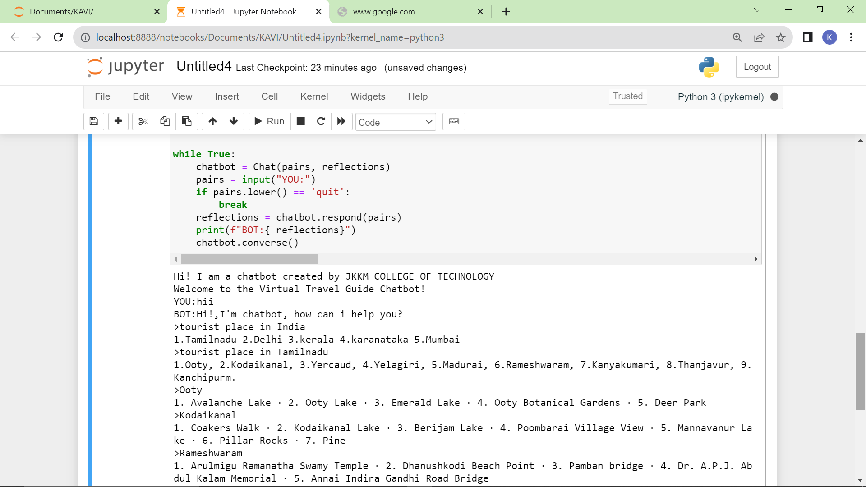
Output

Slide 17
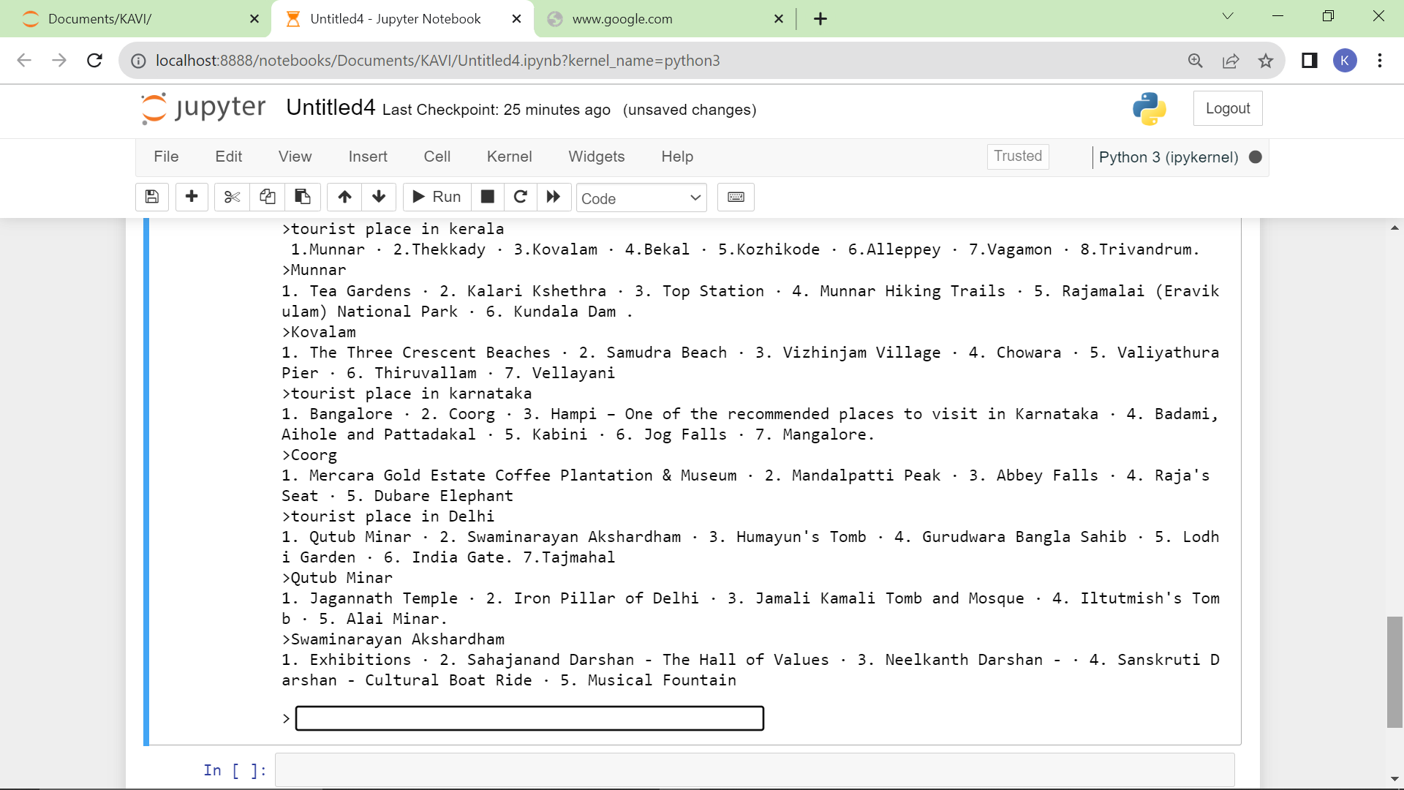

Slide 18
ALGORITHM
Import Necessary Libraries:
Import nltk
From nltk.tokenize import word_tokenize
from nltk.corpus import stopwords
from nltk.stem import WordNetLemmatizer

Slide 19
Initialize NLTK:
nltk.download('punkt')
nltk.download('stopwords')
nltk.download('wordnet')

Slide 20
Preprocess User Input:
Tokenization: Break the input text into individual words or tokens.
Lowercasing: Convert all tokens to lowercase for uniformity.
Removing Stopwords: Remove common words (like "the", "is", "in") that don't contribute much to meaning.
def preprocess(text):
tokens = word_tokenize(text)
tokens = [word.lower() for word in tokens if word.isalnum()]
tokens = [word for word in tokens if word not in stopwords.words('english')]
return tokens

Slide 21
Define Responses:
Create a dictionary or a set of rules that map user inputs to corresponding responses.
responses = {
"hello": "Hello! How can I assist you today?",
"goodbye": "Goodbye! Have a great day!",
# Add more responses based on your chatbot's purpose
}

Slide 22
Process User Input:
Given a user's input, preprocess it and check if it matches any predefined patterns or keywords.
def respond(user_input):
tokens = preprocess(user_input)
for token in tokens:
if token in responses:
return responses[token]
return "I'm not sure how to respond to that."

Slide 23
Run the Chatbot:
Prompt the user for input and provide responses based on their input.
while True:
user_input = input("You: ")
if user_input.lower() == 'exit':
break
response = respond(user_input)
print("Bot:", response)

Slide 24
THANKING YOU
Mentor Evaluator SPOC HOD

