Slide 1
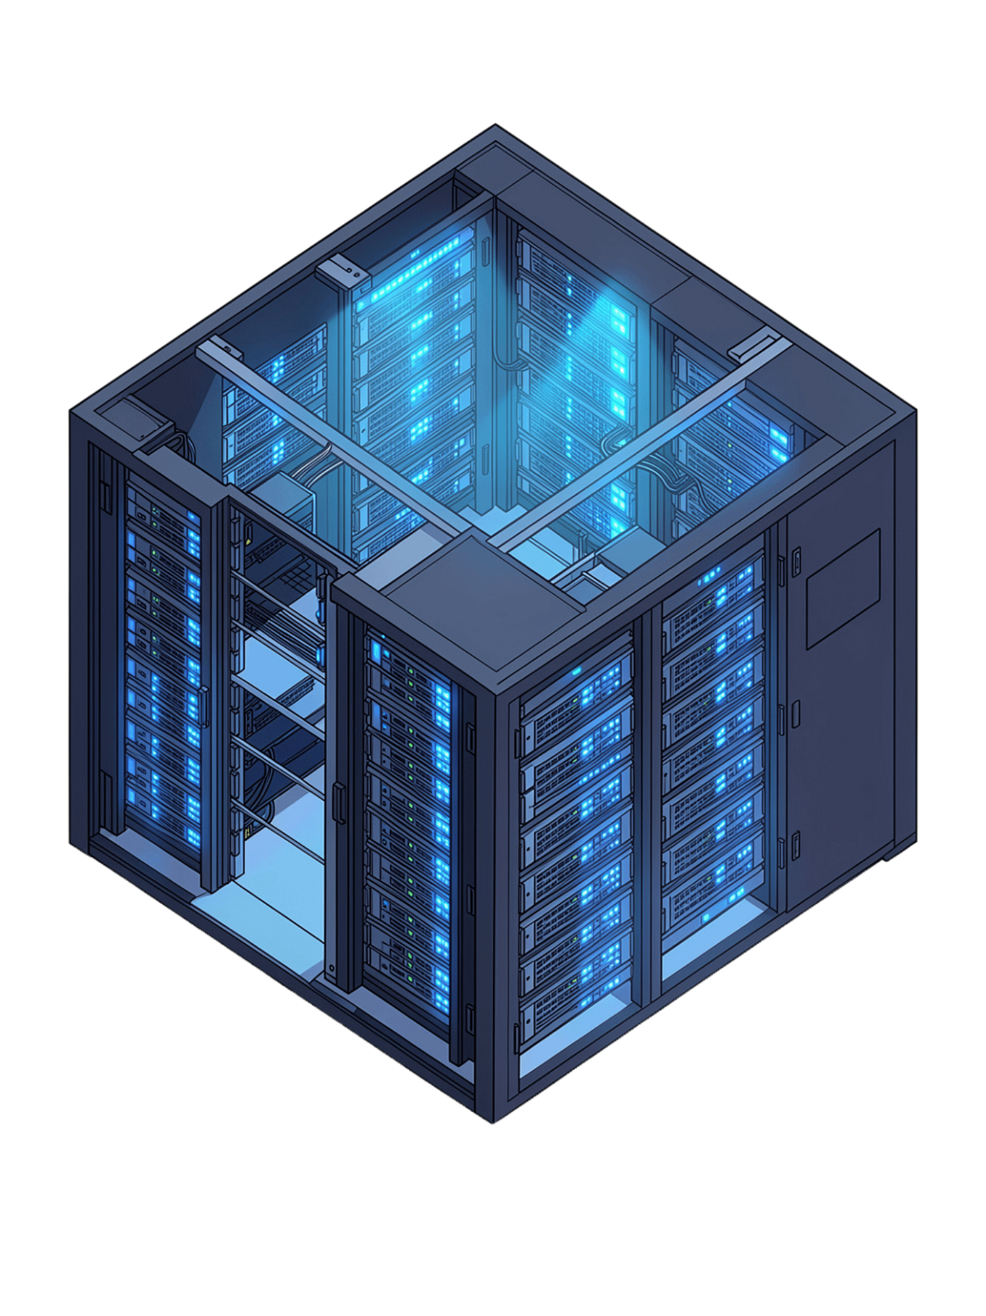
SkyDriveX
A Secure Cloud-Based File Storage Platform

Slide 2

Project Overview
MERN Stack
AWS S3
Secure, scalable cloud storage platform built end-to-end with the MERN Stack
Integrated with Amazon S3 for reliable, enterprise-grade file storage
Private Accounts
Users get private, secure accounts to store and manage their digital files

Slide 3
Key Features
Authentication
File Operations
Secure registration & login powered by JWT + Bcrypt encryption
Upload, download, preview, rename, move, search, and delete files with ease
Folder Management
S3 Storage
Create and organize files into folders for clean, structured storage
All files stored securely and durably on Amazon S3 infrastructure

Slide 4

Technology Stack
Frontend
Backend
Database
React.js, Vite, HTML5, CSS3
Node.js, Express.js
MongoDB Atlas
Cloud Storage
Security
Amazon S3
JWT, Bcrypt

Slide 5

Architecture & Data Flow
Amazon S3
React.js frontend
Stores and retrieves files
Sends authenticated requests
Authorized Data Flow
Node.js / Express.js
MongoDB Atlas
Stores user data and metadata
Authorizes and routes requests
Every request is authorized at the backend layer — ensuring users access only their own data, while files rest securely in S3 and metadata lives in MongoDB Atlas.

Slide 6



Team & Next Steps
Ravi Ranjan Bhakt — Backend
Monika Agarwal — Frontend
25MCC20020
Node.js, Express.js, MongoDB Atlas, AWS S3 integration
25MCC20032
React.js, Vite, UI/UX design, responsive interface
Shubham
25MCC20078
Together, Ravi and Monika cover the full MERN Stack — from secure cloud infrastructure to a polished user experience.

