Slide 1
CO206-Design and analysis of algorithms
Project Topic – Implementing a simple encryption algorithm using some basic ciphers.
Dhiraj Saharia (CSB17026)
Ravi Kumar (CSB17078)

Slide 2
Contents
Need for network security.
Basic terms.
What is cryptography?
Encryption and Decryption process.
Techniques used in our algorithm.
Motivation for the algorithm.
Some applications.

Slide 3
Need for Network Security The network needs security against attackers and hackers.
To protect the information from unwanted editing.
To protect the identity of users.
To protect the network from packet loss and congestion.
To protect the network’s ability to function properly and efficiently.
To protect the devices connected to the network.

Slide 4
Basic terms
Plain Text – is a readable, plain message that anyone can read.
Cipher Text – is the result of encryption process. ”Random Characters”.
Cipher – is an algorithm for performing the encryption or decryption.
Encryption and Decryption – process of transforming information so it is unintelligible to anyone but the intended recipient.
Cryptography – science of encryption and decryption.
Keys – tell the algorithm how to transform the plain text to cipher text.

Slide 5


What is Cryptography?
Derived from the Greek Word which meant for “secret writing”.
It is the ability to send information between particulars in a way that it prevents others from reading it.
Two fundamental principles-
Redundancy in the message.
Freshness of a message. (Timestamp Validation).
To mainly protect information.
Mainly three types of cryptographic algorithms.

Slide 6
Types of Cryptographic algorithms
Secret key cryptographic (SKC) – Uses a single key for both encryption and decryption; also called symmetric encryption.
E.g. – DES, AES etc.
Public key cryptographic (PKC) – Uses one key for encryption and another for decryption; also called asymmetric encryption.
E.g.- RSA, Diffie-Hellman key exchange etc.
Hash Functions – Uses a mathematical transformation to irreversibly "encrypt" information, mainly for message integrity.
E.g.- SHA, MD5 etc.

Slide 7
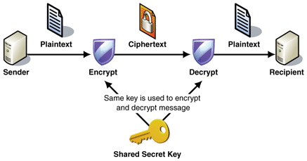
Encryption and Decryption

Slide 8
Techniques used in our algorithm
We will use a two step encryption algorithm consisting of two very basic cipher techniques.
Caesar Cipher and
XOR Cipher.
And also we will use 1’s complement.
So, What are Caesar and XOR Ciphers?

Slide 9
Caesar Cipher
One of the earliest known cipher technique used by Roman soldiers.
Type of substitution cipher.
In which each letter in the plaintext is 'shifted' a certain number of places down the alphabet.
For E.g.- with a shift of 1, A would be replaced by B, B would become C, and so on.
Not very secure and could be broken by hand also. Since, only 25 shifts are possible.
Mainly used with other cipher techniques.

Slide 10
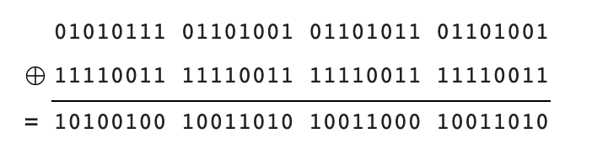
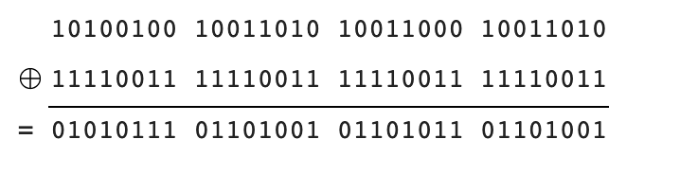
XOR Cipher
It is hard to crack by brute-force method, i.e. using random keys.
first define a XOR – encryption key and then to perform XOR operation of the characters in the String with this key which we want to encrypt.
For decryption we have to perform XOR operation again with the defined key.
if we don’t know the XOR-encryption key before decrypting the encrypted data, it is impossible to decrypt the data.
Encrypting
Decrypting

Slide 11
Algorithm
For Encryption
Use 1’s Complement
PLAIN TEXT
E.g. - CAT
Caesar Cipher
Cipher Text #1
E.g. – ROT1
C -> D
A -> B
T -> U
01000011 01000001 01010100
01000100 01000010 01010101
10111011 10111101 10101010
8-bit ASCII code
8-bit ASCII code
Cipher Text #2
The key is XORed with the previous bit pattern
XOR Cipher
An 8-bit XOR-key is selected at random
E.g. - 10110011
Transmitted Code
00001000 00001110 00011001
The same process is done in reverse for decrypting the message.

Slide 12
Motivation for the algorithm
Most encryption algorithms are very mathematical.
Not everyone could implement the complex algorithms.
Since algorithms are first tested and run on an abstract machine, the machine architecture sometimes becomes complicated.
So we made an algorithm that was -
Easy to implement.
Easy to check by hand.
Require minimum concepts of mathematics.
Without the XOR key, it is hard to crack the code and since only the recipient will know the correct process and the use of 1’s complement in the algorithm.

Slide 13
Applications-
We could use it to encrypt Emails, messages or any information.
We could use it to encrypt the networking interfaces between raspberry pi an any other peripheral devices.
Since not very resource intensive, it could be used on limited hardware devices.

Slide 14
Thank You

