Slide 1
Online Taxi Booking System
Group Number 2
Mentors
Notes:
Add instructor notes here.

Slide 2
Objectives
Project Understanding
Approach used
Project Execution
Modules
Learning
Best Practices
Opportunity for improvement
Demo and Code Walkthrough
Q&A
Notes:
Add instructor notes here.

Slide 3
Project Understanding
Transport is an integral part of our Society. In the current system customer first contacts with transport company for getting transport service. The company then books the vehicle for customer on the requested date and time and then sends the vehicle to the customer place on time.
The main objective of the project is to develop a web application for general Taxi booking.
Notes:
Add instructor notes here.

Slide 4
Project Understanding (Continued)
The Online taxi booking system is the online service which will automate the process of booking a taxi and will facilitate both the customer and the company with reduced time and efforts.
Notes:
Add instructor notes here.

Slide 5
Approach used :
Transport The distributed web application has been traditionally designed and built across three logical tiers:
Database Access Layer (DAL)
Business Logic Layer (BLL)
Presentation Layer
Notes:
Add the notes here.
Add instructor notes here.

Slide 6
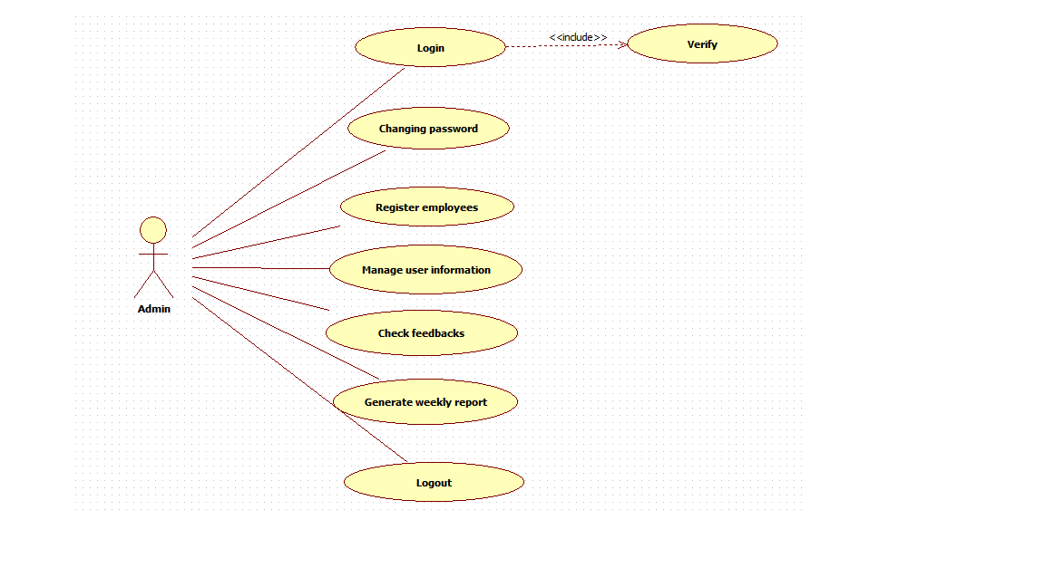
UML Diagrams
Use case diagram for Admin

Slide 7
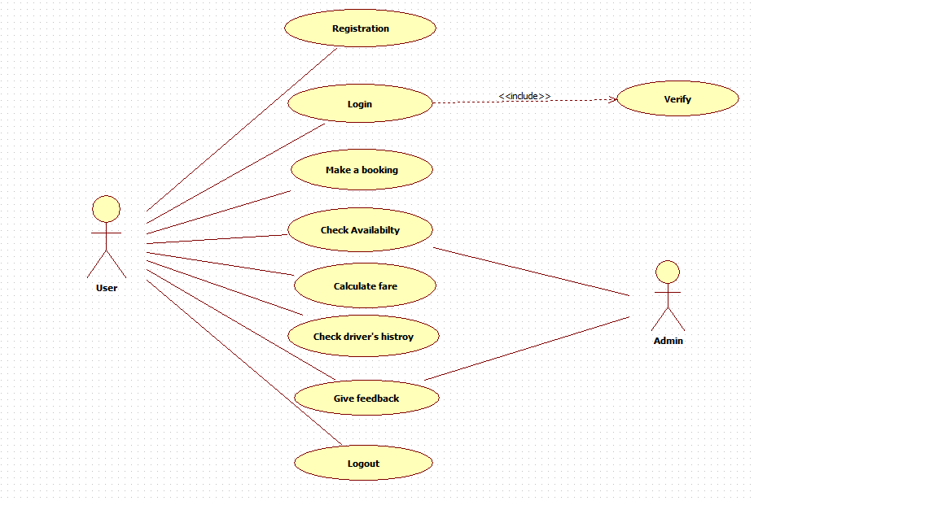
UML Diagrams
Use case diagram for user.

Slide 8
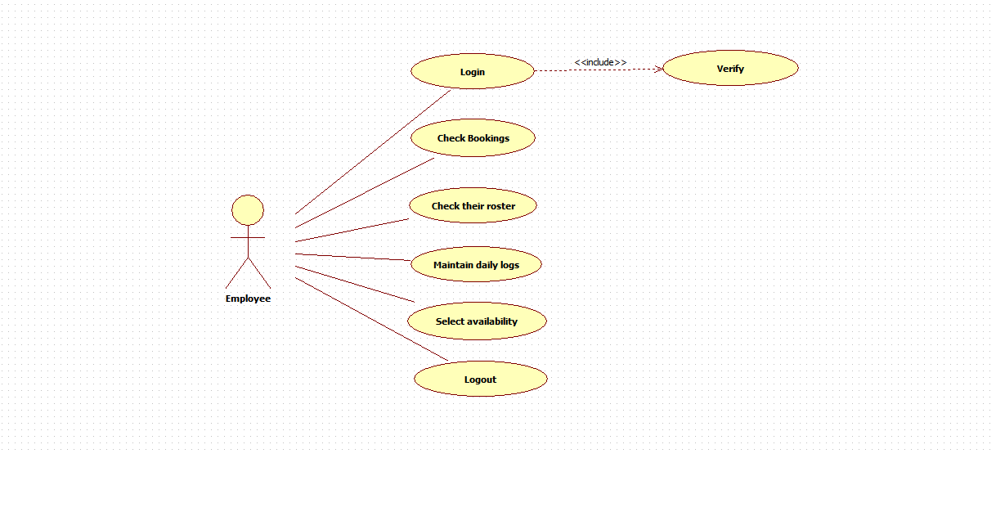
UML Diagrams
Use case diagram for Employee.

Slide 9
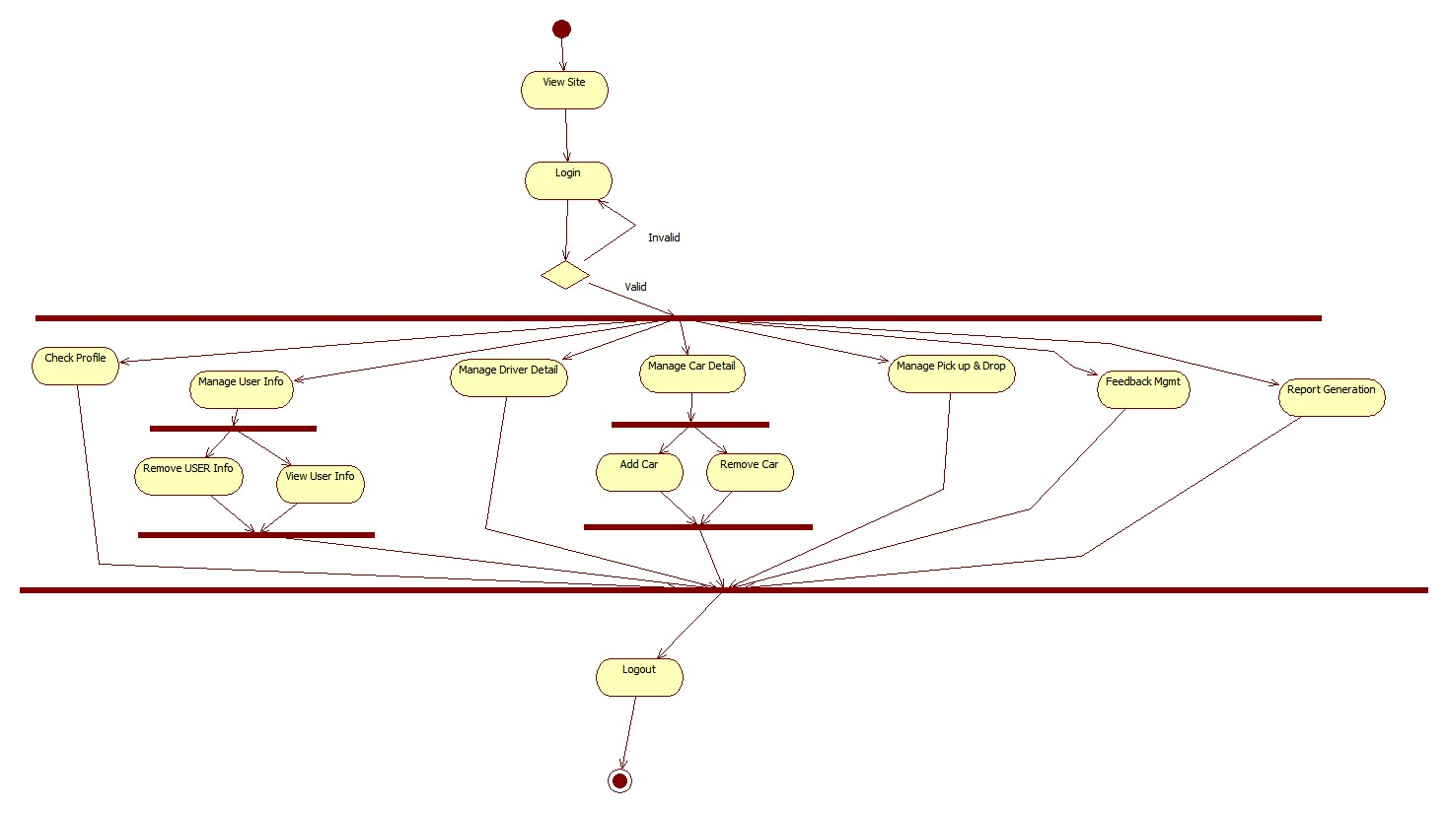
UML Diagrams
Activity diagram for Admin.

Slide 10
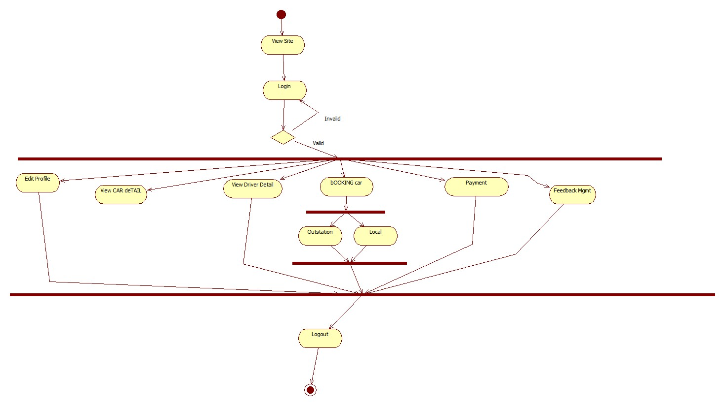
UML Diagrams
Activity diagram for User.

Slide 11
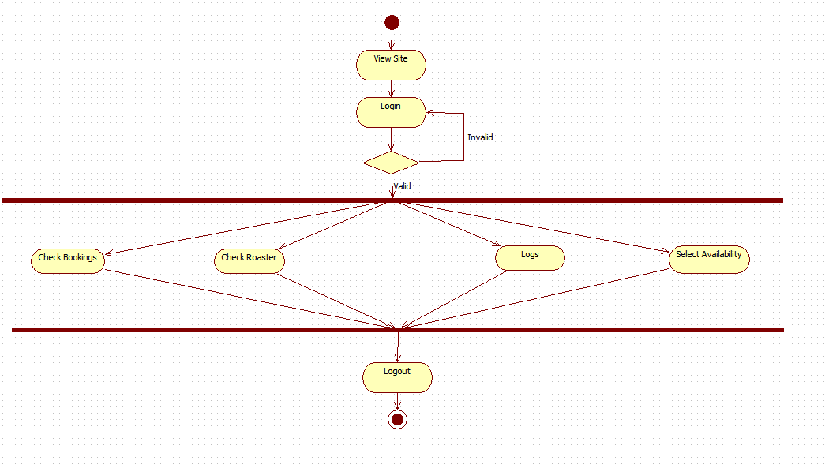
UML Diagrams
Activity diagram for Employee.

Slide 12
Project Execution
The Waterfall SDLC model was used for the development of the Application.
Requirement Analysis
Design(LLD/HLD)
Development Phase
Testing Phase(UTP)
Deployment(None)
Notes:
Add the notes here.
Add instructor notes here.

Slide 13
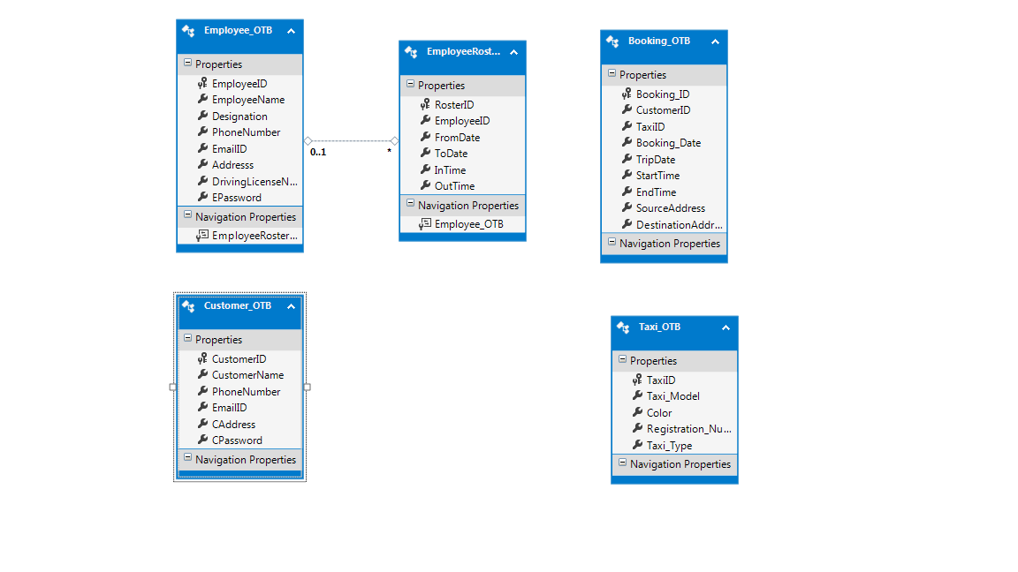
Modules
Data Layer
C# Classes that interacts directly to the Database to implement business rules.
Notes:
Add the notes here.
Add instructor notes here.

Slide 14
Modules
The modules used in Online Taxi Booking System are :-
Admin
User
Employee.

Slide 15
Admin
Following are the functions of Admin:
Perform weekly roster of Employees.
Print reports annually, weekly, and daily.
Check feedbacks.
Manage all system users.
Changing password.
Register Employees

Slide 16
User
The functions of User are:
Register to System
Make a booking.
Check their booking status.
Calculate the fare.
Check the driver history.

Slide 17
Employee
The functions of employee are:
Check the online bookings.
Check their rosters.
Maintain daily logs.
Select availability.

Slide 18
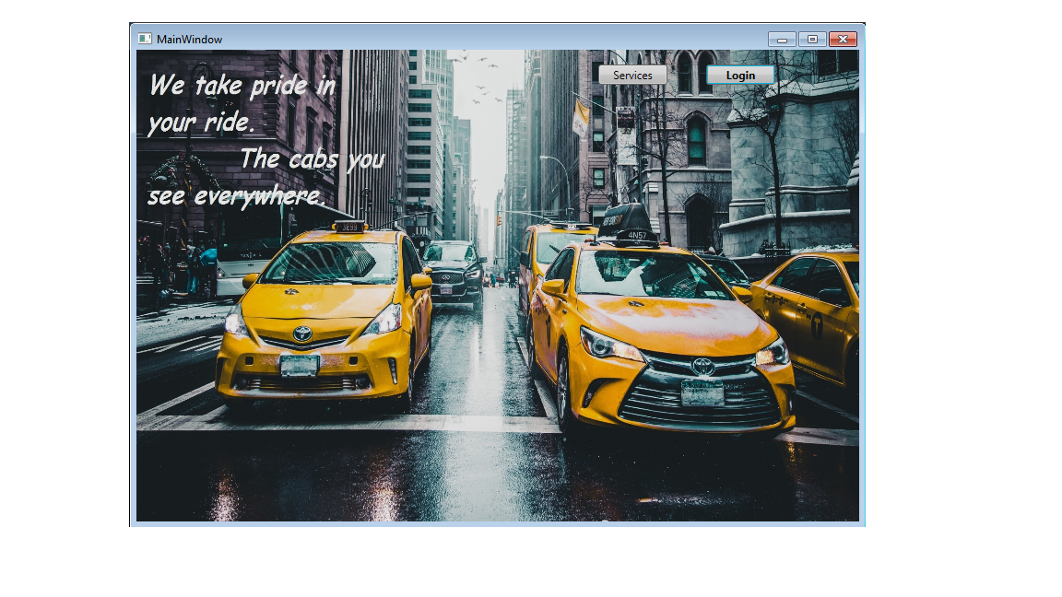
Modules
The Home page of the application is as follows:-

Slide 19
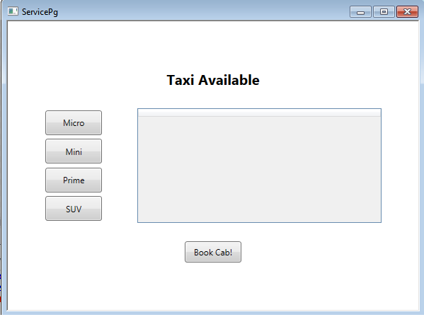
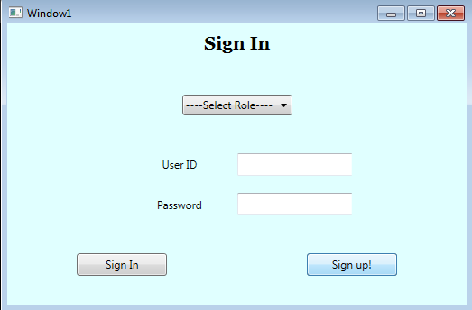
Modules
The Services and the Login are as follows:

Slide 20
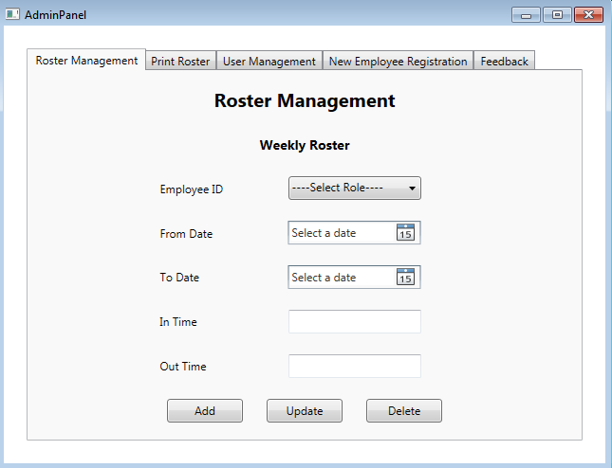
Modules
The Admin Panel is as follows:

Slide 21
Learning
ADO .NET
Advanced SQL Server & LINQ.
Layered Architecture.
UI(WPF).
Notes:
Add the notes here.
Add instructor notes here.

Slide 22
Best Practices
Nomenclature.
Stored procedure.
Exception handling.
Notes:
Add the notes here.
Add instructor notes here.

Slide 23
Opportunity for improvement
This project can be further enhanced by developing a web application with a better GUI.
Live location tracking can be implemented.
Cancellation of the booking can be enabled.
Driver can be assigned based on the pick up location.
Estimated time of arrival can be displayed on the customer dashboard.
Notes:
Add the notes here.
Add instructor notes here.

Slide 24
Q & A
Notes:
Add the notes here.
Add instructor notes here.

Slide 25
Thank You!
Notes:
Add the notes here.
Add instructor notes here.

