Slide 1
DS-670:Capstone:big Data & data Science Auto Insurance Fraud Detection
Ravindra Babu Ponnapula
Praveen Ravulapalli
Akhil Karumanchi

Slide 2
Project Overview
Objective: Develop a predictive model to identify potentially fraudulent insurance claims.
Dataset: Insurance claims data with multiple features.
Target Variable: Fraud Reported (Yes/No)

Slide 3
Introduction to Auto Insurance Fraud
Defining Auto Insurance Fraud
Conceptual Definition: Intentional deception in insurance claim processes to obtain financial benefits
Typologies of Fraud:
Soft Fraud: Exaggeration of legitimate claims
Hard Fraud: Completely fabricated claims or staged incidents

Slide 4
Economic Impact
Global Perspective:
Estimated annual insurance fraud losses: $40-80 billion in the United States alone
Approximately 10-20% of all insurance claims show fraudulent characteristics
Significant economic burden on insurance companies and consumers

Slide 5
Business Need
Fraud is a pervasive issue that significantly impacts the insurance industry, leading to increased premiums for honest customers and substantial financial losses for companies. There is a critical need for more sophisticated and accurate fraud detection methods to:
Reduce financial losses due to fraudulent claims
Improve the efficiency of claims processing
Maintain fair pricing for honest customers
Enhance overall trust in the insurance system
Our project addresses this need by developing an advanced, data-driven fraud detection system that can quickly and accurately identify potentially fraudulent claims.

Slide 6
Problem Definition
The primary problem this project aims to solve is:
How can we develop a robust, accurate, and scalable machine learning system to automatically detect fraudulent insurance claims in real-time, reducing financial losses for insurance companies while maintaining a positive experience for legitimate claimants?
Sub-problems include:
Identifying the most relevant features for fraud detection
Handling imbalanced datasets (as fraudulent claims are typically a small percentage of total claims)
Developing models that can adapt to evolving fraud tactics
Creating an interpretable system that can provide insights into why a claim is flagged as potentially fraudulent

Slide 7
About Data
Analyze 15-20 relevant papers/sources, taking notes on: 2. Methodologies used
Key findings and results
Limitations and gaps identified
Synthesize the information to identify trends

Slide 8
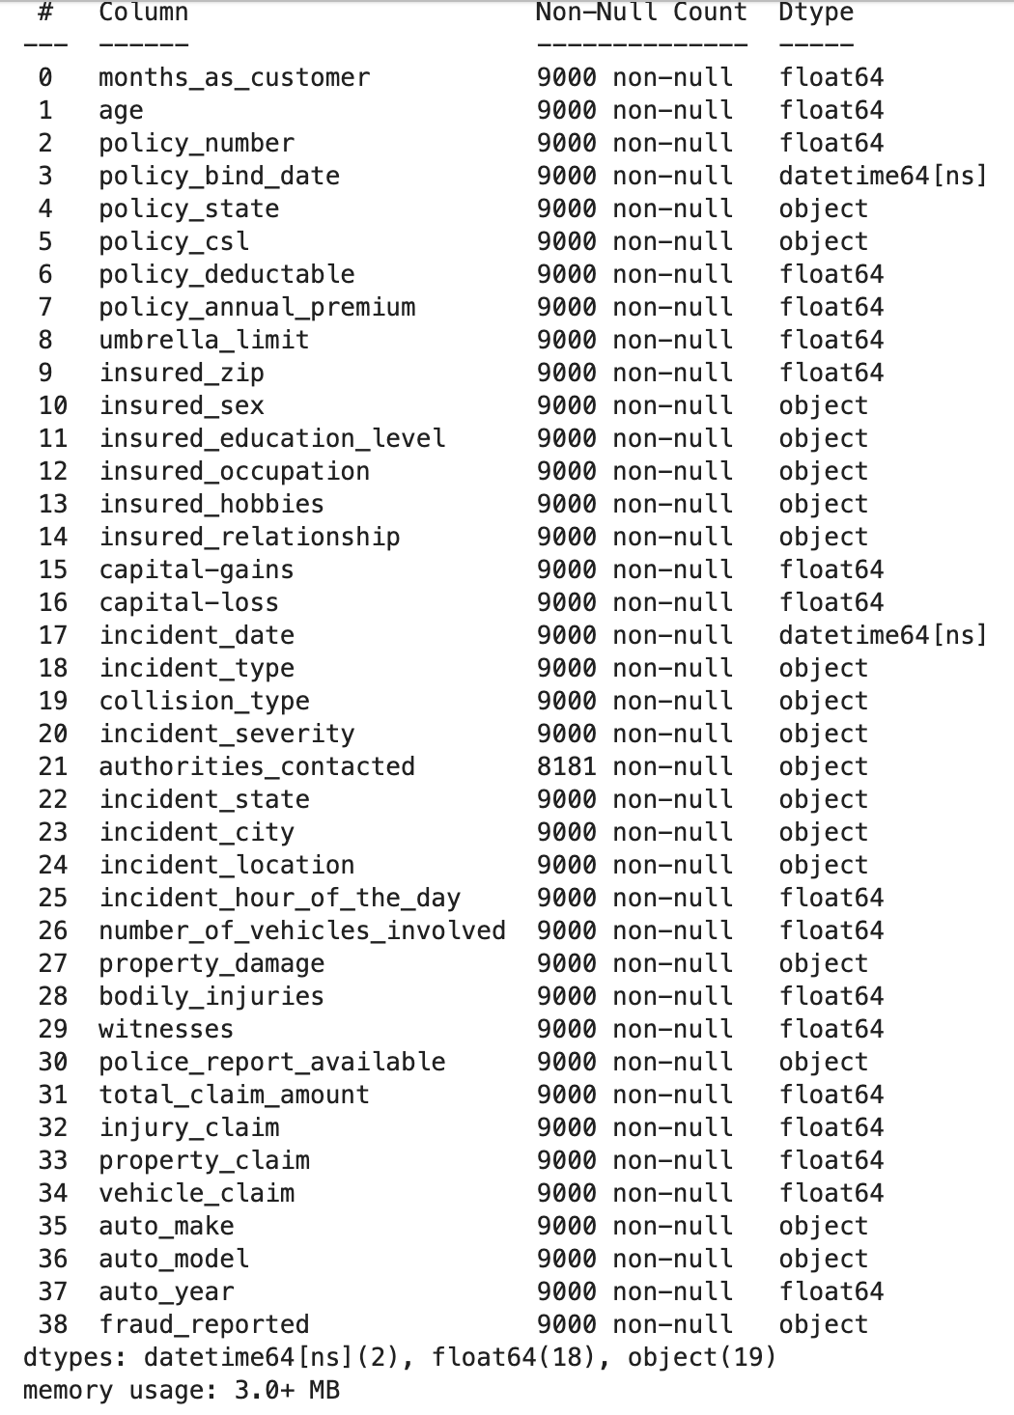

Slide 9
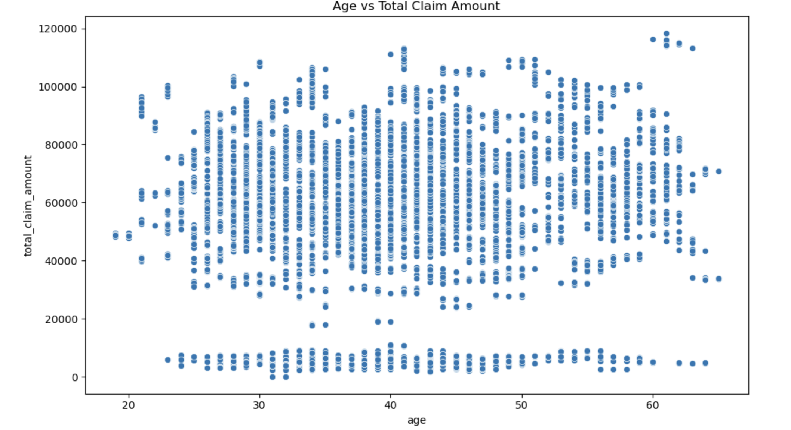

Slide 10
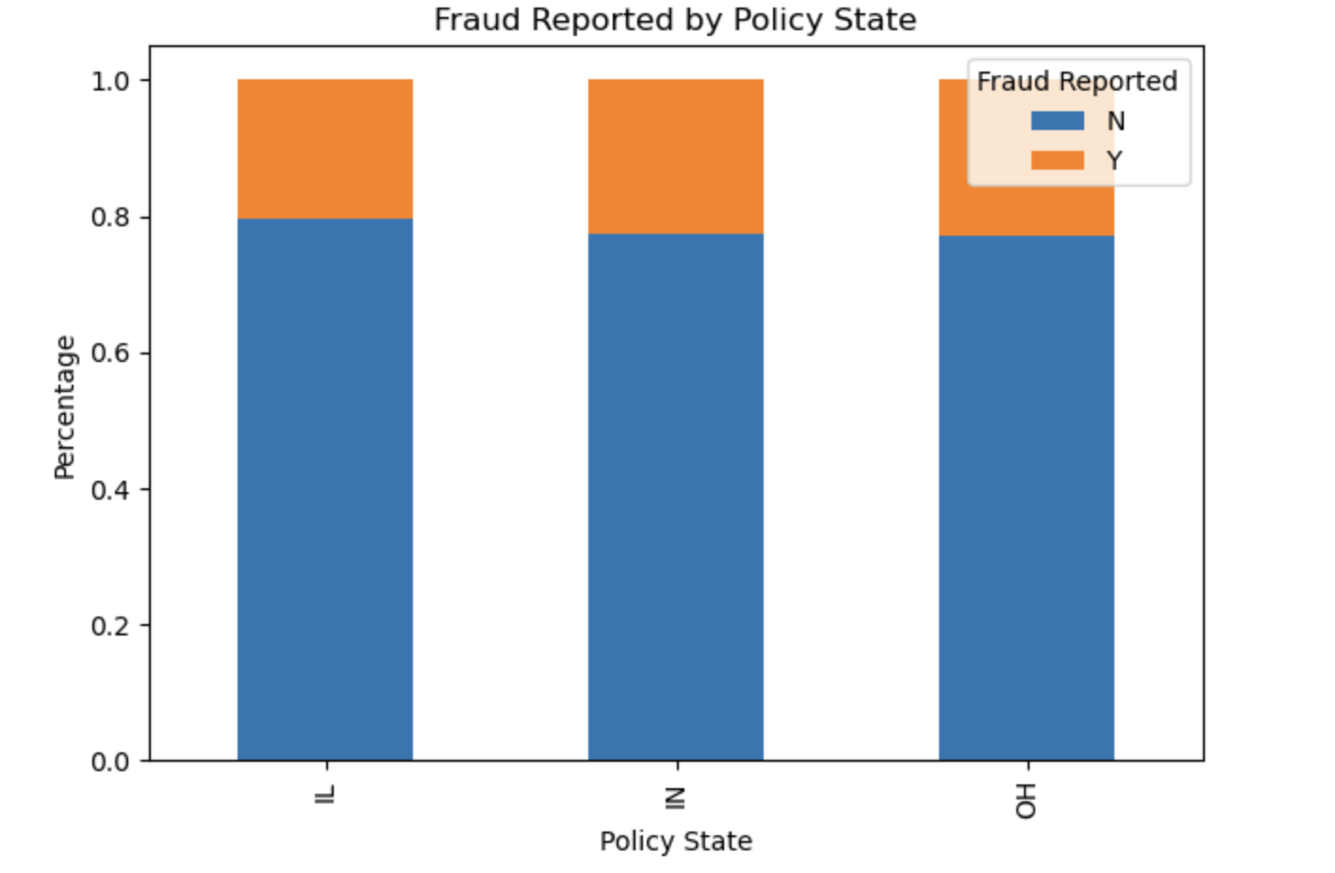

Slide 11
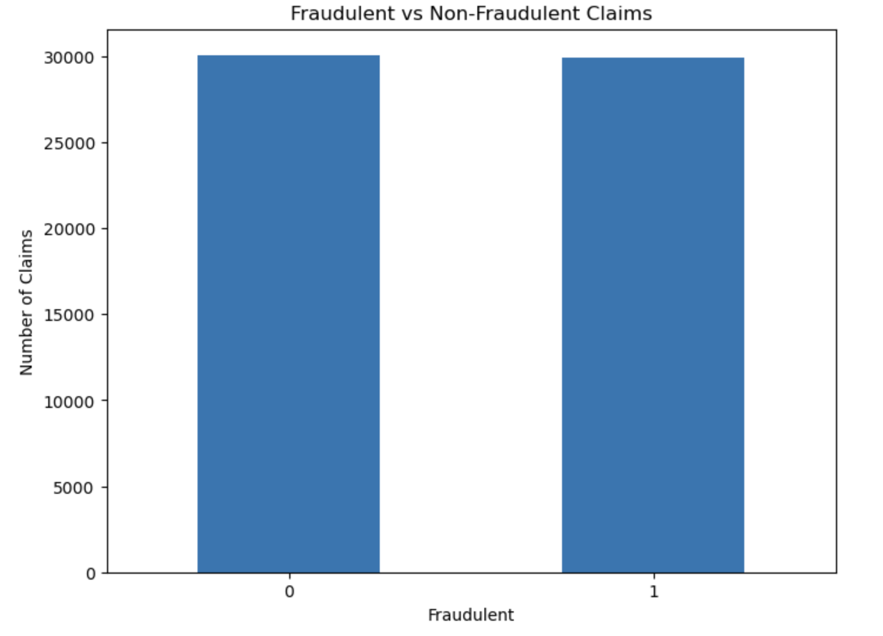

Slide 12
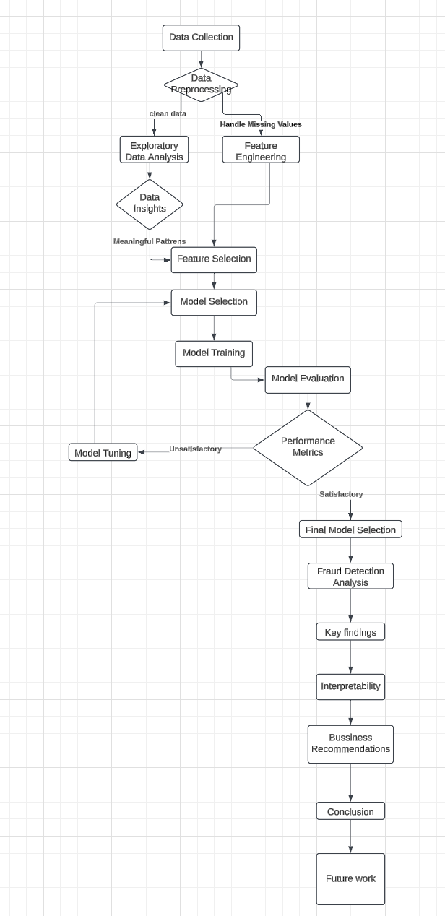
Flow Chat

Slide 13
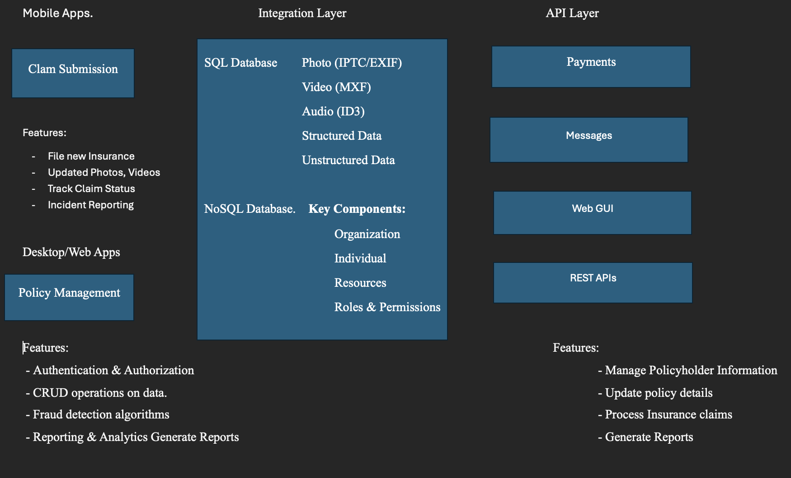
Architecture

Slide 14
Literature Review Methodology
Search Strategy
Databases Consulted:
IEEE Xplore
ACM Digital Library
ScienceDirect
Google Scholar
zenodo
Search Keywords:
"Insurance fraud detection"
"Machine learning in fraud analysis"
"Predictive modeling for insurance claims"
"Fraud detection algorithms"

Slide 15
Key Theoretical Frameworks
Existing Fraud Detection Approaches
Rule-Based Systems
Pros: Simple, interpretable
Cons: Limited adaptability, high false-positive rates
Statistical Methods
Techniques: Logistic Regression, Discriminant Analysis
Strengths: Statistical significance, interpretability
Limitations: Assumes linear relationships
Machine Learning Approaches
Supervised Learning:
Random Forest
Gradient Boosting Machines
Support Vector Machines
Unsupervised Learning:
Clustering techniques
Anomaly detection algorithms

Slide 16
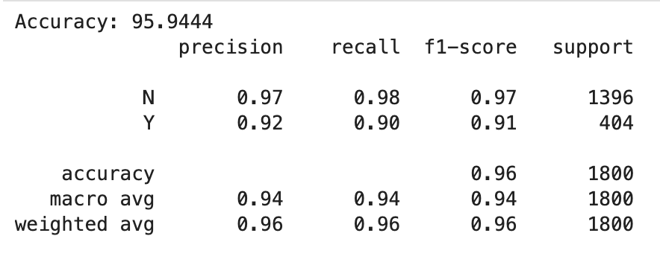
Logistic Regression

Slide 17
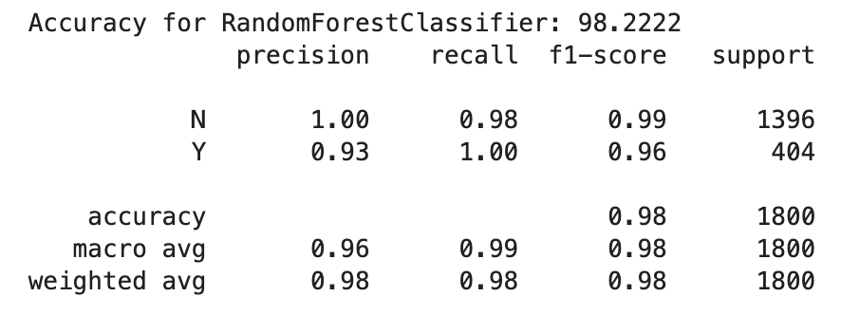
Random Forest Classifier

Slide 18
XGB Classifier

Slide 19
References
Xu, Y.; Wei, F.; Yang, W.; Wang, J. Fraud Detection Using Graph Neural Networks: A Survey and Benchmarking. Knowledge-Based Systems 2022, 243, 108560. https://doi.org/10.1016/j.knosys.2022.108560.
Wang, Z.; Yang, Q.; Zhang, Z.; Jin, H. A Hybrid Ensemble Learning Model for Insurance Fraud Detection. Applied Soft Computing 2023, 135, 110013. https://doi.org/10.1016/j.asoc.2023.110013.
He, T.; Pan, Y.; Zhang, Z.; Zhou, W. Federated Learning for Fraud Detection in Distributed Financial Systems. IEEE Transactions on Neural Networks and Learning Systems 2023, 34 (5), 2201–2213. https://doi.org/10.1109/TNNLS.2023.3245123.
Chen, L.; Wang, X.; Huang, Q.; Wu, Y. Financial Fraud Detection Using Ensemble Learning and Data Augmentation Techniques. Computers & Security 2022, 104, 102210. https://doi.org/10.1016/j.cose.2021.102210.
Guo, H.; Huang, C.; Lu, Q.; Zhang, J. Adaptive Fraud Detection with Reinforcement Learning and Deep Neural Networks. Neural Networks 2022, 153, 217–226. https://doi.org/10.1016/j.neunet.2022.06.008

Slide 20
Thank You

