Slide 1

CLASSIFICATION OF GENDER BASED ON TWEETS DATA
RAVI TEJA VEMURI
SPRINGBOARD CAPSTONE PROJECT #2
DATA SCIENCE CAREER TRACK

Slide 2

TWITTER PROFILES

Slide 3

WHAT IS THE GOAL?
To simply view a Twitter profile and judge whether the user was a male, a female, or a brand (non-individual).
This is useful for the prospective client in determining a gender in analyzing well, based on seeing a user’s tweet or a profile.

Slide 4
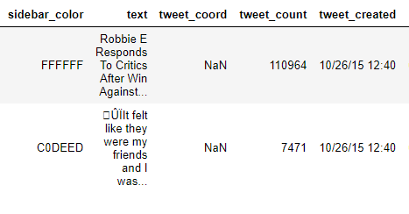
ACQUIRING THE DATA
The data acquired is stored in a .csv file.
It consists of 20050 rows and 26 columns/features.
The dataset was obtained from Kaggle Crowdflower Dataset
The text data consists tons of information for analysis but there were few missing values which had to be cleaned for text analysis.

Slide 5
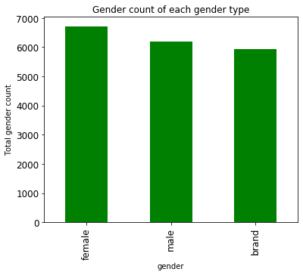
DATA CLEANING
Gender count plot by dropping the unknown gender values.
Applied techniques like Lemmatization, Tokenization and stop words.
The above methods reduce the number of words in the vocabulary, in order to make it suitable for standard ML algorithms .
Dropped the features not required for the classification like gender_gold etc.
Missing values in the description column were concatenated with that in the text column to impute the NaN values.

Slide 6
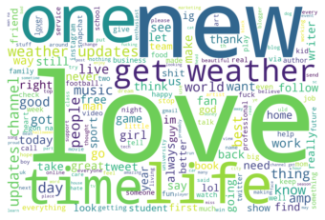
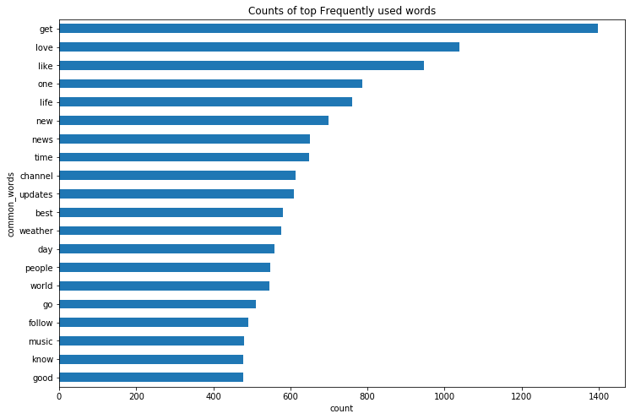
EXPLORATORY DATA ANALYSIS
Common words of cleaned Tweets in a plot.
Generated word cloud for the most common words .
Removed the duplicates in the tweets text as well.
Word Cloud represents the frequency or the importance of each word.

Slide 7
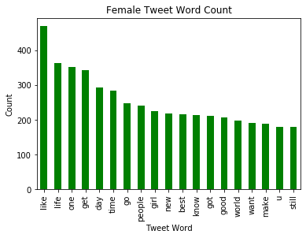
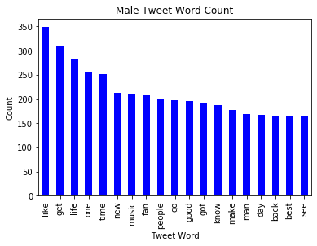
EDA(continued..)
The plots shows the female and male word tweet counts.
These words are the most frequent used in their tweets.
These text is analyzed from the cleaned data, where I applied Tokenization, stop words, and Lemmatization.

Slide 8


INFERENTIAL STATISTICS(TWO TAILED T-TEST)
Null Hypothesis H₀ = There is no difference in average length of words for male and female genders(Identical).
There is a statistically significant difference between male and female average length of words in a text.
There is a statistically significant difference between male and female average length of words in a cleaned version text data.

Slide 9

BAG OF WORDS
Converts text to a matrix where every row is an observation and every feature is a unique word.
Used CountVectorizer on the features/predictors which will be useful in ML models which also performs tokenization. It counts the word frequencies.
LabelEncoder was used to convert the target variable classes to ordinal numbers like 0,1,…n-1. Later, I used inverse transform to decode the target classes back to categories for us to know.

Slide 10
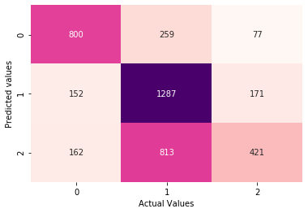
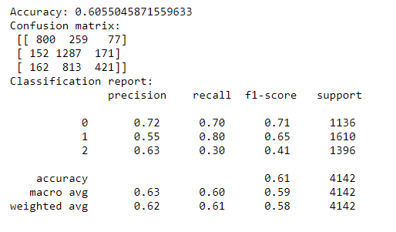
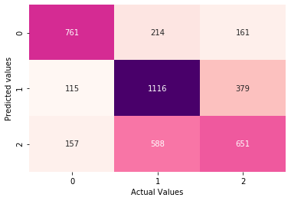
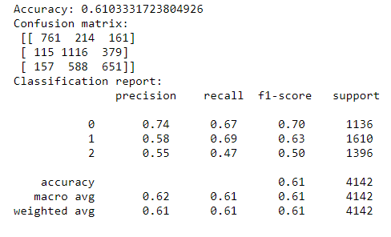
LOGISTIC REGRESSION MODEL
Confusion Matrices
Optimized Parameters using GridSearchCV using 5 folds (penalty = 'l1', C= 0.1)
This result is for the original tweets(non cleaned version of text and description combined)
Optimized Parameters using GridSearchCV using 5 folds (penalty = 'l1', C= 0.1)
This result is for the cleaned tweets(using process of Lemmatization, tokenization, stop words)

Slide 11
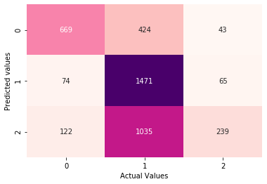
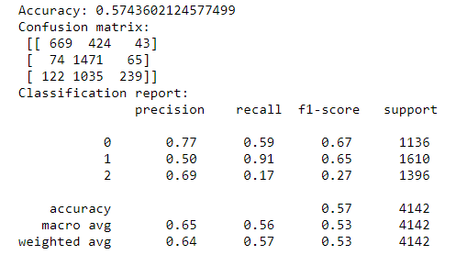
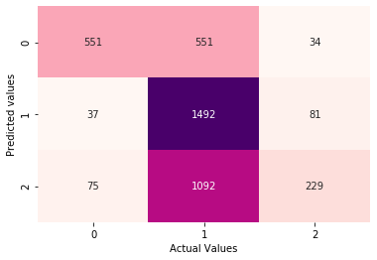
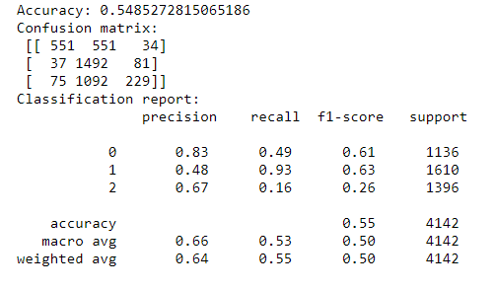
RANDOMFOREST MODEL
Confusion Matrices
Hypertuned parameters using GridSearchCV with 5 folds(n_estimators= 50, max_depth=15)
This result is for the original tweets feature, non cleaned.
Hypertuned parameters using GridSearchCV with 5 folds(n_estimators= 50, max_depth=15)
This result is for the cleaned tweets feature.

Slide 12
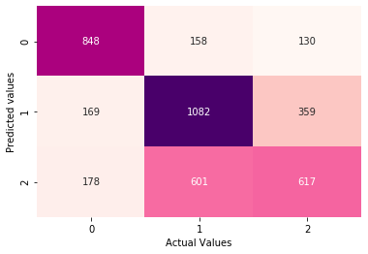
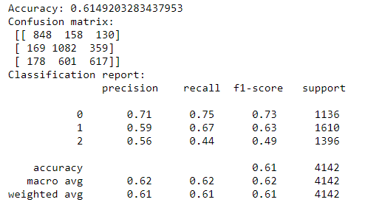
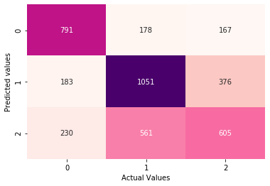
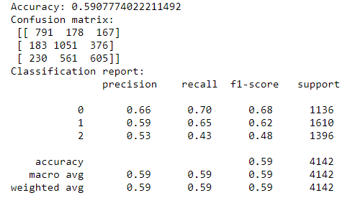
SUPPORT VECTOR MACHINE
Confusion Matrices
Optimized parameters with GridSearchCV 5 folds(C=1,gamma='scale', kernel='linear’)
This result is for the original tweets feature, non cleaned.
Optimized parameters with GridSearchCV 5 folds(C=1,gamma='scale', kernel='linear’)
This result is for the cleaned tweets feature,

Slide 13
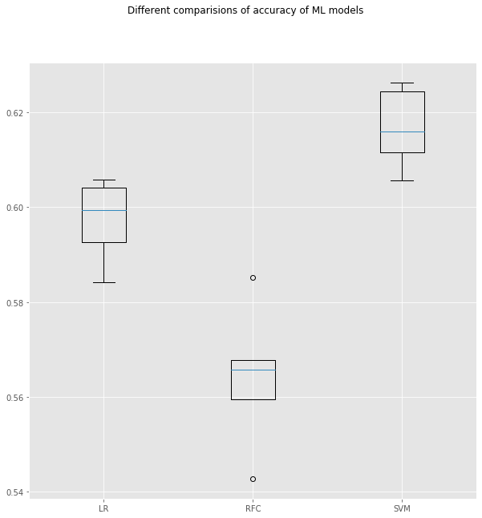
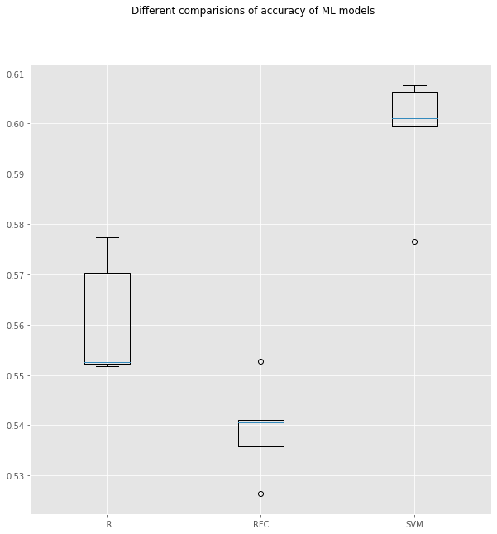
COMPARISION OF MODEL BOXPLOTS
Original Tweets model accuracies using Kfold splits of 5
Cleaned Tweets model accuracies using Kfold splits of 5
LR: 0.597185 (0.007982) RFC: 0.564169 (0.013691) SVM: 0.616746 (0.007782)
LR: 0.560856 (0.010851) RFC: 0.539329 (0.008562) SVM: 0.598219 (0.011240)

Slide 14
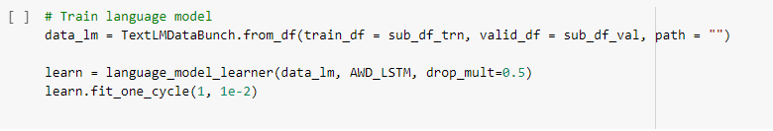
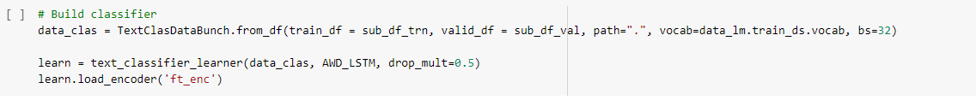
USING FASTAI FOR PREDICTIVE MODELLING (TRANSFER LEARNING)
Transfer learning is a machine learning method where a model developed for a task is reused as the starting point for a model on a second task.
Used Google Colab notebooks since it’s on cloud as has GPU as runtime.
TextLMDataBunch used to get the data ready for a language model
TextClasDataBunch used to get the data ready for a text classifier

Slide 15
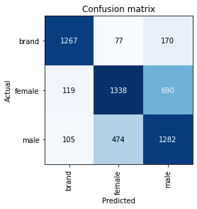
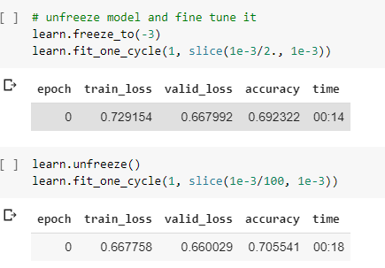
FINE TUNING AND CONFUSION MATRIX
Freeze(freeze_to) and unfreezing(unfreeze) is helpful in us deciding which specific layers of the model we want to train at a certain point of time in an epoch.
Confusion-matrix is a good technique to summarize the performance of a classification algorithm. We use ClassificationInterpretationclass here.

Slide 16
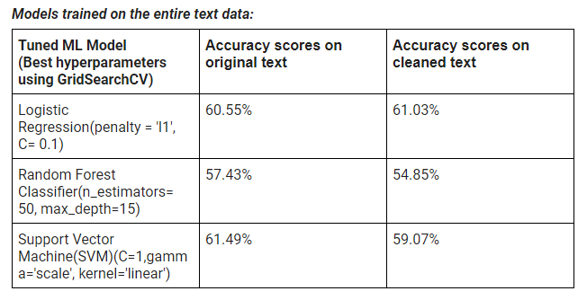
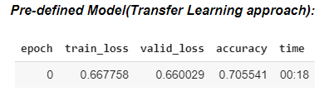
RESULTS
Confusion matrix → good distribution of true positives/true negatives
Summary of the model’s performances. I used 5 epochs for the final accuracy.
Using more epochs is causing the data to overfit. So had to early stop.
Better performance using fastai deep learning library in comparison to the models built.

Slide 17
FUTURE WORK
Using profileImage feature to perform Image Classification of the gender(male, female, brand) with fastai library
SVM can be worked along with PCA for reducing the feature space, where I encode my text data as separate vectors
I can incorporate some more features along with the text data into my predictors, so maybe some improvement can be seen on the classification

Slide 18
ACKNOWLEDGEMENT
A Special thanks to my mentor, Konstantin Palagachev, for helping me in every way.
Thanks to Springboard team, Katherine Allen.
Thanks to the author/preparer of the data Data For Everyone Library on Crowdflower.

