Slide 1

PREDICTING THE PRICES OF AIRBNB IN BERLIN
RAVI TEJA VEMURI
SPRINGBOARD CAPSTONE PROJECT# 1
DATA SCIENCE CAREER TRACK

Slide 2

HOUSES IN BERLIN

Slide 3
PROBLEM & SIGNIFICANCE
If a new host enters the market, he/she would want to know what price their home might cost to offer it to the customers.
The analysis given here is important because it tries to provide information for Airbnb company to improve their services and provide a best solution to the hosts in determining a good price for their apartments.

Slide 4

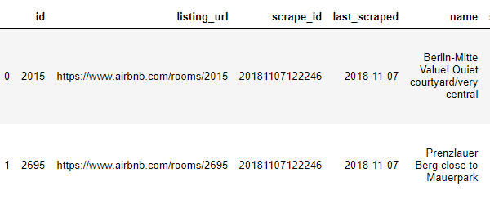
DATA ACQUISITION
The data has been acquired and stored as a .csv file
It has been almost cleaned, but still there was some information missing, where I used some cleaning techniques and have handled outliers too
It has 22552 rows and 96 columns
The dataset was obtained from Kaggle Dataset
This data was created by Murray Cox and his Inside Airbnb project which can be found here

Slide 5
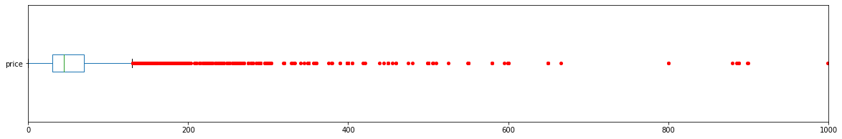
DATA WRANGLING
Columns like cleaning fee, security deposit had missing values, so it was imputed with 0’s or the mean/median values
The outliers were removed after €400 for the price column to clean up, since this is target variable
I have used Imputer for the ‘size’ column and replaced it with median for missing values.

Slide 6
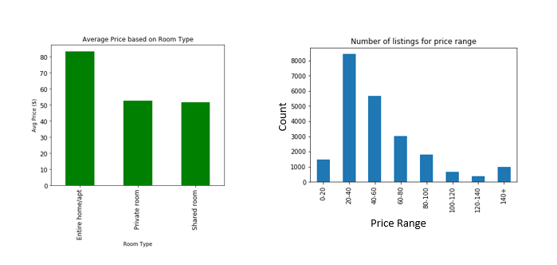
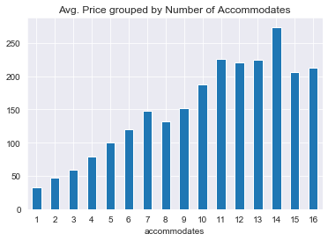
EXPLORATORY DATA ANALYSIS
Different plots of the features based on the price range and the average price per room type.
Number of listings for each price range
Bar Histogram plot of average price based on number of accommodates.

Slide 7
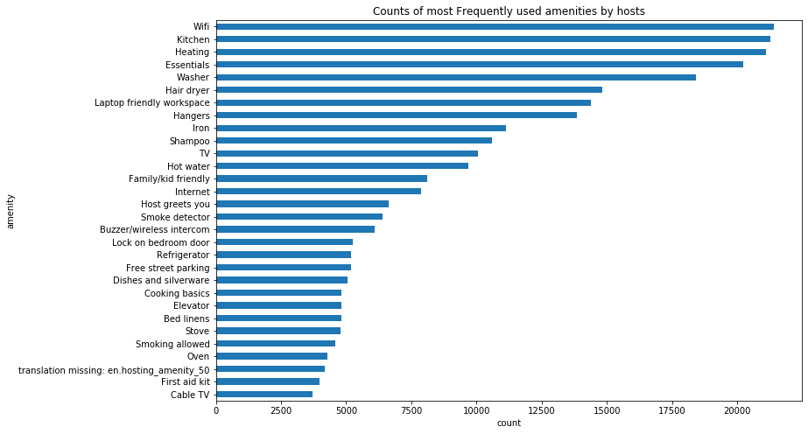
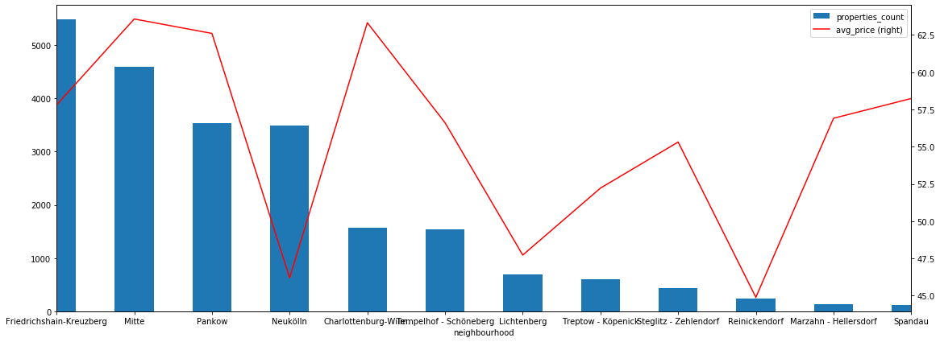
EDA(Continued..)
Plot of the different amenities used by the hosts frequently. Most common 30
The plot below it shows the properties count within each neighborhood and the average price associated with it.

Slide 8
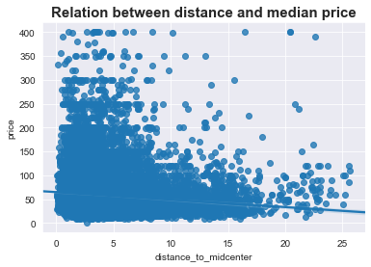
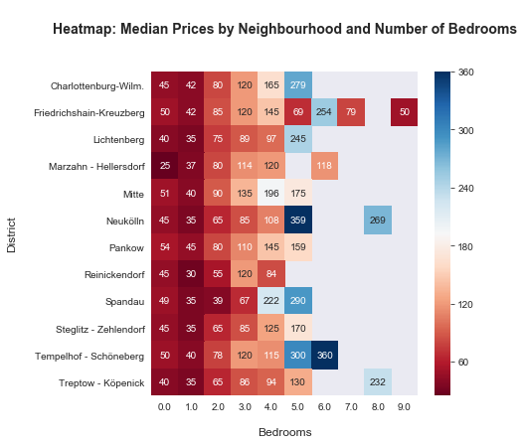
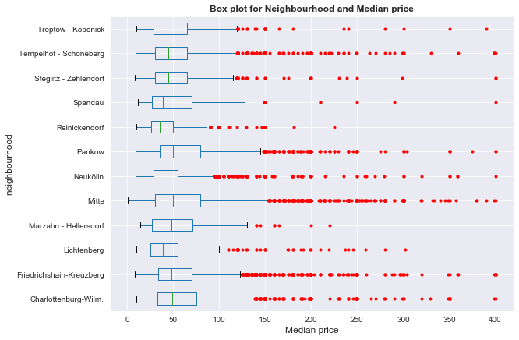
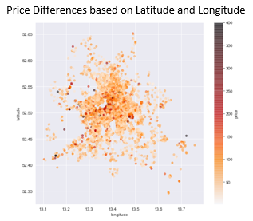
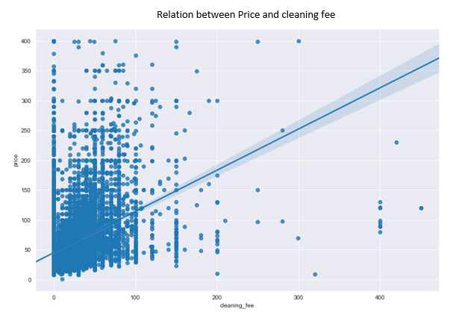
MORE EDA PLOTS

Slide 9
INFERENTIAL STATISTICS
Performed statistical test by calculating the p-value for different columns
The Pearson correlation coefficient of accommodates and price features is 0.5745 and the p-value was ~0, which are strongly correlated(null-hypothesis can be rejected, which in this case was that it was not a good measure)
The Pearson correlation coefficient of cleaning fee and price features is 0.4041 and the p-value was ~0, which are strongly correlated

Slide 10
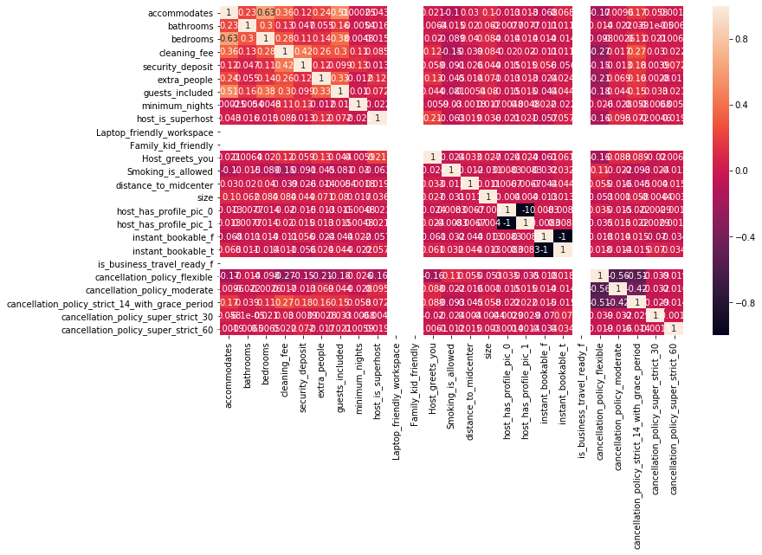
OLS MODEL
This model is useful for determining which features are a good measure for the target variable
Here is the measure of metric is the R squared value to check how the features correlated with each other
Correlation matrix plot on the right
Model | Features | R^2
OLS | 25 | 0.422

Slide 11


LINEAR REGRESSION MODEL
Model | Features | MSE | R^2
Linear Regressor | 25 | Train : - 0.4895 | Train: - 0.332
 | 25 | Test : - 0.4782 | Test : -0.317
Linear Regression models a target prediction value based on independent variables.

Slide 12
RIDGE REGRESSION MODEL
Model | Features | MSE | R^2
Ridge Regressor | 25 | Train - 0.3223 | Train : -0.368
 | 25 | Test: - 0.3071 | Test : -0.177
Ridge regression can shrink the coefficients and helps to reduce the model complexity and multi-collinearity, which was seen from above OLS methods
RidgeCV model was used to cross validate and obtain the best hyperparameter from the model to train

Slide 13
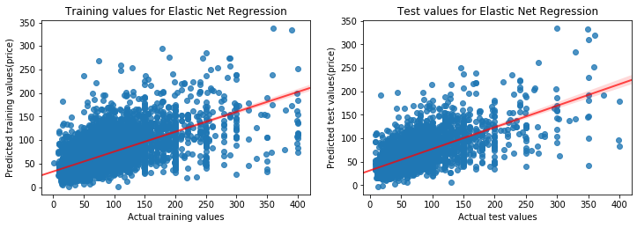
ELASTIC NET REGRESSION
Elastic Net Model is useful when there are more correlated variables(deals with multicollinearity issues)
Sets the proper alpha value between 0 and 1
Model | Features | MSE | R^2
Elastic Net Regressor | 25 | Train - 0.3223 | Train : -0.3682
 | 25 | Test - 0.3071 | Test : -0.1776

Slide 14
RANDOM FOREST REGRESSOR
Random Forest Regressor combines multiple decision trees in determining the final output rather than relying on individual decision trees
Model | Features | MSE | R^2
Random Forest Regressor(n_estimators= 500, oob_score=True) | 25 | Train: 0.2117 | Train : 0.7507
 | 25 | Test: 0.2722 | Test : 0.5729
Random Forest Regressor(n_estimators= 1000, oob_score=True) | 25 | Train: 0.2116 | Train: 0.7511
 | 25 | Test: 0.2723 | Test: 0.5726
Random Forest Regressor(n_estimators= 1300, oob_score=True) | 25 | Train: 0.2115 | Train: 0.7512
 | 25 | Test: 0.2723 | Test: 0.5727

Slide 15
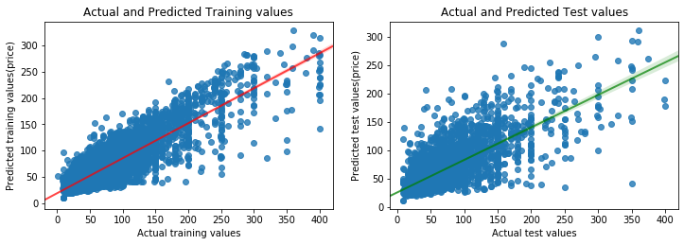
RANDOM FOREST(continued..)
Regression scatter plot for the actual and predicted prices of the training and testing values.

Slide 16
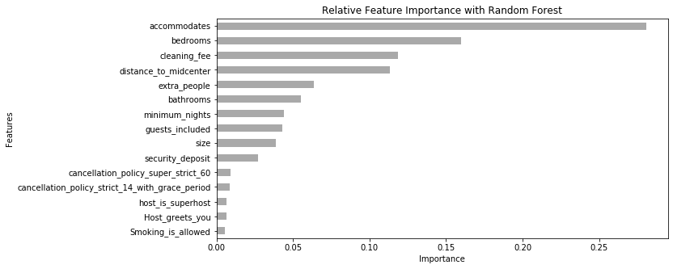
RESULTS
Random Forest Regressor(Non-Linear model) was a good model with a very good accuracy in predicting the prices.
Relative Feature Importance plot for the Random Forest Regressor in price detection

Slide 17
FUTURE WORK
Including other csv files and including different other features. Reviews csv file contain text, so NLP can be used in determining the price.
Tuning more hyperparameters by including various values for the coefficients and including them in a pipeline.
Using other supervised learning methods like KNN, SVM and also can try PCA for dimensionality reduction.

Slide 18
ACKNOWLEDGEMENT
A Special thanks to my mentor, Konstantin Palagachev, for helping me in every way
Thanks to Springboard team, Katherine Allen.
Thanks to the author/preparer of the dataset Murray Cox. Kaggle Dataset

