Slide 1

REVIEW 1
Design, Verification and Performance Evaluation of a Hybrid Mesh–Spidergon Network-on-Chip Architecture
Submitted to: Dr. Deepak CH
By:
Ravi Teja 23BEC7342
John Joyce 23BEC7335
Anirudh 23BEC7217

Slide 2
Project Background
More IP cores on one chip
Every core must talk to others
Dedicated wires / shared bus
Wiring, congestion, latency
Need structured network: NoC
▶
▶
▶
▶
Modern SoCs integrate tens to hundreds of IP blocks, so on-chip communication, not computation, now limits performance.
A shared bus serializes traffic, so adding cores shrinks the bandwidth each core gets.
Full point-to-point wiring avoids that, but every new IP needs a link to every existing IP, so wires and area grow quickly.
Both fail to scale, which leads to a Network-on-Chip: routers and short links that carry packets between IPs.
A NoC also needs a good topology, which is the question this project answers.

Slide 3
Problem Statement
The problem
In a flat Mesh NoC, packets between distant cores must cross many routers hop by hop, so latency and congestion grow with chip size. A single large Ring/Spidergon shortens global paths but cannot physically scale to many routers. How can a 64-router NoC keep Mesh regularity for local traffic and still give distant clusters short, direct paths?
More IP cores
Long multi-hop paths and congestion
Neither pure Mesh nor pure Spidergon fits
Hybrid: Mesh clusters + Spidergon-like backbone
▶
▶
▶

Slide 4
Motivation – Why Hybrid?
Topology | Advantage | Limitation
Bus | Simple | Poor scalability
Ring | Simple global connectivity | Higher latency
Mesh | Regular / scalable | Long global paths
Spidergon | Improved global connectivity | Less suitable as complete local structure
Hybrid | Local regularity + global shortcuts | More complex design

Slide 5
Objectives
Design a hybrid NoC architecture; divide it into local mesh clusters.
Connect clusters with Spidergon-like global links.
Design a multi-port router with buffering, routing, arbitration and crossbar.
Implement packet routing and verify routing correctness.
Test simultaneous, contention and burst traffic.
Develop performance-measurement infrastructure (latency, hops, throughput).
Compare the hybrid approach against baseline architectures.

Slide 6
Existing / Related Work
Architecture | Problem it solved | Gap that motivates us
2D Mesh | Regular, easy layout | Long cross-chip paths
Torus | Fewer hops via wrap-around | Long wires, timing issues
Ring / Spidergon | Short global paths (across links) | Poor physical scaling as one big ring
Fat-Tree / Butterfly | High bisection bandwidth | Complex, irregular wiring
Hierarchical / hybrid | Locality + global shortcuts | Our chosen direction
Also surveyed: XY / adaptive routing, round-robin vs fixed vs age-based arbitration, congestion management.
Notes:
Add 2-3 paper references here if your guide expects citations.

Slide 7
Proposed Architecture
4×4 Mesh cluster
16 routers
4 clusters
Spidergon-like
global network
64-router
Hybrid NoC
▶
▶
▶
Parameter | Design
Clusters / mesh size | 4 / 4×4 (16 routers per cluster)
Total routers | 64
Gateway | Router R0 (0,0) of each cluster
Packet width | 48 bits
Router ports | 6 (Local, N, S, E, W, Gateway)

Slide 8
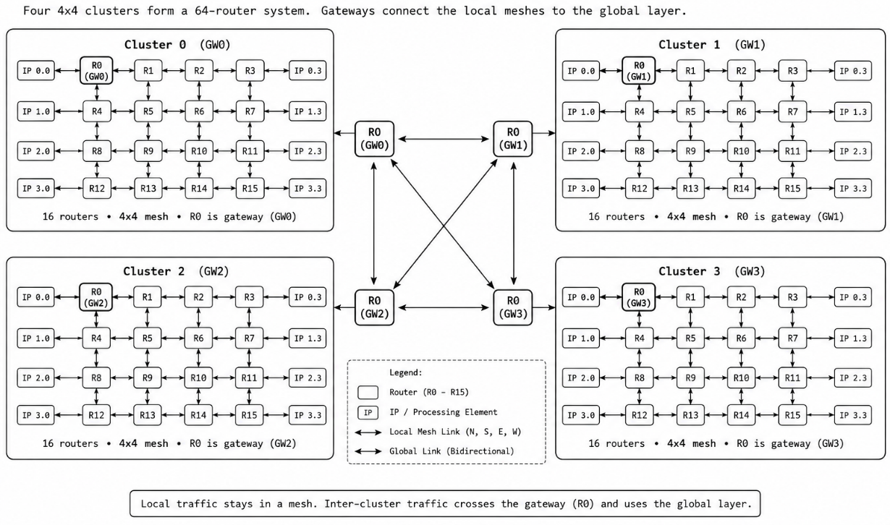
Hybrid Topology Diagram

Slide 9
Router Architecture
LOCAL (IP)
NORTH
Five local ports: Local, North, South, East, West.
Gateway port: 6th port added to R0 of each cluster for global traffic.
Why: no extra gateway router → zero additional router hardware and no extra hop.
ROUTER
(6x6 crossbar)
WEST
EAST
SOUTH
GATEWAY

Slide 10
Packet Format (48 bits)
DC
2b
DR
2b
DCol
2b
SC
2b
SR
2b
SCol
2b
Type
2b
Pri
2b
Payload[31:0]
32 bits (txn ID in metrics)
Destination (cluster/row/col) | Source (cluster/row/col) | Type, Priority | Payload — total 48 bits
Field | Bits | Meaning
Dest cluster / row / col | 2 / 2 / 2 | Target router address
Source cluster / row / col | 2 / 2 / 2 | Origin address
Type, Priority | 2 / 2 | Packet class, arbitration priority
Payload | 32 | Data (later reused as transaction ID by metrics monitor)

Slide 11
Routing Methodology
Same cluster
XY routing inside the 4×4 mesh.
Different cluster
Go to gateway → cross global link → destination gateway → XY.
Source
Gateway R0
Global network
Dest gateway
XY to dest
▶
▶
▶
▶
Local hops: |Sr−Dr| + |Sc−Dc|
Inter-cluster hops: Sr + Sc + 1 + Dr + Dc

Slide 12
Design Flow
Architecture
RTL
Module verification
Integration
Simulation
Debugging
System verification
▶
▶
▶
▶
▶
▶
Tools: Verilog HDL, Vivado XSim.

Slide 13
Expected Contributions
Hybrid Mesh + Spidergon-like topology implementation.
64-router architecture (4 × 4×4 clusters).
Gateway-based inter-cluster communication.
Complete RTL implementation.
Comprehensive verification (exhaustive + stress).
Performance-measurement infrastructure and topology comparison.

Slide 14
Planning / Timeline
Review | Focus | Status
Review 1 | Problem, literature, architecture, methodology | This review
Review 2 | RTL, integration, functional verification | Planned
Review 3 | Verification recap, metrics, benchmarking, comparison | Planned

Slide 15
Finalized Idea: the Full NoC
Item | Final decision
Topology | 4 Mesh clusters + Spidergon-like global links
Size | 4 x (4x4) = 64 routers
Gateway | R0 (0,0) of every cluster
Global links | Ring + opposite (C0-C2, C1-C3)
Router | 6 ports, buffers, arbiter, crossbar
Packet | 48 bit, 32-bit payload
Routing | XY local, gateway-directed global
Architecture frozen; RTL implementation starts in Review 2.

Slide 16
Review 1 – Conclusion
Problem defined: scalable low-hop communication for 64 cores.
Hybrid topology chosen and justified against Bus, Ring, Mesh, Torus, Spidergon.
Full NoC architecture finalized (64 routers, 6-port routers, 48-bit packets, gateway-based routing).
Next: RTL implementation and integration (Review 2).

