Slide 1

REVIEW 2
RTL Implementation and Integration of the 64-Router Hybrid NoC
Submitted to: Dr. Deepak CH
By:
Ravi Teja 23BEC7342
John Joyce 23BEC7335
Anirudh 23BEC7217

Slide 2
Review 1 Recap
Problem:
IP scaling
Hybrid topology
4
clusters
64 routers
▶
▶
▶
Mesh locally for regularity; Spidergon-like links globally for short cross-chip paths.
Review 2 question: how did we turn this architecture into RTL and integrate it?

Slide 3
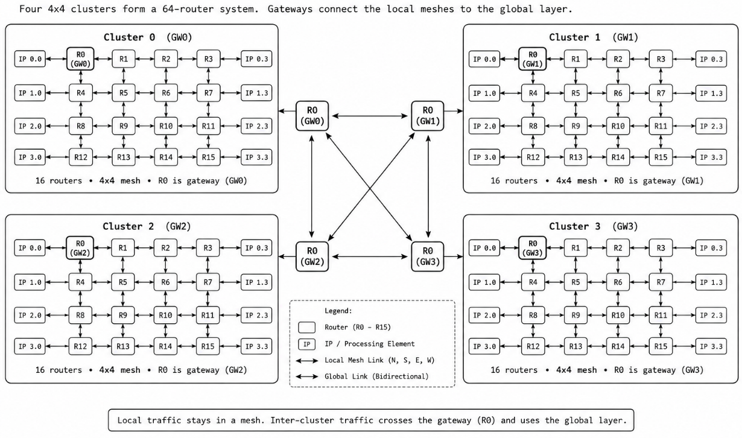
Final Architecture
4 clusters x 4x4 mesh = 64 routers
Gateway: R0 (0,0) of each cluster
Ring + diagonal global links
48-bit packets, 12-port routers

Slide 4
RTL Files We Are Building
Layer | Files
Definitions | noc_defines.vh
Top / network | hybrid_noc_v2.v, mesh_4x4_v2.v, global_network_4cluster.v
Router core | router.v, router_controller.v, router_control_logic.v, crossbar_switch.v
Input side | input_port.v, input_buffer.v, fifo.v, request_generator.v, request_classifier.v, packet_receiver.v
Routing | routing_unit.v, xy_routing.v, spidergon_routing.v, gateway_selector.v, adaptive_routing.v, congestion_checker.v
Arbitration | arbiter_bank.v, round_robin_arbiter.v, grant_to_select.v
Output side | output_port.v, output_buffer.v, packet_generator.v
Notes:
About 5,300 lines of Verilog in the main RTL folder.

Slide 5
RTL Hierarchy
hybrid_noc_v2
├── mesh_4x4_v2 x 4 clusters (C0..C3)
│ └── router x 16 per cluster
│ ├── input_port x 6 (input_buffer + routing_unit + request_generator)
│ ├── router_controller (arbiter_bank, round-robin)
│ ├── router_control_logic (selects, read/write enables)
│ ├── crossbar_switch (6x6)
│ └── output_port x 6 (output_buffer)
├── global_network_4cluster (ring + opposite links)
└── gateway connections (GATEWAY port of R0)

Slide 6
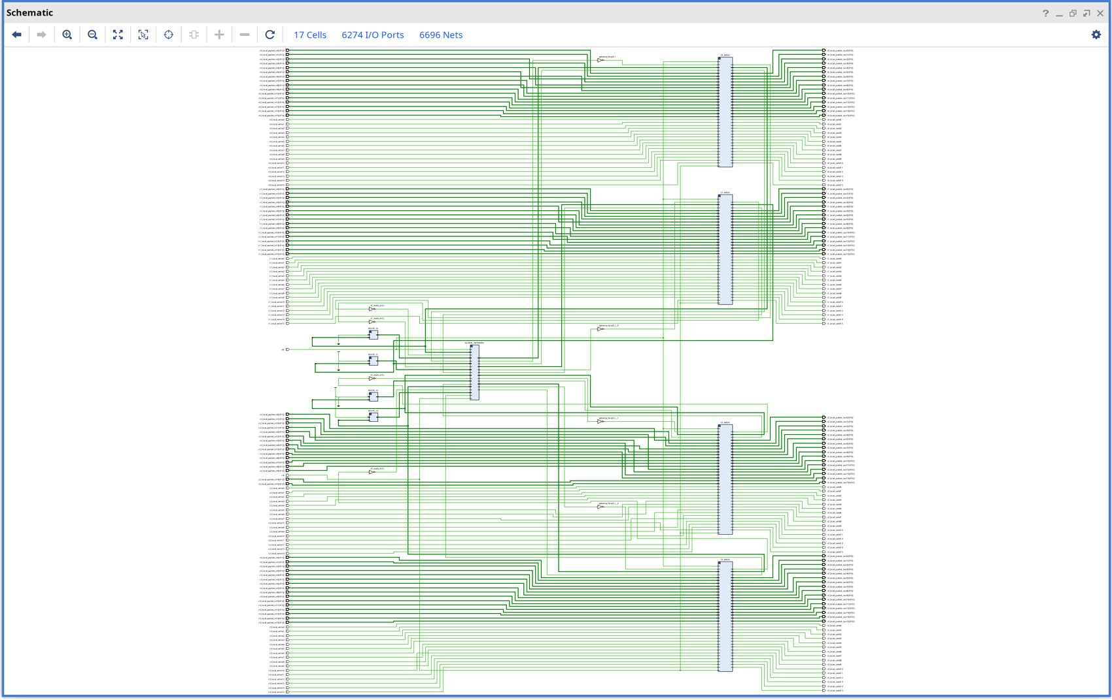
Design Image: Top-Level Schematic
Four mesh blocks C0_MESH..C3_MESH.
GLOBAL_NETWORK in the centre links the clusters.
ROUTE_C0..C3 blocks .
Vivado elaborated schematic: hybrid_noc_v2

Slide 7
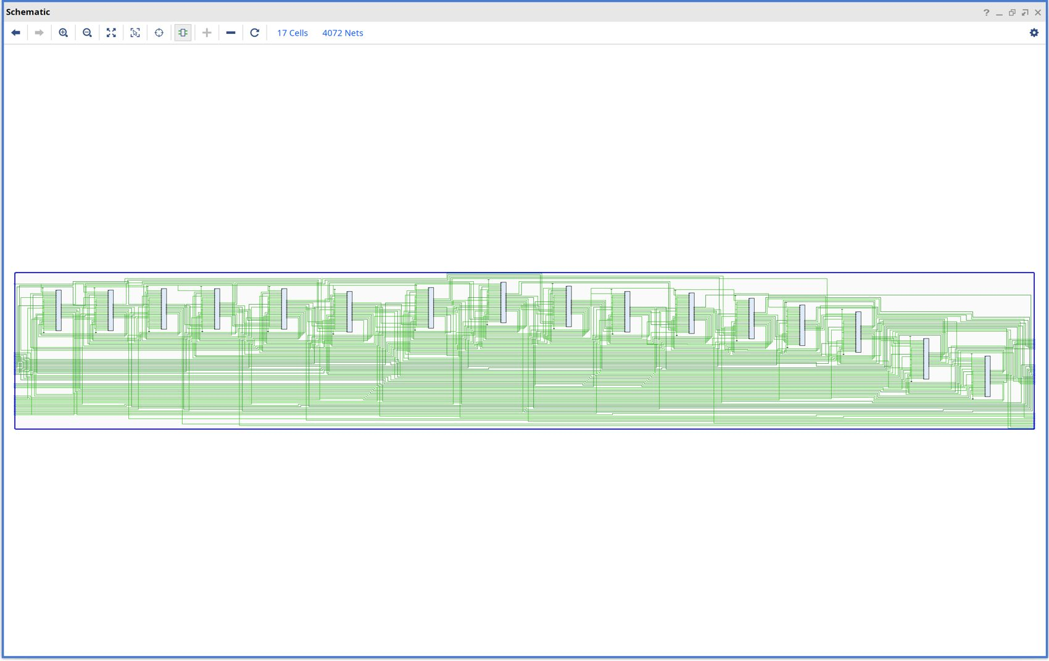
Design Image: One 4x4 Cluster
16 router instances R0..R15 in one cluster.
Neighbour links form the 2D mesh.
R0 carries the extra GATEWAY port.
Elaborated schematic: mesh_4x4_v2 (16 routers)

Slide 8
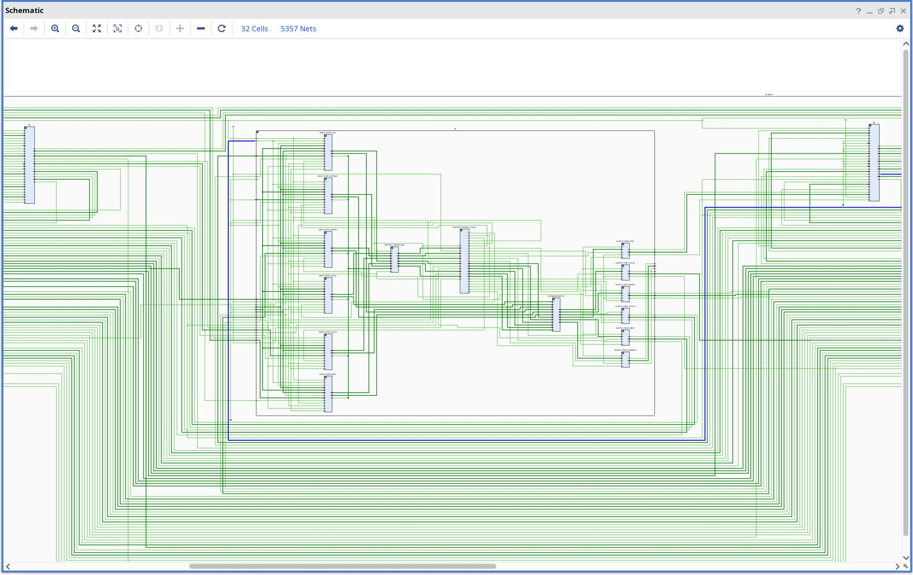
Design Image: Router Overview
Six input ports and six output ports.
router_controller feeds router_control_logic.
crossbar_switch sits between them.
Elaborated schematic: router (R5 of cluster C0)

Slide 9
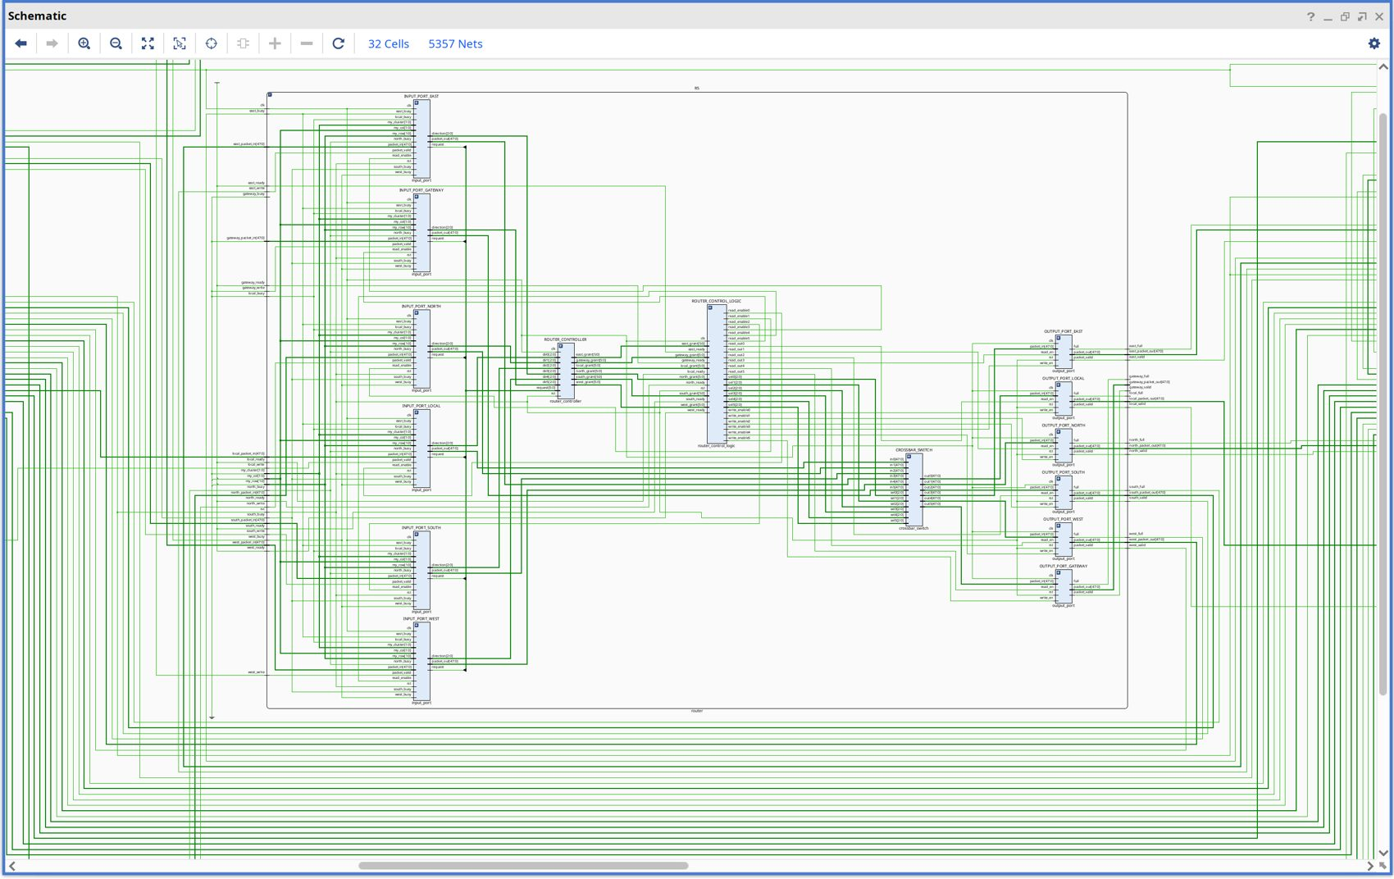
Design Image: Router Detail
input_port x 6: East, Gateway, North, Local, South, West.
router_controller takes dir0..dir5 and requests, returns grants.
Control logic outputs sel0-sel5 and read/write enables.
crossbar in0-in5 to out0-out5 (48-bit).
Router with port names visible

Slide 10
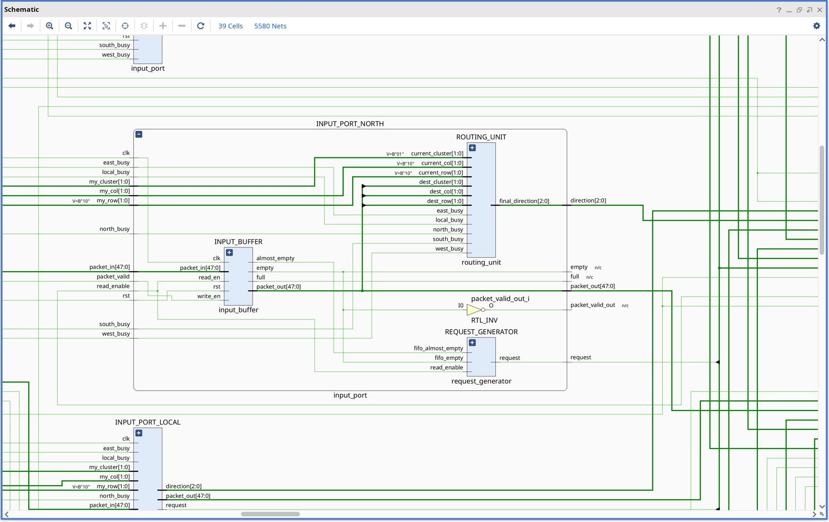
Design Image: Input Port
input_buffer (FIFO) stores 48-bit packets.
routing_unit decodes dest cluster/row/col to a 3-bit direction.
request_generator raises request when FIFO has data.
Elaborated schematic: input_port

Slide 11
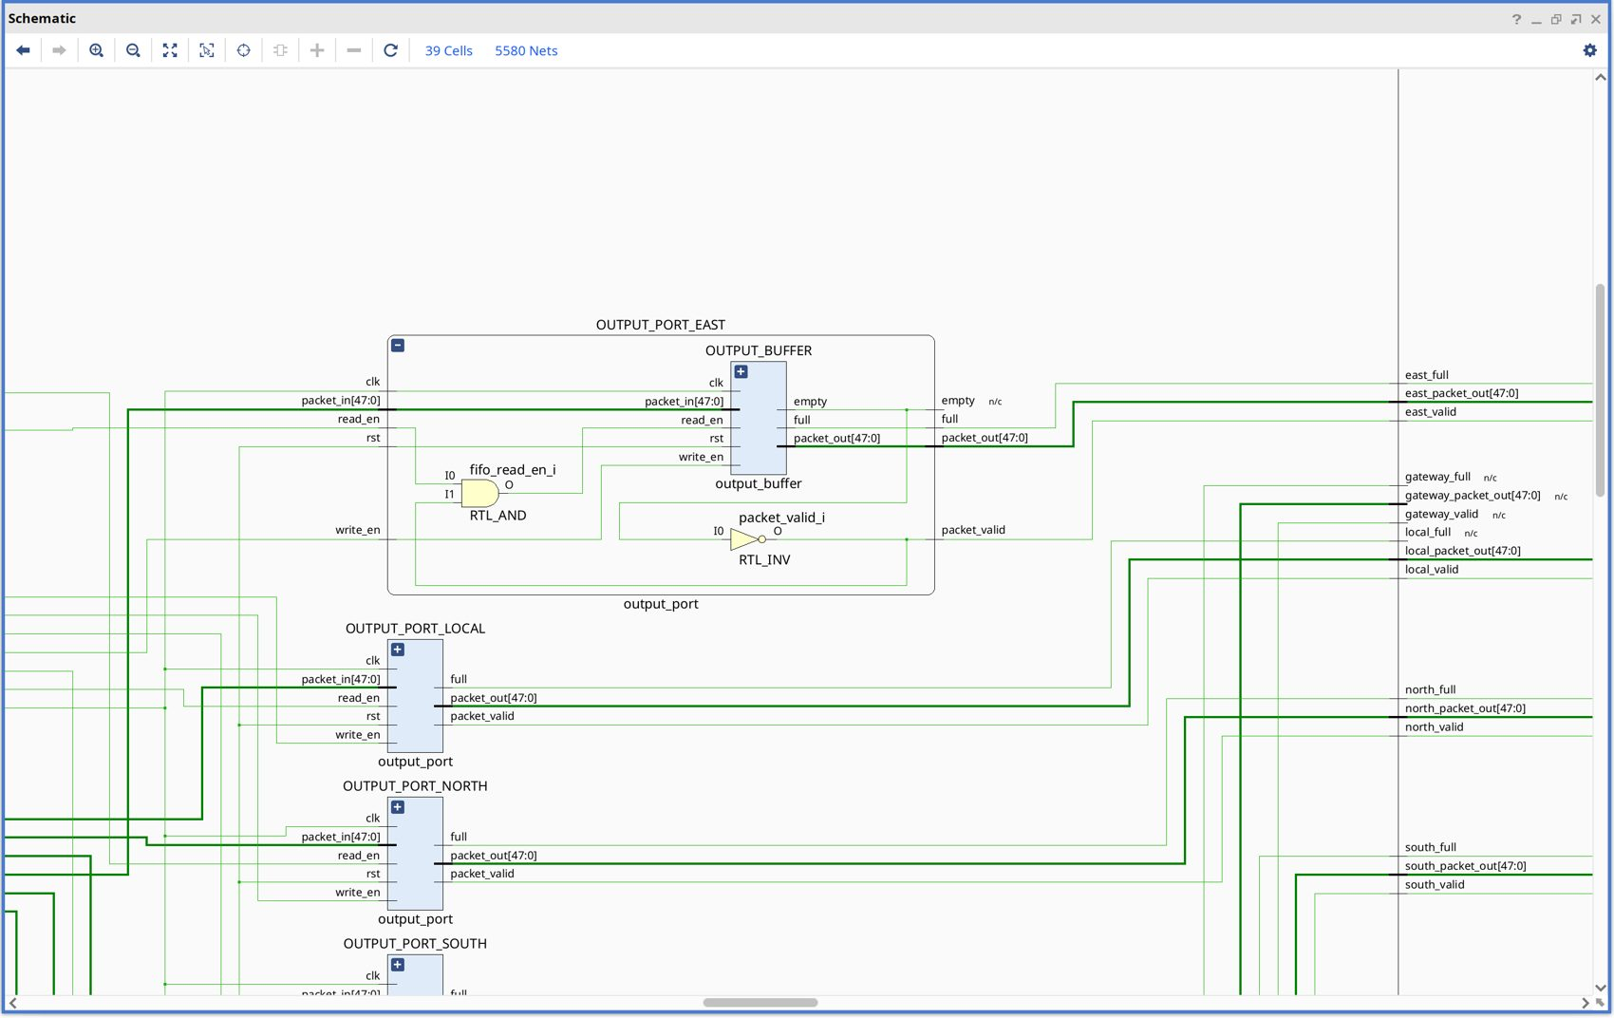
Design Image: Output Port
output_buffer holds the packet to the next router.
read_en gated with a RTL_AND; valid from empty flag.
Six output ports: Local, N, S, E, W, Gateway.
Elaborated schematic: output_port

Slide 12
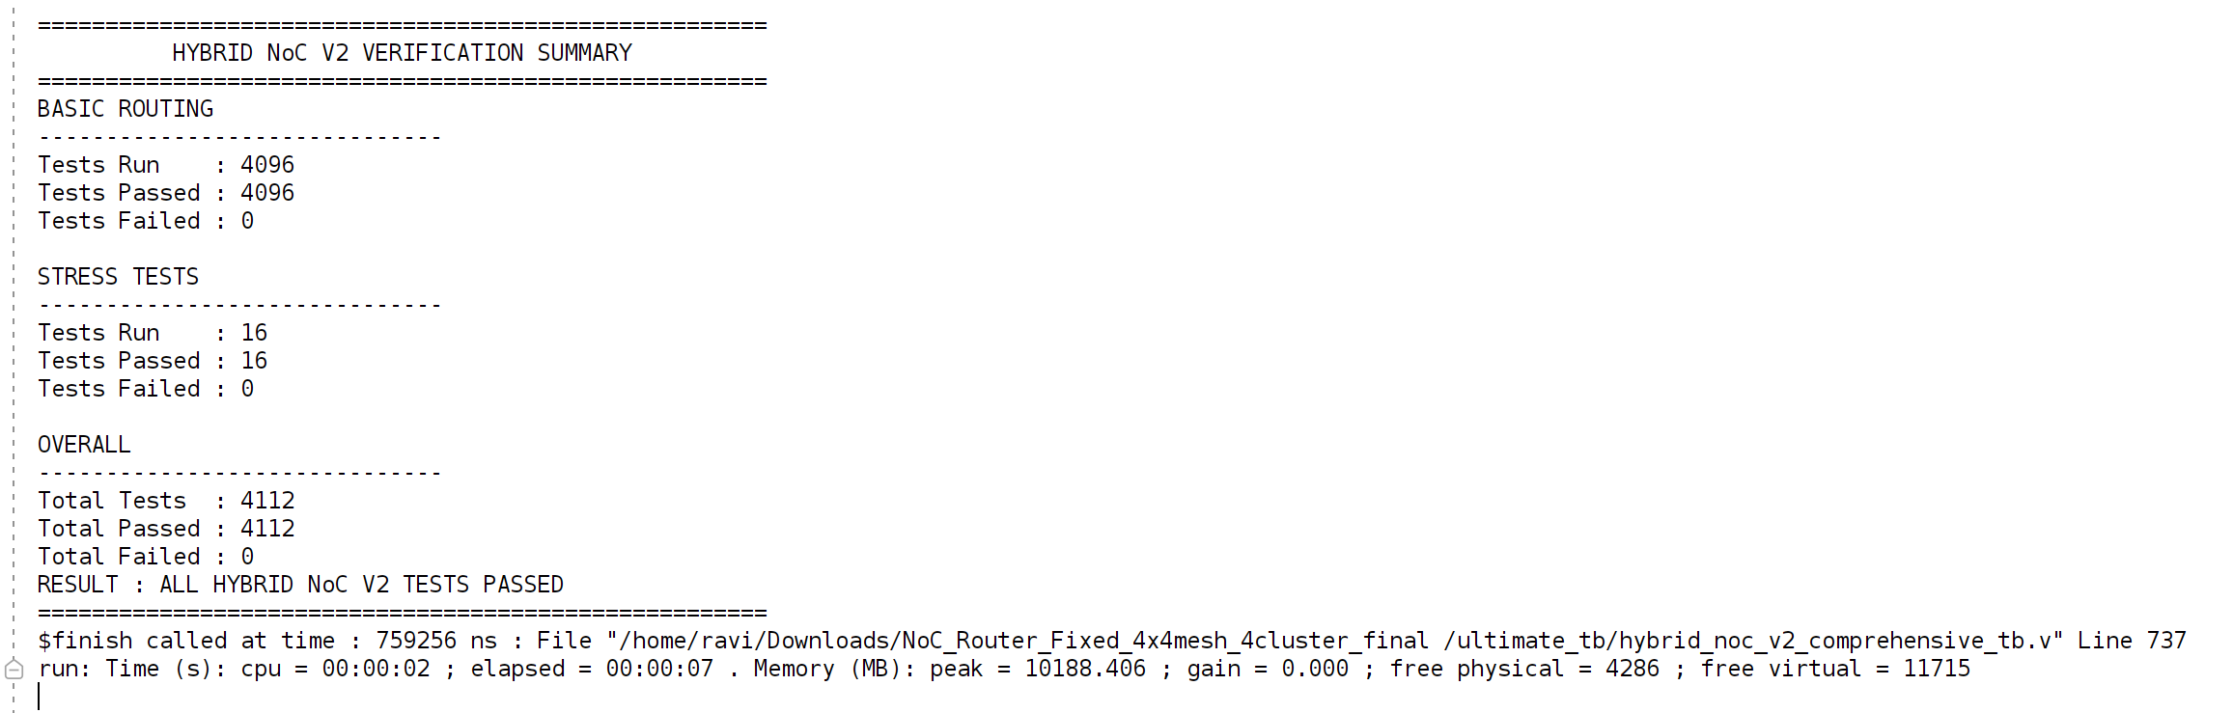
Final Output

Slide 13
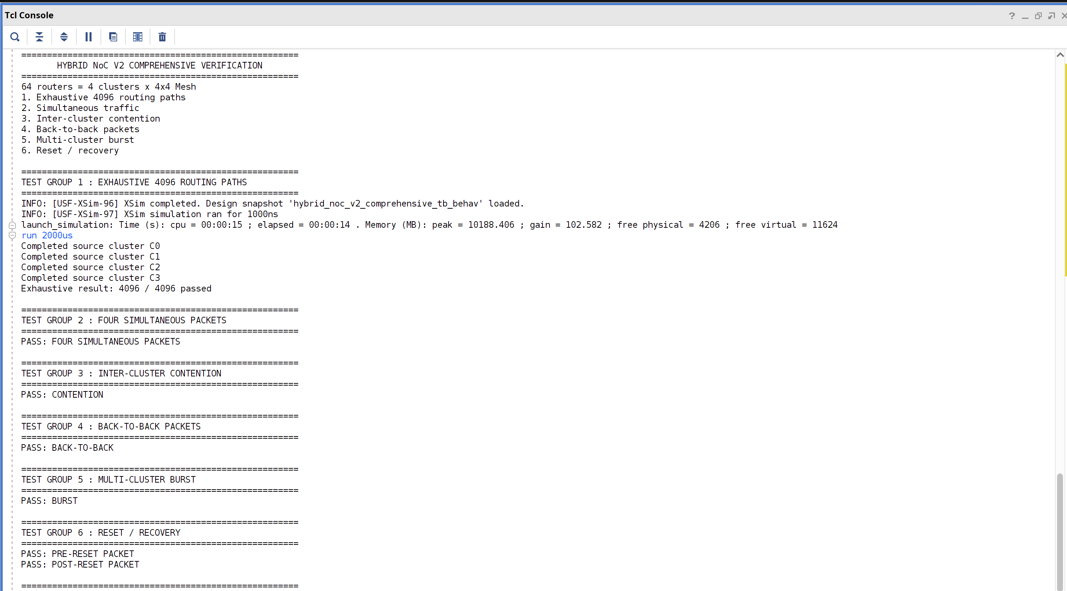

Slide 14
Code: Routing Unit
assign preferred_direction =
gateway_required ? global_direction // other cluster
: xy_direction; // same cluster
gateway_selector GS (.current_cluster, .dest_cluster,
.gateway_required);
xy_routing XY (.current_row, .current_col,
.dest_row, .dest_col, .direction(xy_direction));
spidergon_routing SP(.current_gateway(current_cluster),
.dest_gateway(dest_cluster),
.direction(global_direction));
localparam LOCAL=3'b000, NORTH=3'b001, SOUTH=3'b010,
EAST=3'b011, WEST=3'b100, GATEWAY=3'b101;
This mux is the heart of two-tier routing.
Same cluster: XY.
Different cluster: Spidergon direction toward gateway.
adaptive_routing and congestion_checker are instantiated too; the final route uses the deterministic path.

Slide 15
Code: Round-Robin Arbiter
// search starts after last winner
for (i = 1; i <= NUM_PORTS; i = i + 1) begin
index = last_grant + i;
if (index >= NUM_PORTS) index = index - NUM_PORTS;
if (!found && request[index]) begin
grant[index] = 1'b1; found = 1'b1;
end
end
always @(posedge clk or posedge rst)
if (rst) last_grant <= 3'd5;
else if (|grant) last_grant <= winning_index;
last_grant register rotates priority.
Prevents starvation, unlike fixed priority.
One arbiter per output port inside arbiter_bank.

Slide 16
Why we chose Round Robin over others?
Arbiter | Problem
Fixed priority | The highest-priority input can repeatedly win. Which causes starvation.
Random | Less predicable, more complicated and requires random selection logic
Age based | Requires storage of packet waiting time, more hardware & complexity and more states have to be tracked

Slide 17
Code: Packet Definitions and Hop Model
`define PACKET_WIDTH 48
`define CLUSTER_BITS 2 `define ROW_BITS 2 `define COL_BITS 2
`define TYPE_BITS 2 `define PRIORITY_BITS 2
`define PAYLOAD_BITS 32
`define NUM_CLUSTERS 4 `define ROUTER_PORTS 6
`define LOCAL 3'b000 `define NORTH 3'b001 `define SOUTH 3'b010
`define EAST 3'b011 `define WEST 3'b100 `define GATEWAY 3'b101
// noc_v2_hybrid_hop_calculator: src->(0,0), (0,0)->dst,
// and local hops via three hop_calculator instances
Single definitions file keeps all modules consistent.

Slide 18
Problems Found During Design and Fixes
Problem | Fix
Fixed-priority arbiter starved low-priority ports toward the gateway | Rotating round-robin arbiter with persistent last_grant
Separate gateway routers add area, extra hop, routing tables | R0 doubles as gateway through a 6th GATEWAY port
Gateway interface mismatches and missing ports during integration | Ports added and wiring corrected in mesh_4x4_v2 / hybrid_noc_v2
Include-path problems across folders | Single noc_defines.vh included by all modules
Failure
Log / waveform
Find module
Fix RTL
Re-run
▶
▶
▶
▶

Slide 19
Packet Flow Example: C0/R0 to C2/R3
C0/R0
C0 Gateway
Global link
C2 Gateway
C2/R3
▶
▶
▶
▶
Source router sees dest_cluster different, so routing_unit selects the global direction toward the gateway.
Packet crosses the C0 to C2 opposite link in global_network_4cluster.
Destination gateway sees dest_cluster equal to its own and switches to XY routing into C2.

Slide 20
Review 2 – Conclusion
Complete RTL for the 64-router hybrid NoC written: router, cluster, global network and top level.
Elaborated schematics confirm the intended hierarchy from top level down to port level.
Key mechanisms implemented: two-tier routing mux, round-robin arbitration, 6x6 crossbar, gateway port.
Next (Review 3): verification results, performance metrics and FPGA prototyping.

