Slide 1

REVIEW 3
Design, Verification and Performance Evaluation of a Hybrid Mesh–Spidergon Network-on-Chip Architecture
Submitted to: Dr. Deepak CH
By:
Ravi Teja 23BEC7342
John Joyce 23BEC7335
Anirudh 23BEC7217

Slide 2
A. Recap of Reviews 1 and 2
Why we built it, what we built, how it is structured

Slide 3
Executive Summary
Question | Answer
Problem | Keep Mesh regularity locally yet give distant cores short global paths
Built | 64-router Hybrid NoC: 4 x (4x4) mesh clusters + Spidergon-like global network
Verified | 4112 / 4112 functional tests passed
Measured | 20/20 packets delivered, 9.5-cycle average latency, 3.5 average hops, 0.3030 packets/cycle
Compared | Analytical hop study of Hybrid vs flat 8x8 Mesh vs 64-node Spidergon
Remains | Offered-load sweeps, baseline RTL, FPGA synthesis

Slide 4
Review 1 Recap: Problem and Idea
Problem
In a flat Mesh NoC, distant cores need many hops, and one large Spidergon ring cannot scale physically. A 64-router NoC needs short global paths without losing regularity.
More IP cores
Long paths, congestion
Mesh + Spidergon
Hybrid NoC
▶
▶
▶
Literature: Mesh (regular), Torus (long wires), Spidergon (short global paths), hierarchical NoC (locality + backbone).

Slide 5
Evolution of the Architecture
Initial concept
Router design
Cluster concept
Gateway concept
Hybrid topology
V2
4x4x4 = 64
▶
▶
▶
▶
▶
▶
Router grew from 5 to 6 ports (GATEWAY on R0).
Fixed-priority arbiter replaced by round-robin.
V2: mesh_4x4_v2, global_network_4cluster, hybrid_noc_v2.

Slide 6
B. Final Design and Implementation
Architecture, RTL, schematics and key code

Slide 7
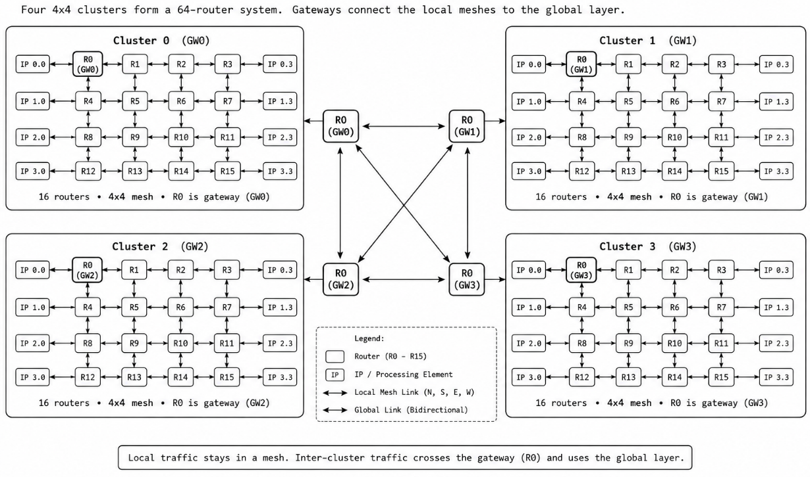
Final V2 Architecture
Parameter | Value
Clusters | 4
Mesh / cluster | 4x4
Total routers | 64
Packet | 48 bits
Ports | 12
Gateway | R0 (0,0)

Slide 8
Packet Format and Routing
DC
2b
DR
2b
DCol
2b
SC
2b
SR
2b
SCol
2b
Type
2b
Pri
2b
Payload[31:0]
32 bits
Destination (cluster/row/col) | Source (cluster/row/col) | Type, Priority | Payload — total 48 bits
Same cluster:
XY
Other cluster:
to gateway
Global link
Dest gateway
XY to dest
▶
▶
▶
▶
Routing is deterministic: XY inside a cluster, gateway-directed across clusters.
adaptive_routing.v and congestion_checker.v .

Slide 9
RTL Hierarchy and Files
hybrid_noc_v2
├── mesh_4x4_v2 x 4
│ └── router x 16
│ input_port x6 (buffer, routing_unit, request)
│ router_controller (arbiter_bank)
│ router_control_logic, crossbar_switch
│ output_port x6
├── global_network_4cluster
└── gateway connections
About 5,300 lines of Verilog in the main RTL folder.
Testbench side: noc_v2_metrics_monitor, noc_v2_hybrid_hop_calculator.
~40 module and integration testbenches plus comprehensive, smoke and metrics-sanity benches.

Slide 10
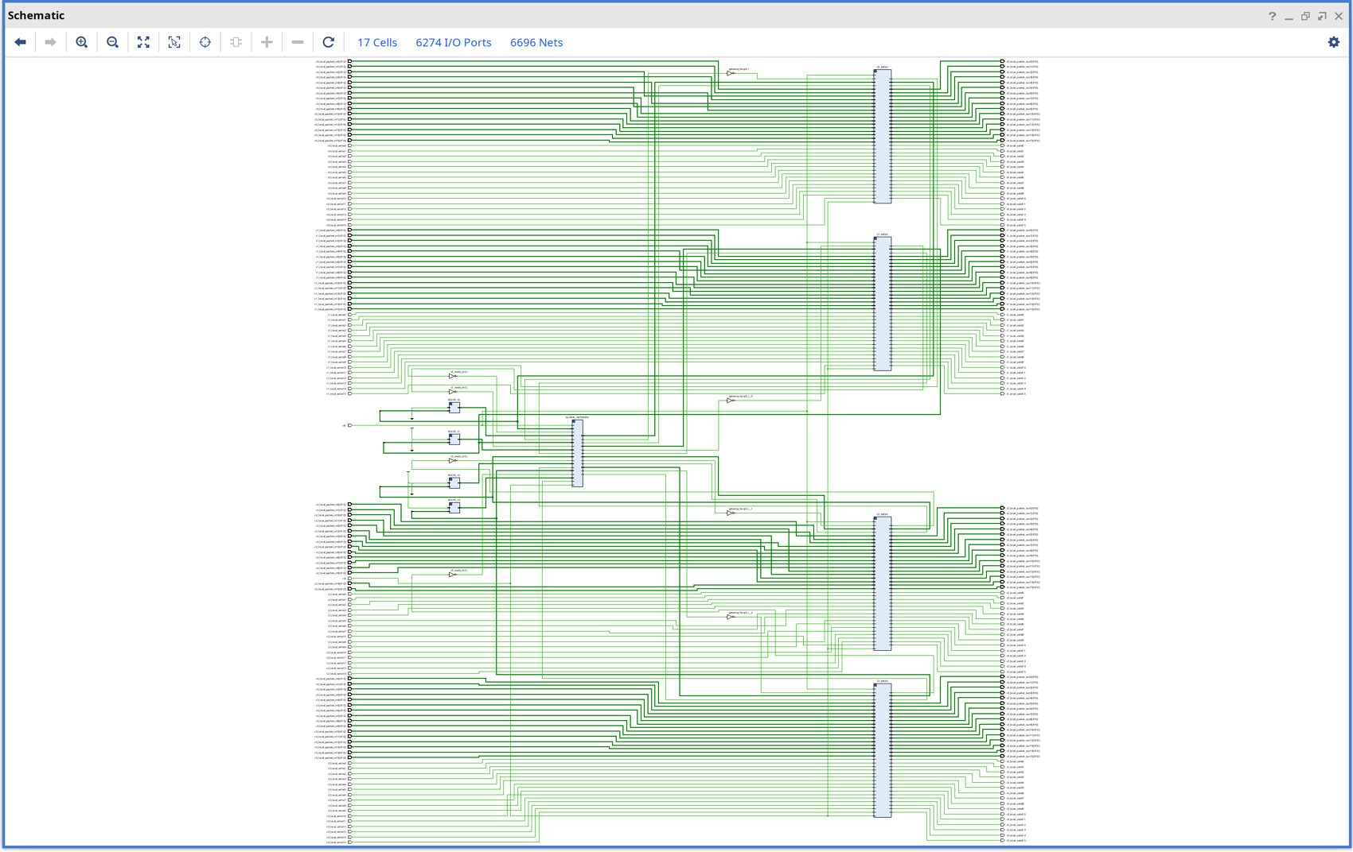
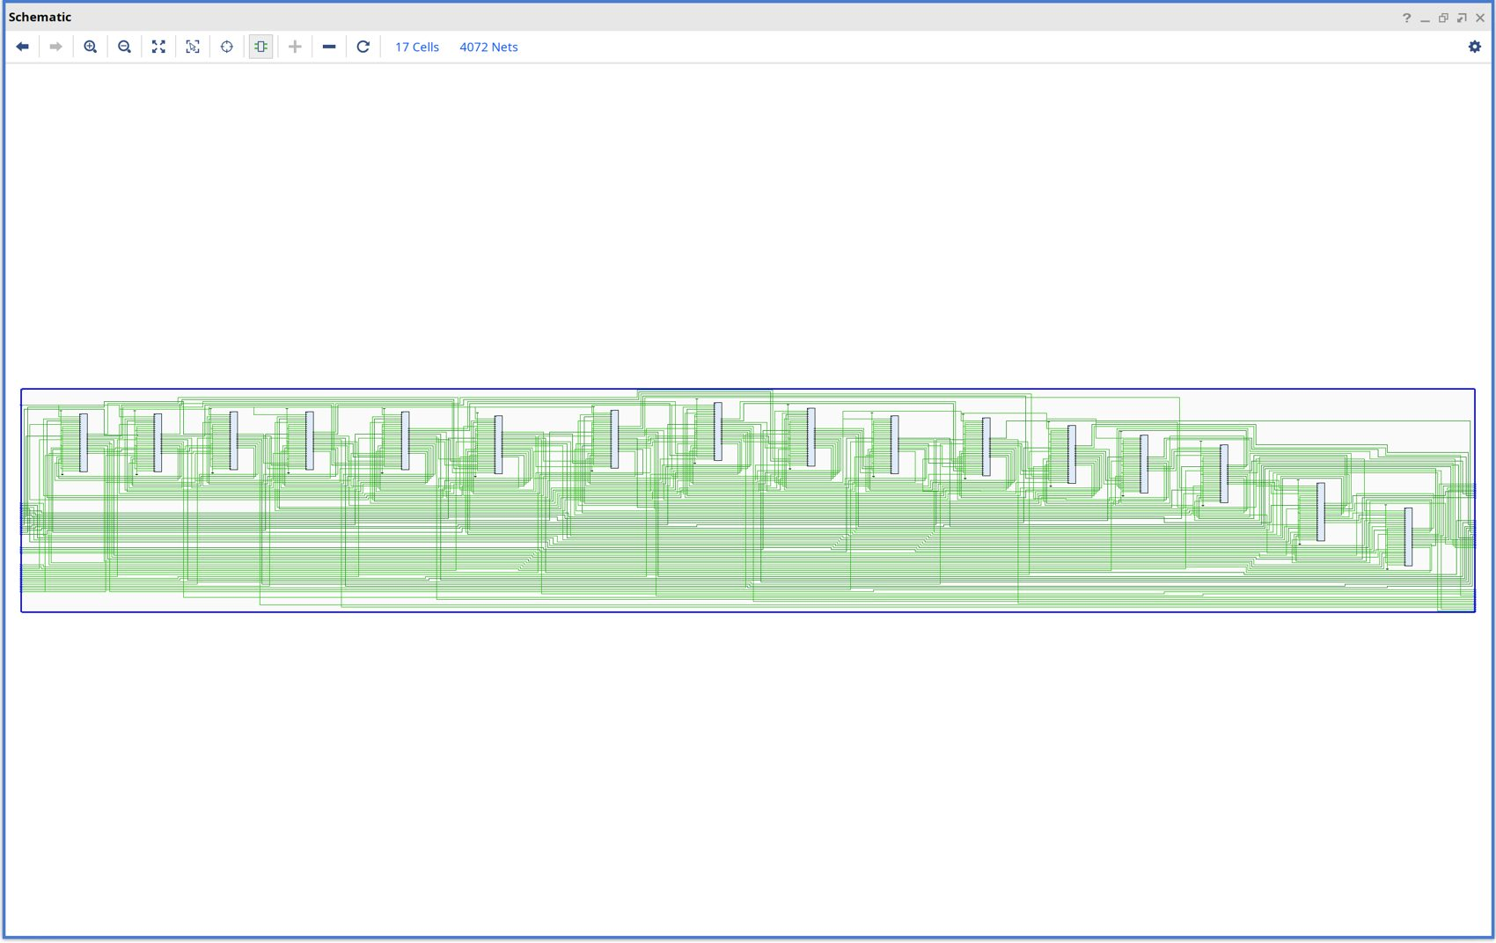
Schematics: Top Level and Cluster
hybrid_noc_v2 (4 meshes + global network)
mesh_4x4_v2 (16 routers)
Elaborated in Vivado 2025.2; hierarchy matches the architecture.

Slide 11
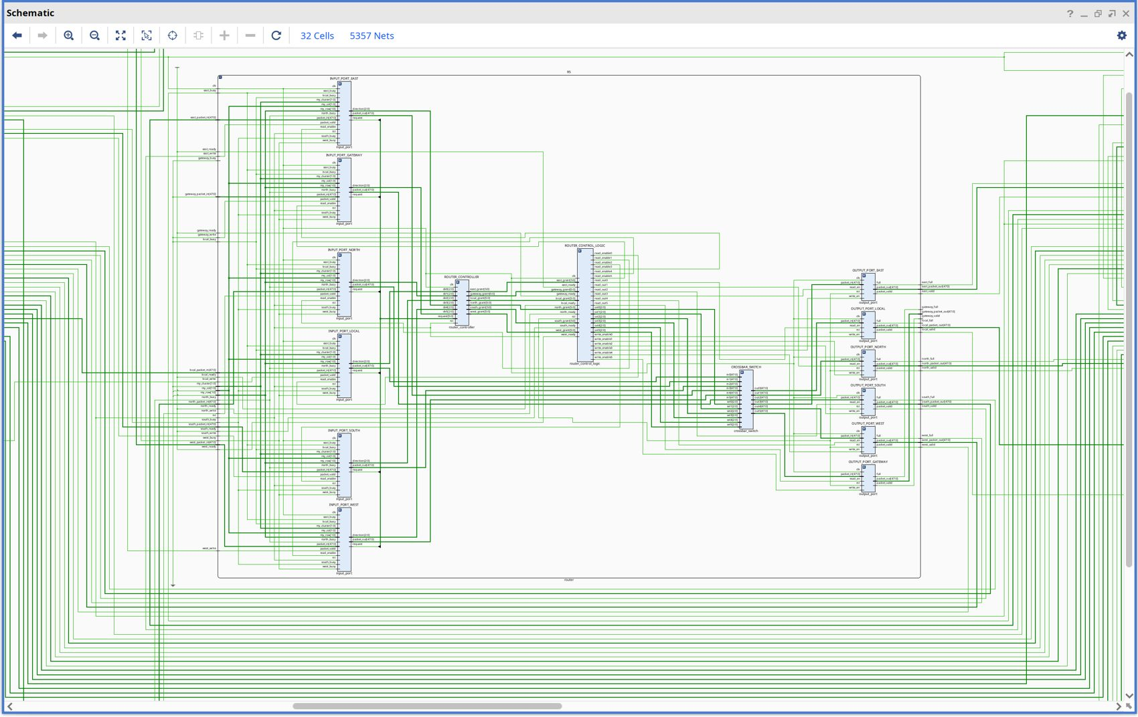
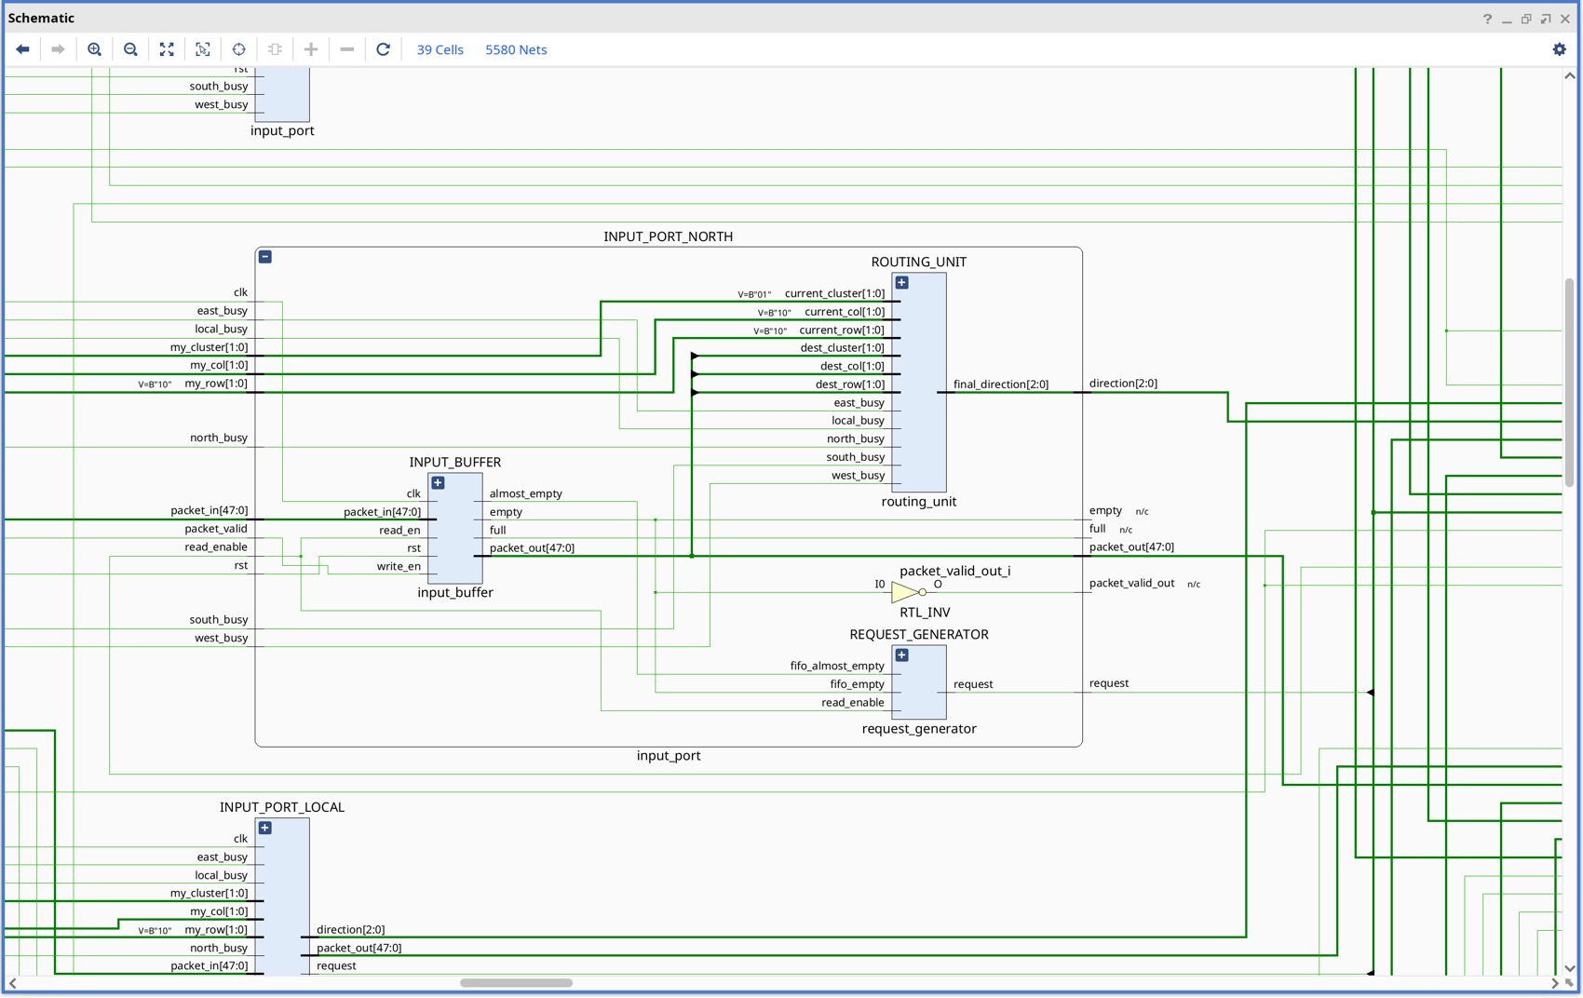
Schematics: Router Internals
router: 6 input ports, controller, crossbar, 6 output ports
input_port: buffer + routing_unit + request_generator
Output port (output_buffer) and crossbar complete the datapath.

Slide 12
Key Code: Routing Mux and Arbiter
assign preferred_direction =
gateway_required ? global_direction
: xy_direction;
Routing: same cluster uses XY, other cluster uses the Spidergon direction.
Arbiter: last_grant rotates priority for fairness.
Gateway: direction 3'b101 sends the flit out of the 6th port.
for (i=1;i<=NUM_PORTS;i=i+1) begin
index=last_grant+i;
if(index>=NUM_PORTS) index=index-NUM_PORTS;
if(!found && request[index]) begin
grant[index]=1'b1; found=1'b1;
end
end

Slide 13
C. Functional Verification
Layered testing from modules up to the full 64-router system

Slide 14
Verification Strategy
Module
Router
Cluster
Network
Exhaustive
Stress
Performance
▶
▶
▶
▶
▶
▶
Bottom-up: ~40 module and integration testbenches in /testbench, then ultimate_tb comprehensive, smoke and metrics-sanity benches.
Tool: Vivado 2025.2 XSim.

Slide 15
Functional Verification Results
Test | Result
Exhaustive routing (all paths) | 4096 / 4096
Simultaneous packets | PASS
Inter-cluster contention | PASS
Back-to-back | PASS
Multi-cluster burst | PASS
Reset / recovery | PASS
Overall | 4112 / 4112 PASS
4112
/ 4112
0 failed. Earlier 4x4-cluster configuration: 256 / 256.

Slide 16
Verification Evolution
Initial failures
Port / interface fixes
Gateway debug
Contention debug
Back-to-back debug
4112 / 4112
▶
▶
▶
▶
▶
Issue | Resolution
Gateway interface mismatches, missing ports | Added GATEWAY port, fixed wiring
Arbiter starvation under contention | Round-robin with last_grant
Back-to-back packet issue | FIFO / handshake debugging
Include-path problems | Single noc_defines.vh

Slide 17
D. Performance Metrics
Latency, hop count, throughput and delivery measured in XSim

Slide 18
Metrics Infrastructure
Injection event
Metrics monitor
Transaction ID
Receive match
Latency + hops
Throughput + delivery
▶
▶
▶
▶
▶
noc_v2_metrics_monitor.v: payload[31:0] is a unique transaction ID per packet.
Latency = receive cycle minus injection cycle; min, max, average and unmatched count kept.
Hop count from noc_v2_hybrid_hop_calculator.v (analytical, not carried in the packet).
Local : H = |Sr-Dr| + |Sc-Dc|
Inter-cluster :
H = Sr + Sc + 1 + Dr + Dc

Slide 19
Console Output: Metrics Sanity Test
HYBRID NoC V2 METRICS SANITY TEST
DUT: 64 routers / 4 clusters x 4x4
Packet width: 48 bits
PHASE A : LOCAL (C0/R0 -> C0/R3)
Injected 10 Received 10 Unmatched 0
Avg latency 8.0 Min 8 Max 8
Avg hops 3.0 PHASE RESULT: PASS
PHASE B : INTER-CLUSTER (C0/R0 -> C2/R3)
Injected 10 Received 10 Unmatched 0
Avg latency 11.0 Min 8 Max 11
Avg hops 4.0 PHASE RESULT: PASS
HYBRID NoC V2 METRICS SUMMARY
Packets injected : 20
Packets received : 20
Unmatched receives : 0
Total latency : 190 cycles
Average latency : 9.5 cycles
Total hop count : 70
Average hop count : 3.5
Delivery rate : 100.0 %
Experiment cycles : 66
Throughput : 0.3030 pkt/cycle
RESULT : ALL V2 METRICS TESTS PASS
Notes:
Source: Vivado XSim Tcl console, hybrid_noc_v2_metrics_sanity_tb, 744 ns.

Slide 20
Result: Local vs Inter-Cluster
Metric | Local | Inter-cluster
Route | C0/R0 to C0/R3 | C0/R0 to C2/R3
Packets / received | 10 / 10 | 10 / 10
Unmatched | 0 | 0
Avg latency | 8 cycles | 11 cycles
Avg hops | 3 | 4
Delivery | 100% | 100%

Slide 21
Result: Overall Metrics
Metric | Value
Injected / received | 20 / 20
Unmatched | 0
Total / avg latency | 190 / 9.5 cycles
Total / avg hops | 70 / 3.5
Delivery | 100%
Experiment cycles | 66
Throughput | 0.3030 pkt/cycle
Metrics infrastructure validated
Two traffic scenarios, so this proves the measurement chain, not a full benchmark.
Inter-cluster cost
Crossing the global network adds about 3 cycles over a local route here.

Slide 22
Result: Hop Calculator and Congestion Checker
Hop calculator test | Hops
C0/R0/C0 to C0/R0/C3 | 3
C0/R1/C2 to C0/R3/C0 | 4
C0/R0/C0 to C2/R0/C3 | 4
C1/R3/C3 to C3/R3/C3 | 13
Congestion check | Result
dir=011, congested=0 / 1 | PASS
dir=001, congested=1 / 0 | PASS
dir=100, congested=1 | PASS
Hop calculator tests : 9/9 PASS
System delivery check : PASS
Local/inter-cluster : PASS
RESULT : ALL V2 METRICS TESTS PASS

Slide 23
E. Topology Comparison
Analytical hop-count study: Hybrid vs Mesh vs Spidergon

Slide 24
Comparison Methodology
Item | Setting
Nodes | 64 for every topology
Pairs | All 64 x 63 = 4032 source-destination pairs
Hybrid | V2 model: local Manhattan; inter-cluster Sr+Sc+1+Dr+Dc
Mesh baseline | Flat 8x8 mesh, Manhattan distance
Spidergon baseline | 64-node ring, across link at N/2, across-first routing
Metric | Link traversals (hops), uniform all-pairs traffic
This is an analytical model, not a cycle-accurate simulation of the baselines.

Slide 25
Result: Average and Worst-Case Hops

Slide 26
Result: Hybrid Local vs Inter-Cluster
Local: 2.67 hops, far shorter than a flat mesh average.
Inter-cluster: 7.0 hops, because every packet funnels through corner gateways (0,0).
Reading: gateway placement, not the global link, dominates inter-cluster cost.

Slide 27
Overall Comparison
Parameter | Mesh 8x8 | Spidergon-64 | Hybrid
Avg hops (4032 pairs) | 5.33 | 8.62 | 5.97
Worst-case hops | 14 | 16 | 13
Local (in-cluster) avg hops | n/a | n/a | 2.67
Router ports | 5 | 3 (+ local) | 5 (6 at gateways)
Long wires | None | Across links | 4 gateway links only
Measured latency (RTL) | not built | not built | 8 / 11 cycles
Measured throughput (RTL) | not built | not built | 0.3030 pkt/cycle
Hybrid beats Spidergon-64 on hops and has the lowest worst case; flat mesh is slightly lower on average under uniform traffic.
Notes:
Latency and throughput for baselines require baseline RTL; listed as next step.

Slide 28
Discussion
Finding: under uniform all-pairs traffic the hybrid is 12% above a flat 8x8 mesh on average hops, but 7% lower in worst case.
Why: one corner gateway per cluster concentrates inter-cluster traffic.
Where hybrid wins: local traffic (2.67 hops), physical simplicity (only 4 global links) and Spidergon-like scaling.
Improvement path: adaptive gateway selection or more gateways per cluster (adaptive blocks already in RTL).

Slide 29
F. Conclusions
Achievements, limitations and future work

Slide 30
Achievements
64-router architecture: 4 x (4x4) mesh clusters + Spidergon-like global network.
Six-port gateway router; 48-bit packet; complete RTL integration.
4112 / 4112 functional tests passed (4096 exhaustive routes + stress).
Metrics infrastructure: latency, hops, throughput, delivery; 20/20 delivered, 9.5-cycle average latency.
Analytical comparison against Mesh and Spidergon baselines.

Slide 31
Limitations
Routing is deterministic; adaptive RTL exists but is not in the final route.
RTL latency/throughput measured for two scenarios only; no offered-load sweep yet.
Baseline comparison is analytical; baselines are not simulated in RTL.
Hop count is analytical, not carried in the packet.
Metrics monitor limited for arbitrary same-cycle events; FPGA synthesis not yet done.

Slide 32
Future Work
RTL Mesh and Spidergon baselines for latency and throughput curves.
Activate adaptive gateway selection; try multiple gateways per cluster.
FPGA synthesis: area, Fmax, power.

Slide 33
Final Conclusion
The project progressed from a topology concept to a complete 64-router RTL Hybrid NoC with four 4x4 mesh clusters and Spidergon-like gateway links.
Functional verification passed 4112/4112 tests, and the metrics chain delivered 20/20 packets at 9.5-cycle average latency.
Analytically, the hybrid has the lowest worst-case hops (13) and 2.67-hop local paths, but a slightly higher uniform average than a flat mesh (5.97 vs 5.33).
Next: offered-load benchmarking and gateway optimisation.

