Slide 1
Building an AI Tic Tac Toe Player with Min-Max
Team Members:
Ravi Prasad Grandhi
Kalkesh Gembali

Slide 2
Table of contents
Tic Tac Toe
Objectives
Overview
Algorithms
Min-Max Algorithm
Algorithm Overview
Performance Analysis
Code

Slide 3
Overview
Objective: Tic-Tac-Toe is a two-player game where the objective is to create a row of three of your own symbols (traditionally "X" or "O") either horizontally, vertically, or diagonally on a 3x3 grid.
Turn-Based Gameplay: Players take turns placing their symbols on an empty spot on the grid. The game begins with an empty board, and players alternately make their moves until one player achieves the objective of getting three of their symbols in a row or the board is filled, resulting in a draw.
Simple Rules: The game is straightforward, with simple rules. Players cannot overwrite each other's moves, and once a row of three is achieved, the game ends. If the entire board is filled without a winner, the game is declared a draw. Tic-Tac-Toe is often used as a basic introduction to strategy games and is widely known for its simplicity and quick gameplay.

Slide 4
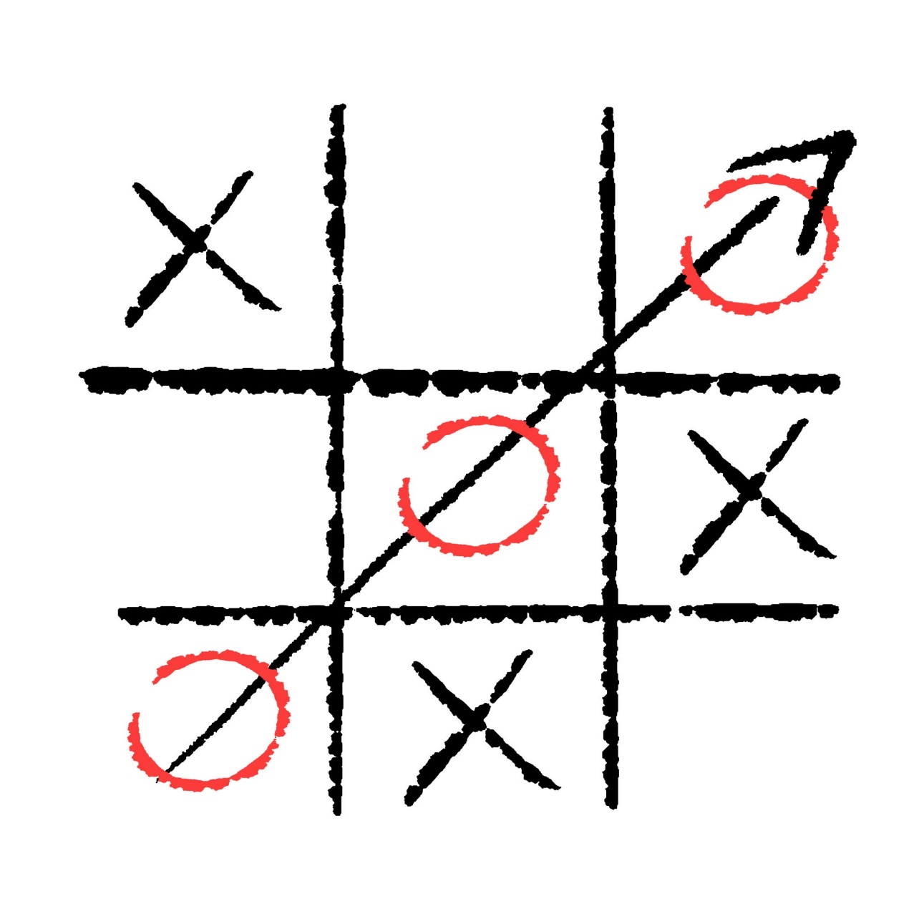
Building an AI Tic Tac Toe Player with Min-Max
The essence of the Minimax algorithm lies in the iterative exchange between the two players, with the player currently taking their turn aiming to select the move that yields the highest possible score.

Slide 5
Algorithms
In creating a Tic Tac Toe game with the Minimax Algorithm, the goal is to enable players to compete against an agent while minimizing the use of computational resources
To ensure the algorithm can be customized to accommodate various Players.
To create an interactive game with a seamless user interface using Python libraries.
Elevate the game's competitiveness with an advanced scoring system.

Slide 6
Min-Max Algorithms
Maximize winning possibility assuming that opponent will try to minimize (Minimax Algorithm)
Ignore the unwanted portion of the search tree (Alpha Beta Pruning)
Evaluation(Utility) Function
A measure of winning possibility of the player

Slide 7
Algorithm Overview
Initialize the Game Board: Create a 3x3 grid to represent the Tic-Tac-Toe board. This can be implemented as a 2D array or any suitable data structure.
Player Turns: Implement a turn-based system where players take alternating turns. On each turn, a player selects an empty spot on the board to place their symbol ("X" or "O").
Check for a Winner: After each move, check if the current player has achieved a winning combination (three in a row) horizontally, vertically, or diagonally. If a winner is found, end the game and declare the winning player.
Check for a Draw: If the entire board is filled and no winner is found, declare the game as a draw.
Game Loop: Continue the game loop until a winner is determined or the game ends in a draw. Allow players to keep taking turns.
Input Validation: Implement input validation to ensure that players can only make valid moves, preventing them from overwriting each other's moves or choosing already occupied spots.
Display the Board: Show the updated game board after each move, so players can see the current state of the game.
Optional: Improve AI (if applicable): If creating a single-player version, consider implementing a simple AI for the computer opponent. This AI should make intelligent moves to challenge the player.
Optional: Replayability: Allow players to choose whether they want to play another round without restarting the entire program

Slide 8
Performance analysis
Time Complexity: The time complexity of the core game loop is constant (O(1)) for each player move since you are dealing with a fixed-size 3x3 grid. Checking for a winner or a draw also involves iterating through a constant number of cells. The overall time complexity for the game remains low.
Space Complexity: The space complexity is also minimal, given that the game board is typically represented by a 2D array with a fixed size. The space required is O(1) since the size of the board doesn't change regardless of the number of moves.
Input Validation: Depending on the level of input validation implemented, the time complexity for input checks could be considered. However, given the small scale of the game, input validation is usually straightforward and does not significantly impact performance.
Scalability: Tic-Tac-Toe is not designed for scalability, as the game grid size is fixed at 3x3. If you were to expand the game to a larger grid or a more complex version, you would need to consider the impact on both time and space complexity.
AI Performance (if applicable): If you implement an AI opponent, the performance will depend on the complexity of the AI algorithm. In a simple AI for Tic-Tac-Toe, where the computer just tries to block the player and make winning moves, the performance impact is still minimal.
Graphics and User Interface (UI): If you decide to add graphical elements or a user interface, the performance may be influenced by the complexity of your graphical implementation. However, for a basic console-based implementation, the impact is typically negligible.

Slide 9

THANK YOU

