Slide 1
Smart Contract Vulnerabilities and Security Solutions
RAVI SHANKAR 22MEI10050
MATRUPRIYA DIBYANSHU PANDA 22MEI10040

Slide 2
Table of Contents
1
Introduction to Smart Contracts
2
Types of Vulnerabilities in Smart Contracts
3
Impact of Vulnerabilities
4
Security Solutions for Smart Contracts

Slide 3
Introduction to Smart Contracts
01

Slide 4
Overview of Smart Contracts
Definition and Purpose
Smart contracts are self-executing contracts with the terms of the agreement directly written into code. They automate and enforce contractual obligations without intermediaries, reducing costs and increasing efficiency in various applications.
01
02
Common Platforms
Prominent platforms for developing smart contracts include Ethereum, Binance Smart Chain, and Solana. Each platform offers unique features and programming languages, with Ethereum being the most widely used for decentralized applications.
Importance in Blockchain
03
Smart contracts are fundamental to blockchain technology, enabling decentralized applications (dApps) and facilitating trustless transactions. They enhance security and transparency, making them essential in sectors like finance, supply chains, and real estate.

Slide 5



Evolution of Smart Contracts
Historical Context
Key Developments
Future Trends
The concept of smart contracts dates back to the 1990s when cryptographer Nick Szabo introduced programmable contracts. However, their practical implementation gained traction with the advent of blockchain technology in the 2010s.
Significant advancements include the introduction of Ethereum in 2015, which allowed for more complex programming capabilities. These developments have driven innovation and the proliferation of decentralized finance (DeFi) applications.
The future of smart contracts includes increased scalability, interoperability between blockchains, and the adoption of formal verification methods to enhance security and reliability in critical applications.

Slide 6
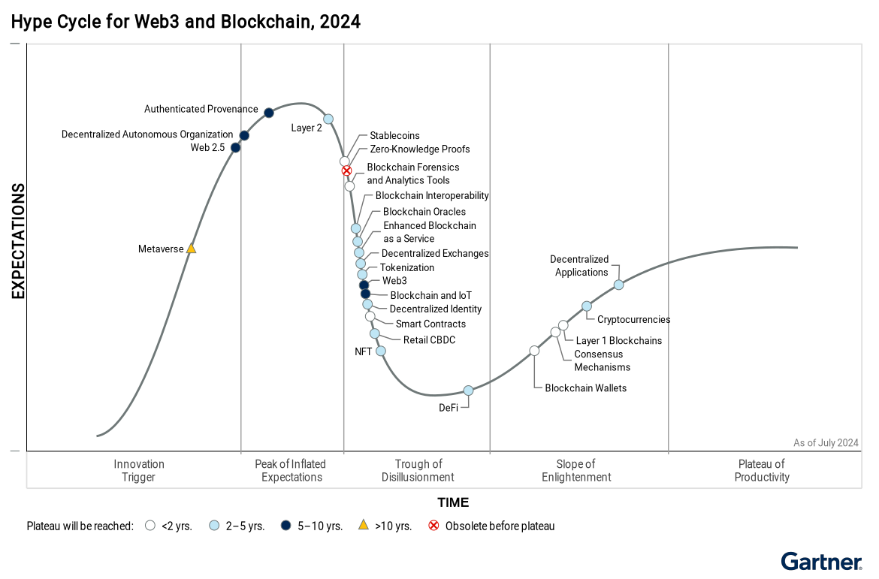

Slide 7
Types of Vulnerabilities in Smart Contracts
02

Slide 8
Common Vulnerabilities
Reentrancy Attacks
Timestamp Dependence
Reentrancy attacks exploit the ability of a contract to call back into itself before a previous execution finishes, potentially leading to unexpected behaviors, such as draining funds from the contract.
Contracts often rely on block timestamps for certain functionalities. Manipulating these timestamps can enable attackers to gain unfair advantages, presenting risks in time-sensitive transactions and conditions.
Integer Overflow/Underflow
Integer overflow and underflow occur when operations exceed the maximum limit or fall below the minimum value of integers, which can lead to unexpected results and vulnerabilities in financial calculations.

Slide 9
Case Studies of Exploits
The DAO Hack
01
In 2016, The DAO was exploited due to a vulnerability in its smart contract, leading to the theft of around $50 million worth of Ether. This incident highlighted the need for comprehensive security assessments in decentralized applications.
Parity Wallet Incident
02
The Parity wallet incident involved a bug that allowed an attacker to freeze over $160 million in Ether by exploiting a vulnerability in a multi-signature wallet contract, demonstrating the risks associated with complex smart contract code.
Recent High-Profile Breaches
03
Recent breaches include attacks on decentralized exchanges and DeFi projects, where vulnerable contracts have led to significant financial losses, showcasing the ongoing security challenges in smart contract development.

Slide 10
Impact of Vulnerabilities
03

Slide 11

Financial Losses
Quantifying the Losses
The financial losses due to smart contract vulnerabilities are staggering, amounting to billions in lost investments. This impacts not only individual investors but also the overall market confidence in cryptocurrencies and blockchain technologies.
Long-term Implications for Investors
Repeated breaches can discourage investment in blockchain projects, leading to reduced capital inflow and slower technological advancement. Trust issues can persist long term, affecting stakeholders’ willingness to engage with blockchain solutions.

Slide 12


Trust and Adoption
01
02
Impact on User Trust
Barriers to Mainstream Adoption
Vulnerabilities in smart contracts can erode user trust in blockchain applications. Users may hesitate to adopt new technologies or platforms if they perceive a lack of security and reliability.
Trust issues resulting from past exploits create barriers to the widespread adoption of blockchain technologies. Businesses and consumers may prefer traditional systems over decentralized solutions, hindering innovation and market growth.

Slide 13
Security Solutions for Smart Contracts
04

Slide 14
Best Practices in Coding
Code Reviews and Audits
Real-time Monitoring
Conducting thorough code reviews and third-party audits is essential to identify and mitigate vulnerabilities before deployment, ensuring the contract performs as intended under various scenarios.
Implementing real-time monitoring solutions to track contract performance and unusual activities can help detect and respond to potential exploits early, enhancing the overall security posture.
Using Established Libraries
Utilizing well-maintained and audited libraries, such as OpenZeppelin, helps developers implement secure smart contracts efficiently without reinventing the wheel, reducing risks associated with custom code.

Slide 15
Security Tools and Frameworks
01
02
03
Automated Testing Tools
Formal Verification Methods
Use of Bug Bounties
Automated testing tools like Truffle and MythX allow developers to simulate and test smart contract behavior comprehensively. They can identify vulnerabilities and ensure the contract survives edge cases.
Formal verification provides mathematical proofs of the correctness of smart contracts. This rigorous approach enhances security by ensuring that the contract’s implementation matches its specified properties.
Establishing bug bounty programs incentivizes security researchers to identify potential vulnerabilities, encouraging community engagement and enhancing the robustness of deployed contracts through proactive discovery.

Slide 16

Industry Standards
01
02
Best Practices Frameworks
Role of Organizations
Industry organizations are developing best practices frameworks to guide smart contract development, such as the Ethereum Smart Contract Security Best Practices, which help developers avoid common pitfalls.
Organizations like the Blockchain Security Alliance and the Enterprise Ethereum Alliance advocate for best practices, standardization, and education in smart contract security, fostering a safer blockchain ecosystem.

Slide 17
Thank you.

