Slide 1

Model Complexity and Neural Network Pruning
ECE 595 Ravi Mann
Notes:
NOTE:
To change the image on this slide, select the picture and delete it. Then click the Pictures icon in the placeholder to insert your own image.

Slide 2
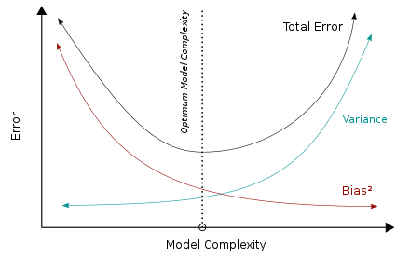
Importance of Model Complexity
Performance Optimization
Capture patterns in the data
Overfitting
Bias-Variance Trade-off
Error & sensitivity
Computational Resources
Power & Memory

Slide 3
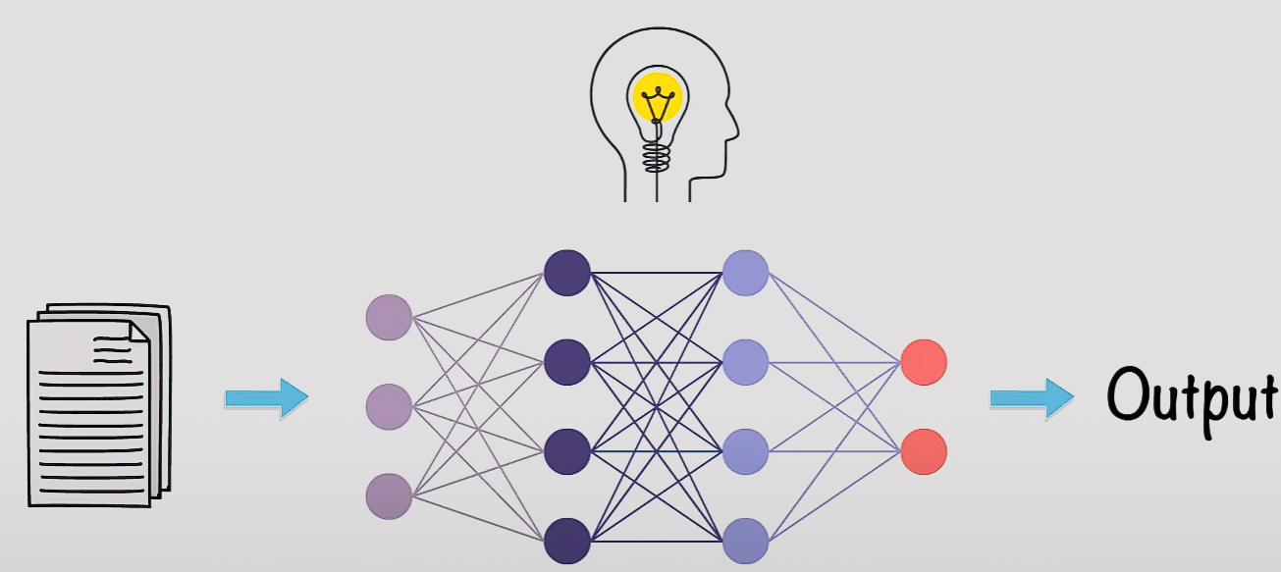
Introduction to Neural Networks
Each neuron receives input signals, processes them using an activation function, and produces an output signal, which may be passed on to neurons in the next layer.
Input layer
Feature or Attribute
Hidden Layer
Learn complexity
Output Layer
Prediction
Binary classification task
1 neuron for prob. of belonging to one class
Image classification, Speech recognition, and Machine translation

Slide 4
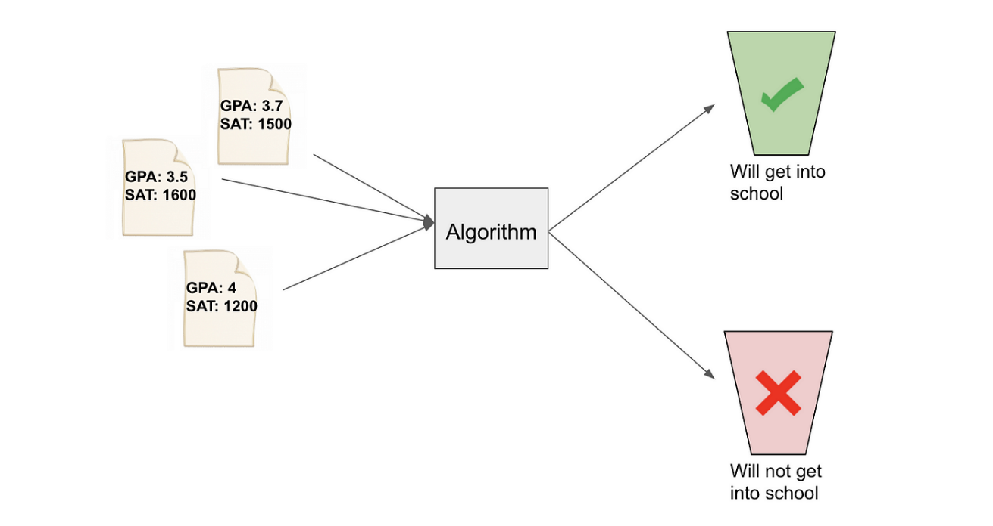
Binary Classification Dataset
Outputs categorized as one of two categories
Features used for classifying
Classes are observation categories

Slide 5
Building Neural Network
Architecture
Number of layers and neurons
Activations function for each layer
Select Activation Function
Rectified linear Unity: f(x) = max(0,x)
Hidden layers
Sigmoid: f(x) = 1/(1+e^-x)
Output layers ( 0 to 1)
Hyperbolic Tangent: f(x) =(e^x – e^-x) / e^x + e^-x)
Hidden layers (-1 to 1)

Slide 6
Cont. Building Neural Network
Optimization Techniques
Update weights during training
Gradient Descent
Steepest decent of loss function
Training the Network
Splitting data into test sets
Forward propagate
Calculate error in prediction
Backpropagate the loss by updating the weights
Repeat process for multiple epochs
Evaluate

Slide 7
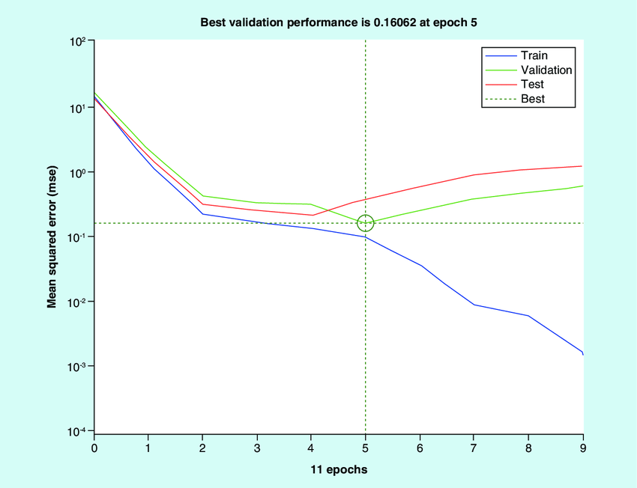
Testing Performance
Accuracy
Overall correctness of the classifier
Precision
Avoiding false positive
Recall
Avoiding false negative

Slide 8
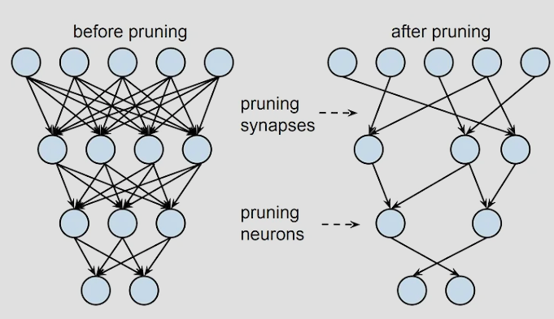
Understanding Neural Network Pruning
Reduce the complexity of a trained neural network
Removing connection or neurons
Efficiency without sacrificing performance
Prevents overfitting and noise memorization

Slide 9
Magnitude-Based Pruning Method
Removing connections (weights) with low magnitudes.
Initial Training
Applied after training with gradient descent
Ranking Weights
Magnitudes of all weights
Threshold and Pruning
Fixed % of largest weight
Validation and Testing
Validated with test dataset for performance

Slide 10
Pruning Thresholds and Impacts
Fixed Percentage Threshold
Magnitude Threshold
Layer-wise Threshold
Thresholds for individual layers
Impact
Number of parameters
Classification Accuracy

Slide 11
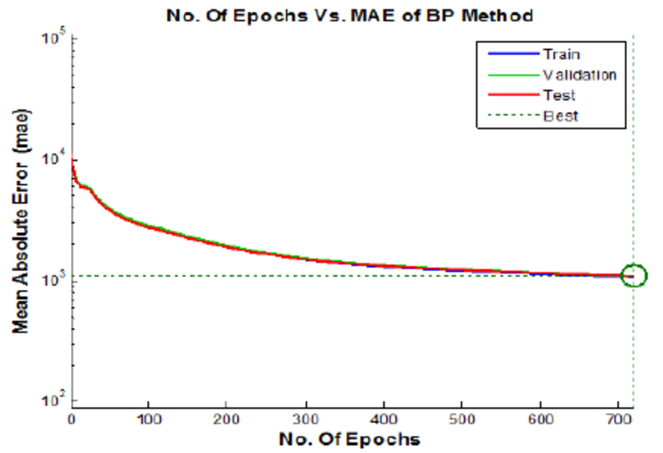
Results Analysis
Classification Accuracy Analysis
Higher Sparsity vs Lower Accuracy
Efficient but lower accuracy
Lower Sparsity vs Higher Accuracy
Less efficient but higher accuracy

Slide 12
Conclusion
Magnitude based pruning
Scalability and effectiveness
Evaluation of pruned models
Balance model of sparsity and accuracy
Multiple layers
Overfitting and vanishing gradient

Slide 13
Future Directions
Dynamic Pruning Techniques
Explore adaptive pruning methods based on real-time feedback or importance metrics during training or inference.
Structured Pruning
Research methods targeting entire neurons, layers, or groups of layers for efficient network architecture refinement.
Sparse Representation Learning
Explore methods leveraging pruning-induced sparsity for learning more interpretable and efficient representations of data

Slide 14

Questions

