Slide 1
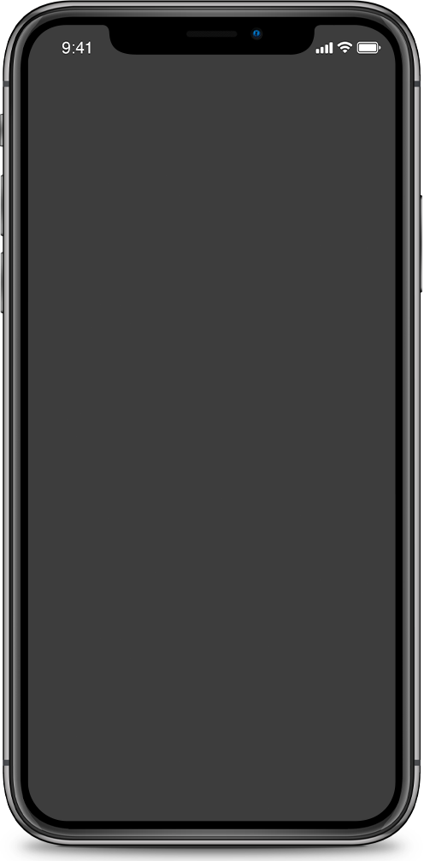
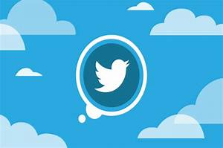
ARVR TREnd
Twitter Sentimental Analysis
Tejaswini Vallepu - u3235439
Elizabeth Mathachan - u3237787
Ravikumar Oza - u3208406

Slide 2
Leaders and influencers use Twitter for product debuts. Twitter's engaged audience helps businesses. When businesses engage with a suitable audience, they gain widespread exposure and cultural effect. What is the best month and days to introduce a product based on audience attitudes and moods to increase buzz, revenue, and recognition?
Problem Description
Sentiment Analysis

Slide 3
Introduction
Objective
Scope of Work
Exploration of the tweets data overview associated with sentiment.
Visualize the Tweets data based on multiple feelings/sentiments, trends, time intervals, and conditions.
Analyzing the trends of the various sentiment attributes.
Determine the ideal month & days for the launch of the business product by evaluating the insights from the tweet analysis.
Identifying the top feelings in order to target the audience appropriately.

Slide 4



Data Sources
Source |  | Period |  | Attributes
KAGGLE Tweets Data: https://www.kaggle.com/datasets/kazanova/sentiment140 https://www.kaggle.com/datasets/bobnau/daily-website-visitors |  | 2014 - 2020 |  | Tweet Messages, Unique words, Sentiments, Period of time (months and weeks), Number of page visitations.

Slide 5
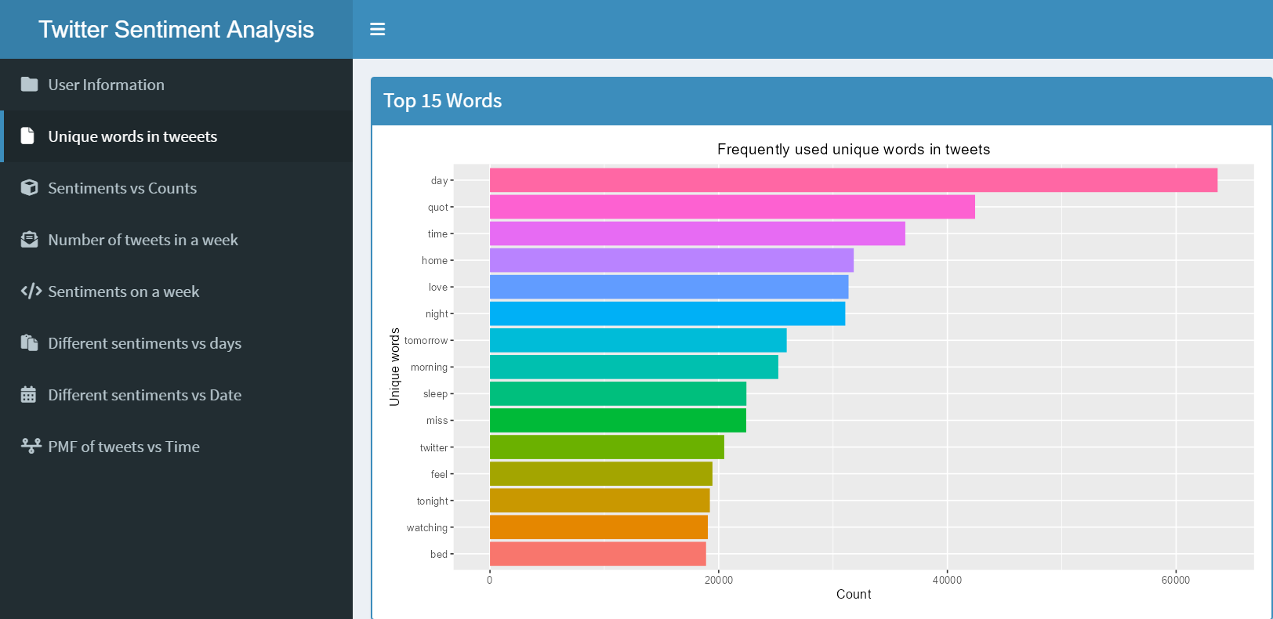
Unique words in Tweets
To better depict our data, we filtered out the following leaving us with only the "original" tweets.
Unnecessary characters
Usernames
Replies
Retweets

Slide 6
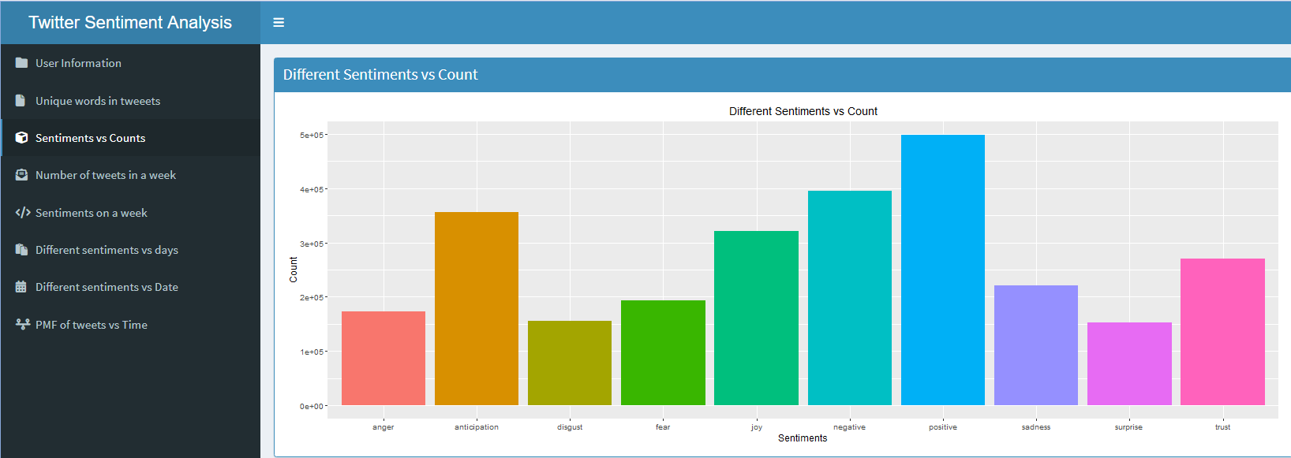
Twitter's Sentimental Trends
Positive, negative, and anticipatory tweets dominate.
Anger, disgust, and surprise are evenly distributed in tweets.
Users have tweeted about trusted and feared issues.

Slide 7
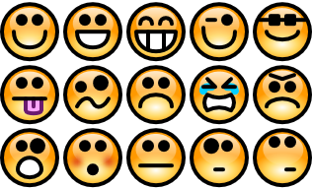



Top 3 Sentiments
Anticipation, negativity, and positivity are top tweets.
Negative
Positive
Anticipation

Slide 8
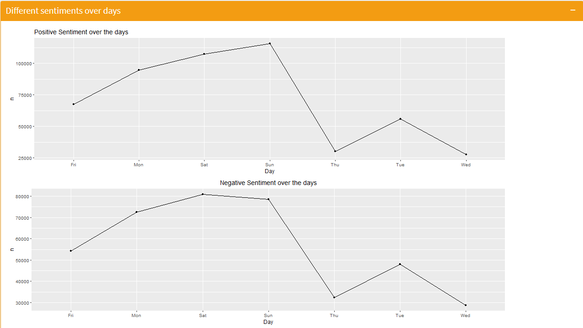
Time Series: Positive & Negative
Visualisation tool: Time Series (sentiments over days)

Slide 9
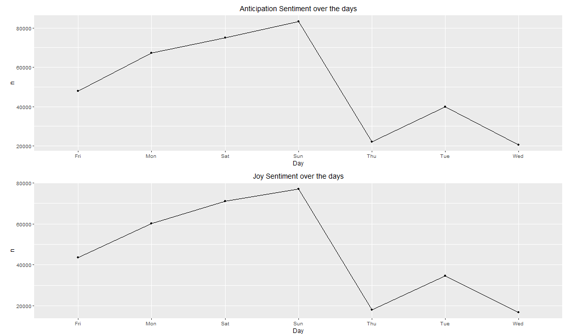
Time Series: Anticipation & Joy
Visualisation tool: Time Series (sentiments over days)

Slide 10
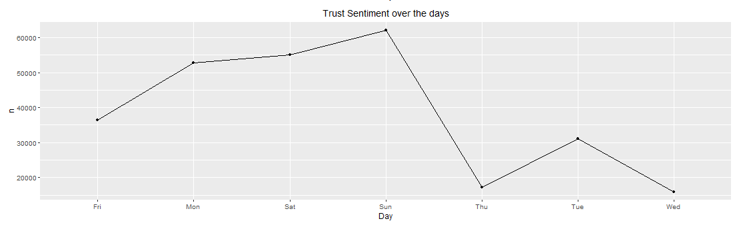
Time Series: Trust
Visualisation tool: Time Series (sentiments over days)

Slide 11
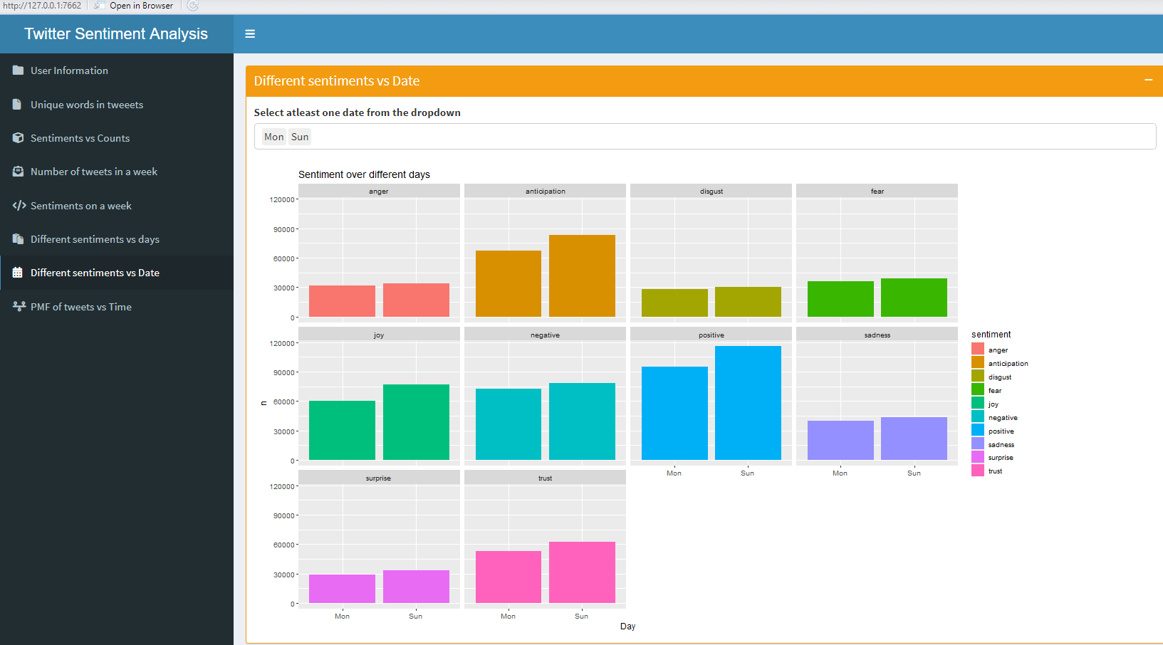
Sentiment VS Date
Visualisation tool: Sunday & Monday

Slide 12
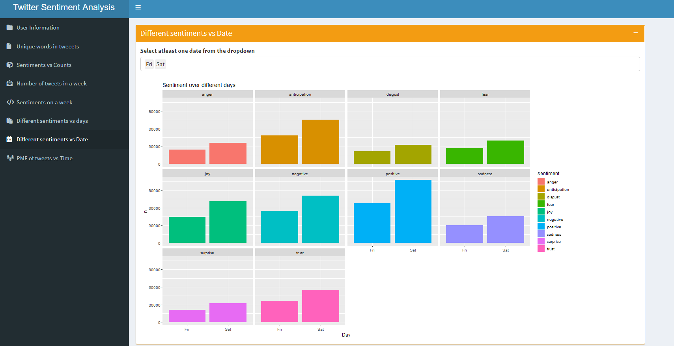
Sentiment VS Date
Visualisation tool: Friday & Saturday

Slide 13
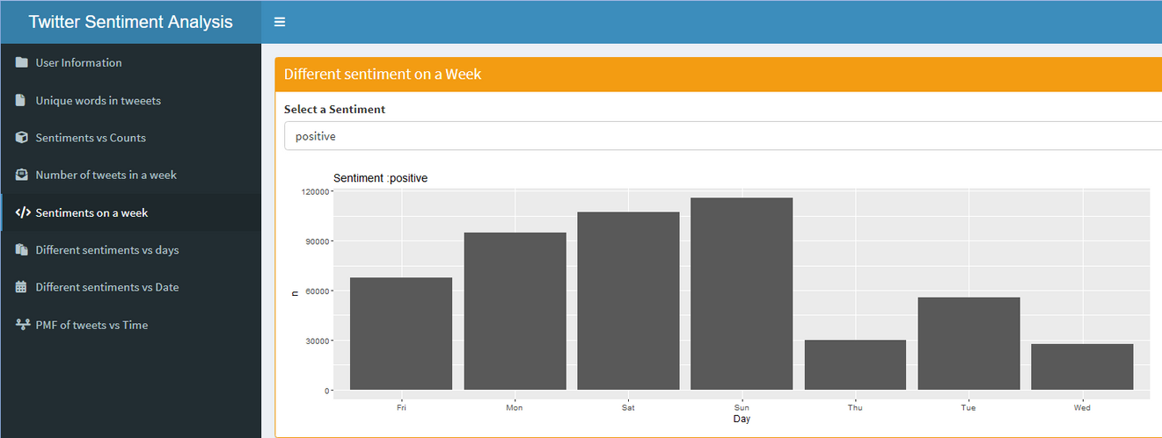
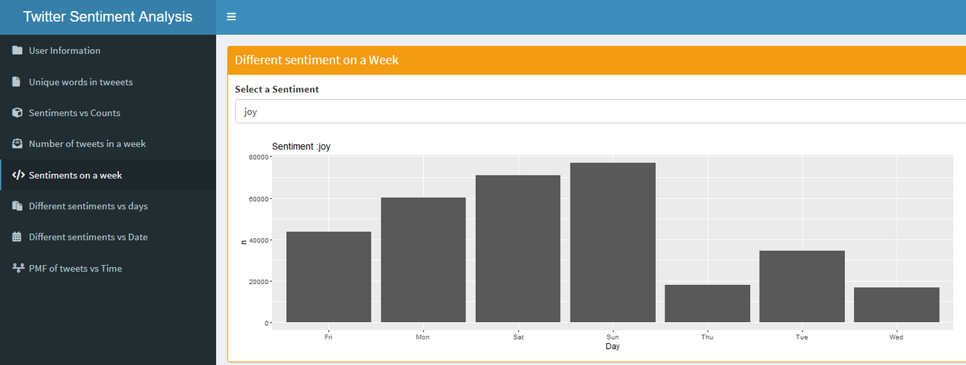
Sentiment VS Week
Visualisation tool: Positive & Joy sentiments
Positive Sentiment trends are high on
Sunday
Saturday
Monday
Joy Sentiment trends are high on
Sunday
Saturday

Slide 14
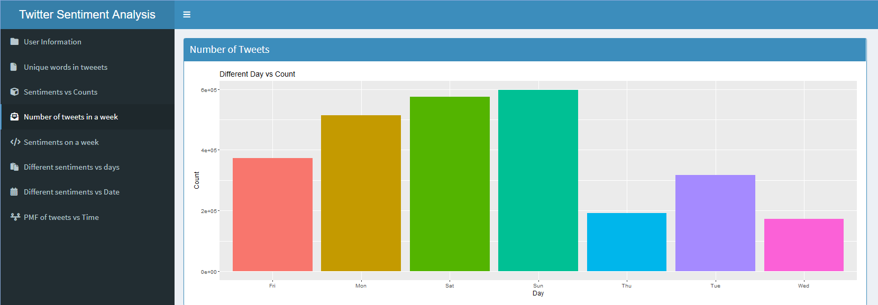
Tweet Trends - Week
Visualisation tool: Number of Tweets in a week

Slide 15
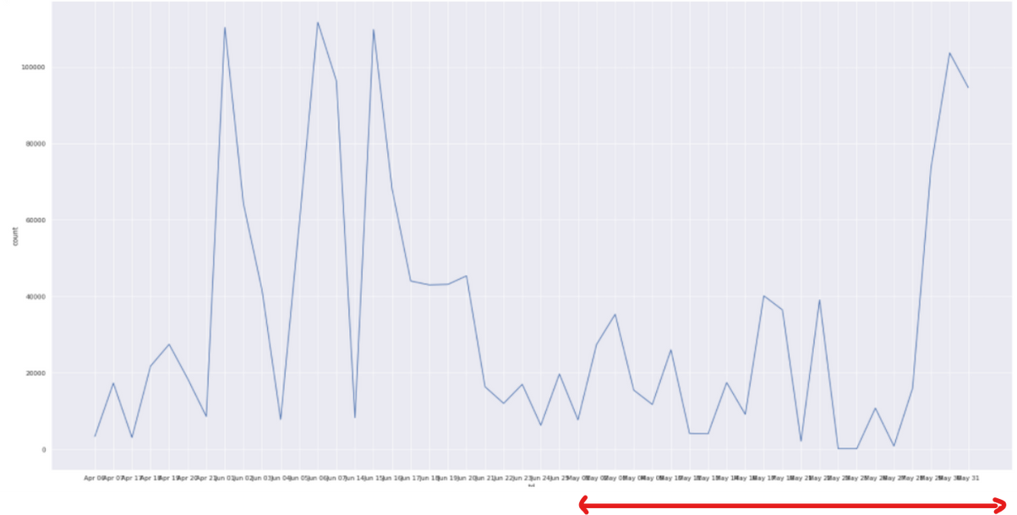
Tweet Trends - 3 Months
The trend analysis incorporated information from April, May, and June.
There are three months where there are more tweets than any other, but the trend begins to shift dramatically in May.
May

Slide 16
Insights from the Analysis
Day appears 63,000 times in 1.6 million tweets.
Saturday, Sunday, and Monday are the most tweeted days.
1
3
Positive, Negative, and Anticipation are top sentiment trends.
2
4
May has the most tweets, changing the trend.

Slide 17



Call of Action
Weekends and Mondays are the preferable days to target the audience's interest and buzz.
Positive, negative, and anticipation are top 3 sentiments, it allows prediction and plan-making.
May is the month when people tweets actively and it maybe the best possible month to launch products.
Twitter's role in commercial decision-making and product buzz.

Slide 18

 | From 1.6 million tweets, data visualisation revealed many patterns - Graphs, text mining, probability, and time series data gave us business insights.
 | The most common term is day, while the top sentiments are positive, negative, and anticipation.
 | Weekends and Mondays have the most tweets, and May has the most tweet engagement.
 | Businesses should launch products on weekends and in May using sentiment analysis to determine the target audience's favorable and adverse opinions for task planning.
 | Twitter sentiments can help marketing companies foresee and plan for the future.
Conclusion

Slide 19



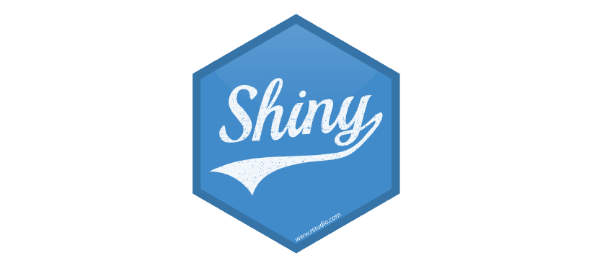

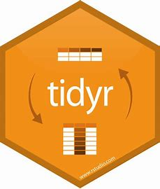
Packages

Slide 20
Any Questions?
FinTech are technologies, tools, or platforms that assist and improve financial transactions and services.

