Slide 1
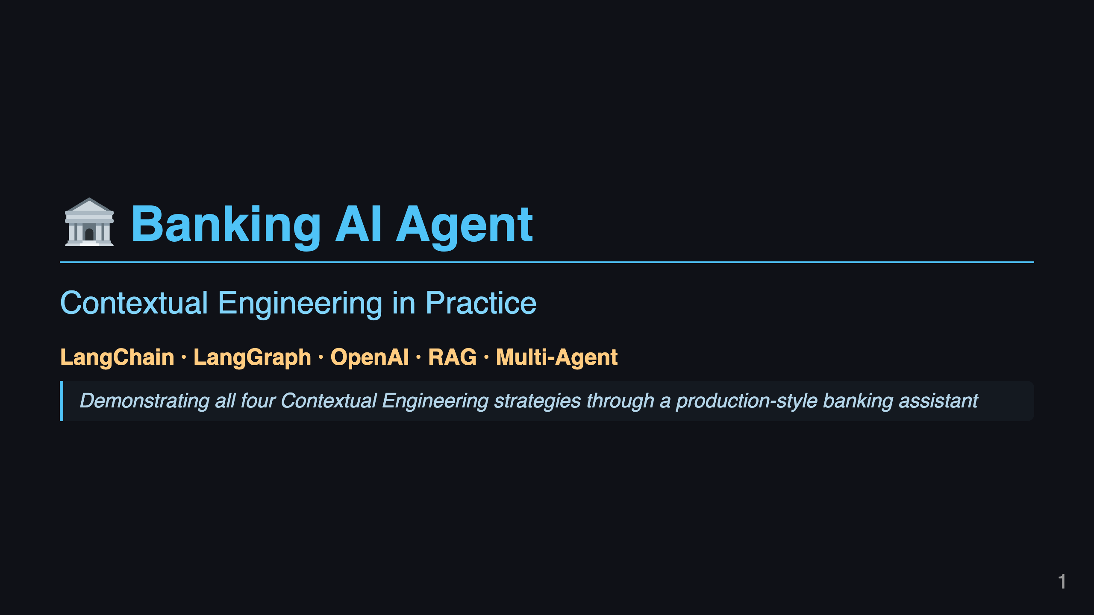
Notes:
Slide 1: Title

Slide 2
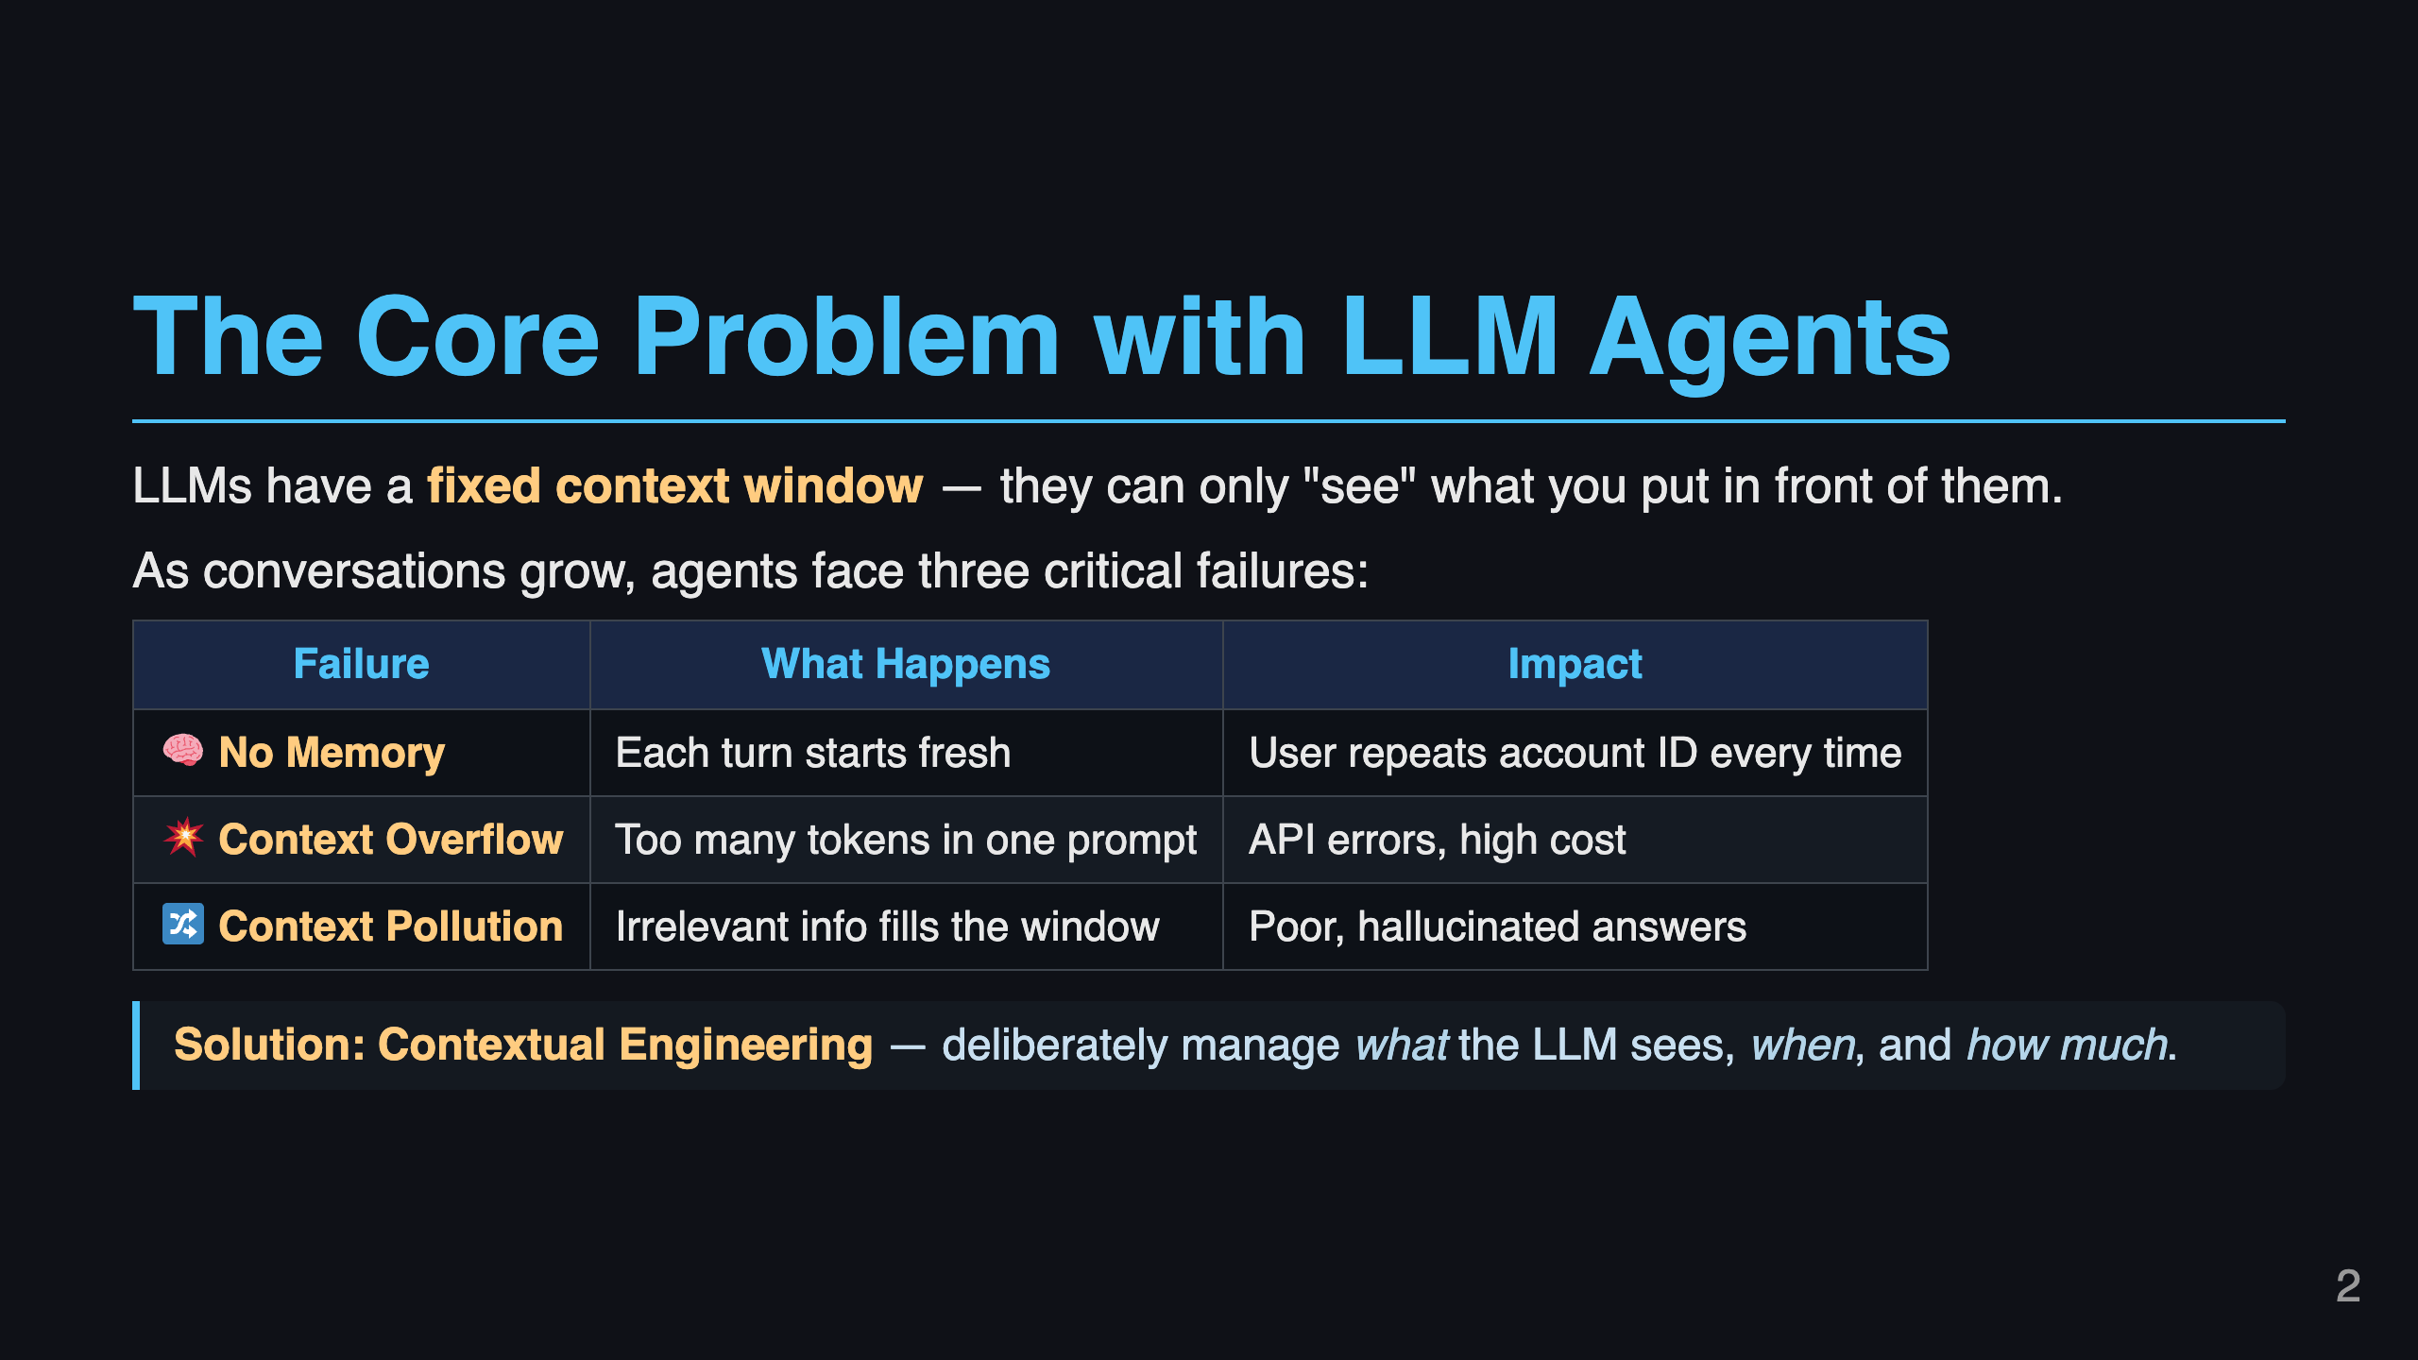
Notes:
Slide 2: The Problem

Slide 3
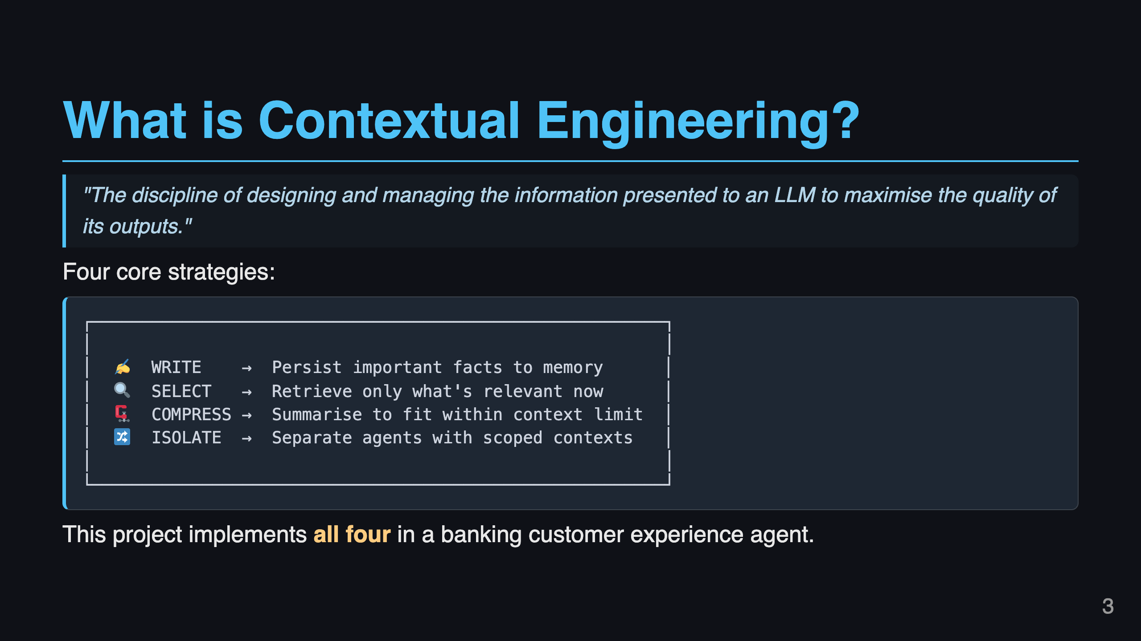
Notes:
Slide 3: What is Contextual Engineering

Slide 4
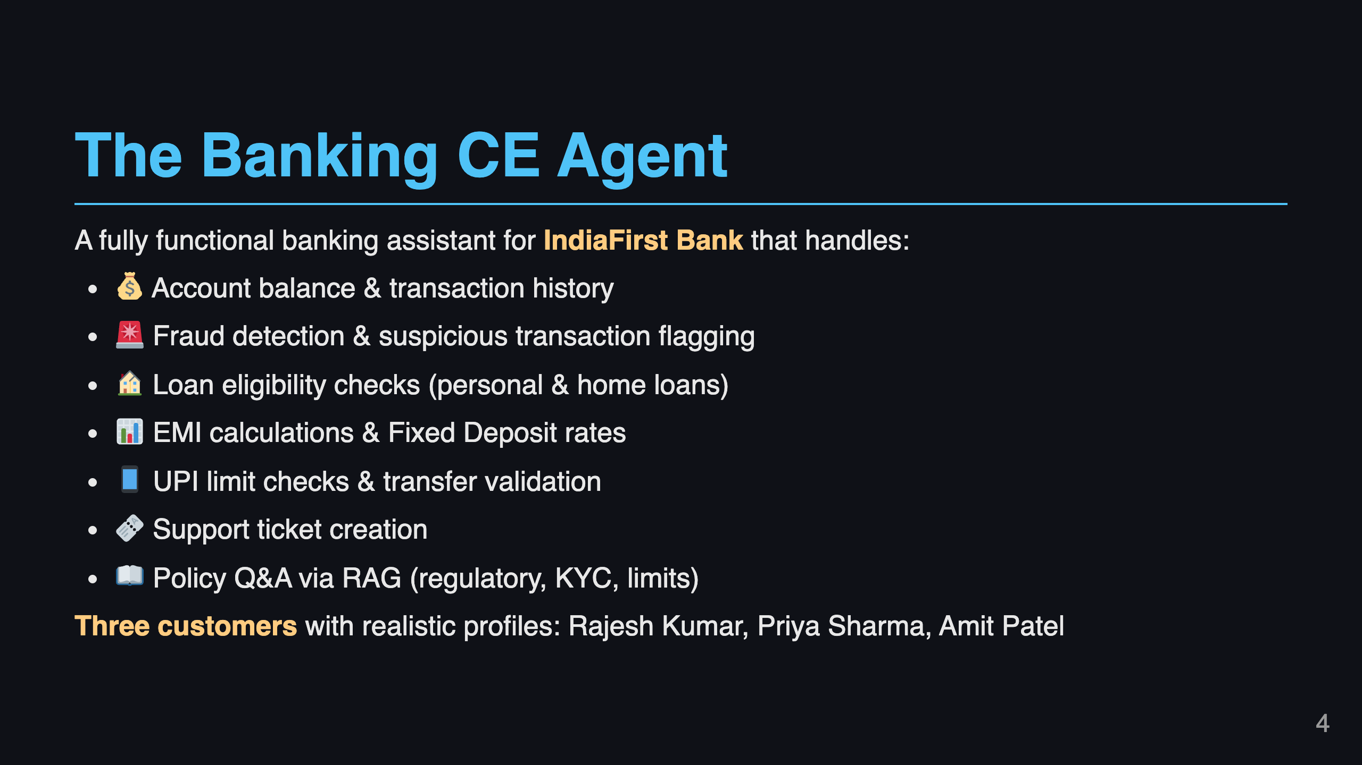
Notes:
Slide 4: Application Overview

Slide 5
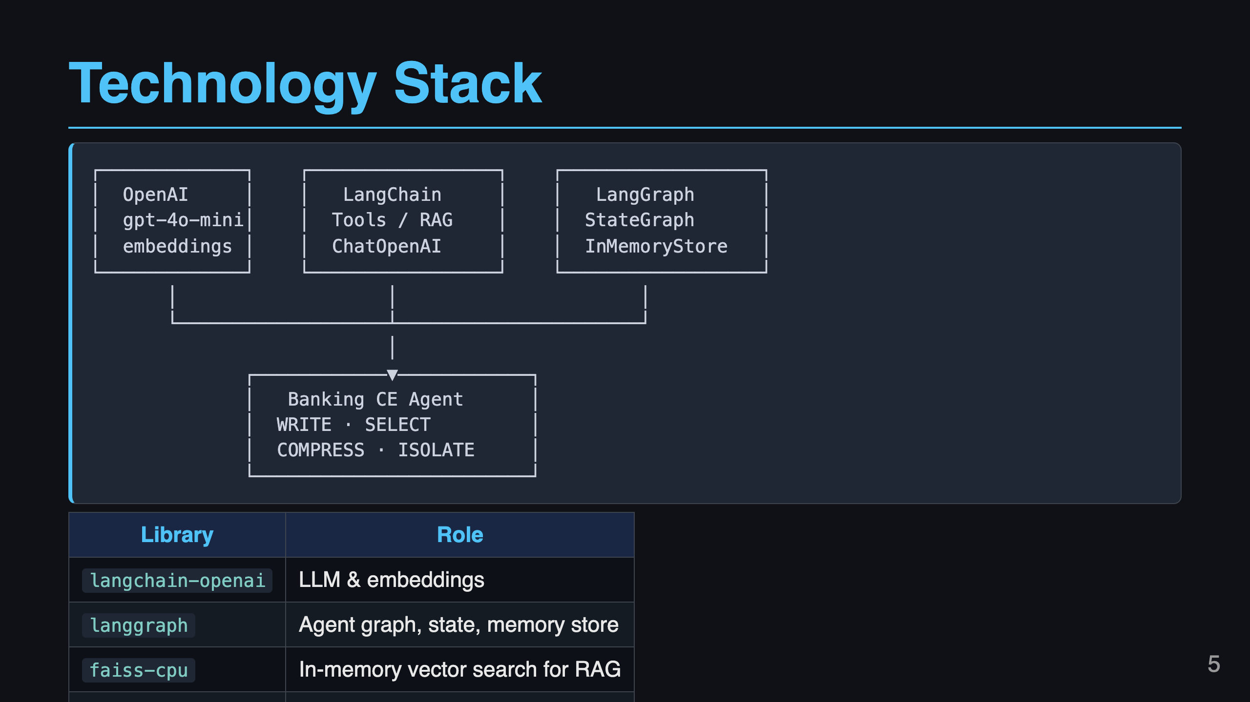
Notes:
Slide 5: Tech Stack

Slide 6
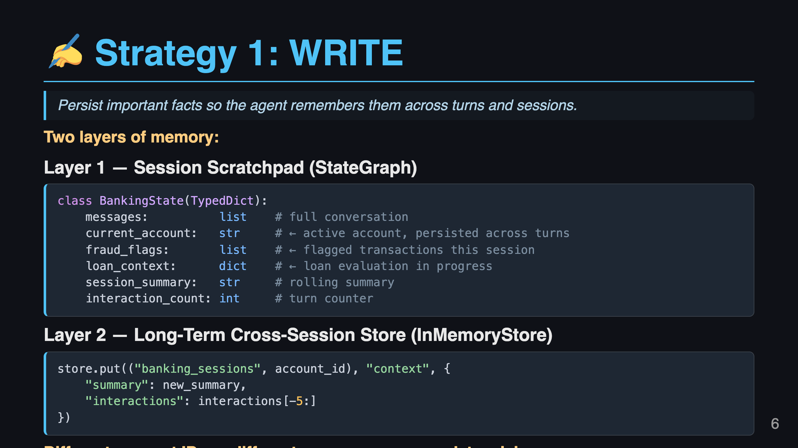
Notes:
Slide 6: Strategy 1 - WRITE

Slide 7
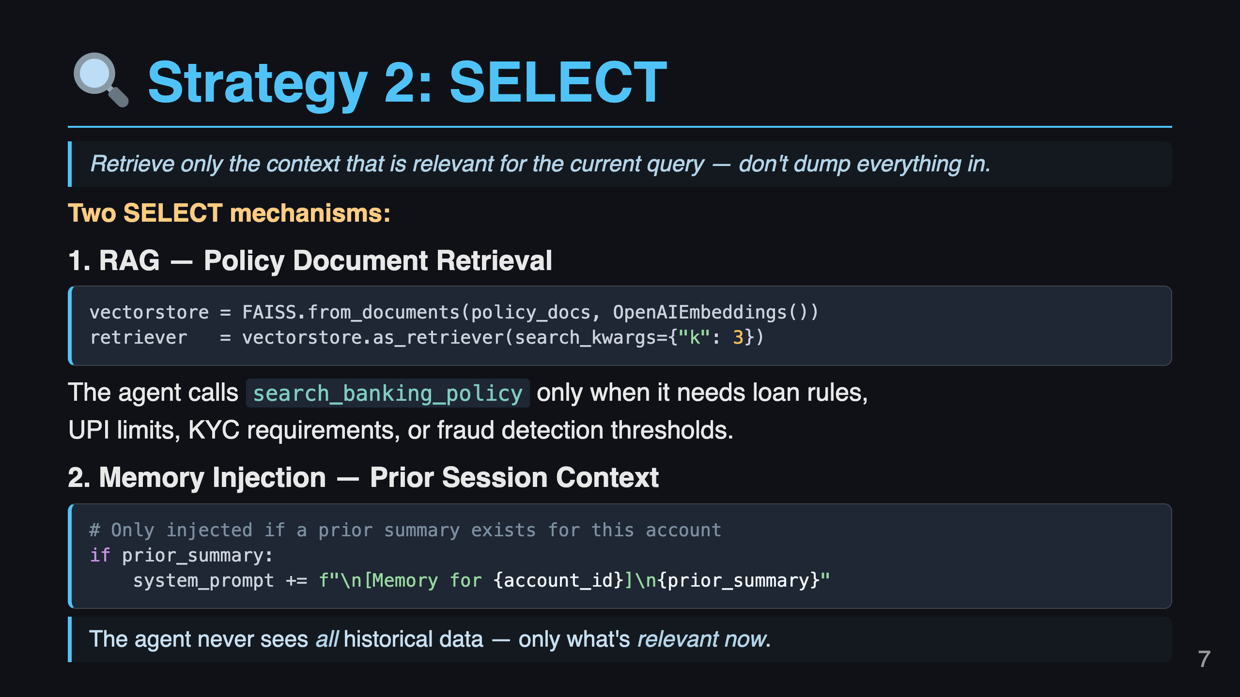
Notes:
Slide 7: Strategy 2 - SELECT

Slide 8
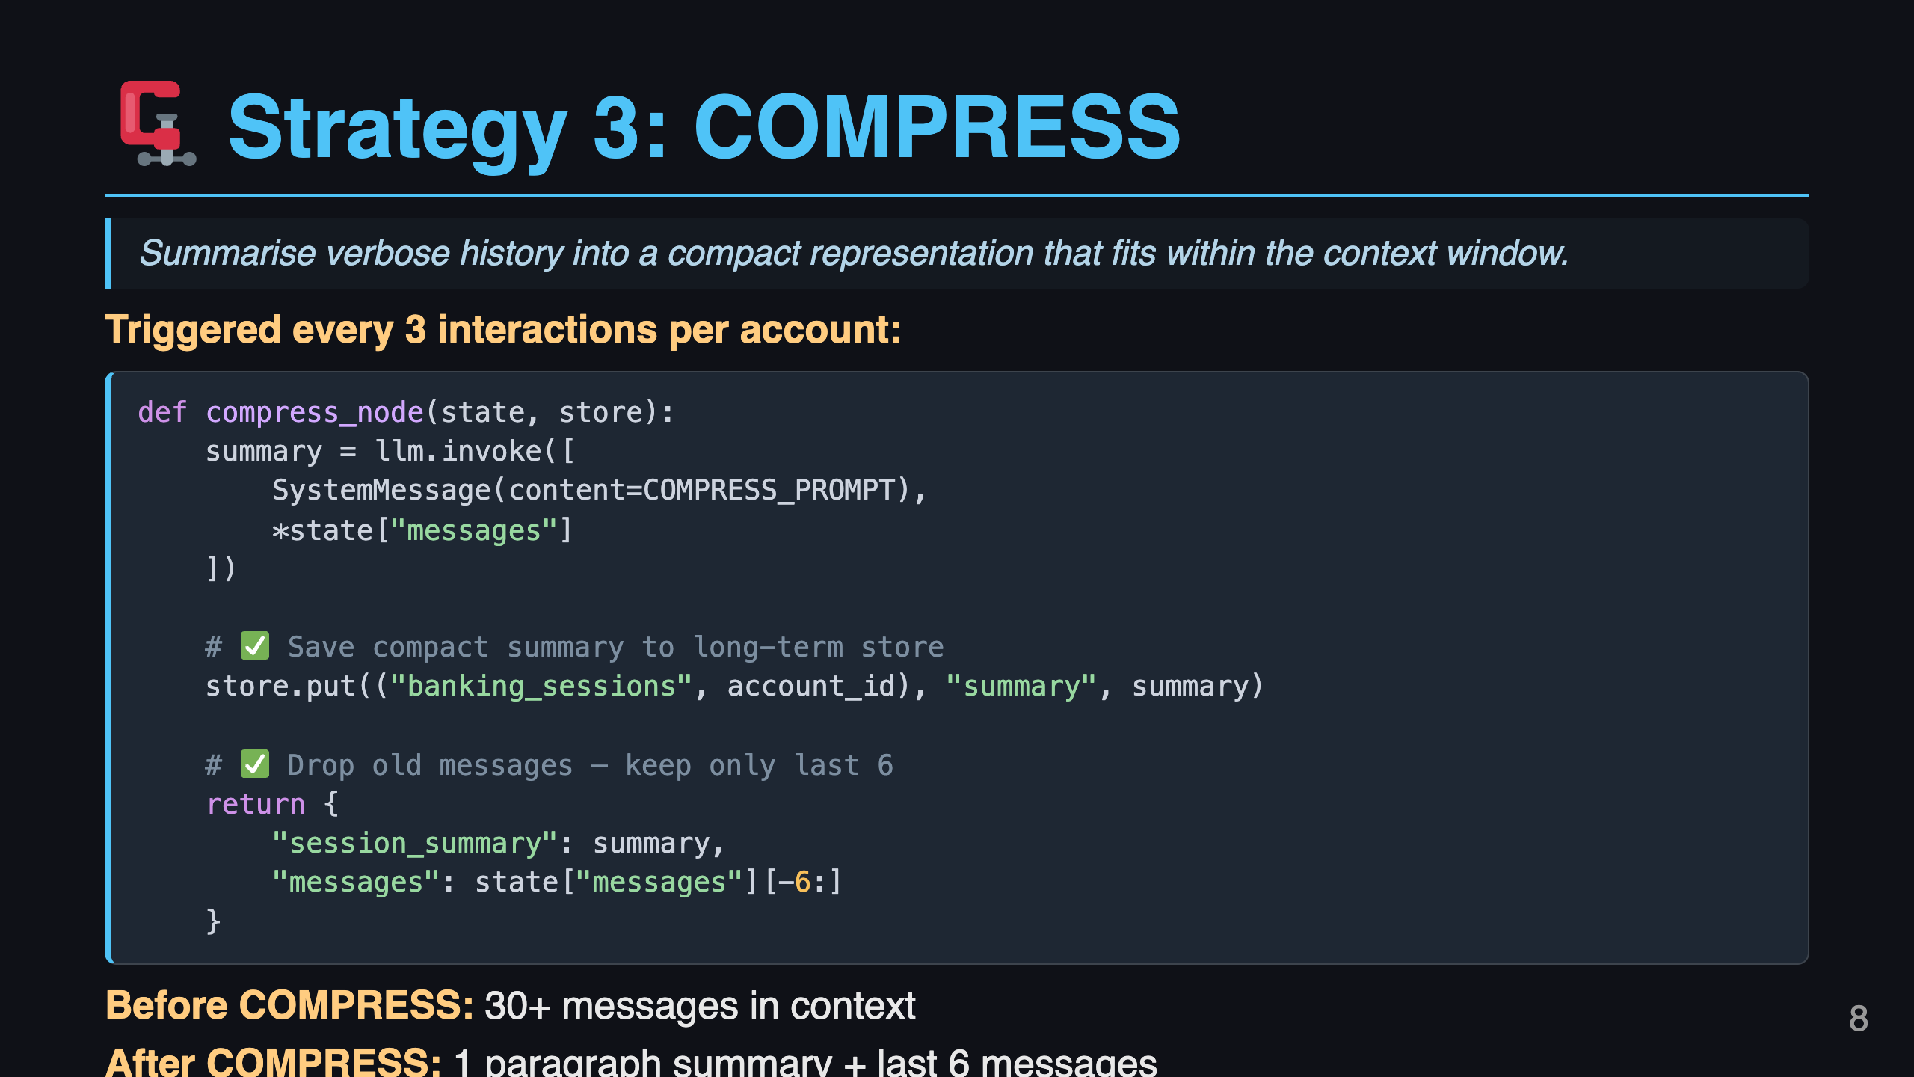
Notes:
Slide 8: Strategy 3 - COMPRESS

Slide 9
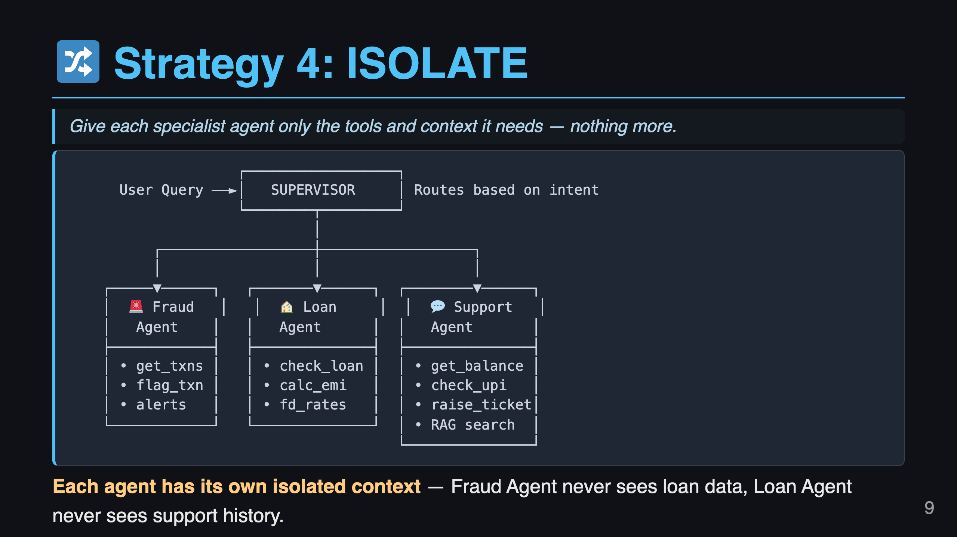
Notes:
Slide 9: Strategy 4 - ISOLATE

Slide 10
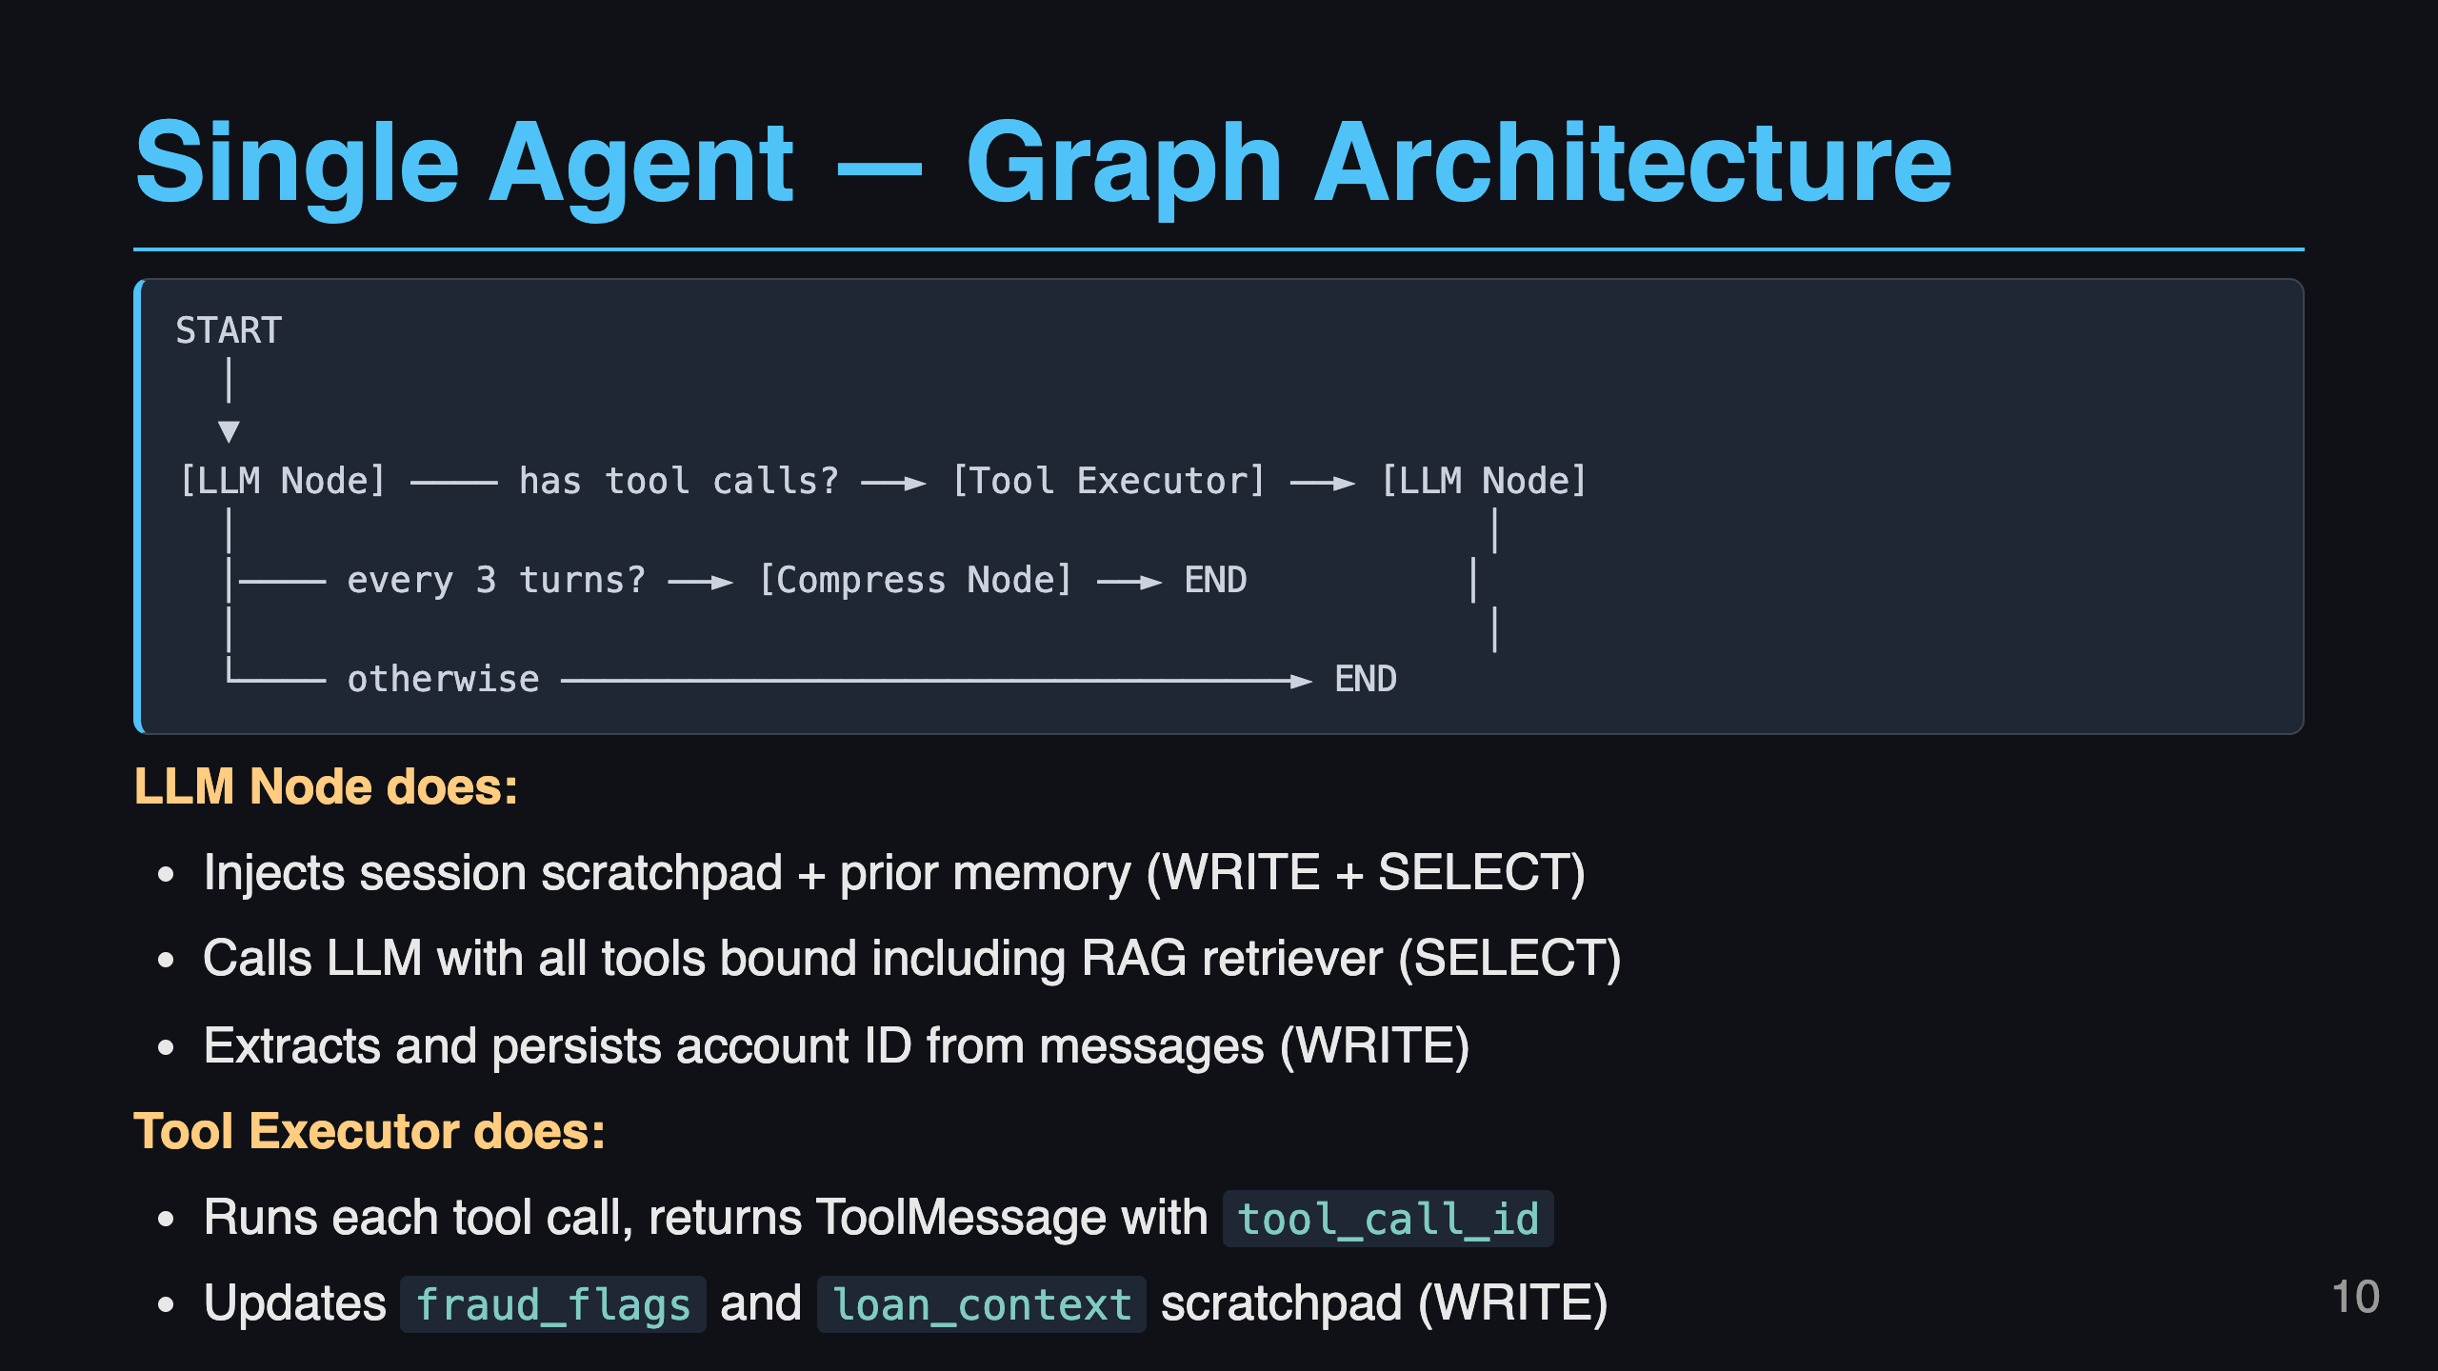
Notes:
Slide 10: Single Agent Architecture

Slide 11
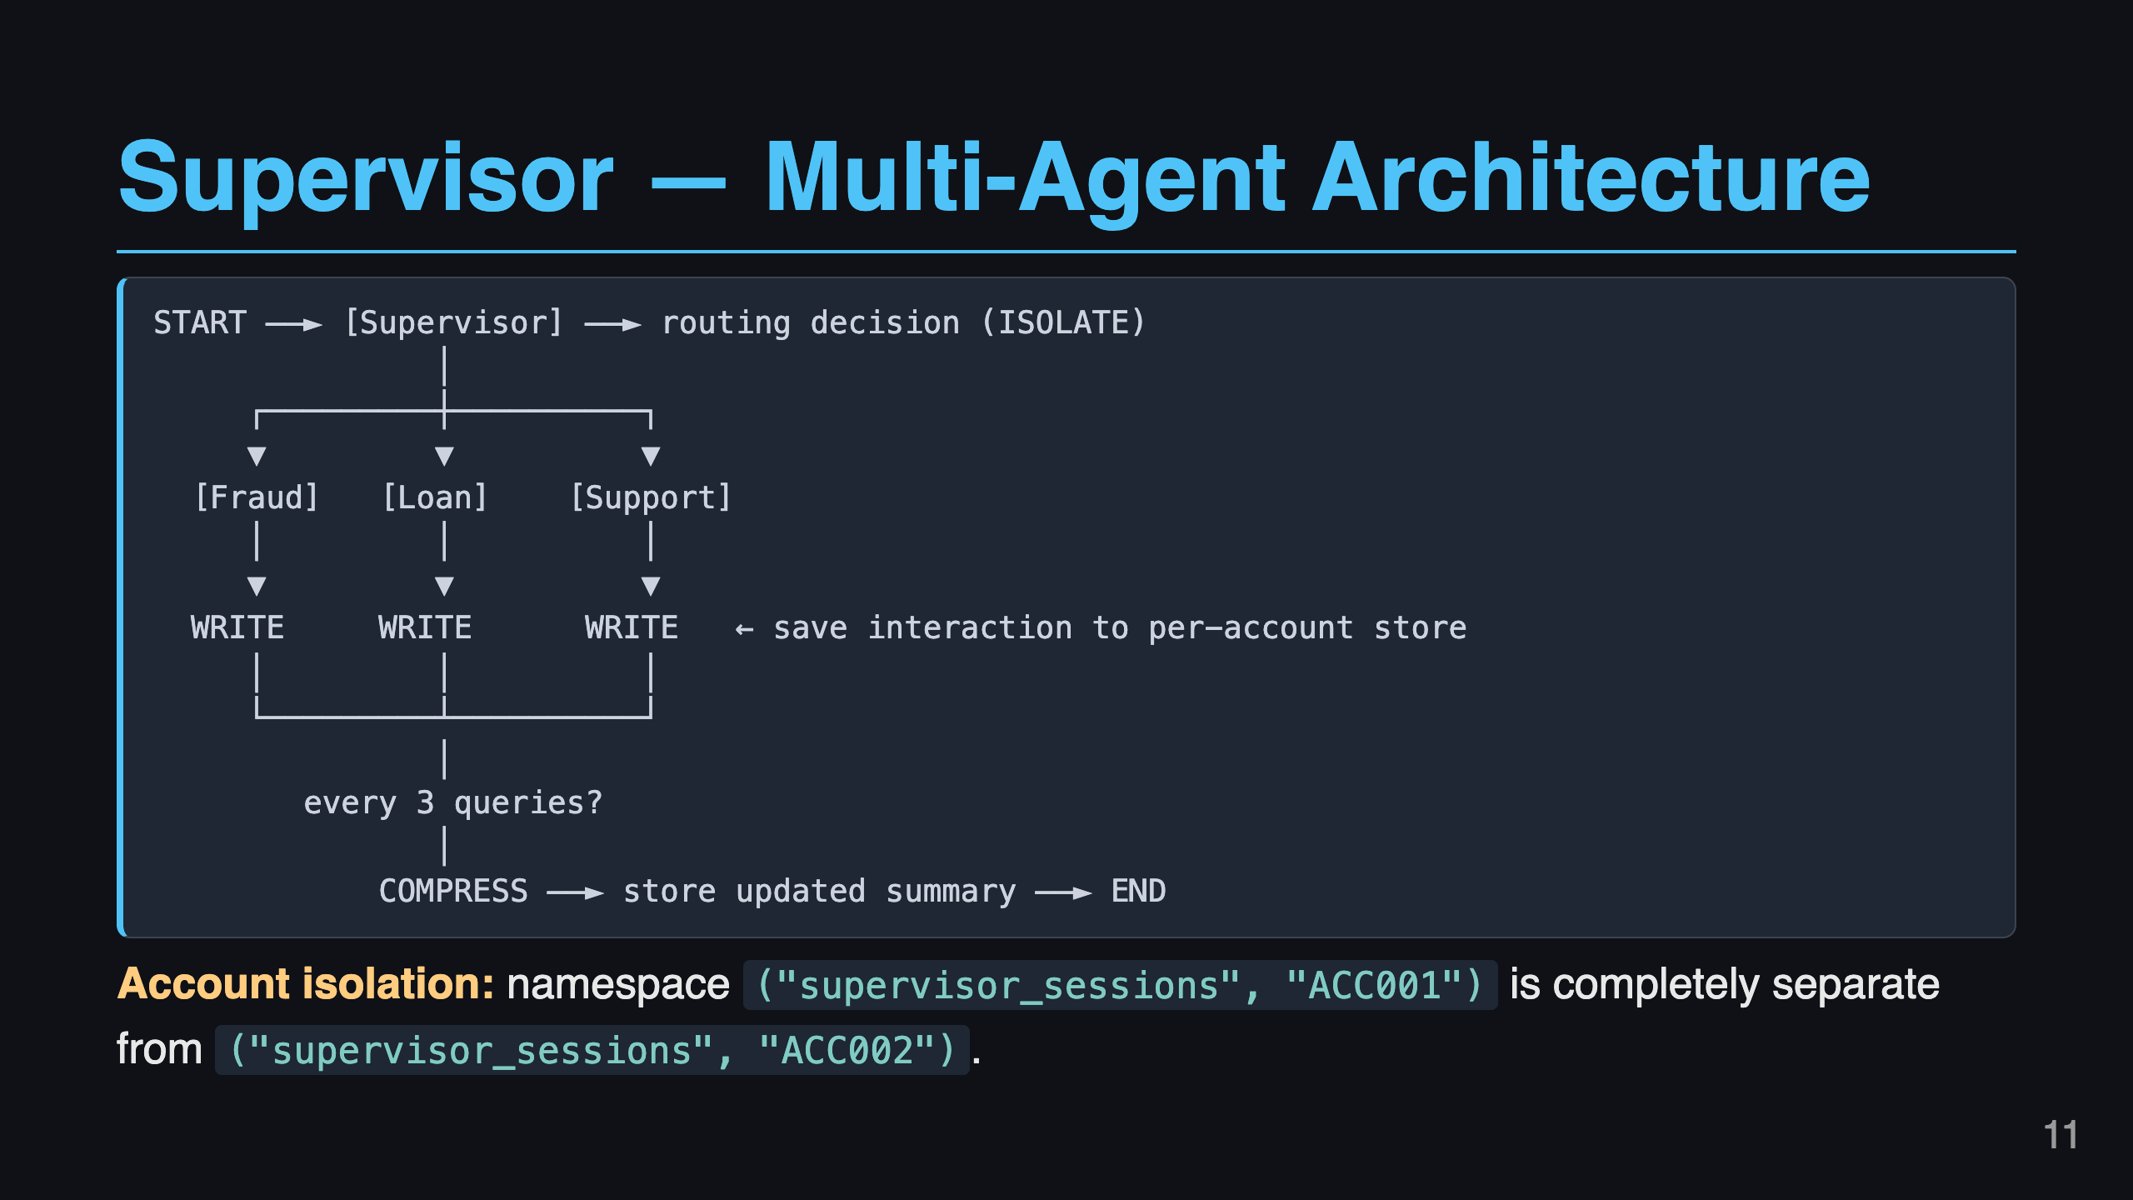
Notes:
Slide 11: Supervisor Architecture

Slide 12
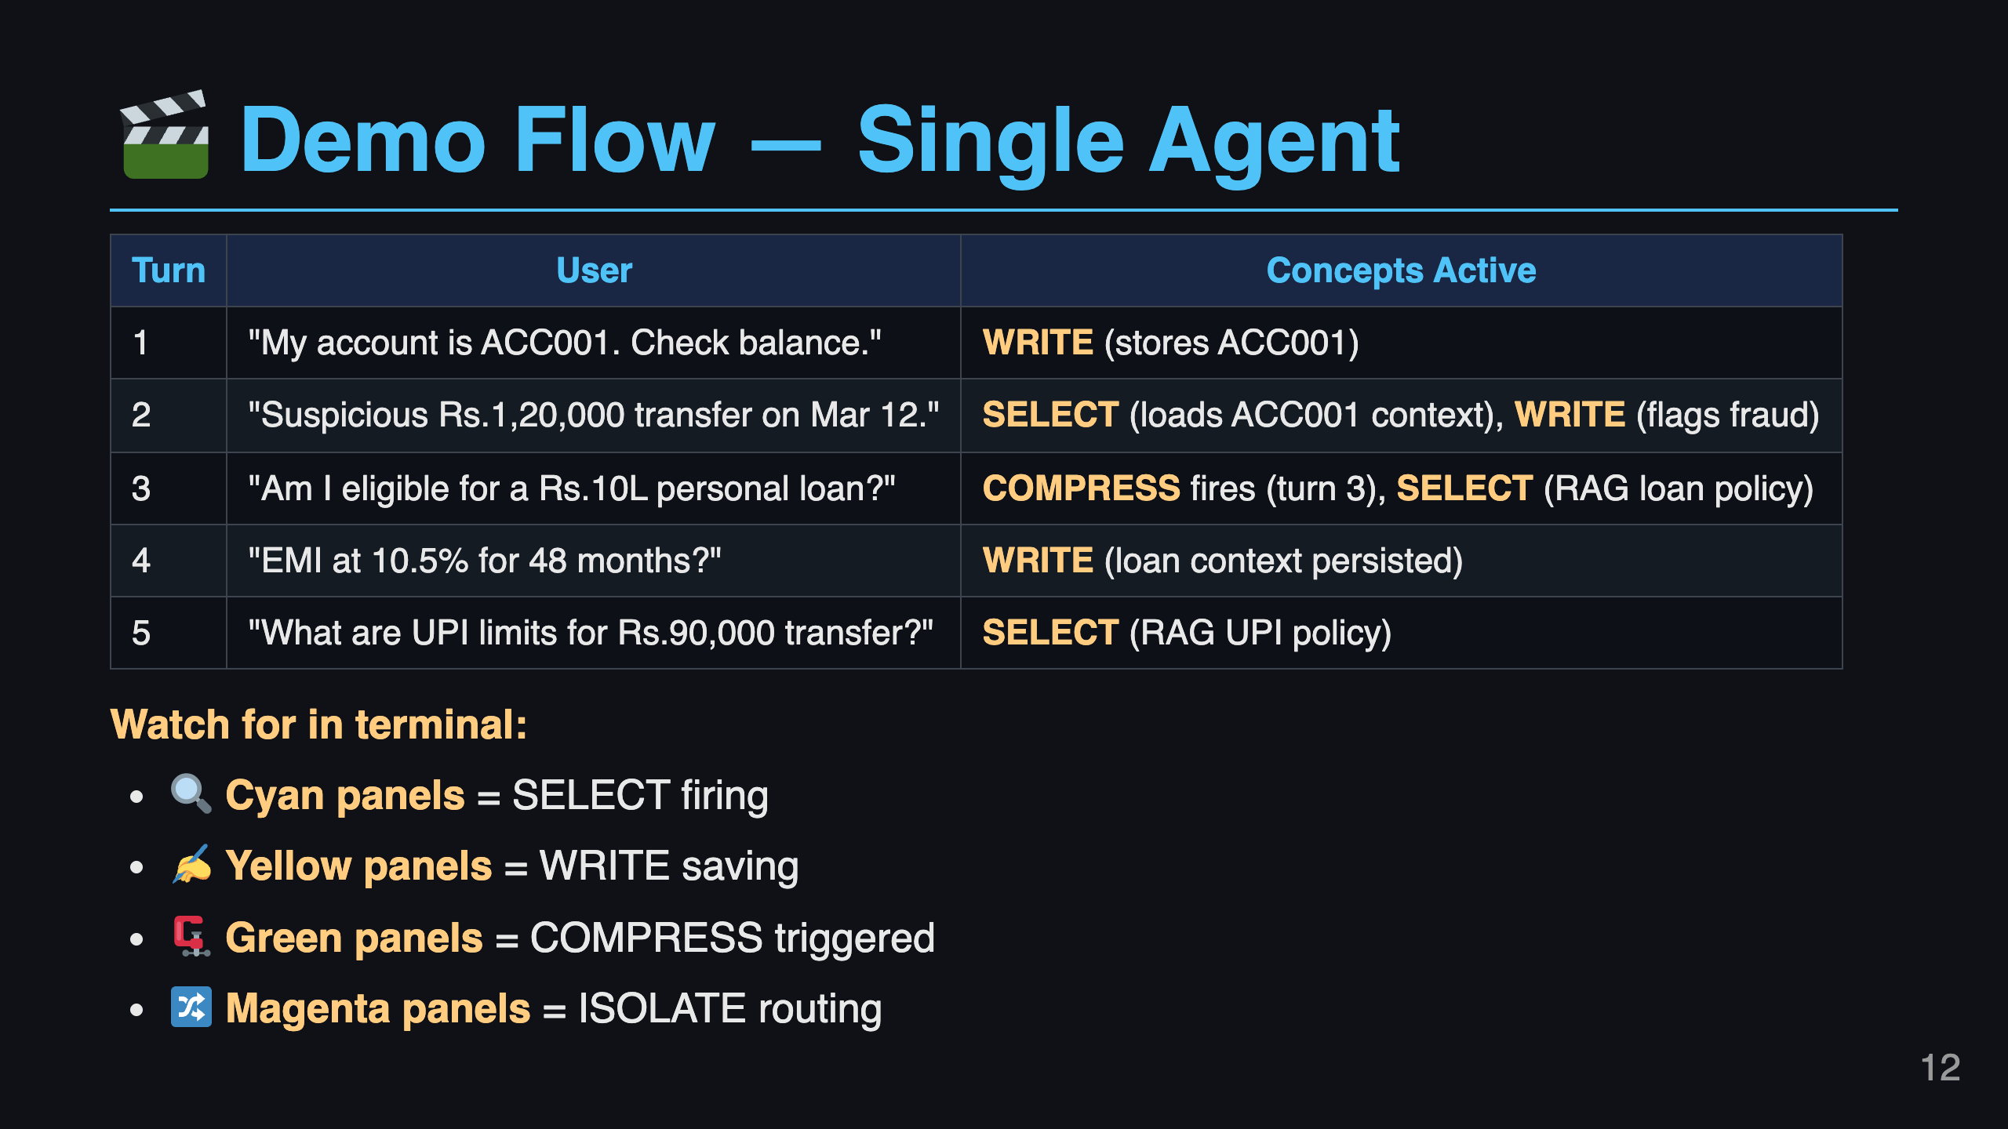
Notes:
Slide 12: Live Demo Flow - Single Agent

Slide 13
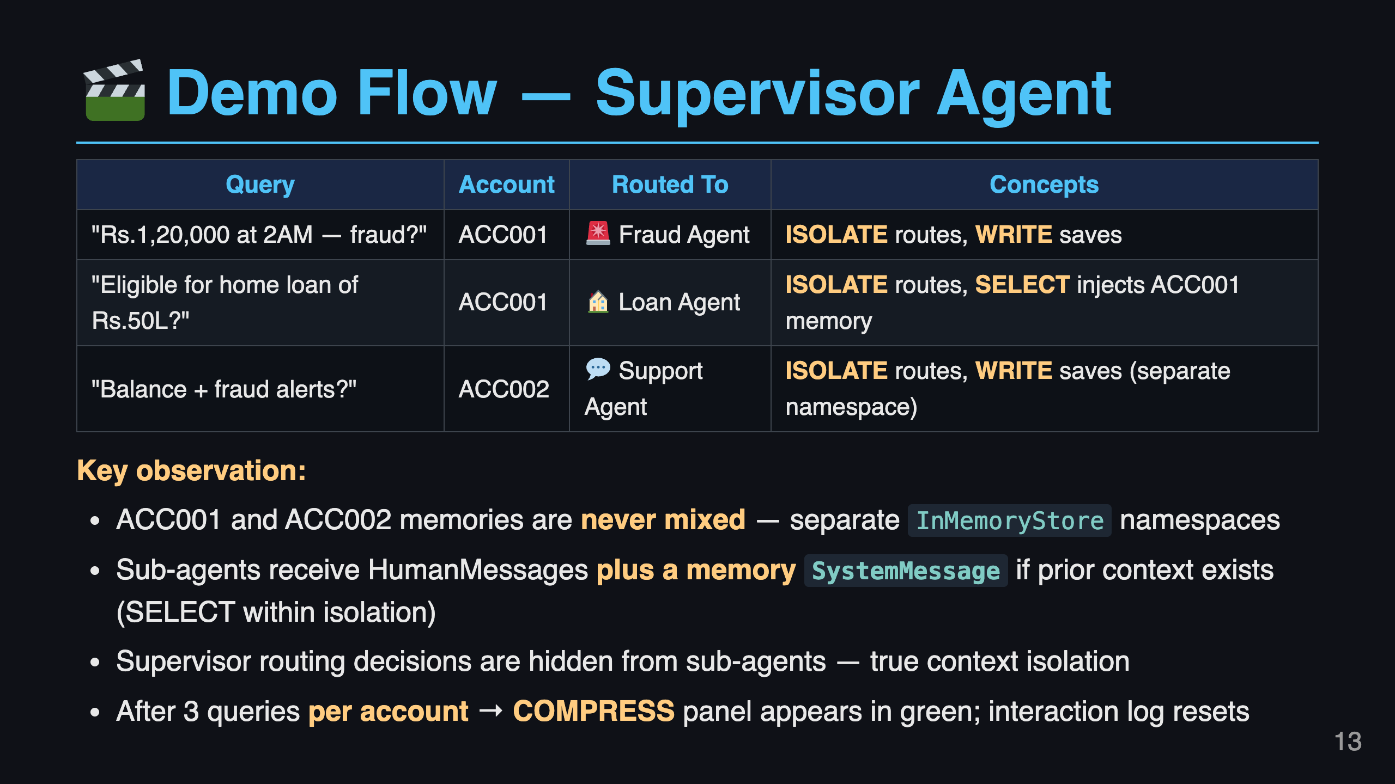
Notes:
Slide 13: Live Demo Flow - Supervisor

Slide 14
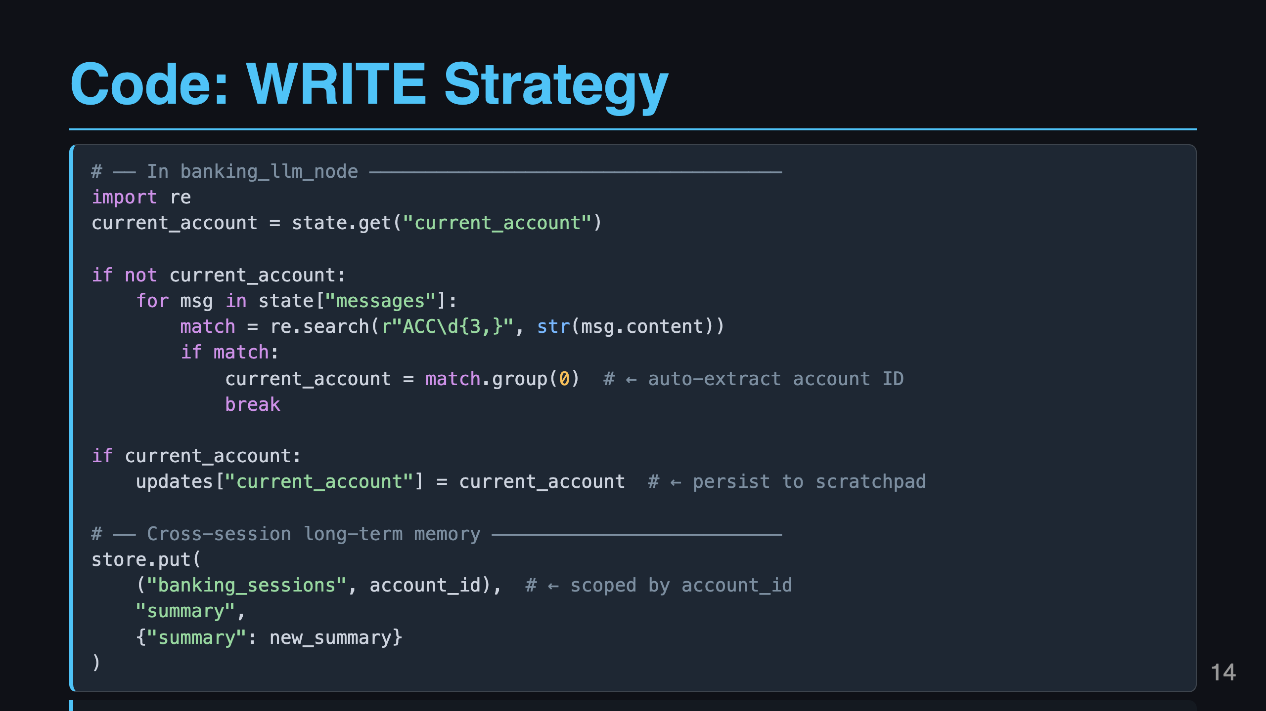
Notes:
Slide 14: Code Highlight - WRITE

Slide 15
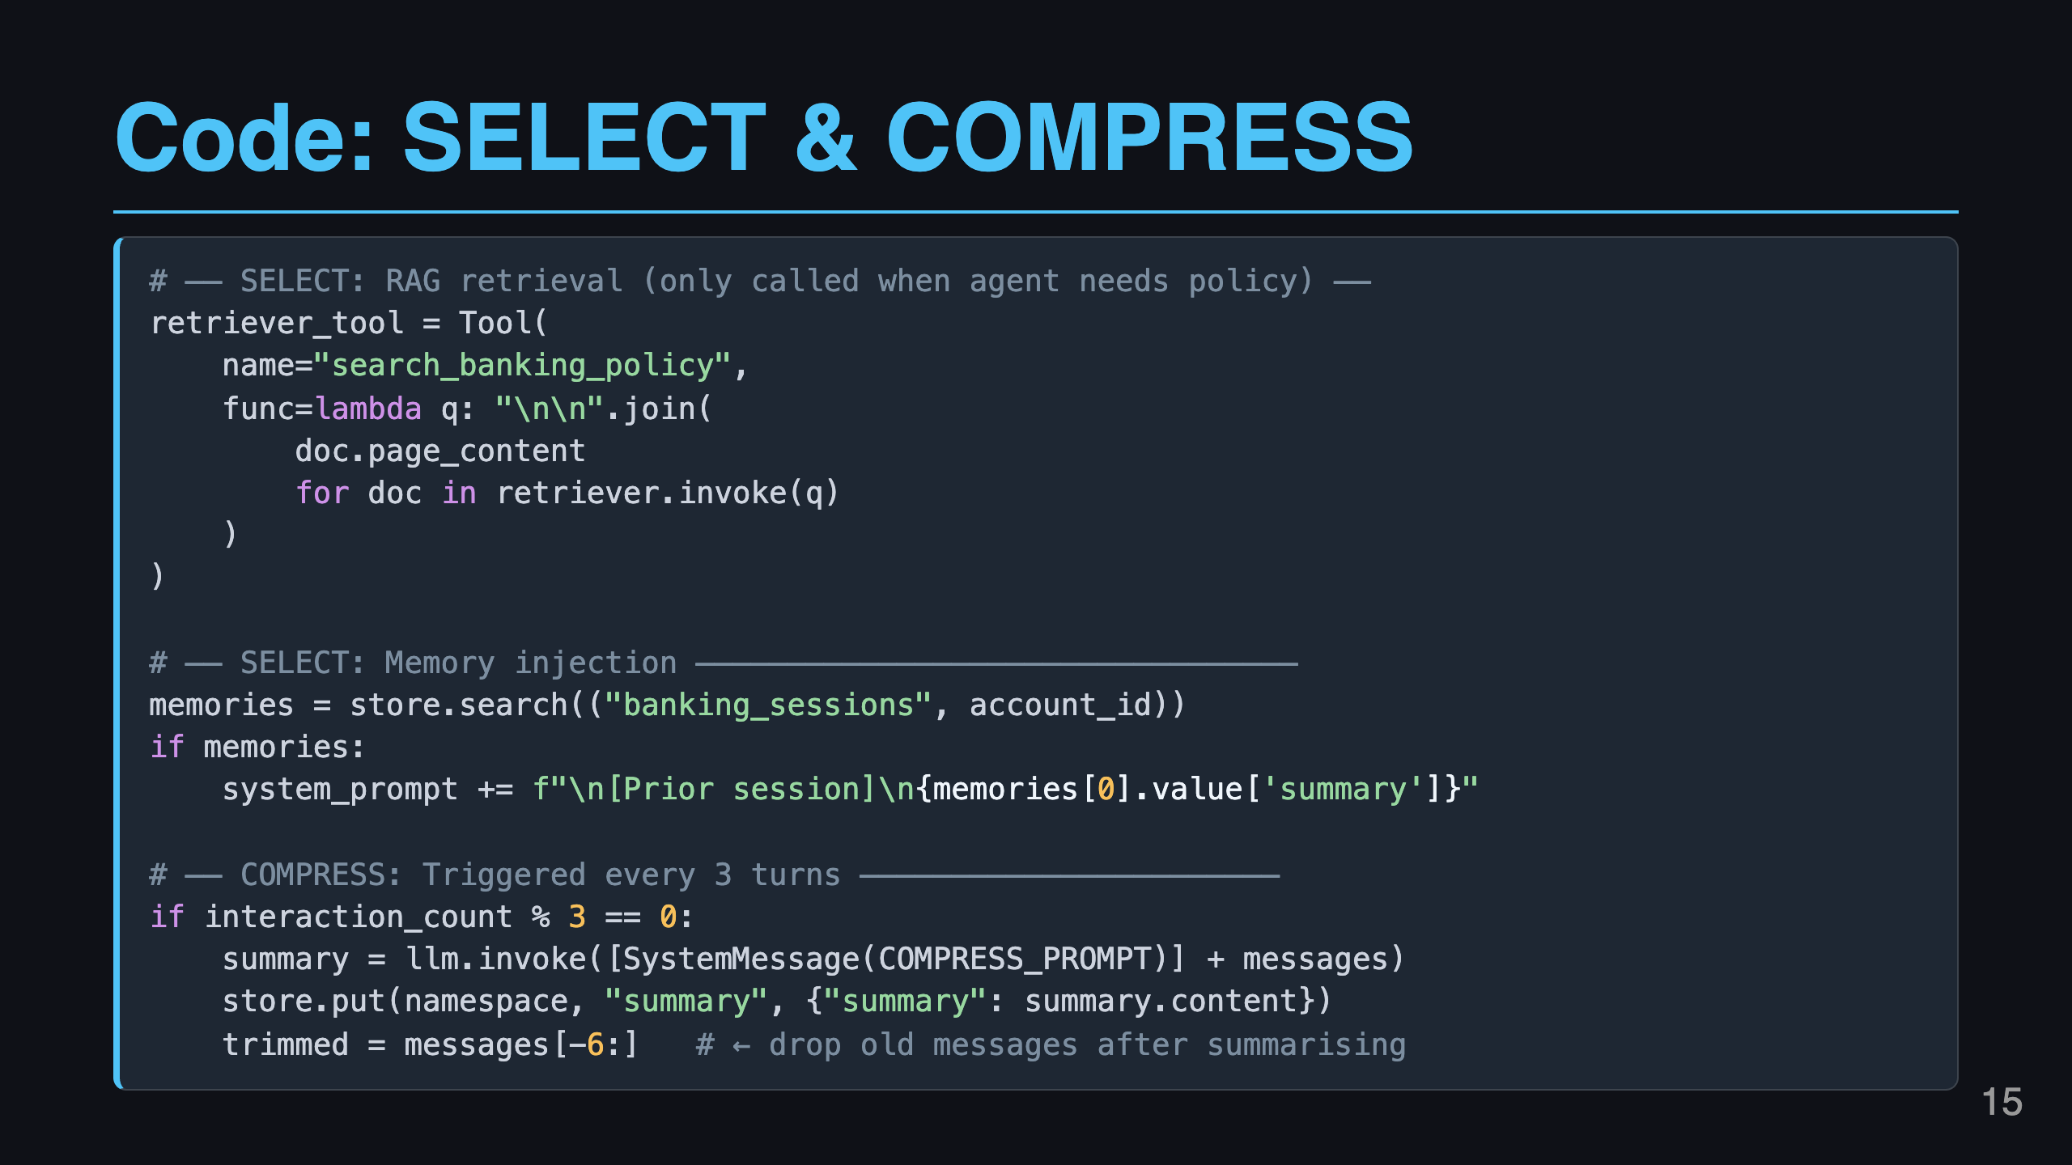
Notes:
Slide 15: Code Highlight - SELECT + COMPRESS

Slide 16
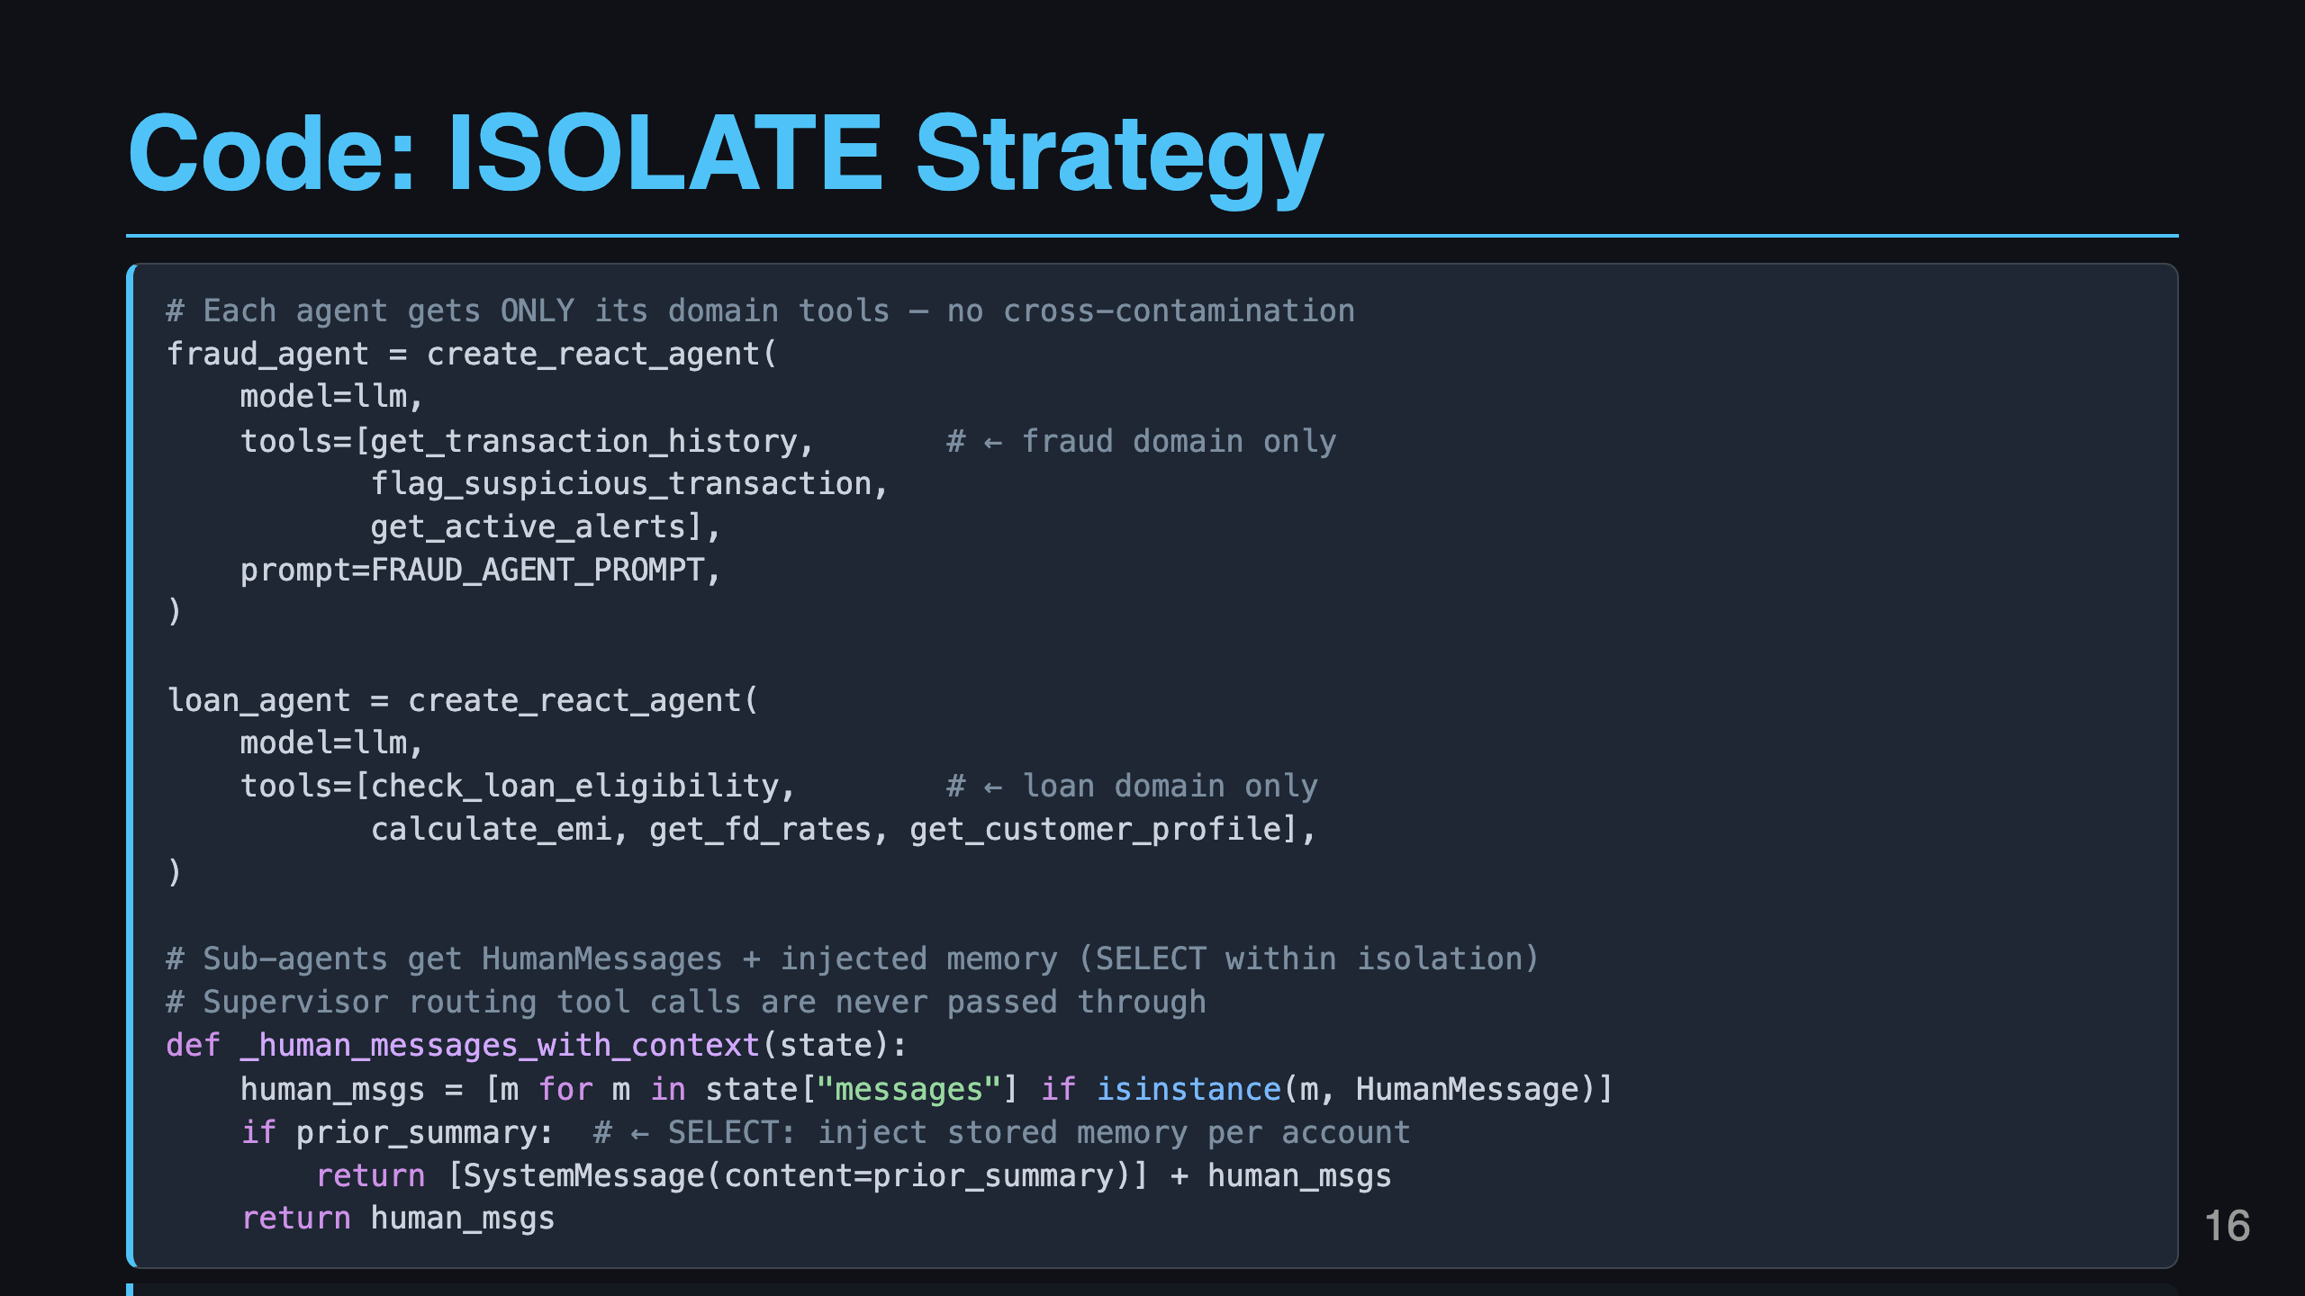
Notes:
Slide 16: Code Highlight - ISOLATE

Slide 17
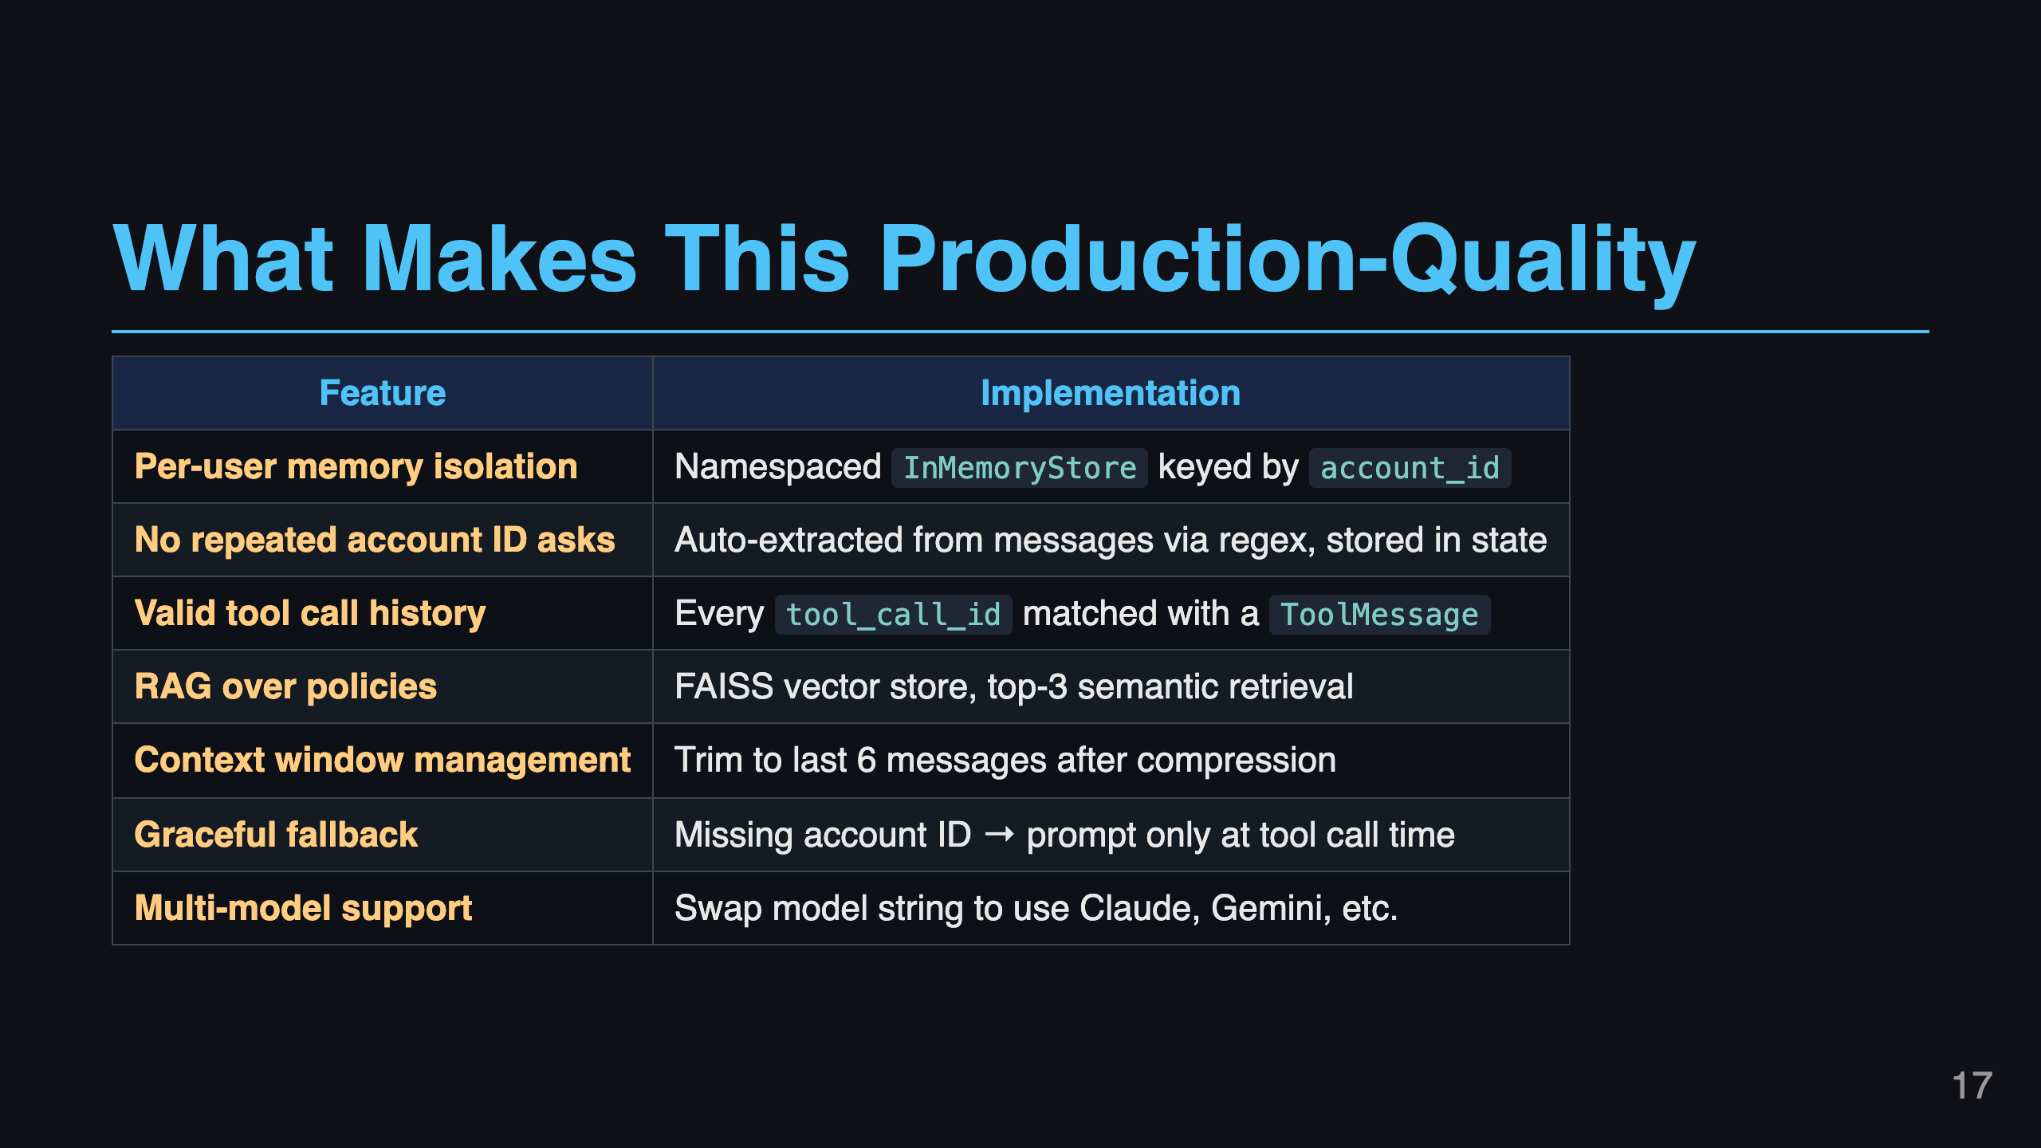
Notes:
Slide 17: What Makes This Production-Quality

Slide 18
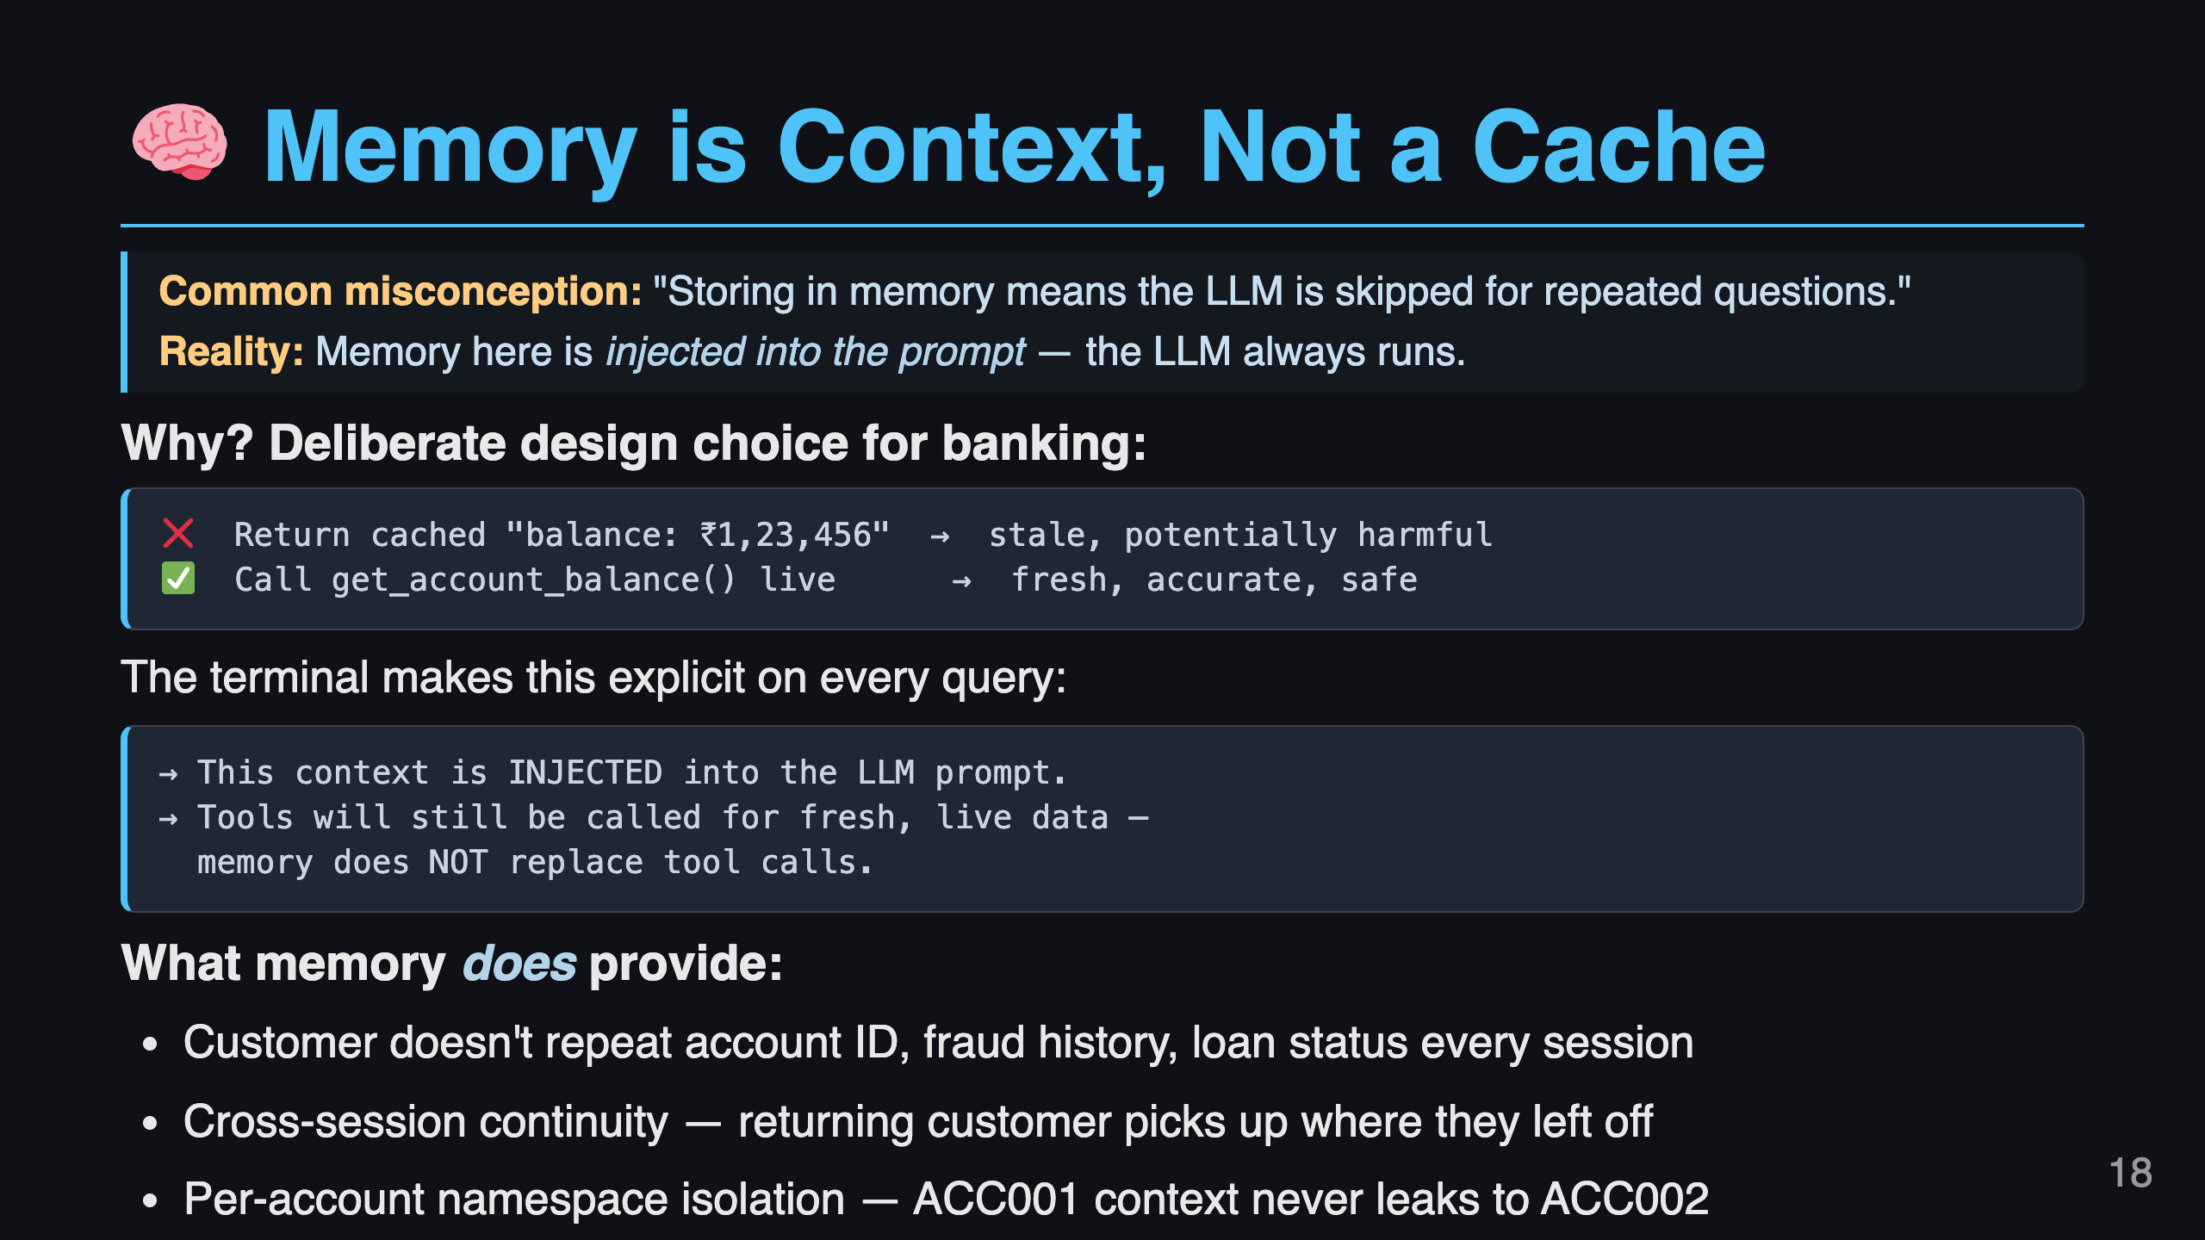
Notes:
Slide 18: Memory is Context, Not a Cache

Slide 19
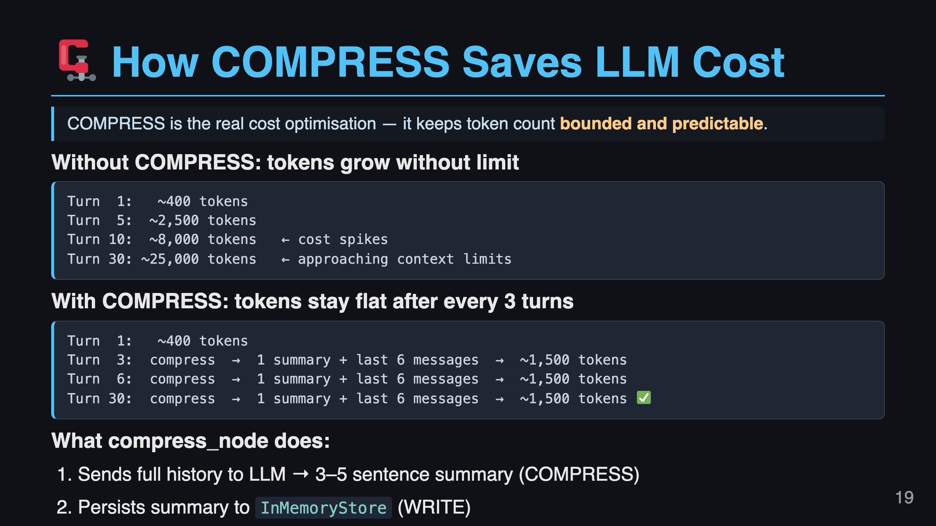
Notes:
Slide 19: How COMPRESS Saves Cost

Slide 20
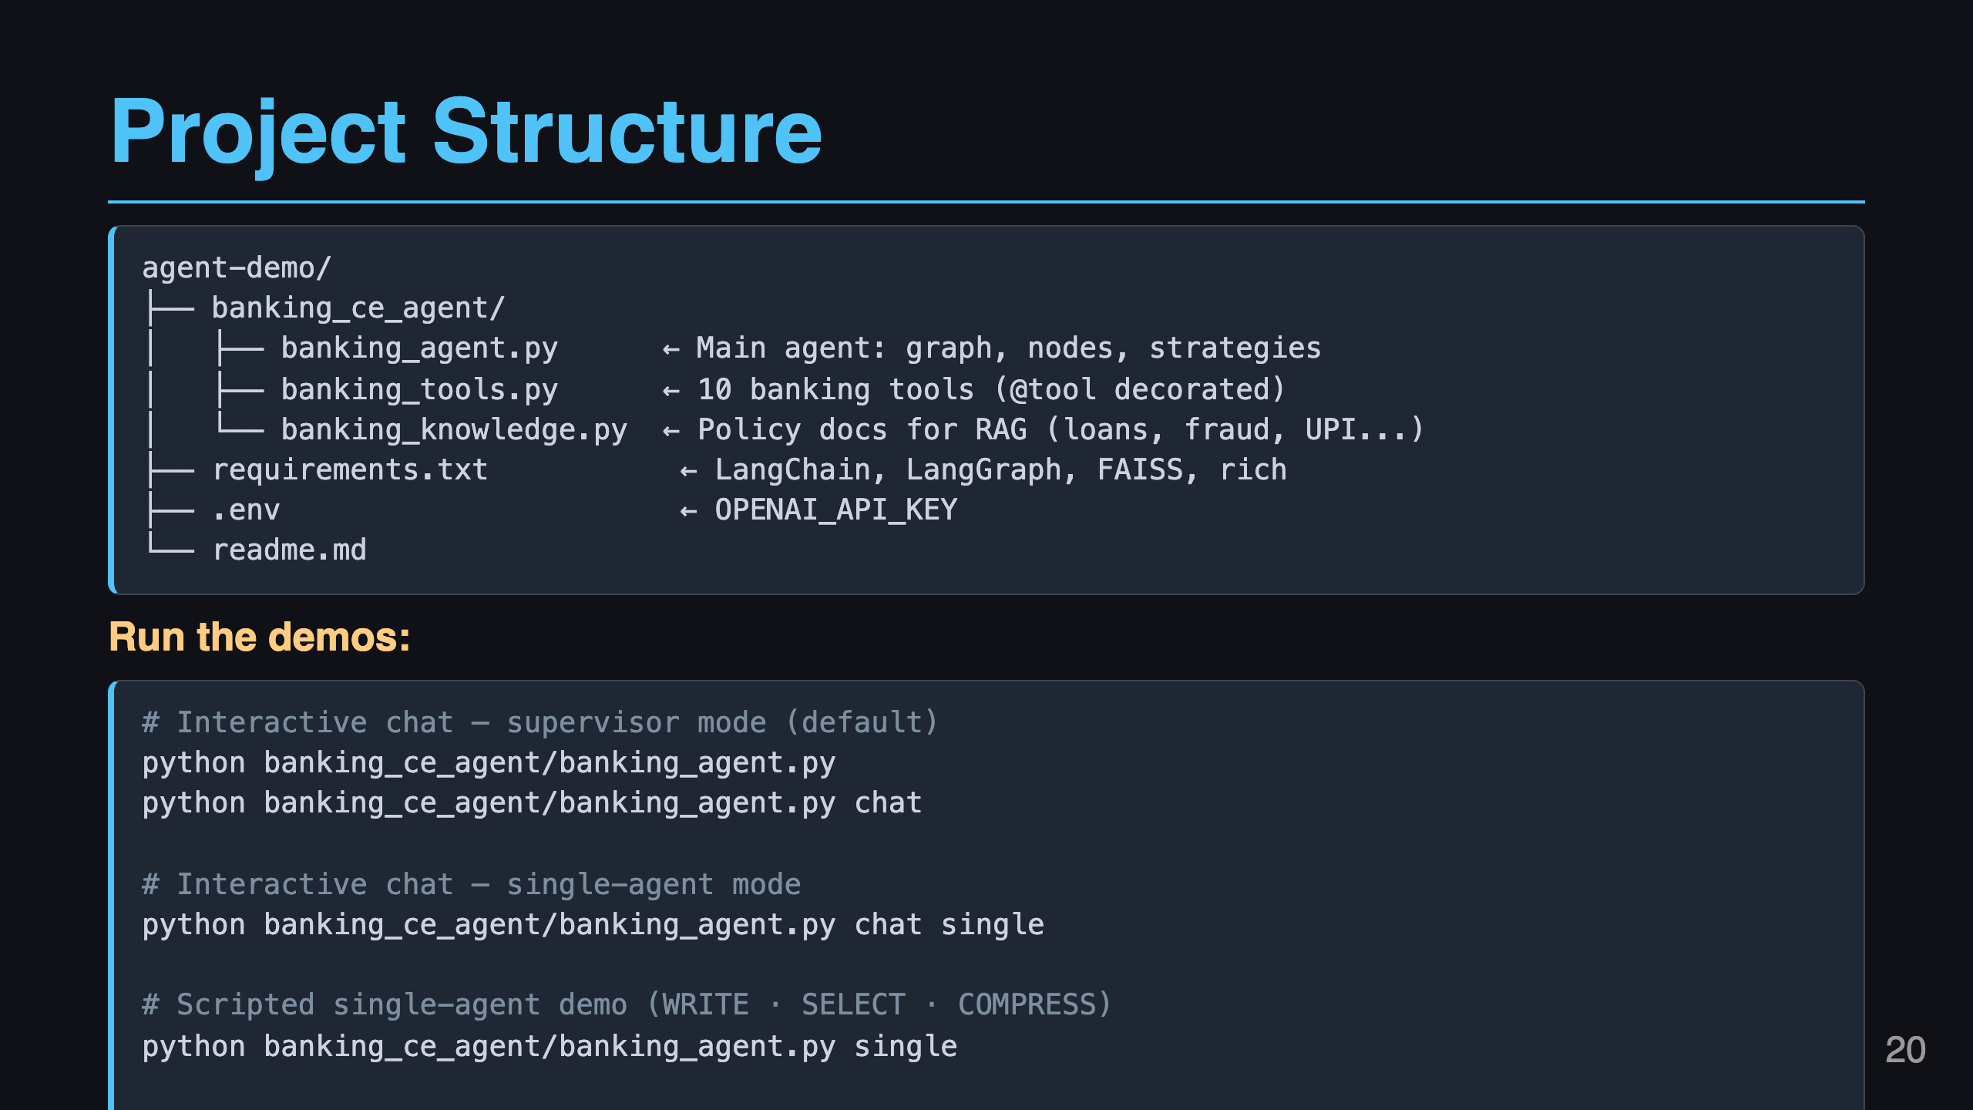
Notes:
Slide 20: Project Structure

Slide 21
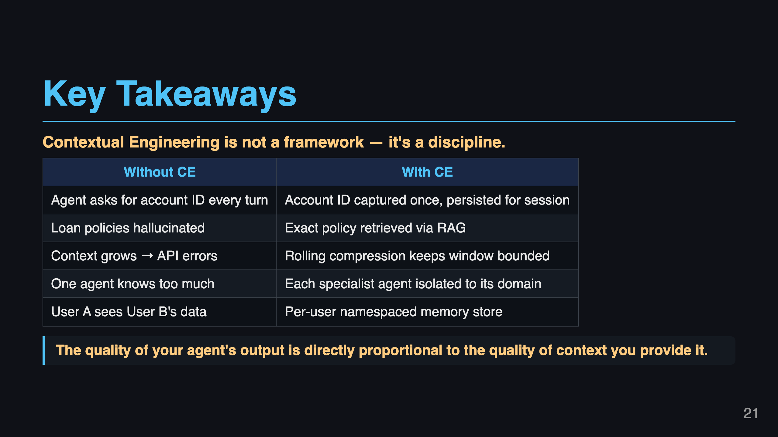
Notes:
Slide 19: Key Takeaways

Slide 22
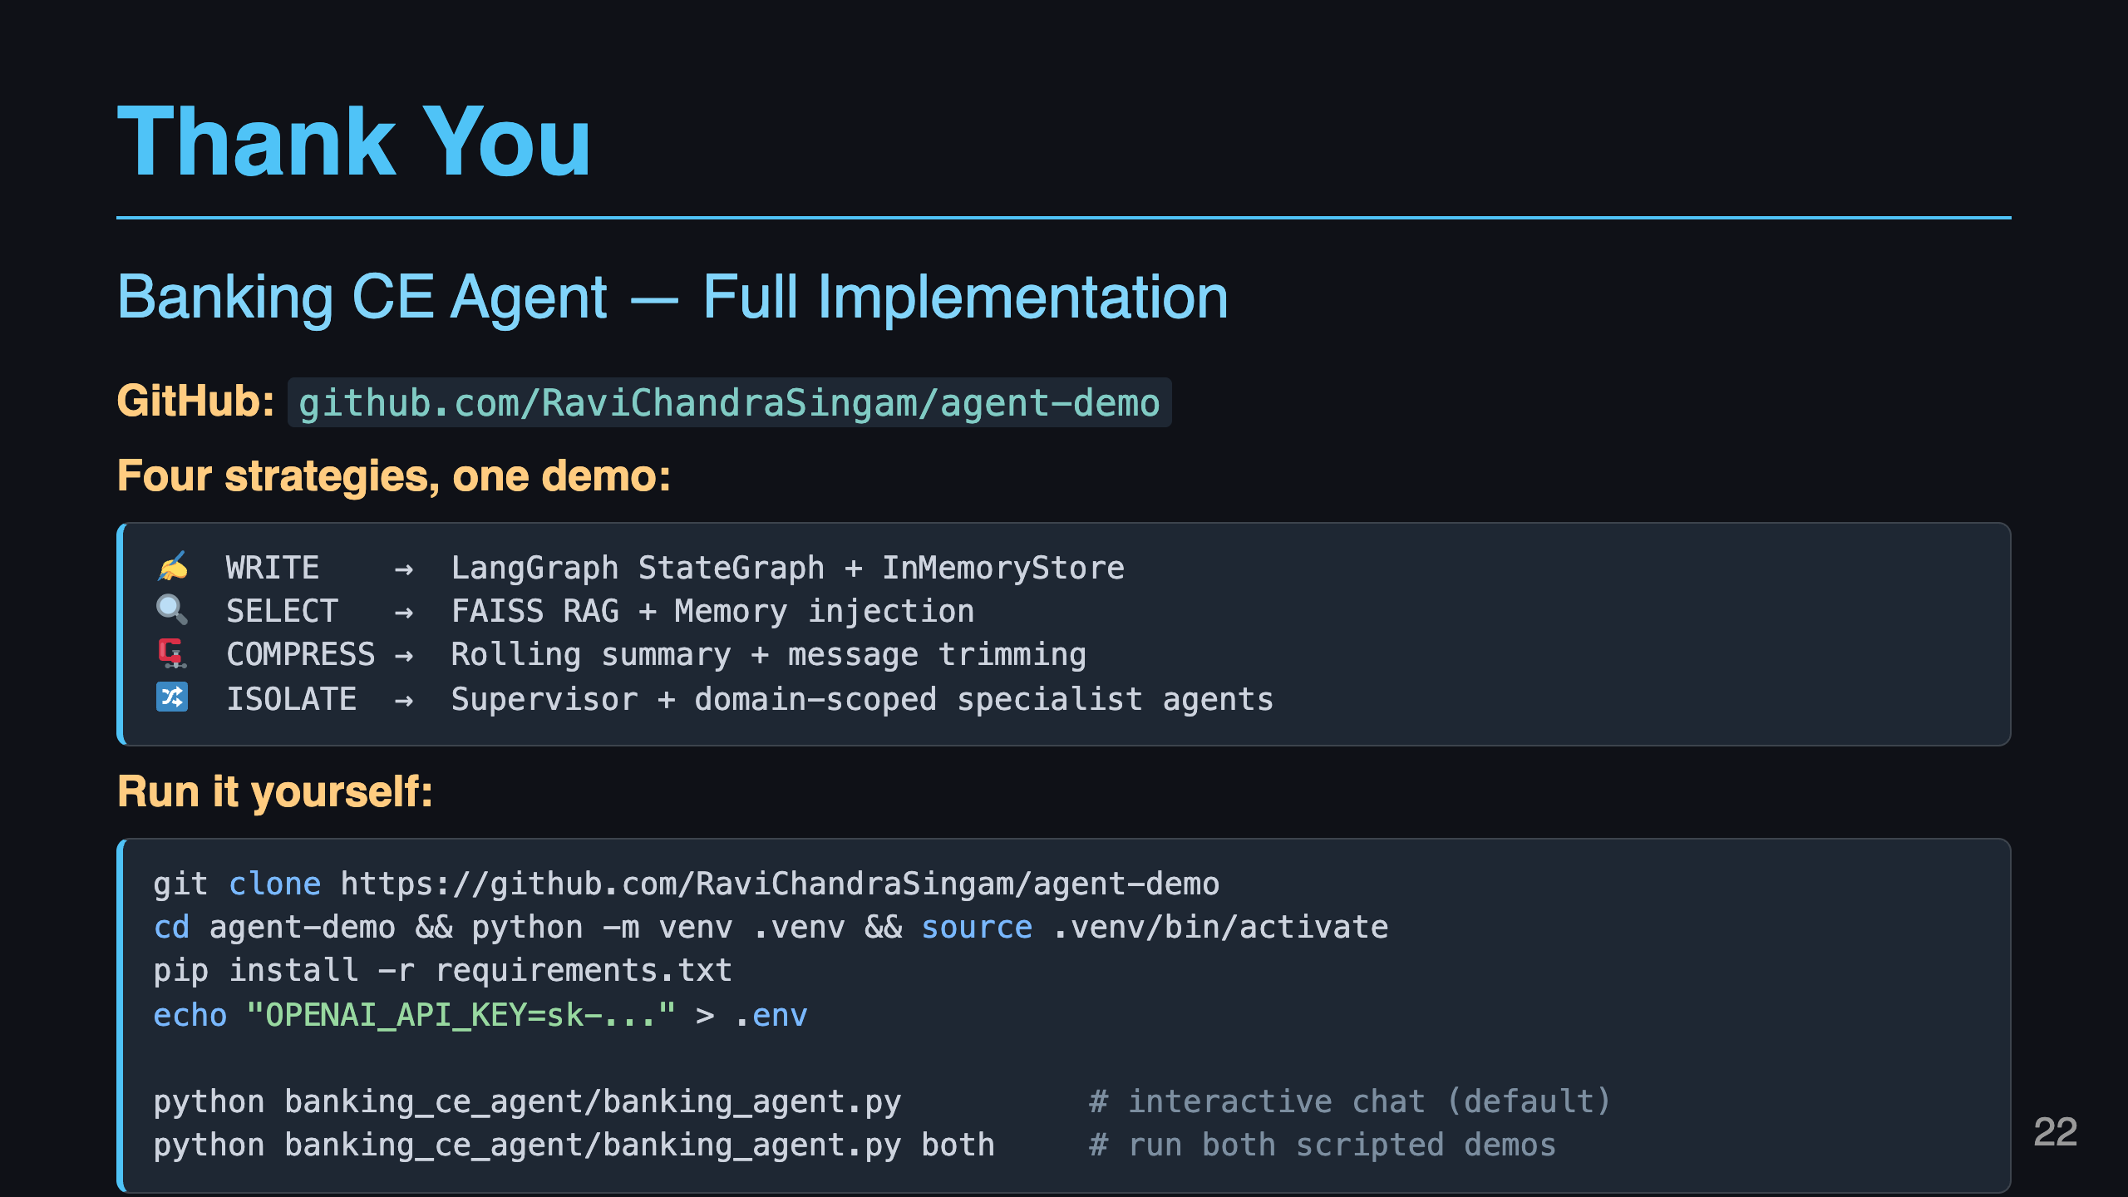
Notes:
Slide 20: Thank You

