Slide 1

Digital Assignment - 2 Implementing Network Protocols along with my First Website
Sri Sai Ravi Charan Siddabathuni
21BAI1918

Slide 2



Agenda
Approach
Technologies used
HTTP - CSS, Java Script
SMTP
FTP
SNMP

Slide 3



Approach
Explored firebase for couple of days, but couldn’t succeed
Thought of using EC2 instance on AWS cloud, but I explore that during my last hackathon.
Heard of “GoDaddy” but never explored so that of exploring that.
Took a one-month webhosting subscription from “GoDaddy” for building my website
After couple of hours of struggle, It was ended up as an easy task to build a website on GoDaddy
Went further and added some code to demonstrate the implementation of HTTP, HTML, CSS, Java scripting, PHP, SMTP

Slide 4


Technologies used
Web page development
HTML
CSS
Java scripting
SMTP Programming
PHP
Filezilla [Tool used for FTP demonstration]
Ubuntu shell
For exploring SNMP service

Slide 5


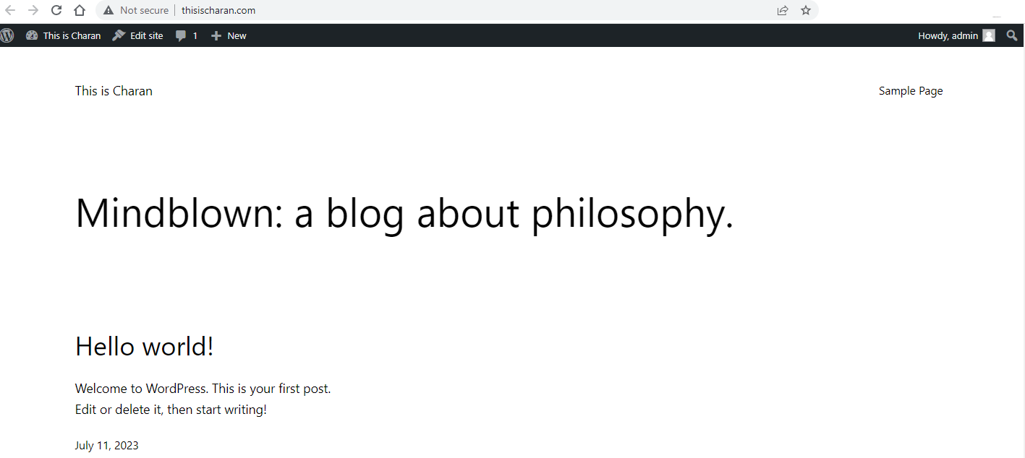
Building a Web Site – Steps followed
Signed up for a one-month subscription on GoDaddy
Registered my own domain name to give my website a unique identity
GoDaddy has “cPanel” which is a server and site management platform
cPanel – Control panel software used for web hosting
cPanel User interface & documentation helps us in building a website from the scratch
A range of in-built web themes are available in GoDaddy which helps web site building activity seamlessly easy.
With couple of back and forth tries in just couple of hours I was able to bring up my new website.
[As of now I haven’t started any web programming]
My New Web Site
Built using a word-press theme

Slide 6
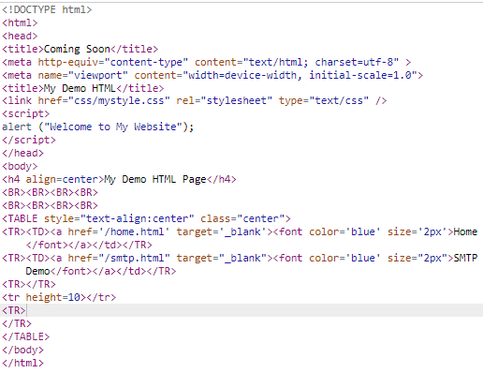
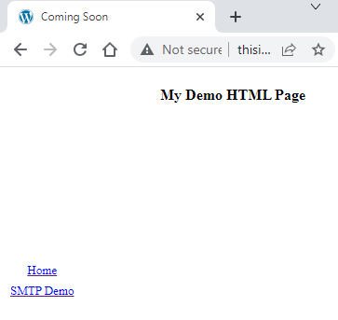
Web Development
Output
Code

Slide 7
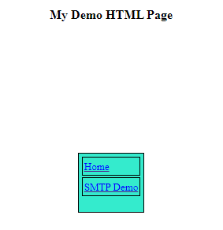
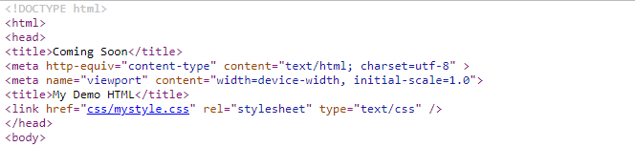
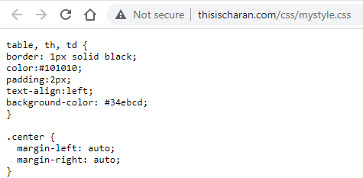
Web Development
CSS Code
Output
CSS code helps in centering the table, adding background color, adding table border

Slide 8
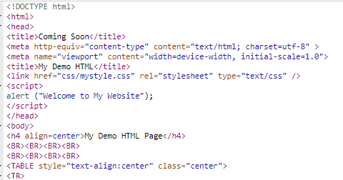
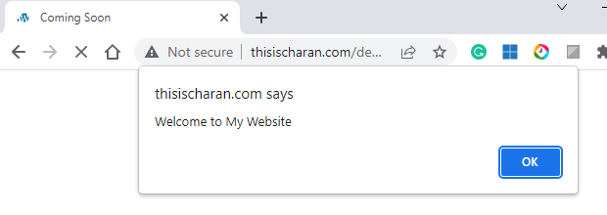
Java Script
Web Development
Simple Java script to add an alert “Welcome to My Website” which pops-up when the user first visits the webpage on his web browser
A lot can be done using Java scripting but for now I did this small piece

Slide 9
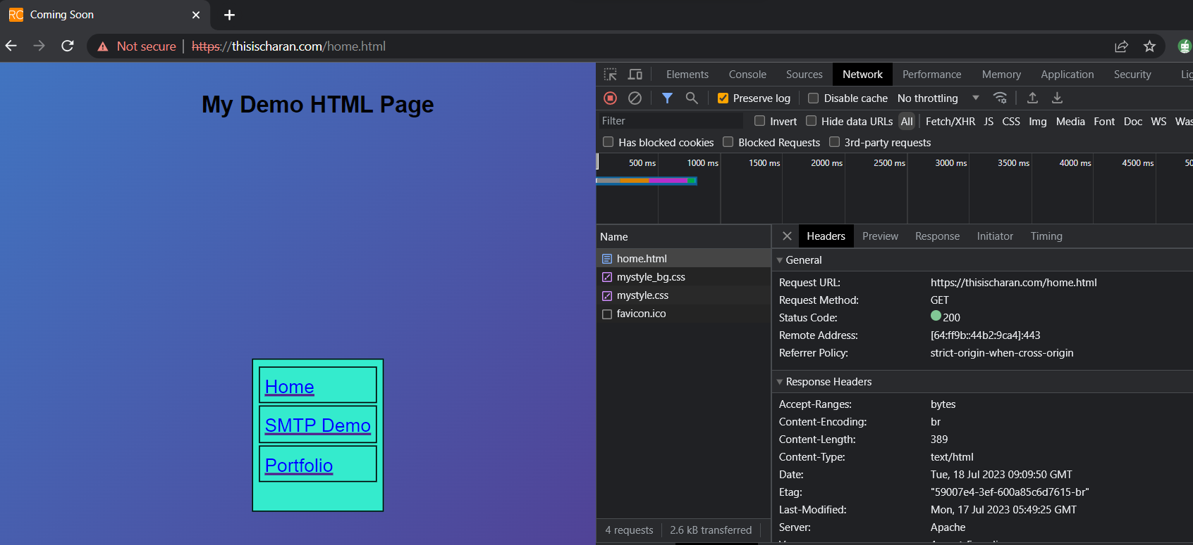
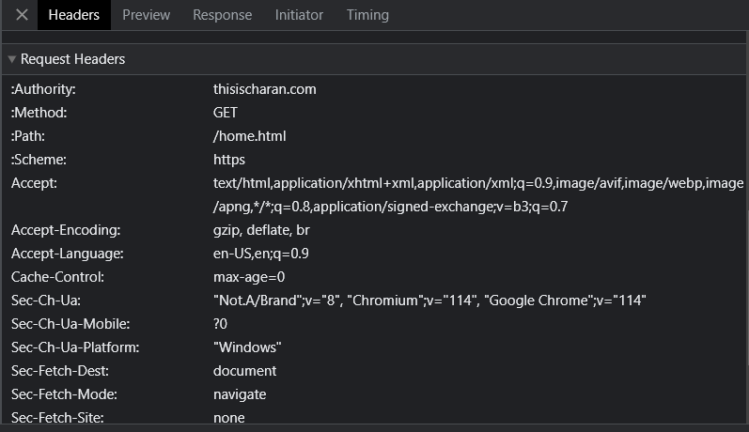
Analysing HTTP Requests and Responses with Chrome Devtools (Ctrl + Shift + I)
Response Headers
Request Headers

Slide 10
SMTP – Simple Mail Transfer Protocol
Used to send, receive, and relay outgoing emails between senders and receivers
We need the following to demonstrate SMTP functionality:
SMTP Server
Email Account(s)
Software program which can communicate with the SMTP server and submit an email
SMTP Server
We have free/paid SMTP servers
Example: Google, Yahoo (Freeware); PostMark, SendinBlue(Paid)
For security reasons, GoDaddy doesn’t allow the usage of Google, Yahoo. It allows a more secured Google API based SMTP connection

Slide 11
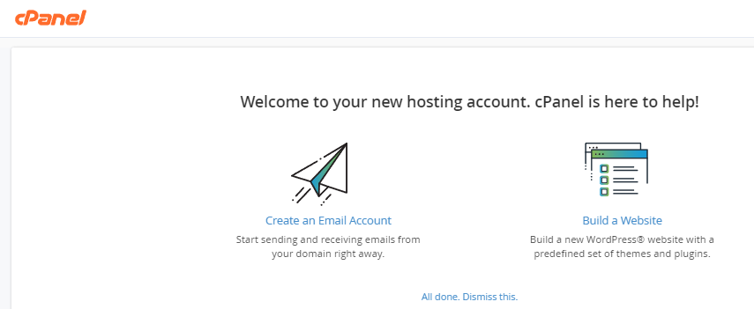
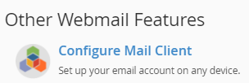
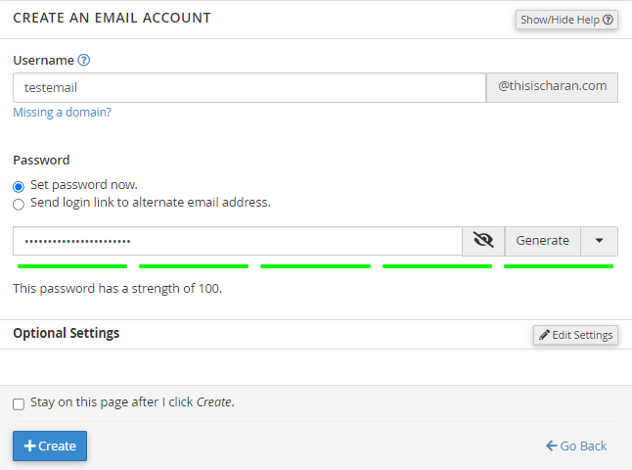
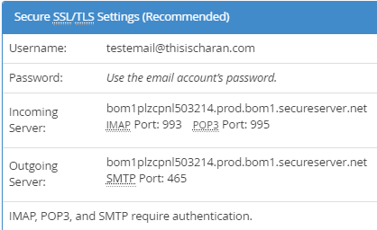
SMTP – Simple Mail Transfer Protocol
1
GoDaddy web hosting account provides a built-in SMTP server
Creation of email account in GoDaddy will setup a personal SMTP server
4
2
5
Due to the restrictions/complexity involved in using Google, Yahoo like freeware SMTP servers, I opted for the GoDaddy built-in SMTP server.
3

Slide 12
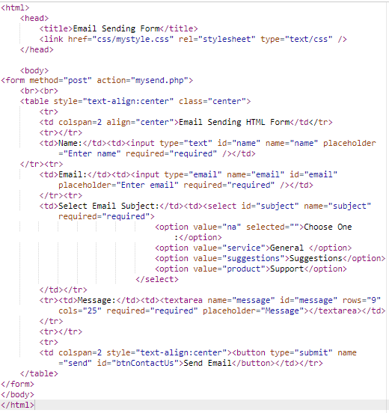
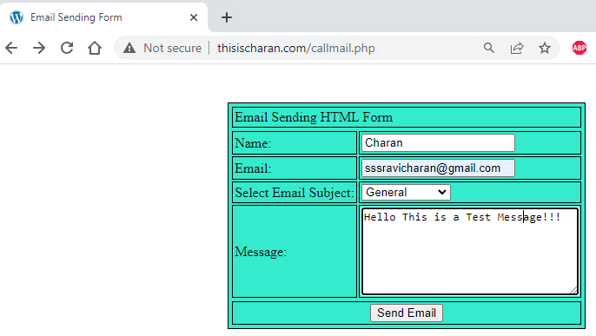
SMTP – Simple Mail Transfer Protocol
HTML Code for Email input form
Output
On clicking “Send Email”, the HTML form will call “mysend.php

Slide 13
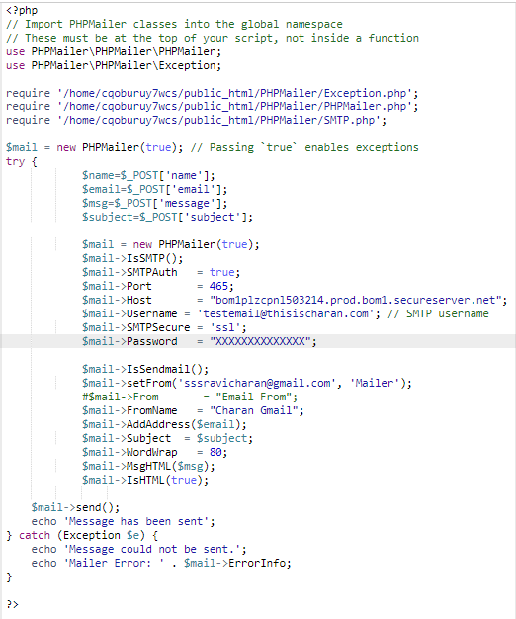
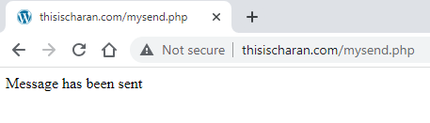
SMTP – Simple Mail Transfer Protocol
PHP Code
PHPMailer Module/Extension
Output
PHP Code for capturing the email form input
SMTP Server configuration
Email object construction
References:
https://www.youtube.com/watch?v=a6VenL0d5Gw
PHPMailer Module Download
Invoke Email send function

Slide 14
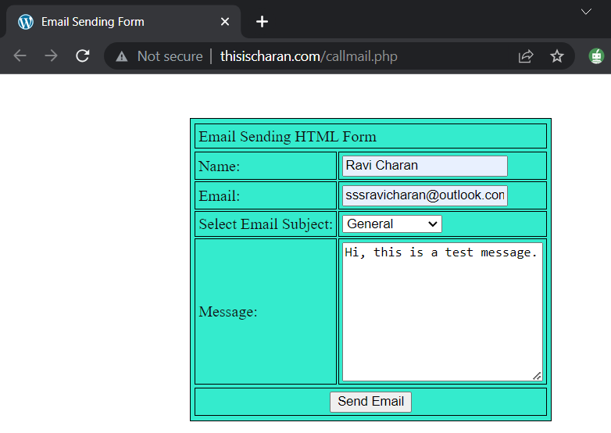
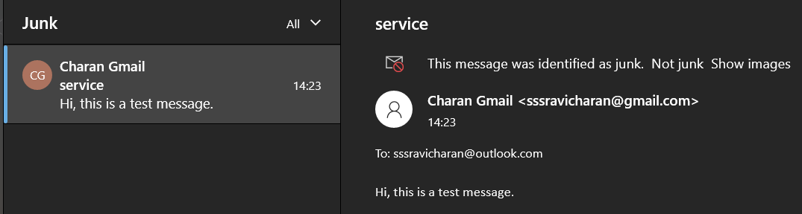
Example
Give it a try
https://thisischaran.com/smtp.html

Slide 15
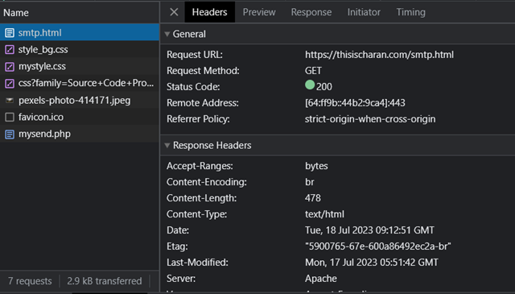
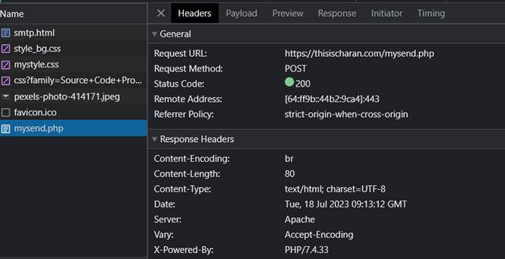
Analysing SMTP Requests methods with Chrome Devtools (Ctrl + Shift + I)
GET method
POST method

Slide 16
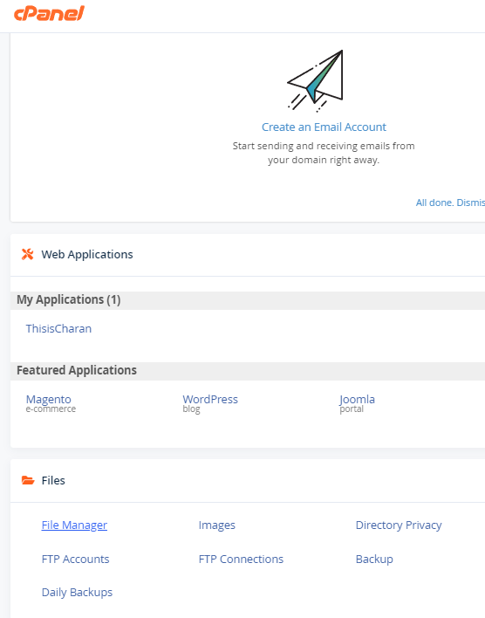
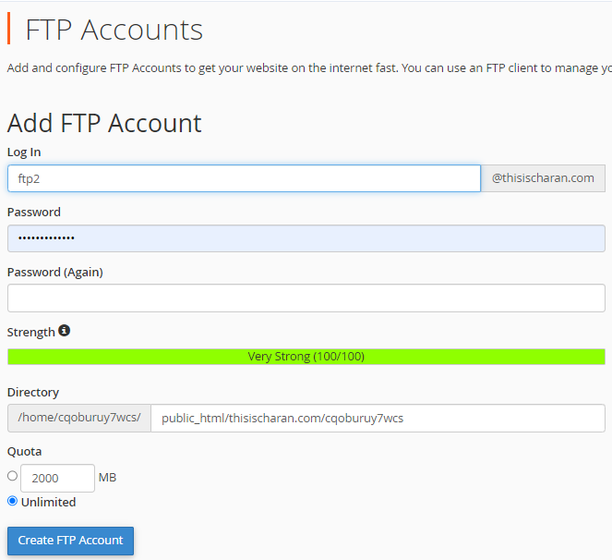
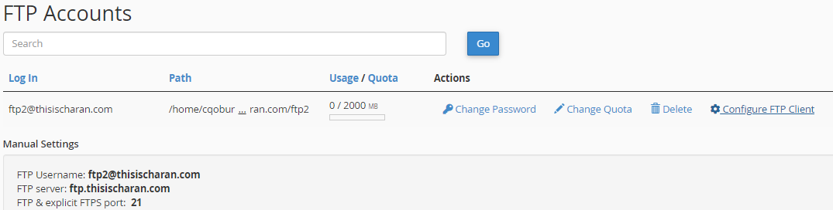
FTP – File Transfer Protocol
1
GoDaddy web hosting account provides a built-in FTP server
Creation of FTP account in GoDaddy will allow us to demonstrate FTP.
FTP server creation on any Linux machine is simple [Reference Link]
FTP server is now ready along with an account which we can use for connecting and exchanging files
2
3

Slide 17
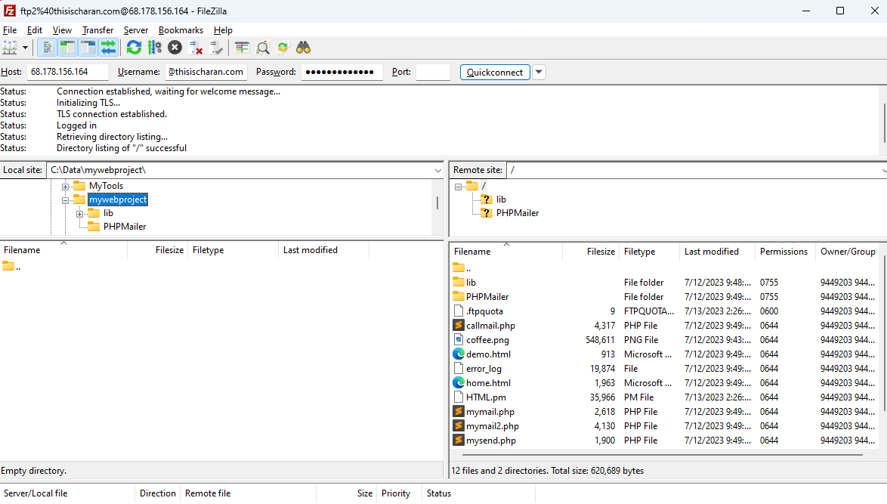
FTP – File Transfer Protocol
In order to use the FTP services, we need a client program (like Filezilla, winscp, etc.,)
These programs will connect to the FTP server and allows us to exchange (download/Upload) files
I used Filezilla as my FTP client
Filezilla can be installed from here
You can drag & drop the files/folder between FTP server “1” & Local Folder “2”
FTP Server
Username
Password
Local Folder
1
Files on FTP Server
2

Slide 18
SNMP – Simple Network Management Protocol
SNMP is one of the widely accepted network protocols that manages and monitors network element
Most of the professional–grade network elements come with bundled SNMP agent
These agents have to be enabled and configured to communicate with the network monitoring tools or network management system (NMS)
Given the limited scope of network elements, I was able to install SNMP service on my Windows Ubuntu shell and used snmpwalk tool to view the SNMP service output.

Slide 19


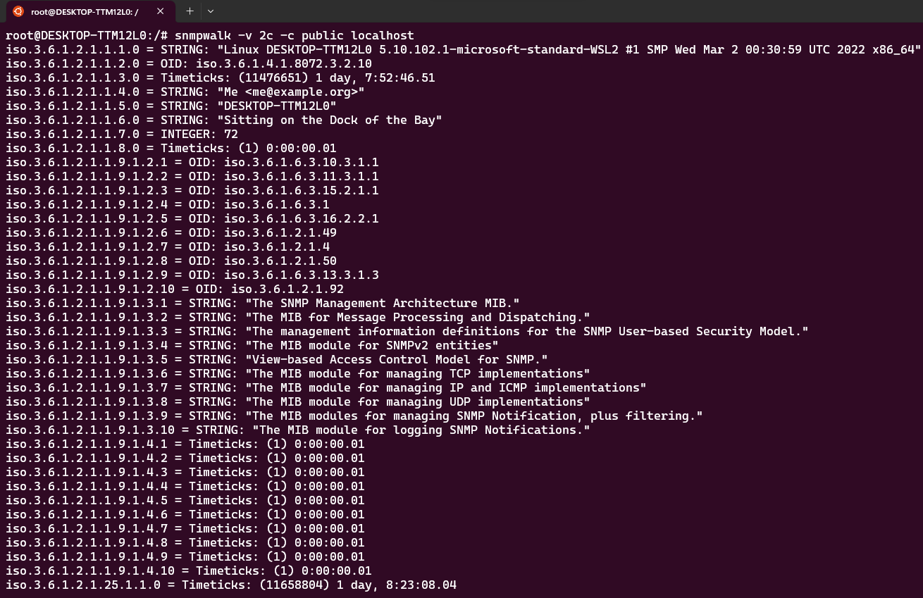
SNMP – Simple Network Management Protocol
Install SNMP Service
Check the SNMP Service status
Querying SNMP service output using snmpwalk command

Slide 20
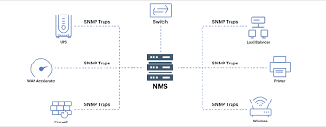
Allows administrator to monitor network equipment's current state (switches, routers, servers, etc)
Remotely modify setting and configuration.
OID - Object Identifier
MIB - Management Information Base
MIB is a text file that translate numerical to wordbased oid
Command to get up time of a devive: "sysuptime.0"

Slide 21
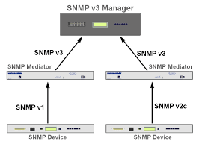
Polling: Network monitor connects to device on port 161; tells device which OID info does it want.
Notifying: Device sends OID related message to monitor system port 162.
These messages are also called as traps, notifications or informs.
SNMP versions:
Version - 1 & 2c:
No username
Use "community string"
No encryption
Version 3:
Provides Username password
Provides Encryption

Slide 22
Links
http://thisischaran.com/demo.html
https://thisischaran.com/smtp.html
https://venture-redirector.godaddy.com/
cPanel Login
https://favicon.io/
https://filezilla-project.org/download.php?platform=win64
https://egghead.io/lessons/chrome-devtools-analyze-http-requests-and-responses-with-chrome-devtools

Slide 23


Thank You
“My sincere thanks for providing me this opportunity which helped me understand certain basics of web hosting, development and knowledge about certain protocols.” – Charan
sri.sairavicharan2021@vitstudent.ac.in
http://thisischaran.com/demo.html

