Slide 1
🔐
Password Cracking &
Credential Attack Suite
Cybersecurity Project
Presented by: Ravi

Slide 2
Introduction
🔒
Password security is a critical part of cybersecurity
⚠️
Weak passwords are easily exploited by attackers
🔨
Attackers use techniques like brute-force & dictionary attacks
🔍
This project demonstrates real-world password vulnerabilities

Slide 3
Problem Statement
01
Users rely on weak and common passwords
02
Lack of awareness about password security risks
03
Systems are vulnerable to credential-based attacks
04
Need for tools to demonstrate these vulnerabilities

Slide 4
Objectives
⚔️
Attack Simulation
📊
Strength Analysis
Simulate password attack techniques in a controlled environment
Analyze and score password strength using entropy metrics
#️⃣
Hash Demo
📝
Security Reports
Demonstrate hashing algorithms and cracking attempts
Generate detailed security reports for analysis

Slide 5
Project Scope
✅ IN SCOPE
❌ OUT OF SCOPE
Dictionary & Brute-Force Attacks
Real-world Hacking
Password Strength Analysis
Network-based Attacks
Hash Cracking Simulation
Multi-Factor Auth Bypass
Security Report Generation
Unauthorized System Access

Slide 6
Tools & Technologies
🐍
💻
#️⃣
Python
VS Code
Hashlib
Core programming language
Development environment
MD5 / SHA hashing library
⌨️
🪟
CLI Interface
Windows OS
Command line interaction
Operating system platform

Slide 7
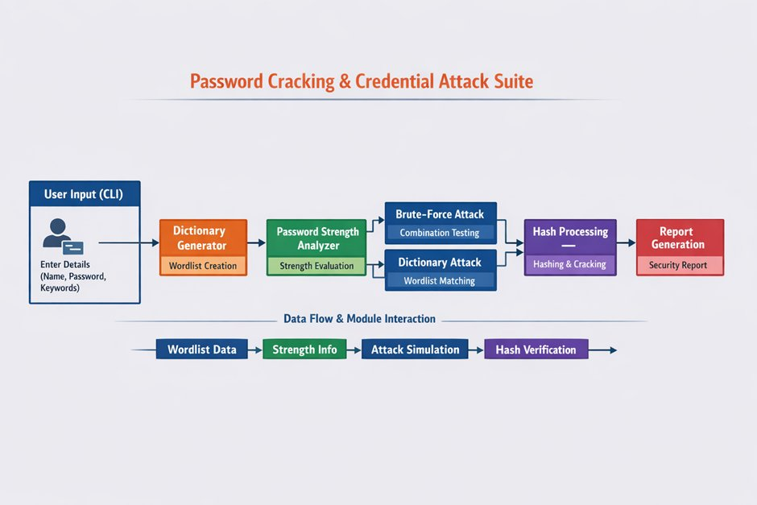
System Architecture

Slide 8
Workflow
1
2
3
4
5
User Input
Dictionary Generation
Password Analysis
Attack Simulation
Report Generation

Slide 9
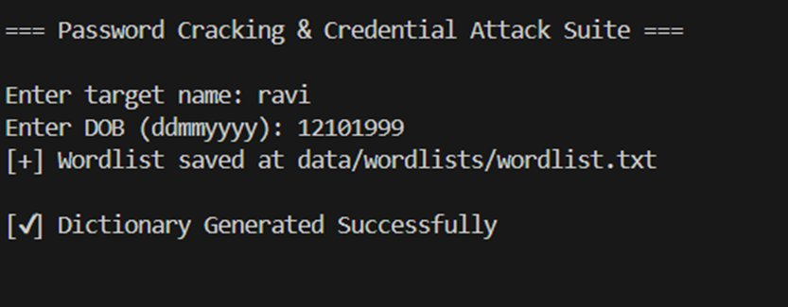
Dictionary Generator
Generates password wordlists from user data
Uses name, DOB & common patterns
Adds variations (numbers, symbols, cases)
Saves output to data/wordlists/wordlist.txt

Slide 10
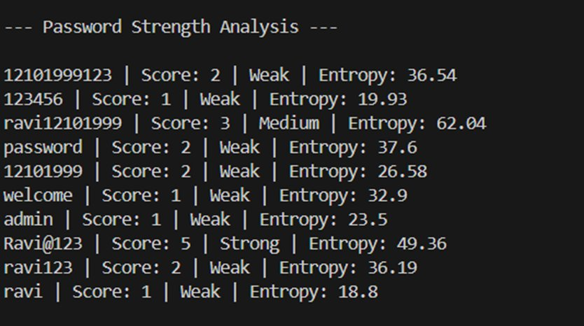
Password Strength Analyzer
Evaluates password complexity
Calculates bit entropy for strength score
Classifies: Weak / Medium / Strong
Scores from 1 (weakest) to 5 (strongest)

Slide 11
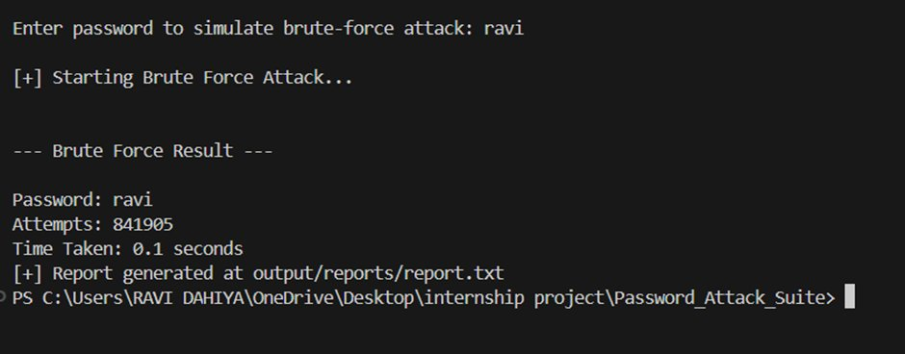
Brute Force Attack
Tries multiple character combinations
Measures total attempts made
Records time taken to crack
Exposes vulnerability of short/simple passwords

Slide 12
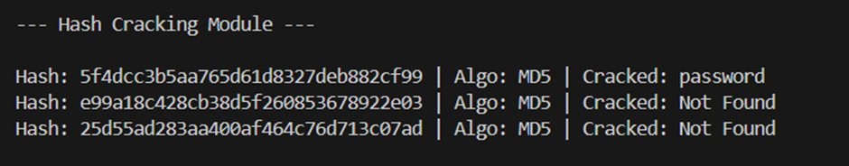
Hash Cracking Module
Converts passwords to MD5/SHA hashes
Compares against wordlist hashes
Identifies matching plaintext passwords
Demonstrates hash vulnerability

Slide 13
Results
< 1s
841K+
Weak passwords cracked
Brute-force attempts
e.g. 'ravi', 'admin', '123456'
for 4-char password in 0.1s
Score 5
MD5
Ravi@123 scored Strong
'password' hash cracked
Entropy: 49.36 bits
via wordlist matching

Slide 14
Security Recommendations
🔐
Use Strong Passwords
🚫
Avoid Common Passwords
Mix uppercase, lowercase, numbers & symbols (12+ chars)
Never use names, DOBs, or dictionary words
📱
Enable MFA
🗄️
Use Password Managers
Multi-Factor Authentication adds an extra security layer
Store unique passwords securely with a manager

Slide 15
Learning Outcomes
⚔️
Learned password attack techniques like brute-force & dictionary attacks
🐍
Improved Python programming skills through modular project development
#️⃣
Understood hashing algorithms and their role in password security
🔍
Gained hands-on cybersecurity knowledge in a practical context

Slide 16
Conclusion
🌐
Project demonstrates real-world credential attack risks
🔑
Highlights the critical importance of strong, unique passwords
📚
Serves as a valuable cybersecurity learning and awareness tool

Slide 17
Future Enhancements
01
GUI Interface
02
Advanced Cracking
Build a graphical interface for easier interaction
Integrate tools like Hashcat and John the Ripper
03
MFA Simulation
04
Better Reports
Simulate multi-factor authentication bypass attempts
Generate detailed PDF/HTML security analysis reports

Slide 18
🔐
Thank You
Password Cracking & Credential Attack Suite
Presented by: Ravi

