Slide 1
CYBERSECURITY INTERNSHIP PROJECT
Windows Registry
Change Monitoring
System
Presented by: Ravi Dahiya
Organization: Unified Mentor
Mentor: Mr. Harshit

Slide 2
Introduction
🗄
Windows Registry is a hierarchical database built into the Windows OS
⚙
Stores critical configuration data for system, applications, and hardware
🚀
Essential for system startup, user preferences, and runtime operations
⚠
Frequently targeted by malware for achieving persistence on compromised systems

Slide 3
Problem Statement
Unauthorized registry changes often go unnoticed by system administrators
01
Malware exploits registry entries to establish persistence after system reboot
02
Manual detection of registry tampering is difficult, slow, and error-prone
03
Basic Windows systems lack real-time registry change monitoring capabilities
04

Slide 4
Project Objectives
This project aims to build a Python-based tool that monitors critical Windows Registry keys for unauthorized changes and alerts the user in real time.
01
Monitor critical registry keys in real time
04
Generate real-time alerts and maintain audit logs
02
Detect unauthorized additions, deletions, or modifications
05
Understand and demonstrate registry-based attack techniques
03
Identify suspicious and malware-like registry entries

Slide 5
Scope of the Project
✔ IN SCOPE
✖ OUT OF SCOPE
Monitoring selected startup registry paths
Full registry monitoring (all hives and keys)
Detecting newly added and deleted registry entries
GUI interface or complex malware analysis
Basic keyword-based malware detection logic
Automated deletion or restoration of entries
Logging detected changes and generating real-time alerts
Remote system or network-wide monitoring

Slide 6
Tools & Technologies Used
Python
Language
winreg
Module
Main programming language used to build baseline and monitoring scripts
Built-in Python module for accessing and reading Windows Registry data
JSON
Format
VS Code
IDE
Used to store baseline snapshot of registry entries for comparison
Primary IDE used for writing, debugging, and running project scripts
PowerShell
Execution
Used for executing scripts and observing real-time monitoring output

Slide 7
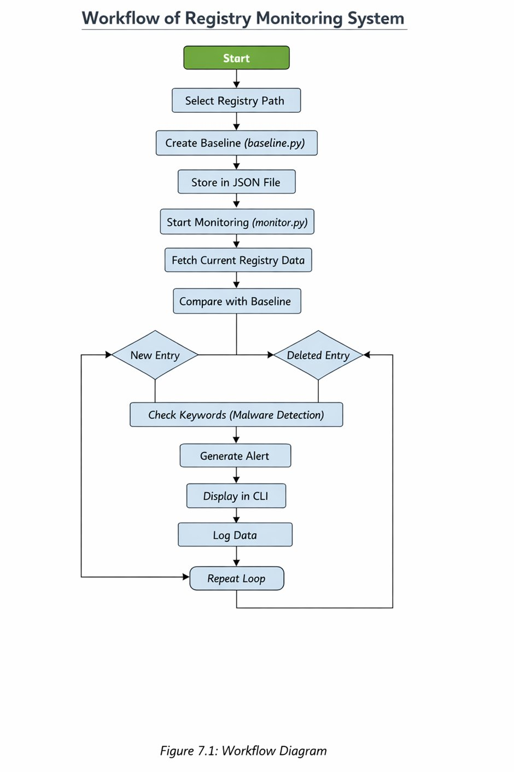
Workflow / Architecture (Figure 7.1)
1. Select Registry Path
Choose startup-related registry keys to monitor
2. Create Baseline
Run baseline.py → snapshot stored in JSON file
3. Start Monitoring
Run monitor.py → continuously scans registry
4. Compare with Baseline
Detect new entries or deleted entries
5. Keyword Check
Flag suspicious names using malware keywords
6. Alert & Log
Display alert in CLI and write to log.txt
7. Repeat Loop
Continuous monitoring loop for real-time detection
Figure 7.1: Workflow Diagram

Slide 8
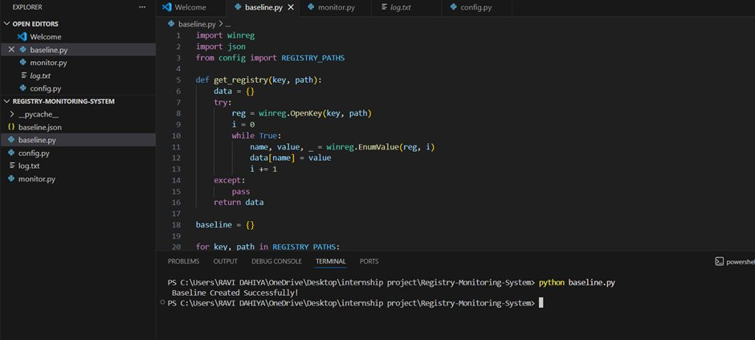
Implementation – Steps 1 to 3
Step 1: Selection of Registry Path (Figure 8.1)
Registry Path: HKEY_CURRENT_USER\Software\Microsoft\Windows\CurrentVersion\Run
This startup path is monitored as malware commonly adds entries here to auto-execute on boot.
Step 2: Baseline Creation (Figure 8.2)
Run baseline.py to capture a snapshot of the current registry and store it in baseline.json.
Figure 8.2: Baseline Creation Output

Slide 9
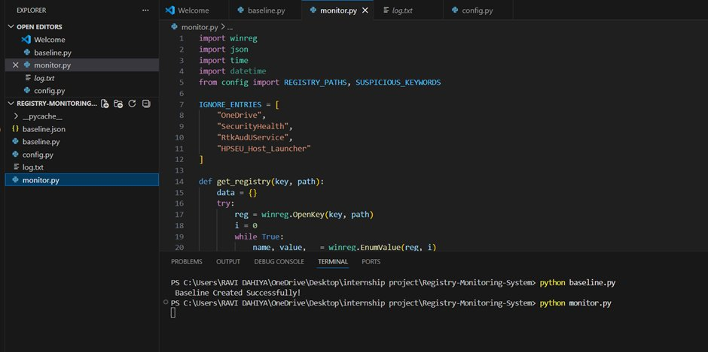
Implementation – Step 3: Start Monitoring
Step 3: Start Monitoring (Figure 8.3)
Run monitor.py → the script continuously scans the selected registry path and compares it against the stored baseline snapshot. Any difference triggers an alert.
Figure 8.3: Monitoring Process Started

Slide 10
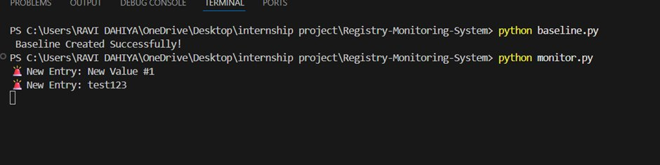
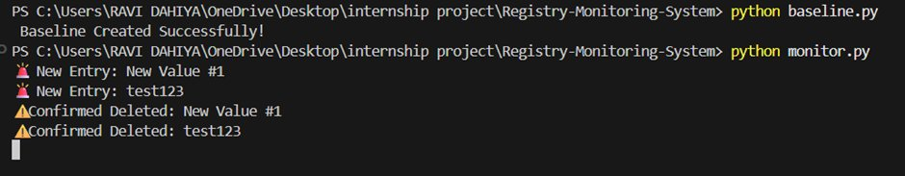
Implementation – Steps 4 & 5: Entry Detection
Step 4: New Entry Detection (Figure 8.4)
Step 5: Deleted Entry Detection (Figure 8.5)
System detects entries that were added after the baseline was created.
System detects entries that existed in baseline but are now removed.
Figure 8.4: New Entry Detection
Figure 8.5: Deleted Entry Detection
Detection Logic
New Entry: Key exists in current snapshot but NOT in baseline → 🚨 Alert raised Deleted Entry: Key exists in baseline but NOT in current scan → ⚠️ Confirmed Deleted alert

Slide 11
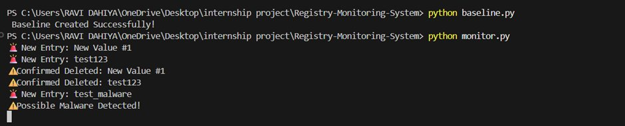
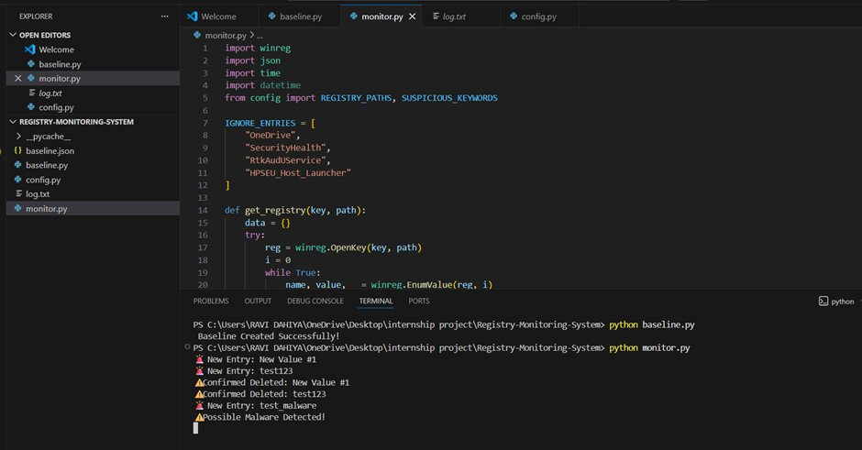
Implementation – Steps 6 & 7: Malware & Continuous Monitoring
Step 6: Malware Detection (Figure 8.6)
When a new entry name matches a suspicious keyword (e.g., "malware", "virus", "trojan"), a "Possible Malware Detected!" alert is triggered in CLI.
Figure 8.6: Malware Detection Alert
Step 7: Continuous Monitoring (Figure 8.7)
The monitoring loop runs indefinitely, scanning the registry at regular intervals to provide persistent real-time protection.
Figure 8.7: Continuous Monitoring Process

Slide 12
Results & Findings
Fig 8.2
Baseline created successfully — registry snapshot saved to baseline.json
Fig 8.3
Real-time monitoring confirmed — monitor.py runs continuously without interruption
Fig 8.4
New entries detected accurately — newly added registry keys identified immediately
Fig 8.5
Deleted entries detected — removed registry keys flagged with 'Confirmed Deleted' alert
Fig 8.6
Malware alerts triggered correctly — keyword 'test_malware' flagged as possible malware
Fig 8.7
Continuous monitoring confirmed — loop repeats and detects all subsequent changes

Slide 13
Security Recommendations
🔒
📡
Restrict Registry Access
Enable Continuous Monitoring
Limit write permissions on critical registry keys to prevent unauthorized modifications
Deploy monitoring tools like this system to detect any registry changes in real time
💾
✅
Maintain Registry Backups
Install Trusted Software Only
Regularly backup the registry to allow fast recovery from malicious changes
Avoid running unknown executables which may silently create persistence registry entries
🛡
🔍
Enable Antivirus & UAC
Periodic Registry Reviews
Keep antivirus updated and maintain User Account Control to block unauthorized access
Regularly audit startup and run keys for suspicious or unrecognized entries

Slide 14
Learning Outcomes
Windows Registry Structure
Python System-Level Scripting
Gained in-depth understanding of hives, keys, values, and registry hierarchy
Learned to use winreg module for registry access and programmatic monitoring
01
02
Real-Time Detection & Alerts
Baseline Comparison Method
Implemented continuous loop-based detection with CLI alert output
Designed snapshot-based comparison logic using JSON serialization
03
04
Basic Malware Detection
Debugging & Problem Solving
Applied keyword-based detection to identify suspicious registry entries
Resolved Python script errors, registry access issues, and false positives
05
06

Slide 15
Conclusion
✓
System successfully detects registry changes in real time without user intervention
✓
New registry entries and deleted entries are both accurately identified and alerted
✓
Keyword-based logic correctly flags suspicious or malware-related entry names
✓
Continuous monitoring loop and detailed logging provide a strong audit trail
✓
Project establishes a solid foundation for advanced cybersecurity solutions

Slide 16
Future Enhancements
🖥
GUI Interface:
Develop a graphical dashboard for easier interaction, log viewing, and configuration management
🧠
Advanced Malware Detection:
Integrate signature-based and behavioral analysis to improve malware identification accuracy
📧
Real-Time Notifications:
Send instant email or desktop alerts when suspicious registry changes are detected
🤖
Automated Response:
Auto-delete or restore registry entries upon detection of known malicious patterns
🏢
Enterprise Integration:
Integrate with SIEM tools and enterprise security platforms for organization-wide deployment

