Slide 1

THREAT INTELLIGENCE
AGGREGATOR
( NON-AI BASED )
Name:
Ravi Dahiya
Internship:
Cybersecurity Internship
Organization:
Unified Mentor

Slide 2


INTRODUCTION
What is Threat Intelligence?
Importance in Cybersecurity
Collecting & analyzing cybersecurity threat data
Identifying Indicators of Compromise (IOCs)
Supporting proactive defense strategies
Derived from structured & unstructured sources
Enables early threat detection
Reduces response time to incidents
Informs security policy decisions
Protects critical infrastructure assets

Slide 3



PROBLEM STATEMENT
Manual Analysis is Slow
Security analysts spend hours manually sifting through threat logs and feeds, creating dangerous delays in incident response.
Unstructured Threat Data
IOCs are scattered across TXT, CSV and log files with inconsistent formats, making correlation and triage extremely difficult.
No Centralized Aggregation
Organizations lack a unified pipeline to ingest, normalize, and correlate threat indicators from multiple sources.

Slide 4




PROJECT OBJECTIVES
Extract IOCs
Normalize Data
Parse IPs, URLs, and domains from multi-format threat feeds using regex
Standardize all extracted indicators into a unified structured format
Correlate Threats
Generate Blocklists
Cross-reference IOCs across sources and calculate frequency counts
Output categorized IP, URL, and domain blocklist files automatically

Slide 5


TOOLS & TECHNOLOGIES
Python 3
Regex (re)
Core Programming Language
Pattern Matching Engine
Primary language — lightweight, no external dependencies, easy to deploy on any system
Built-in module — extracts IPs, URLs, domains from raw text and CSV without extra libraries
CSV Module
File Handling
Structured Data Parser
I/O Operations
Built-in module — parses structured threat feeds row-by-row with zero external dependencies
Native Python I/O — reads multi-format feeds and writes blocklists; fully portable and lightweight

Slide 6
WORKFLOW DIAGRAM
PROCESSING PIPELINE
Input Files
Parsing
Normalization
Correlation
Risk Classification
Blocklist Gen.
Output
TXT / CSV
Regex Engine
Structuring
Cross-Reference
HIGH / LOW
Output Files
Reports
Each stage transforms raw threat data into actionable intelligence outputs
Input Phase
Processing
Risk Analysis
Output Phase

Slide 7
SYSTEM ARCHITECTURE
parse
normalize
correlate
User Input
Parser
Data Processor
Correlation Engine
TXT / CSV Files
Regex + CSV
Normalization
Risk Scoring
Output Module
Blocklists + Report

Slide 8

IMPLEMENTATION DETAILS
● parser.py — Core Engine
Regex Parsing
# Step 1: Define IOC patterns
ip_pat = r"\b(\d{1,3}\.){3}\d{1,3}\b"
url_pat = r"https?://[^\s]+"
dom_pat = r"[a-z0-9.-]+\.[a-z]{2,}"
# Step 2: Extract from each line
for line in feed_data:
ips = re.findall(ip_pat, line)
urls = re.findall(url_pat, line)
doms = re.findall(dom_pat, line)
# Step 3: Normalize + tag source
iocs.append({type, value, source})
IP, URL, domain patterns applied to raw text and CSV rows
Data Extraction
All IOC types extracted and tagged with their source file
Data Structuring
Extracted IOCs stored as typed dictionaries for further processing

Slide 9
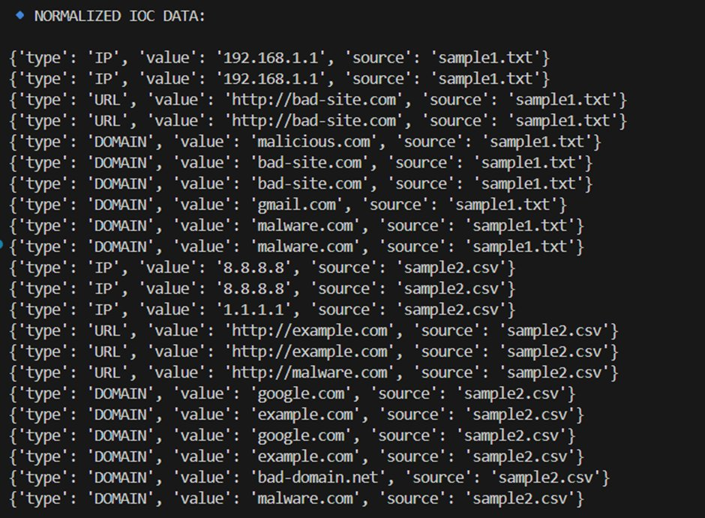
NORMALIZED IOC DATA OUTPUT
TERMINAL OUTPUT ▸ Normalized IOC Data (type | value | source)
Structured format: type | value | source — ready for correlation and risk scoring

Slide 10
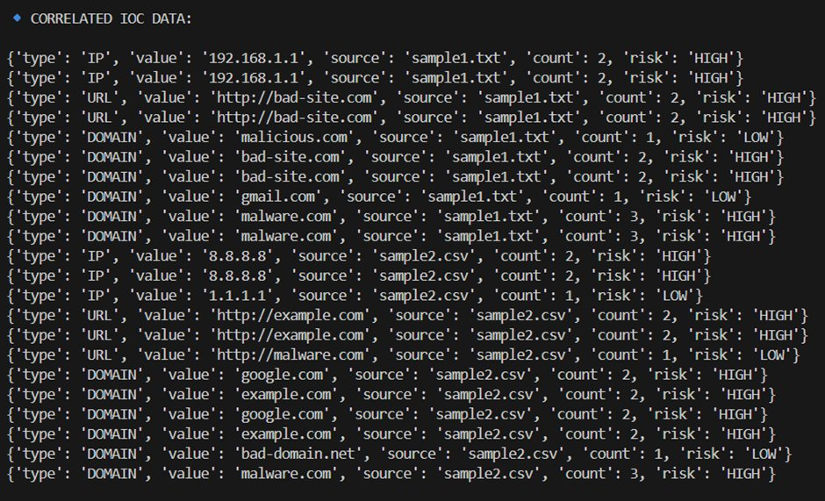
CORRELATED IOC DATA WITH RISK LEVELS
TERMINAL OUTPUT ▸ Correlated IOC Data (type | value | source | count | risk)
⚠ malware.com count: 2
IOCs appearing ≥2 times classified as HIGH RISK • malware.com count: 2 • count + risk fields added per source

Slide 11
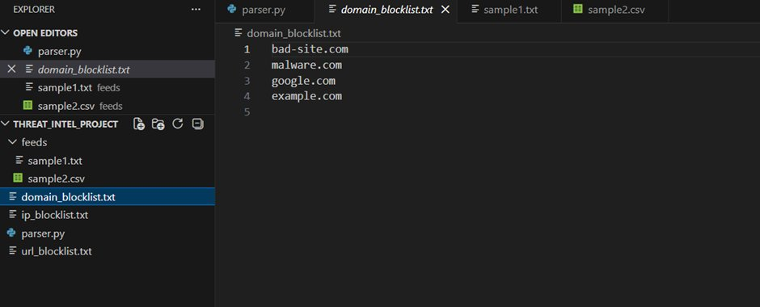
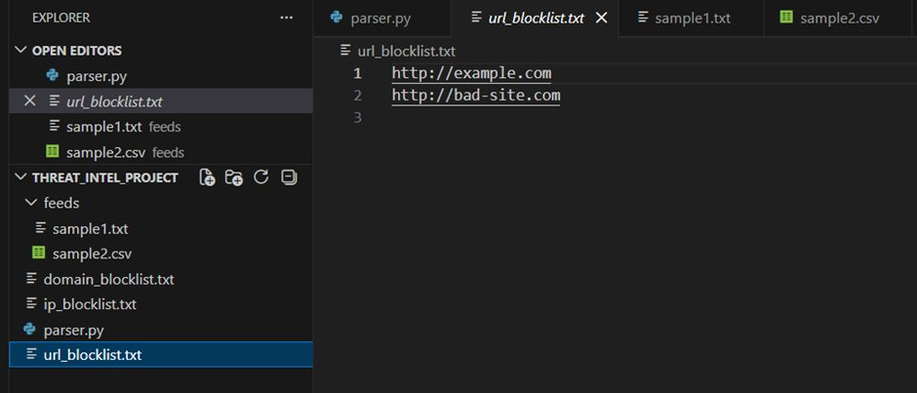
GENERATED BLOCKLIST FILES
DOMAIN BLOCKLIST
URL BLOCKLIST
Separate blocklist files generated for IPs, URLs, and Domains — ready for firewall deployment

Slide 12



RESULTS & FINDINGS
Accurate IOC Extraction
Repeated Threats Detected
Regex patterns accurately extract IPs, URLs, and domains from TXT and CSV feeds using defined pattern matching
Correlation engine identifies malware.com (×3) and bad-site.com (×2) as HIGH risk across multiple feed sources
Structured Output
Blocklists Generated
All normalized and correlated data stored in clean dictionary format suitable for downstream SIEM integration
Three separate blocklist files (domain, IP, URL) created automatically from the aggregated threat intelligence data

Slide 13



SECURITY RECOMMENDATIONS
01
Deploy Blocklists Actively
Integrate generated IP, URL, and domain blocklists directly into firewall rules, IDS/IPS, and DNS sinkholes for immediate threat blocking.
02
Automate Detection Pipelines
Schedule the aggregator to run at regular intervals, ingesting new threat feeds automatically and updating blocklists in real-time.
03
Continuous System Monitoring
Combine generated intelligence with SIEM tools to monitor network activity for IOC matches and generate automated alerts.
04
Subscribe to Threat Feeds
Expand the input data by subscribing to public and commercial threat intelligence feeds (e.g., AlienVault OTX, MISP, VirusTotal).

Slide 14


LEARNING OUTCOMES
Python Skills
Cybersecurity Concepts
Advanced regex pattern writing
File I/O and CSV parsing
Data structuring with dicts
IOC types and threat feeds
Risk classification logic
Blocklist-based defense strategy
Data Engineering
Project Development
Data normalization pipelines
Multi-source data correlation
Structured output generation
End-to-end tool design
Modular code architecture
Real-world problem solving

Slide 15

CONCLUSION
The Threat Intelligence Aggregator successfully demonstrates a fully functional, Python-based, non-AI pipeline that automates the extraction, normalization, correlation, and risk classification of Indicators of Compromise from multiple threat feed formats.
End-to-end automated IOC pipeline — no AI/ML dependencies
Multi-format support: TXT and CSV threat feeds
HIGH/LOW risk classification via frequency-based correlation
Three ready-to-deploy blocklist files generated as output
Demonstrates core cybersecurity engineering with pure Python

Slide 16
FUTURE ENHANCEMENTS
Real-Time API Integration
Connect to live threat intelligence APIs (VirusTotal, Shodan, AlienVault OTX) for continuously updated IOC ingestion and scoring.
Machine Learning Integration
Apply ML classifiers to automate anomaly detection, false-positive reduction, and predictive threat scoring based on historical patterns.
Graphical User Interface
Build a web-based or desktop GUI dashboard using Flask/Django or Tkinter for analysts to visualize threats without command-line usage.
Database Backend
Store IOCs in SQLite or PostgreSQL for persistent threat tracking, historical queries, and trend analysis across multiple ingestion cycles.

Slide 17
THANK YOU
Questions & Discussion
Presenter:
Ravi Dahiya
Internship:
Cybersecurity Internship
Organization:
Unified Mentor
Threat Intelligence Aggregator • Non-AI Based • Cybersecurity Internship Project

