Slide 1
AI-BASED DIABETES PREDICTION SYSTEM
SUBMITTED BY
RAVINDHAR G - 710021106314
DEPARTMENT OF ELECTRONICS AND COMMUNICATION ENGINEERING
ANNA UNIVERSITY REGIONAL CAMPUS COIMBATORE

Slide 2
PROBLEM STATEMENT
The problem at hand is the growing prevalence of diabetes, a chronic disease with serious health consequences. Traditional methods of diabetes diagnosis often occur late in the disease's progression, leading to inadequate management and increased healthcare costs. To address this issue, we propose the development of an AI-based diabetes prediction system that can accurately identify individuals at risk of diabetes at an early stage.

Slide 3
DESIGN THINKING APPROACH
1.Problem Definition:
Identify the need for early diabetes prediction and personalized intervention to reduce the burden of the disease.
Understand the target user groups, including patients, healthcare providers, and caregivers.
2.Empathize:
Conduct user interviews and surveys to gather insights into the challenges faced by individuals at risk of diabetes.
Understand the existing healthcare system and its limitations in diabetes management.

Slide 4
DESIGN THINKING APPROACH
3.Ideation:
Brainstorm potential AI-driven solutions, considering data sources, algorithms, and user interfaces.
Explore technologies like machine learning, deep learning, and natural language processing for data analysis and prediction.
4.Prototyping:
Develop a prototype of the diabetes prediction system, focusing on a user-friendly interface and data integration.
Create mockups and wireframes to visualize the user experience.

Slide 5
DESIGN THINKING APPROACH
5.Testing:
Gather feedback from potential users and healthcare professionals on the prototype.
Iterate on the design based on user feedback to improve usability and functionality.
6.Implementation:
Develop the AI algorithms for diabetes prediction, considering features like blood glucose levels, medical history, lifestyle data, and genetic factors.
Build a secure and scalable infrastructure to handle large volumes of data.

Slide 6
DESIGN THINKING APPROACH
7. Evaluate:
Monitor system performance: Continuously assess the AI model's accuracy and update it as needed.
Gather feedback: Seek feedback from users and healthcare providers to make improvements.

Slide 7
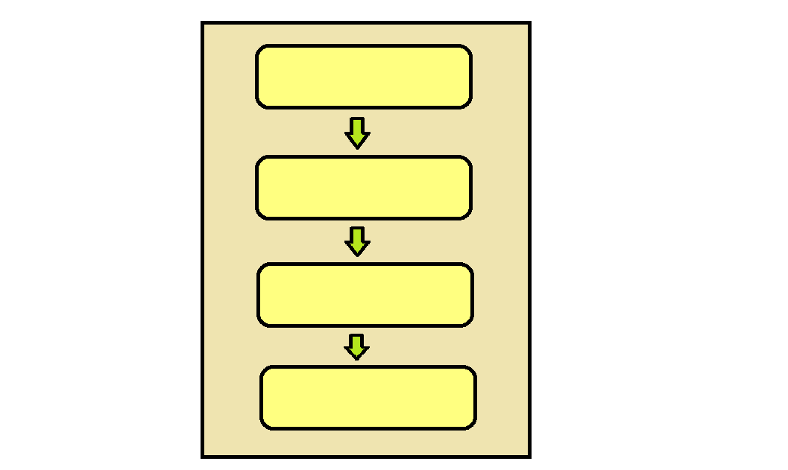
SYSTEM ARCHITECTURE
DATA SOURCE
DATA PREPROCESSING
AI MODEL
USER INTERFACE

Slide 8
SYSTEM ARCHITECTURE
Data Sources: This is where the system collects data from various sources, such as medical records, lifestyle data, and patient demographics.
Data Preprocessing: Data preprocessing involves cleaning the data, selecting relevant features, and scaling them to make them suitable for the AI model.
AI Model: The AI model consists of machine learning algorithms that analyze the preprocessed data to make predictions about diabetes risk.
User Interface: The user interface allows users (patients or healthcare providers) to input relevant data and view the predictions generated by the AI model.
These components work together to create an end-to-end system for diabetes prediction.

Slide 9
CONCLUSION
The AI-based diabetes prediction system is a proactive solution to the problem of late diabetes diagnosis. By applying a design thinking approach, we have developed a system that leverages advanced AI techniques to predict diabetes risk early, enabling timely interventions and personalized healthcare. This system has the potential to improve the lives of individuals at risk of diabetes and enhance the efficiency of healthcare delivery. Early diagnosis is the key to better managing diabetes and reducing its long-term complications, and our AI system is a step forward in achieving this goal.

