Slide 1




Movies Rating EDA
By
Ravi Ranjan
&
Paras Prakash
Notes:
Preface:-

Slide 2
Problem Statement
The dataset is about1000 movie rating. How a movie Producer can determine a combination for making a movie with good rating and good revenue earning?

Slide 3
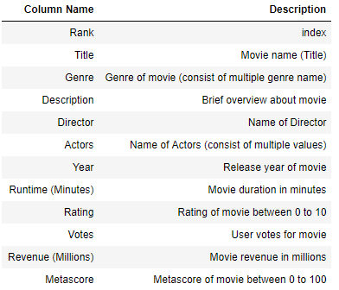
Data Description

Slide 4
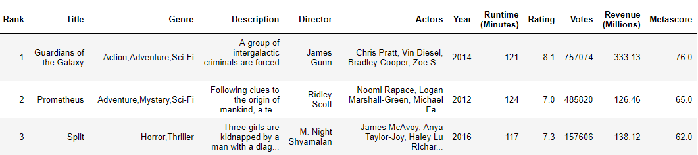
Data Sample

Slide 5
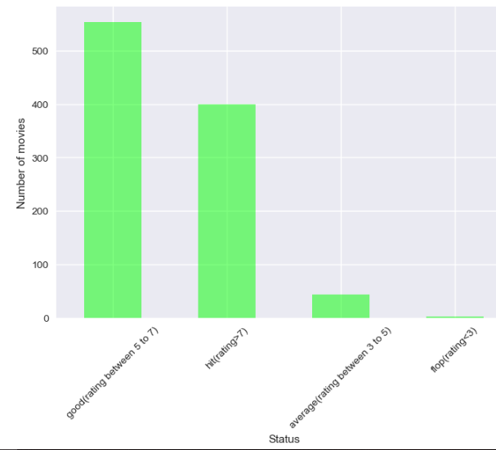
How much hit movies are present in dataset?

Slide 6
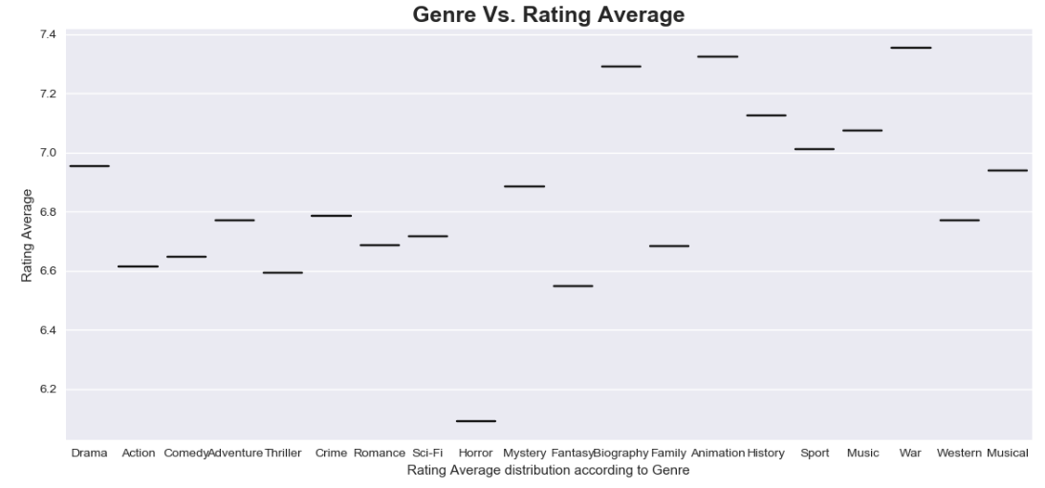
Which genres earn most and least rating?

Slide 7
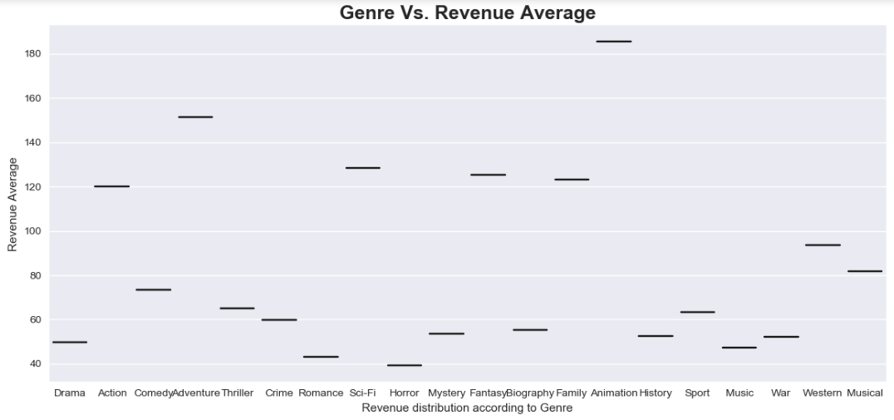
Which genres earn most and least revenues?

Slide 8
What makes gross revenue increase?
Very less number of movies earn more than 400 million.
Revenue increase with number of votes. High number of votes can represent high number of viewers which leads to high revenue earning.
Revenue has medium correlation with rating and Metascore i.e. average rated movies can also earn good revenue.
year doesn't have much impact on revenue earning.

Slide 9
How rating varies with different parameters
Rating doesn't vary much with Number of votes and Runtime of movie.
Rating and Metascore follow a similar pattern.
Rating doesn't have a convincing pattern with year. Most of the Old movies are of good rating but Number of old movies procuced are very less.
More number of new movies are getting average and bad rating than old movies, But, Number of new movies procuced are very high than old movies.

Slide 10
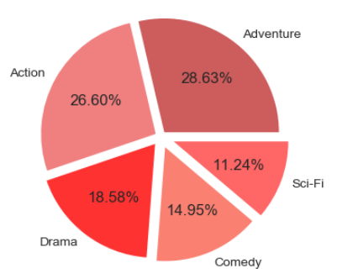
Top 5 Genre contribution in terms of revenue
Taking a sum of the revenue from the top 5 genres

Slide 11
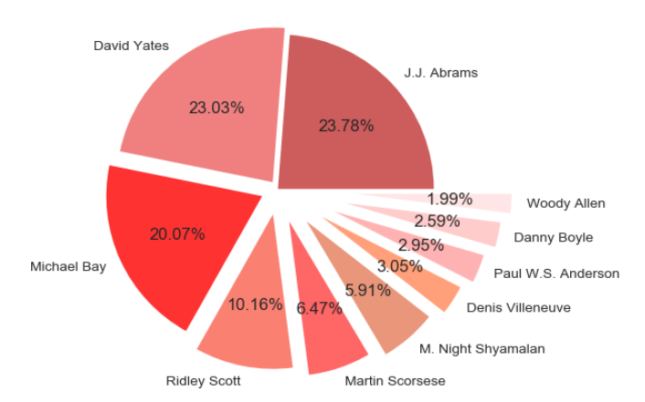
Most Active Directors Revenue Contribution
Taking a sum of the revenue from the top 10 Directors

Slide 12
Conclusion
Good rating movie have good metascore.
Movies in which technologies are used on large scale like scientific, animation, action are earning good revenue
The total revenue for Old movies is less as compared to new movies which depicts more industry exposure to end customers.
To earn good revenue, movie Producers should consider "Director vs revenue", "Actor vs Revenue", "Genre vs Revenue" plot for deciding a combination in a movie. Similar approach should follow for good rating.
Horror movies are not a good choice for good revenue and good rating.
War movies is the best choice for good rating movie.
Sci-Fi, Animation and War are some genres of which movies are good deal for good rating and good revenue.
So if anyone is planning for making a movie then he should consider the 2nd and 4th point in mind before risking anything.

Slide 13
Thank You

