Slide 1
FIFA 2018 Man of the Match Prediction Model
By
Ravi Ranjan & Paras Prakash

Slide 2
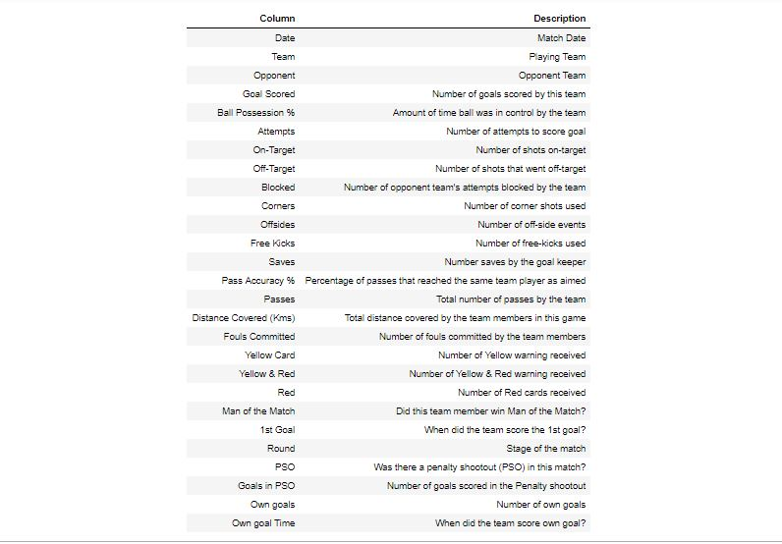
EDA on FIFA 2018 Dataset
The dataset comprises of 128 observations of 27 columns. Below is a table showing names of all the columns and their description

Slide 3
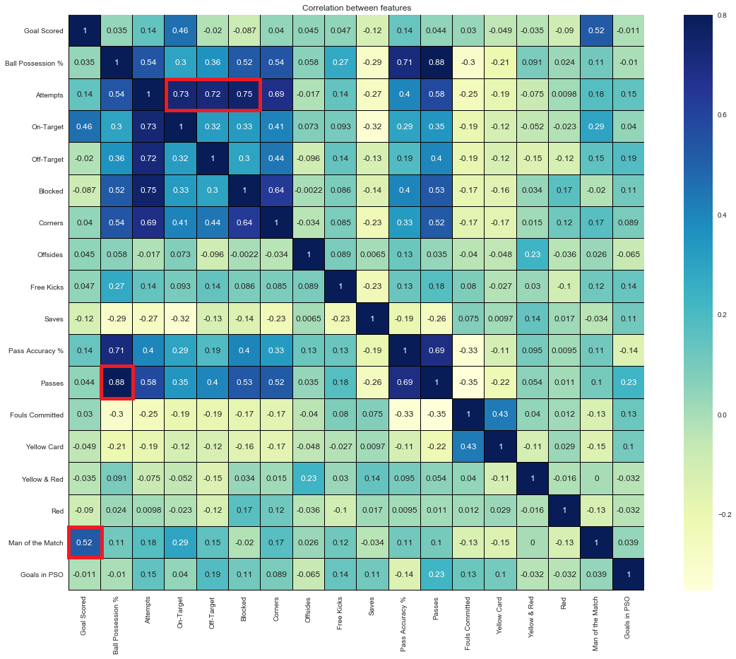
Heat map after pre-processing{NaN removal, data conversion and dropping some columns} of data

Slide 4


Model selection & Accuracy
From above observations, We don't see much correlation between the output(Man of the Match) and input(Rest of the columns). So, We are giving preference to Random Forest on top of Linear regression.
Accuracy score for test data using the Random Forest model with parameter specification: 58 %. Below is the confusion matrix:- [MOM_N means none of the team members got Man of the Match. MOM_Y means one of the team members got Man of the Match]
After further tuning we got the final accuracy score with RandomizedSearchCV as 69%. An increase of roughly 11%. Below is the new confusion matrix:-
the number of correct predictions increased to 18 from 15 and number of false predictions decreased to 8 from 11.

Slide 5
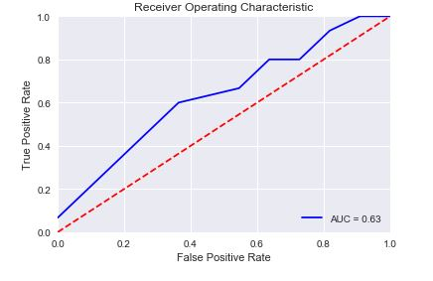
Model Evaluation
Recall score for the final model with parameter specification: 80%
Precision score for the final model with parameter specification: 70.6%
F1 score for the final model with parameter specification: 75%
The AUC score for the final Random Forest RandomizedsearchCV model is 0.63 which is above 0.5

Slide 6
Thank You

