Slide 1
Accent Converter
Listen in your way

Slide 2
Our team:
Priya Sahu (B20AI031)
Soumil Sinha (B20CS071)
Ravi Joshi (B20ME060)
Keshav Mundra (B20CS026)
Chennamsetty Ushakiran (B20MT014)

Slide 3



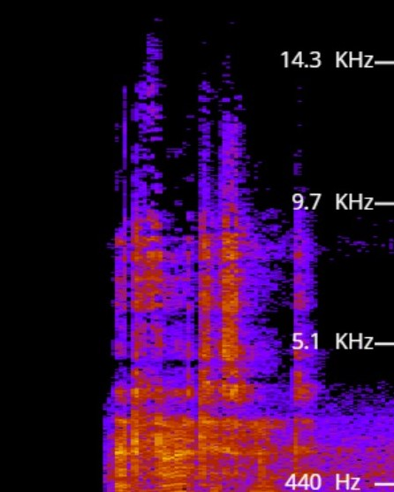
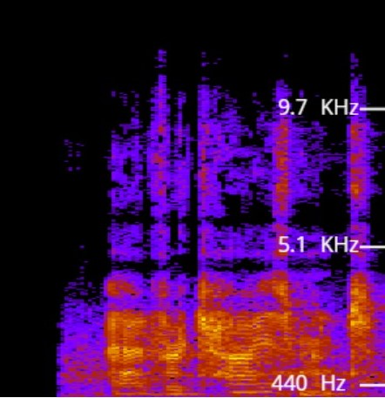

Accent Conversion
Fill accent in which you are speaking
Accent which you want
American(English)
British(English)
American(Eng.)
British(Eng.)
Choose accent
Choose accent
Machine Learning Model

Slide 4
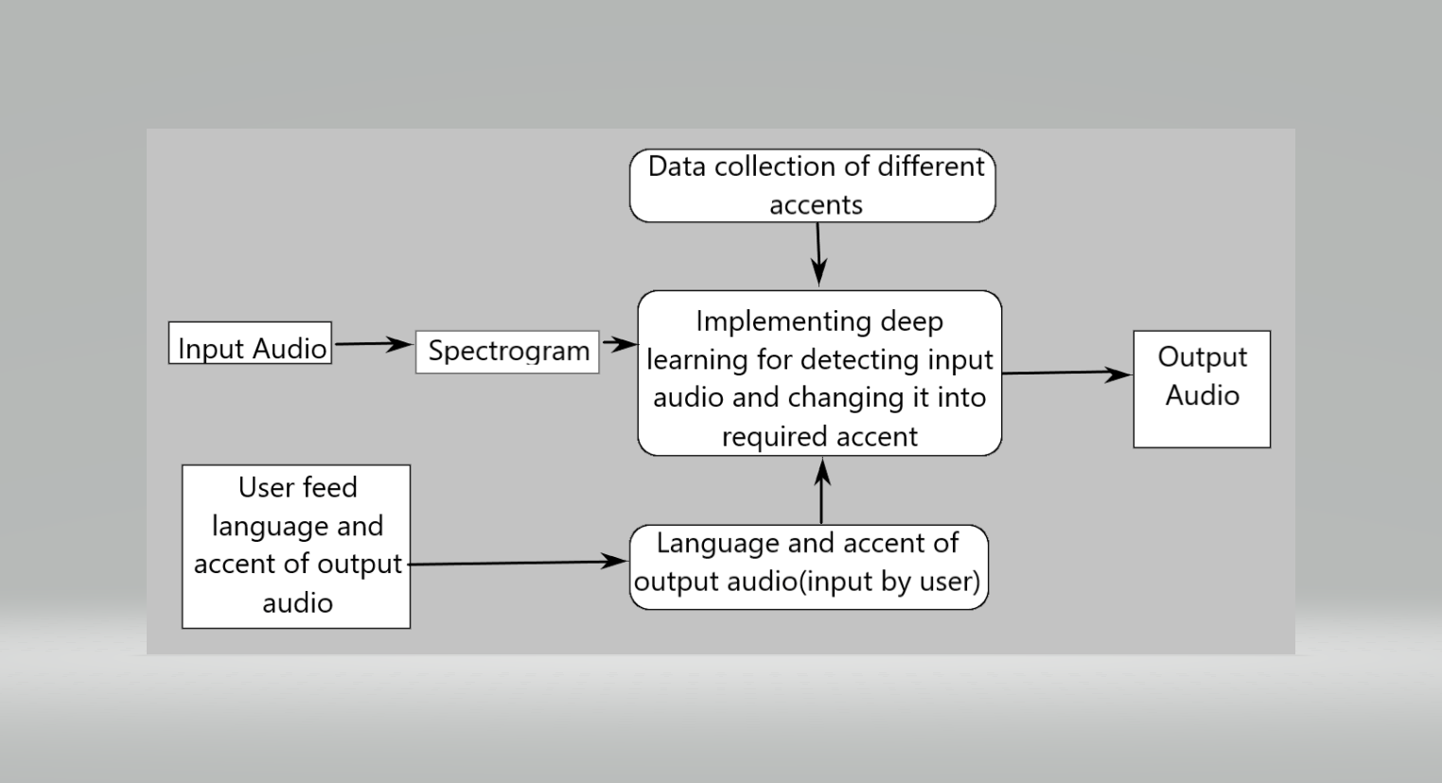
TRAINING OF OUR MODEL

Slide 5
What is the exact role of ML in our project?
It consists of mainly 2 parts - training and testing of the model.
Training part will require an extensive amount of input datasets for making our model more and more accurate.
Input data will consist of alphabets, words and phrases for one and their corresponding tones in one accent and other, in which we want to convert.It will be like a key value relationship between the two accents.
To improve the accuracy of our model, various ML techniques, parameter tuning and l1 and l2 regularization to solve the major problem of overfitting.

Slide 6
The accent modification algorithms are trained in a way that they learn how to modify the spectrogram representing non-native speech to one resembling the same utterance by a native speaker.
The correctness of the modified speech is determined by the accuracy of the speech recognition system trained on a dataset containing native speaker samples, allowing us to evaluate the quality of accent modification.
The criterion which decides whether or not the style-modifying algorithm can perform well is a reduction in the metrics related to the error yielded during the inference using the ASR networks (Automatic Speech Recognition), which were trained on native speaker samples

Slide 7
During the training phase, the autoencoder is fed spectrograms of samples of non-native speakers, whereas the autoencoder’s output is compared against the spectrograms of exactly the same utterances pronounced by native speakers of the particular language.
Then back-propagation causes the autoencoder to learn the conversion of the same words and sentences from the speech containing a non-native accent to the one with the modified accent.
During the inference phase, the input spectrogram created in the first step of our pipeline is fed into the autoencoder as input data.
The output of the autoencoder is a spectrogram which is slightly converted according to the CNN layers’ weights learned after the training.

Slide 8
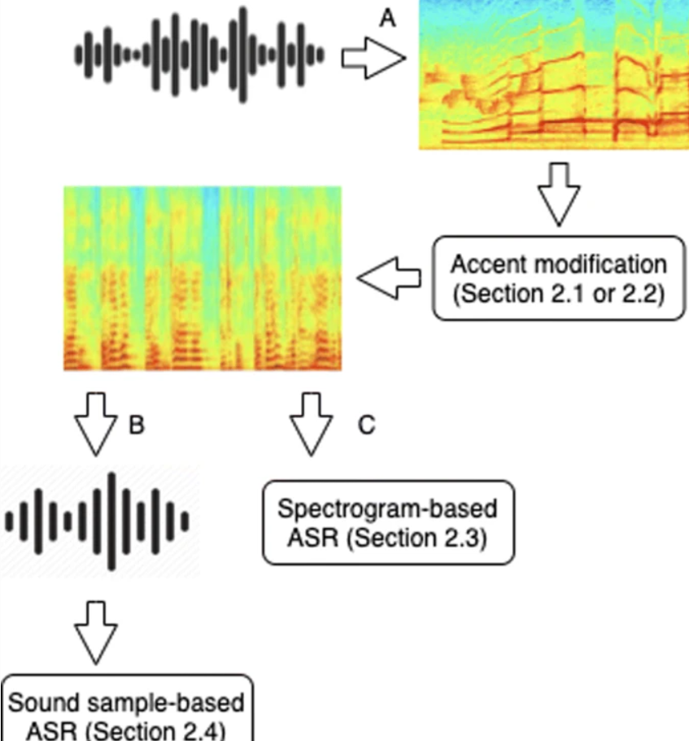

Slide 9
Step 1: Getting our training data for ML model
We have found a voice generator that can generate speech from our text with different accents.
Courtesy: https://www.voicebooking.com/en/free-voice-over-generator
An example:
English UK Accent
English US Accent
English Indian Accent

Slide 10
We provide the target audio while training our model.
For example if the input audio is:
=> English Indian Female Accent
Then the target audio will be:
=> English American Female Accent
The role of the ML Model is to figure out how to convert one audio file to another, using the frequency content that we provide for both the files.
Once it can give comparable results, we will test it out with live recordings.
Later we will deploy it on a server and use an API to connect it to our website.

Slide 11
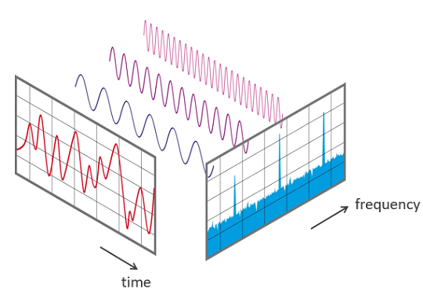
Audio Data Handling using Python
Sound is represented in the form of an audio signal having parameters such as frequency, bandwidth, decibel, etc. A typical audio signal can be expressed as a function of Amplitude and Time.
A typical audio processing process
involves the extraction of acoustics features relevant to the task at hand, followed by decision-making schemes that involve detection, classification, and knowledge fusion. Thankfully we have some useful python libraries which make this task easier.

Slide 12
We found two approach for implementing our idea.
First of all, we need to convert the audio files into PNG format images(spectrograms). From these spectrograms, we have to extract meaningful features, i.e. MFCCs, Spectral Centroid, Zero Crossing Rate, Chroma Frequencies, Spectral Roll-off. Once the features have been extracted, they can be appended into a CSV file so that ANN can be used for classification.
If we want to work with image data instead of CSV we will use CNN. We will convert all our audio files into spectrograms and then will feed those into our CNN model. That model will learn from that.

Slide 13
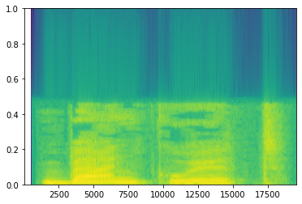
Code for generating input for ML model
import os
import matplotlib.pyplot as
import pandas as pd
#for loading and visualizing audio files
import librosa
import librosa.display
# audio_fpath="audio"
audio_fpath=pd.read_csv("audio.csv")
x_train=[]
for i in audio_fpath:
x, sr = librosa.load(i, sr=44100)
X = librosa.stft(x)
x_train.append(X)

Slide 14
The CNN we use has the following layers
Convolution layer with kernel size : 3x3
Convolution layer with kernel size : 3x3
Max Pooling layer with pool size : 2x2
Dropout layer
Flattening layer
2 Dense layered, Neural Network at the end

Slide 15
AUTOENCODERS FOR AUDIO RECONSTRUCTION
An autoencoder is, by definition, a technique to encode something automatically. By using a neural network, the autoencoder is able to learn how to decompose data (in our case, audio) into fairly small bits of data, and then using that representation, reconstruct the original data as closely as it can to the original.
For handling millions of requests with large data at the same time, streams of data have to be reduced somehow in order for us to be physically able to provide them to users - this is where data compression kicks in.
There are two main types of compression :
Lossless: Data integrity and accuracy is preferred, even if we don't "shave off" much.
Lossy: Data integrity and accuracy isn't as important as how fast we can serve it - imagine a real-time audio transfer, where it's more important to be "live" than to have high quality audio.

Slide 16
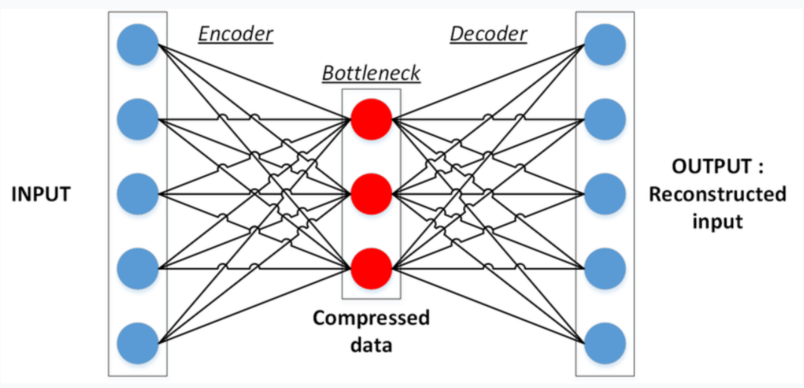
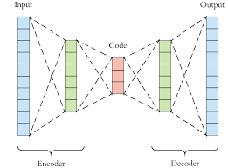
There are two key components in this task:
Encoder: Learns how to compress the original input into a small encoding
Decoder: Learns how to restore the original data from that encoding generated by the Encoder
These two are trained together in symbiosis to obtain the most efficient representation of the data that we can reconstruct the original data from, without losing so much of it.

Slide 17
Autoencoder Structure
• Encoder: compress input into a latent-space of usually smaller dimension. h = f(x)
• Decoder: reconstruct input from the latent space. r = g(f(x)) with r as close to x as possible.

Slide 18
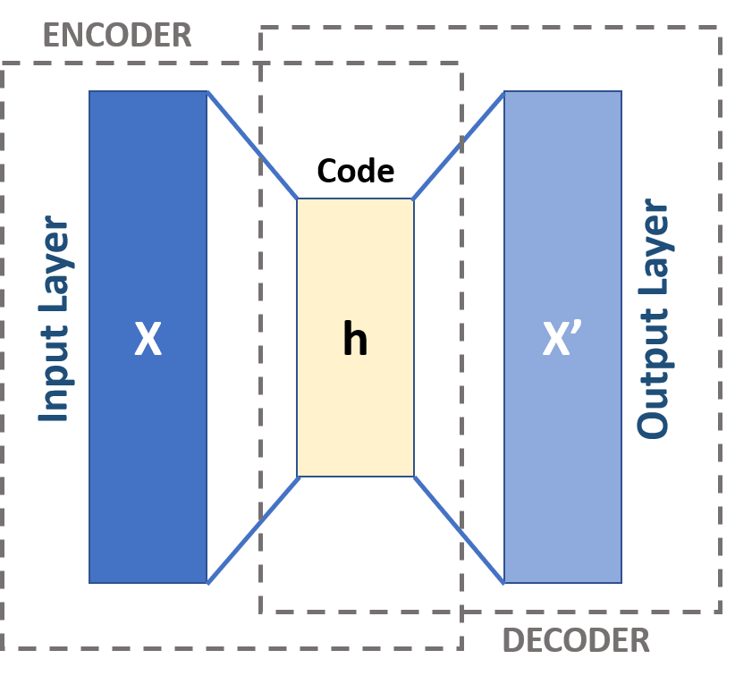
Bottleneck layer of Autoencoder
• Suppose input images are nxn and the latent space
is m < nxn.
• Then the latent space is not sufficient to reproduce
all images.
• Needs to learn an encoding that captures the
important features in training data, sufficient for
approximate reconstruction.

Slide 19
Uses
Autoencoders are designed to reproduce their input, especially for images.
• Key point is to reproduce the input from a learned encoding.
• Compare PCA/SVD
• PCA takes a collection of vectors (images) and produces a usually smaller set of vectors that can be used to approximate the input vectors via linear combination.
• Very efficient for certain applications.
• Fourier and wavelet compression is similar.
• Denoising: input clean image + noise and train to reproduce the clean image.

Slide 20
We have build the model based on autoencoders. We tried to made predictions. We have put all our efforts but yet the results obtained are not perfect. We are done with its base but much work is still to be done which will require more knowledge. We have learned a lot from this project and a lot more is yet to be learnt.
Thank you

