Slide 1
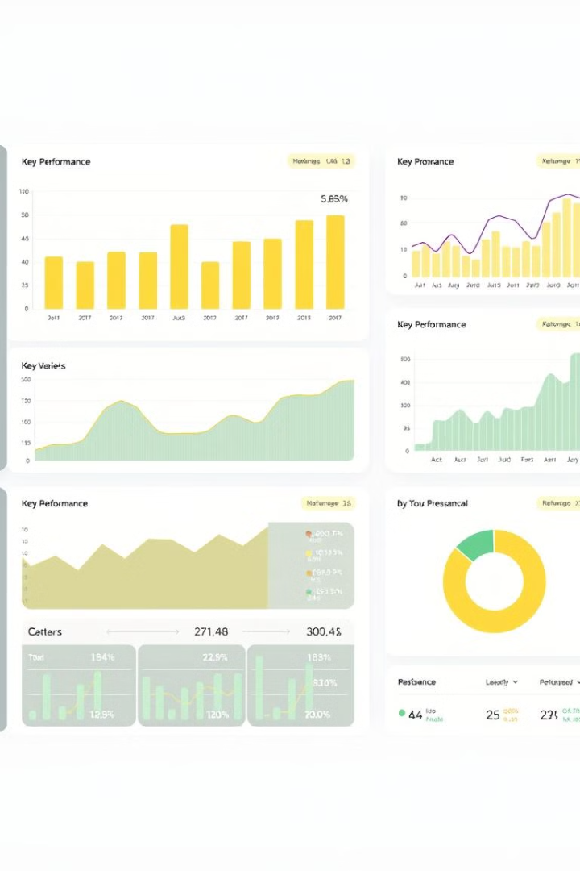

Blinkit Performance Analysis
This presentation outlines a detailed analysis of Blinkit's performance, covering requirement gathering, data processing, dashboard development, and insight generation. We will explore key performance indicators (KPIs) related to sales, customer satisfaction, and inventory distribution. Our goal is to provide actionable insights for optimization and strategic decision-making within Blinkit's operations, enhancing overall efficiency and profitability.

Slide 2

Business Requirements & KPI Metrics
The primary business requirement is to conduct a comprehensive analysis of Blinkit's sales performance, customer satisfaction, and inventory distribution. This involves leveraging various KPIs and visualizations within Power BI to identify opportunities for optimization.
Total Sales
Average Sales
Overall revenue generated from all items sold.
The average revenue per sale.
Number of Items
Average Rating
The total count of different items sold.
The average customer rating for items sold.

Slide 3




Sales Analysis by Item Properties
Several charts are required to analyze different aspects of Blinkit's sales data, focusing on item properties like fat content. These visualizations will provide insights into customer preferences and the impact of product attributes on sales performance.
Sales by Fat Content
Sales by Item Type
Fat Content by Outlet
Metrics such as Average Sales, Number of Items, and Average Rating will be assessed alongside these charts to provide a comprehensive view.

Slide 4





Outlet Performance & Sales Geography
Additional chart requirements focus on outlet-specific metrics and geographic distribution of sales. These insights will help optimize resource allocation and marketing strategies based on outlet characteristics and location.
Sales by Outlet Establishment
Evaluate the influence of outlet age/type on sales.
Sales by Outlet Size
Analyze correlation between outlet size and sales.
Sales by Outlet Location
Assess the geographic distribution of sales.
All Metrics by Outlet Type
Comprehensive view of metrics by outlet types.

