Slide 1

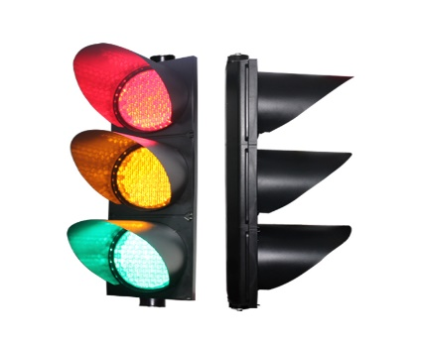
Rajiv Gandhi University of Knowledge of Technologies, Srikakulam
Department of Electronics and Communications Engineering
Mini Project – Batch 02
SMART TRAFFIC LIGHT CONTROLLER
Using Verilog HDL
Presented By :
K Ravi Kumar – S180217
Y Sai Santhoshi – S180066
E Bharath – S180367
J Sandhya – S180486
S Jagadeep Naik – S180458
Guided By :
Mr. Nuthakki Ramesh Babu, M.tech
Assistant Professor, ECE
Rgukt Srikakulam.

Slide 2
Contents :
Objective
What’s New
Specifications
Block diagram
State diagram
RTL Design
Simulation Output
Advantages and Disadvantages
References
Conclusion

Slide 3
Objective :
The main moto of this project is to
design a Four way Smart Traffic Light Controller by
input sensors and alert sensors using Verilog
(Intersection of one Highway road and
one Narrow road).
Abstract :
The main purpose is to make the existing
Traffic Light System a “SMART ONE” by incorporating
the specialised Timers , sensors and alerts to face
any situations wisely.

Slide 4
A Brief Background goes as : A traffic signal with light is first placed in London in 1868 and the purpose of this traffic signal is to help the traffic police especially at night.
Existing System :
Normally placed in Junction Places..
Green ,Yellow and Red lights are used to direct the people on roads
The lights are defined for different directives and will be given different Time intervals to work on…

Slide 5

What’s new :
Timers : These are used to control the traffic efficiently …where the Highway Road is given high preference compared to narrow road which includes less no . of vehicles…And This is done through giving more time space (30 sec)for green light to Highway road and less time(10 sec) for narrow road….
Vehicle Sensors: Senses the vehicles presence…if not the sensor will direct to next road sensor…... Thereby saves the time …
Emergency purposes : If any protocols and emergency situations occurs all the traffic lights will go on RED for certain time period…..like Ambulance Entry , Ministers Entry …
Alerts : Alert 1 internally connected to dividers .. where if there is any collisions due to accidents ,it detects directly contacts to nearby Police Control Room and Hospital .. And Alert 2 detects the collisions between vehicles and perform the same…….

Slide 6

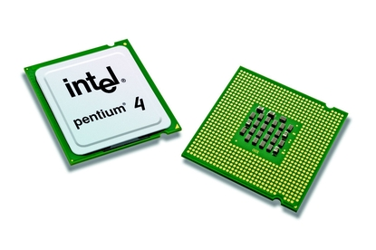
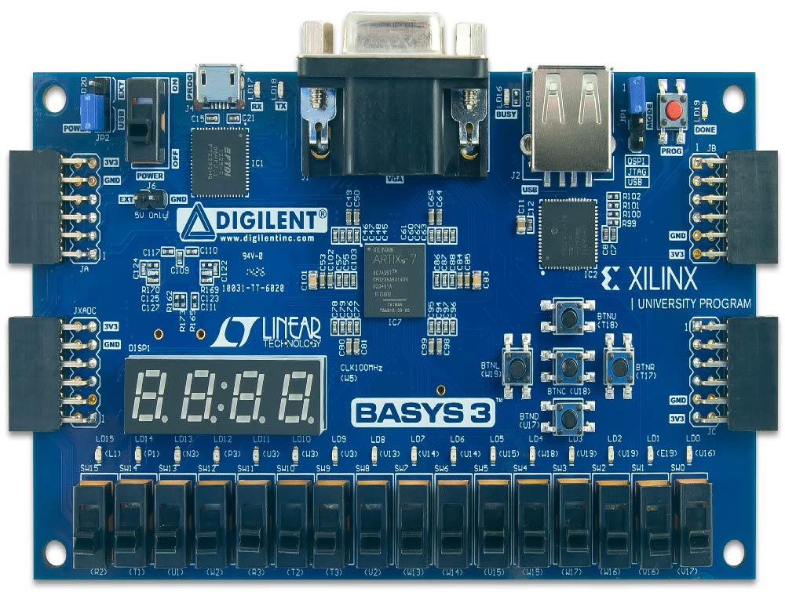
Specifications :
Software Used :
Xilinx Vivado 2018.3
HDL : Verilog language
Hardware Requirements :
Microsoft Windows 10
512 MB RAM
100 MB of available disk space
Intel Pentium 4 Processor or equivalent
or
FPGA Board

Slide 7
Learning Outcomes :
Basics of Digital Electronics
Verilog Coding
Different modelling styles in Verilog
Data flow modelling
Structural modelling
Behavioural modelling
Knowledge on the concept of FSM
Traffic signal controlling system
Concept on design and simulation tool in vivado software
Solutions providing of real time application problems
Project development skills

Slide 8
Block diagram :
Sensor inputs
Direction outputs
SMART
TRAFFIC LIGHT
CONTROLLER
Alerts
Time clock
emergency
clock
ambulance
reset
police

Slide 9
State diagram :
NG=1
sensor_north=0
sensor_west=0
WY=1
S0
NY=1
WY=0
NG=0
S7
S1
WG=0
NY=0
WG=1
S6
S2
EG=1
SY=0
EG=0
S5
S3
SY=1
SG=0
S4
EY=0
EY=1
sensor_east=0
sensor_south=0
SG=1

Slide 10
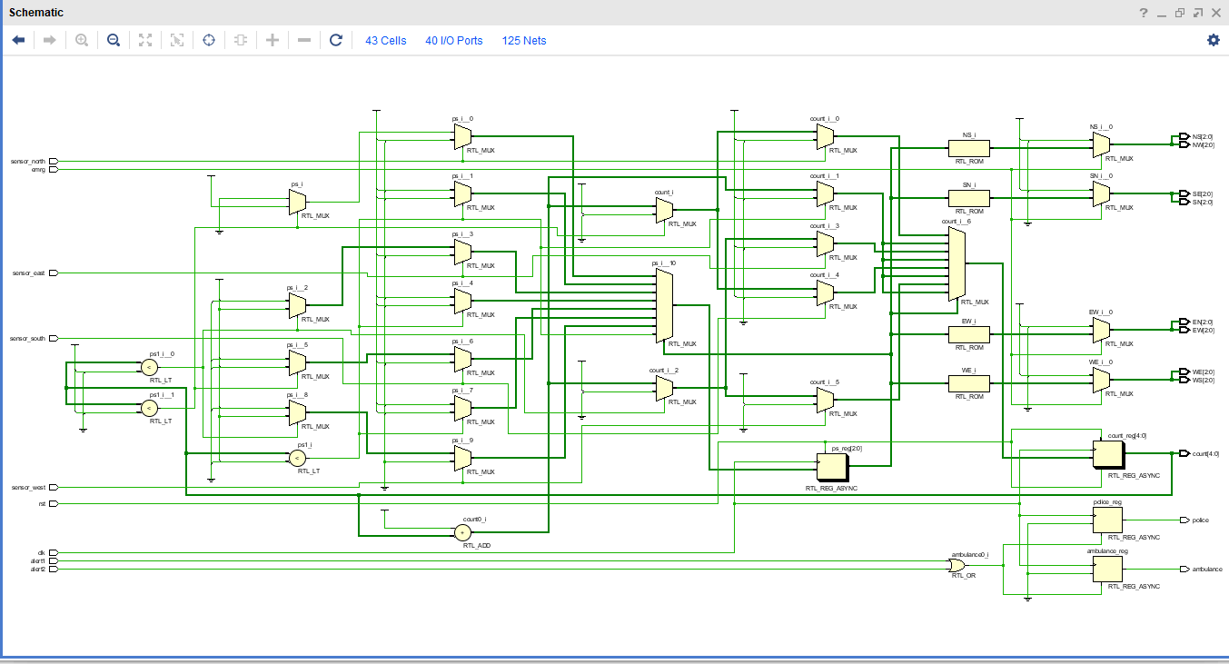
RTL design :

Slide 11
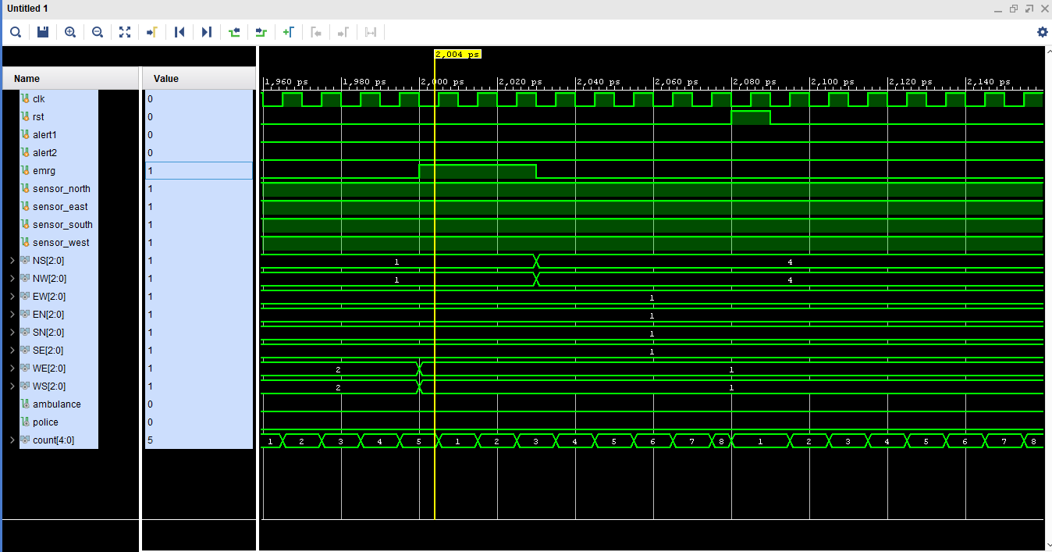
Simulation Output :

Slide 12
Advantages:
Reduction in normal recurring
It improved public transport services
Reduction in emergency response times and safer travel
Improve traffic guidance and traffic flow
Reduce fuel consumption
Less cost
Increase safety by increasing the traffic handling capacity of the intersection using alert sensors
Time management using input sensors

Slide 13
Disadvantages :
Sensors detected short range of area only
They may cause a delay in quick the quick movement of traffics
They delay the traffic by stopping the vehicles at the intersection during peak hours.
During signals breakdown, there are serious and wide-spread traffic difficulties during peak hours.

Slide 14
Conclusion:
In this project, we introduced sensors based technology for traffic light controller.
The Modern ways of Four-Way traffic management improves the traffic condition up to a large extent.
Advanced signalling controllers contribute to the improvement of the urban traffic.
It provides powerful solution to improve existing system with the new smart traffic light controller.
It enables the proposed smart traffic light controller system to realize traffic flow optimization at a single or network junctions.
This system defines more precautions of preventing day to day accidents.
We want to conclude that the smart traffic light controller system is the basic need for today’s busy people or busy world.

Slide 15
References :
Stephen Brown, Fundamentals of Digital Logic with Verilog Design, Third Edition
Google
YouTube
LinkedIn

Slide 16
Thank you….

