Slide 1
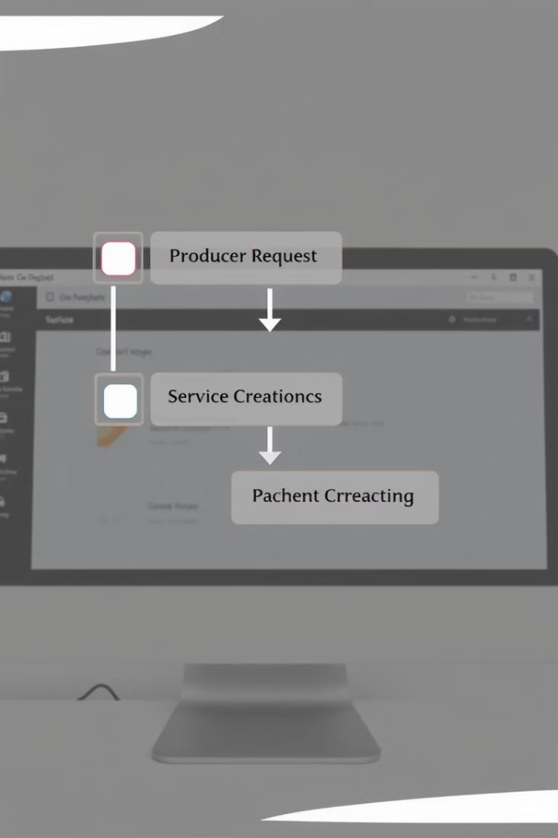

Workflow Diagram: Producer Request to ServiceNow Incident Creation
by Ravi Manicka Raj

Slide 2
Overview of Workflow Stages
Producer Request
Service Creation
Incident Number Fetching
Initiated by website
Processes request to create a ServiceNow incident
Retrieves and uses ServiceNow incident number

Slide 3

Producer Request Stage
1
Initiated by website
2
Captures details: user information, issue description
3
Performs data validation and initial processing
4
Triggers service creation process

Slide 4





Service Creation Stage
Receives data from Producer Request
Processes request to create ServiceNow incident
Interacts with ServiceNow API
Generates unique incident number

Slide 5

Incident Number Fetching Stage
1
Consumer (Windows Service) retrieves incident number
2
Uses incident number for further processing
3
Ensures proper tracking and referencing of the incident

Slide 6
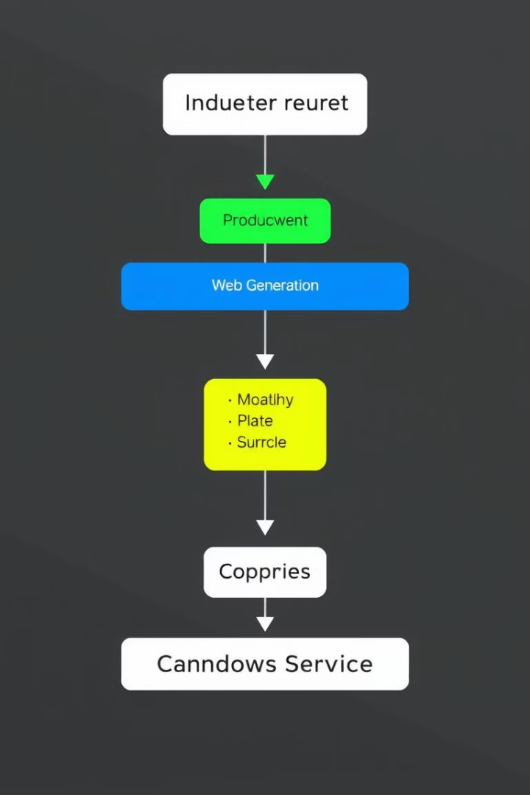




Data Flow Between Stages
Producer Request → Service Creation
Issue details
Service Creation → ServiceNow
Incident creation request
ServiceNow → Service Creation
Incident number
Service Creation → Consumer
Incident number for processing

Slide 7

Key Components and Interactions
Website interface for user input
Application server for request processing
ServiceNow integration for incident creation
Windows Service for ongoing incident management

Slide 8

Summary and Benefits
Streamlined process from user request to incident creation
Automated workflow reduces manual intervention
Improved tracking and management of IT issues
Enhanced user experience and faster resolution times

