Slide 1

INTRODUCTION

Slide 2
What is Spring and why Spring?
Spring framework is an open-source Java platform that provides comprehensive infrastructure support for developing robust Java applications very easily and very rapidly.
Spring could potentially be a one-stop shop for all your enterprise applications. However, Spring is modular, allowing you to pick and choose which modules are applicable to you, without having to bring in the rest.
The Spring Framework provides about 20 modules which can be used based on an application requirement.

Slide 3
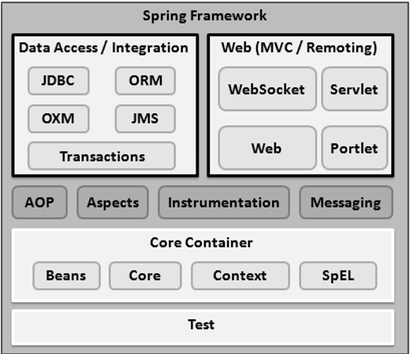

Slide 4
Spring enables developers to develop enterprise-class applications using POJOs. The benefit of using only POJOs is that you do not need an EJB container product such as an application server but you have the option of using only a robust servlet container such as Tomcat or some commercial product.
Spring is organized in a modular fashion. Even though the number of packages and classes are substantial, you have to worry only about the ones you need and ignore the rest.
Testing an application written with Spring is simple because environment-dependent code is moved into this framework.
Spring's web framework is a well-designed web MVC framework, which provides a great alternative to web frameworks such as Struts or other over-engineered or less popular web frameworks.
Spring provides a convenient API to translate technology-specific exceptions (thrown by JDBC, Hibernate, or JDO, for example) into consistent, unchecked exceptions.
Lightweight IoC containers tend to be lightweight, especially when compared to EJB containers, for example. This is beneficial for developing and deploying applications on computers with limited memory and CPU resources.
Spring provides a consistent transaction management interface that can scale down to a local transaction (using a single database, for example) and scale up to global transactions (using JTA, for example).
Notes:
An Enterprise JavaBeans (EJB) container provides a run-time environment for enterprise beans within the application server.
POJO stands for Plain Old Java Object. It is an ordinary Java object, not bound by any special restriction other than those forced by the Java Language Specification and not requiring any classpath. POJOs are used for increasing the readability and re-usability of a program.

Slide 5
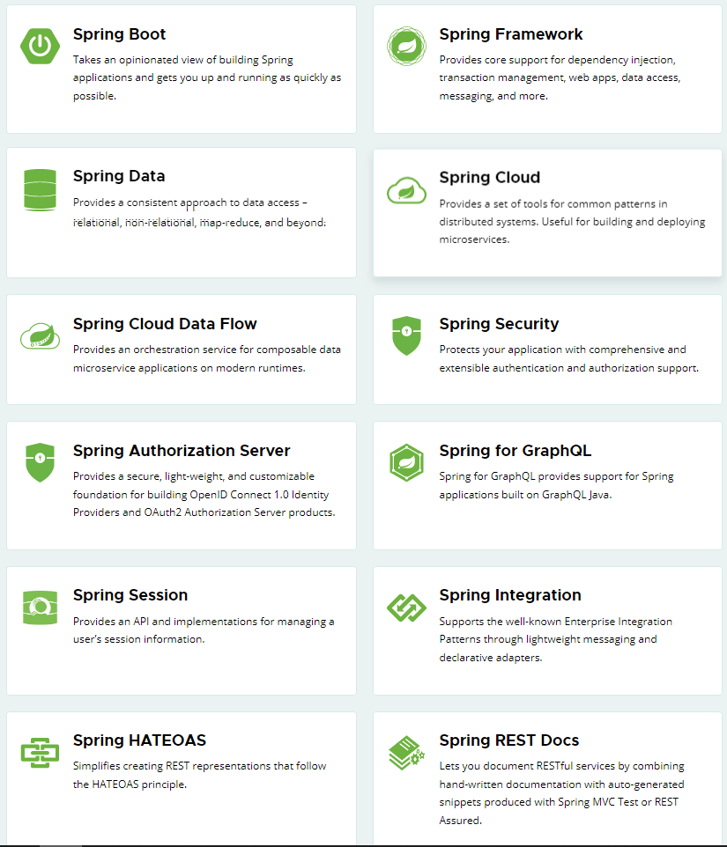
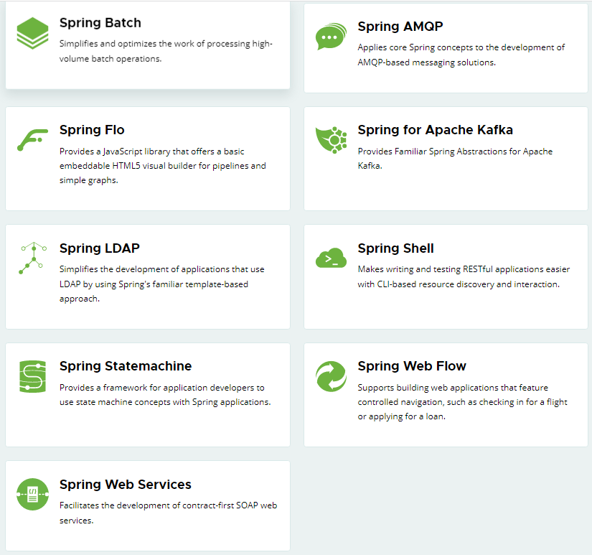
Numerous Projects
From configuration to security, web apps to big data—whatever the infrastructure needs of your application may be, there is a Spring Project to help you build it. Start small and use just what you need—Spring is modular by design.

Slide 6
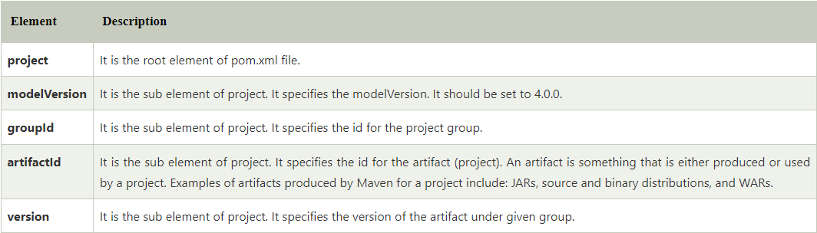
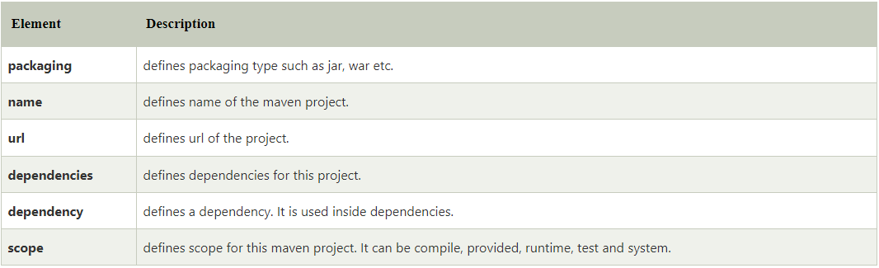
Explaining pom.xml file
Notes:
JAR – Java Archive
WAR – Web Application Resource

Slide 7
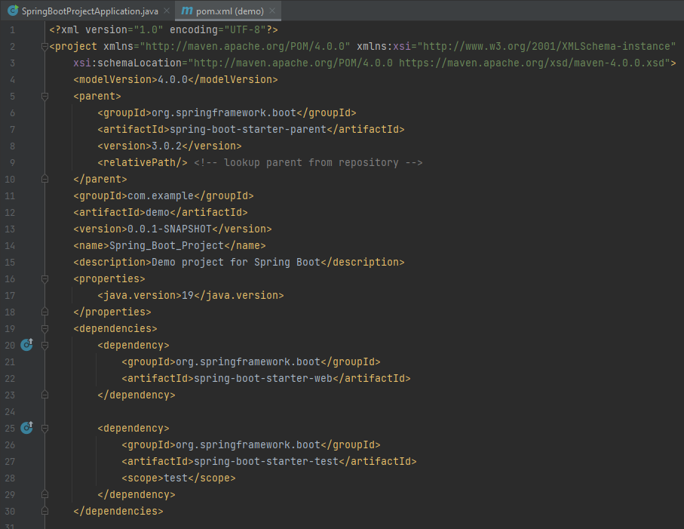
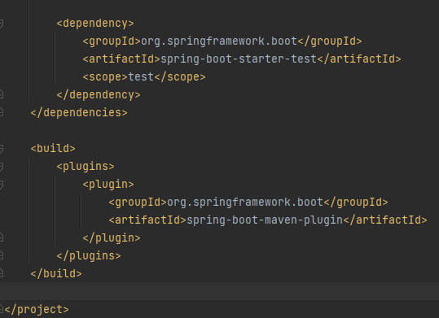
Notes:
Xml – The Extensible Markup Language (XML) is a simple text-based format for representing structured information: documents, data, configuration, books, transactions, invoices, and much more.

Slide 8
Annotations
Spring Boot Annotations is a form of metadata that provides data about a program. In other words, annotations are used to provide supplemental information about a program. It is not a part of the application that we develop. It does not have a direct effect on the operation of the code they annotate. It does not change the action of the compiled program.
The @SpringBootApplication is a combination of three annotations @Configuration (used for Java-based configuration), @ComponentScan (used for component scanning), and @EnableAutoConfiguration (used to enable auto-configuration in Spring Boot).
@RestController Annotation: RestController is used for making restful web services with the help of the @RestController annotation. This annotation is used at the class level and allows the class to handle the requests made by the client.
@GetMapping – It is used to handle GET type of request method.

Slide 9
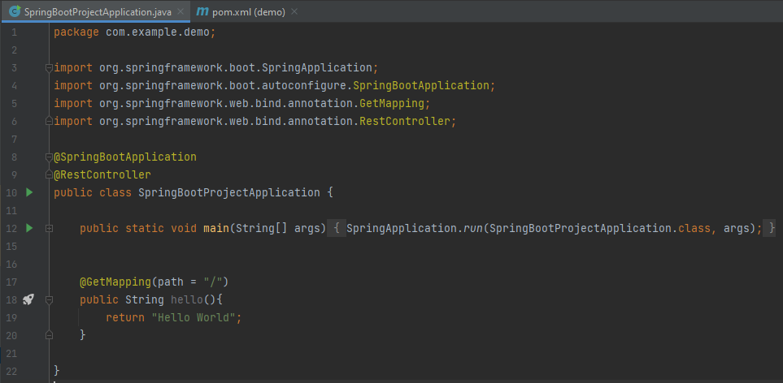
Main file for spring boot application

Slide 10

Thank You
RAVI.PRAKASH2@.FISERVcom

