Slide 1

Input-Output Mapping
via Decision Tree Technique

Slide 2
Mentor: Binod Kumar
Authors: Khobragade Atul Yashwant (B20CS027)
Ravi Ramavat (B20CS053)
Shivi Mathur (B20CS067)

Slide 3
Abstract
Logic synthesis is a fundamental step in hardware design whose goal is to find structural representations of Boolean functions while minimizing delay and area. The project topic is “Input-Output Mapping via Decision Tree Technique”. If we are given an input sequence and an output sequence corresponding to it, we need to find the logic circuit which matches the input-output relations. We have used a decision tree in our solution. With the help of Decision tree We are generating the circuit which can predict output of given input with high accuracy in the care set.

Slide 4

Introduction
Decision Tree Analysis is a general-purpose predictive modelling tool with applications in a variety of fields. Decision Trees are a supervised learning method that may be utilised for both classification and regression applications.
Decision trees are popular representations of Boolean functions. They form the basic inference engine in many well-known machine learning programs .
The task is to obtain a logic circuit that faithfully represents the IO-generator.

Slide 5
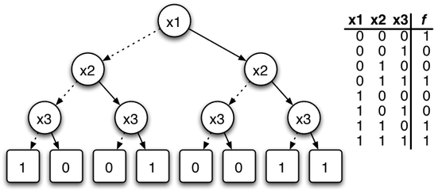
Problem Formulation
Every truth table corresponds to unique Binary decision diagram
If all input-output relations are given..
What to do when some of the input-output relations aren’t given and we have to predict them ?

Slide 6
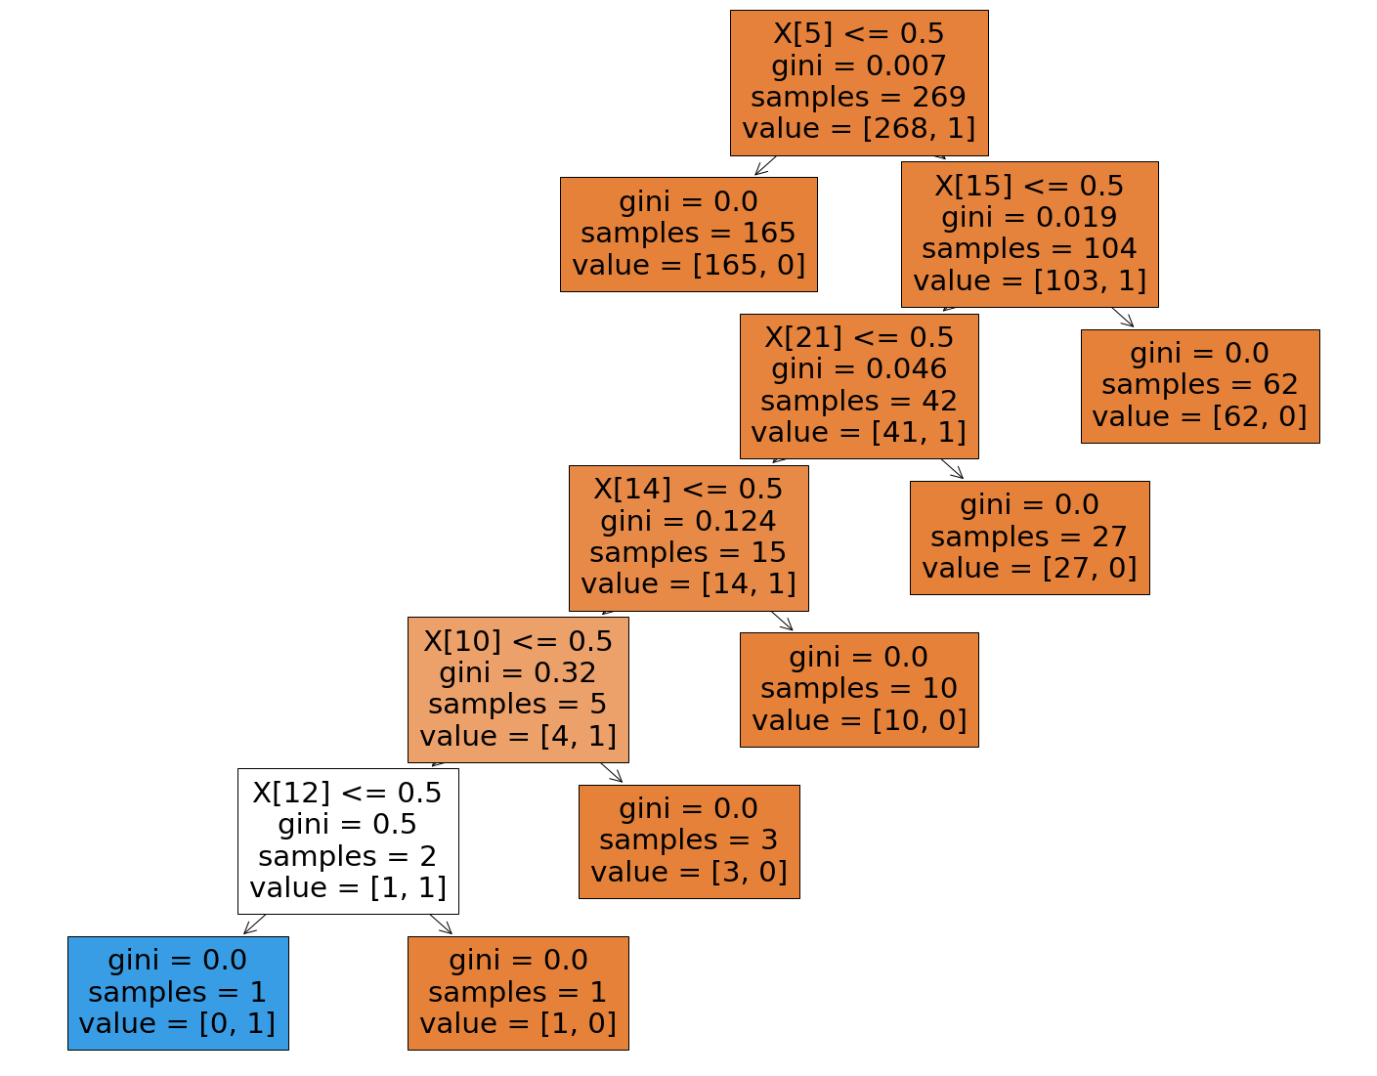
Decision tree Classifier
We can do training on given input and output data and apply a classifier on them.
Why classifier ?
For every output corresponding to every input we need to label it with ‘1’(ON) or ‘0’(OFF).
So it is nothing but a classification problem.
Decision tree classifier creates a decision tree after training which can be used for further
calculations

Slide 7
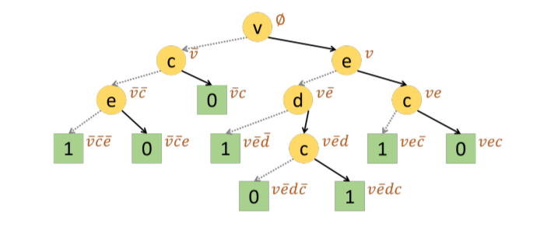
Circuit formulation
Once we get a binary decision tree, we can traverse through this tree and get the minterms.
That means start from the root,reach all the leaves with labelled ‘1’.keep the track of path.
For the shown BDT, minterms would be vec~,ve~dc,ve~d~ and v~c~e~.
So according to the Sum of the products form, the final function is
F = vec~ + ve~dc + ve~d~ + v~c~e~

Slide 8
F = vec~ + ve~dc + ve~d~ + v~c~e~
Further we can define new variables/gates to synthesize the function
i.e. v~ & c~ & e~ = a, v & e~ & d~ = b, v & e~ & d & c = g,
v & e & c~ = h;
Hence F = h + g + b + a.
Where ‘+’ represents the OR gate and ‘&’ represents the AND gate.
That is how we can get physical circuit corresponding to the data set

Slide 9

What to do when there are multiple outputs ?
One of the option is to use multi label decision tree, but if we do so circuit formulation becomes complex.
Plus in the problem statement it is mentioned that all the outputs are independent of each other. So they can be calculated separately. In a for loop,we have trained the dataset for the output one by one,and keep storing all the output string .
So after training of all the output is done we can synthesize all the output string into the final circuit.
That’s how we have handled the multiple outputs problem.

Slide 10

Justification of the selected methodology
This is a classification problem. Since the output is binary, we can classify the inputs, “zero” and “one”.
If there are multiple outputs, we can classify them into multiple labels.
Where priority of asking questions on input variables a,b,c etc. is decided by training of decision tree classifiers on training data.
Also Decision trees are relatively straightforward to create the circuit in comparison of other techniques

Slide 11
Result and Analysis
Decision Trees turned out to be very useful to learn from input-output boolean data and used to map it with the circuit. The accuracy is different for different datasets and it also depends on splitting of testing and training data.
In most cases our overall accuracy was found to be more than 90%.
Resultant circuits and accuracies of model on all of the datasets on which we have run our model are in the report.

Slide 12
Sources and References
These are some sources and references that were really helpful to us :
ICCAD-contest problem A :
http://iccad-contest.org/2019/Problem_A/2019ICCAD_ProblemA_V9_total.pdf
Paper on multi class decision tree:
https://link.springer.com/content/pdf/10.1007/s10115-021-01565-5.pdf
ICCAD-contest problem A top 3 solutions:
http://iccad-contest.org/2019/winners.html

Slide 13
Thank You

