Slide 1
MODULES, HANDLERS AND FILTERS in .NET core
- ADITYA JAMDADE

Slide 2
MODULES
HTTP Modules are components that are part of the ASP.NET request processing pipeline.
They are registered globally and are executed for every incoming HTTP request to the application.
They provide a mechanism to handle global concerns and allow developers to inspect, modify, or even terminate incoming HTTP requests before they reach a handler.
We can create a custom module by implementing the IHttpModule interface.

Slide 3
HANDLERS
Handlers process requests for specific file types or resources.
They are lower in the request pipeline than modules and focus solely on handling requests and returning responses.
Custom handlers are defined by implementing the IHttpHandler interface and registering them in the web.config file.
USE CASE - serving custom files (images, PDF, JSON, etc.)

Slide 4
Filters
Filters are used to hook into the action execution process in MVC/Web API controllers.
Filters allow you to run logic before and after an action method is executed.
Types of Filters:
Authorization Filters: Run before the action to handle authorization.
Action Filters: Run before and after the action method executes.
Result Filters: Run before and after the result is executed.
Exception Filters: Handle exceptions during action execution.
Example: Logging filter: Logs the execution details of a controller action.

Slide 5
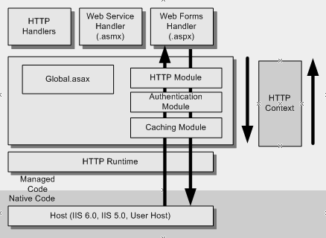
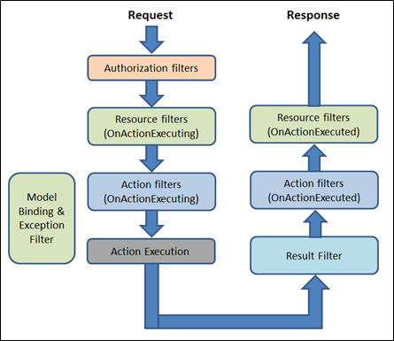

Slide 6
CONCLUSION
Modules, handlers, and filters each play a crucial role in the request processing pipeline in .NET applications.
Modules focus on handling requests globally, handlers process specific types of requests (e.g., serving files or API responses), and filters provide hooks for applying cross-cutting concerns (e.g., logging, validation, and error handling).

Slide 7




THANK YOU
(844) 720-6678
info@simplifyhealthcare.com
simplifyhealthcare.com
Simplify Healthcare
U.S.: 600 N Commons Drive, Suite 110, Aurora, IL 60504
India: 401/402, 4th Floor, Pentagon P-2, Magarpatta City, Pune 411013
CONNECT WITH US
LinkedIn
YouTube
X
Instagram

