Slide 1
Garbage Collection (GC)
Chinmay S. Lute

Slide 2

Garbage Collector (GC)
During lifetime of Applications dynamic memory allocation is taken place on Heap.
Application Developer is accountable for explicit memory management in C. C++ applications .
Java and C# (modern programming languages) use Automatic Memory Management using GC.
In .NET, Garbage Collector (GC) responsible
for reclaiming memory occupied by objects that are no longer in use
(i.e., objects that are no longer referenced by the application).
GC eliminates the need for developers to manually manage memory allocation and deallocation
Use of GC reduce the risk of memory leaks and other memory-related issues.

Slide 3

How Garbage Collector works?
Heap Allocation: When an object is created in .NET. This is where the memory objects is stored.
Reference Tracking: The Garbage Collector tracks references to objects to determine which objects are still reachable and in use by the application. Objects that are no longer reachable are considered eligible for garbage collection.
Garbage Collection Process: Periodically, or when certain conditions are met (such as when the heap becomes full), the Garbage Collector executes a collection cycle.
Generational Garbage Collection: .NET Core's Garbage Collector uses a generational garbage collection algorithm.
Finalization: Some objects may require cleanup operations before they are reclaimed.
Tuning and Optimization: .NET Core provides various options for configuring and optimizing the behavior of the Garbage Collector.

Slide 4
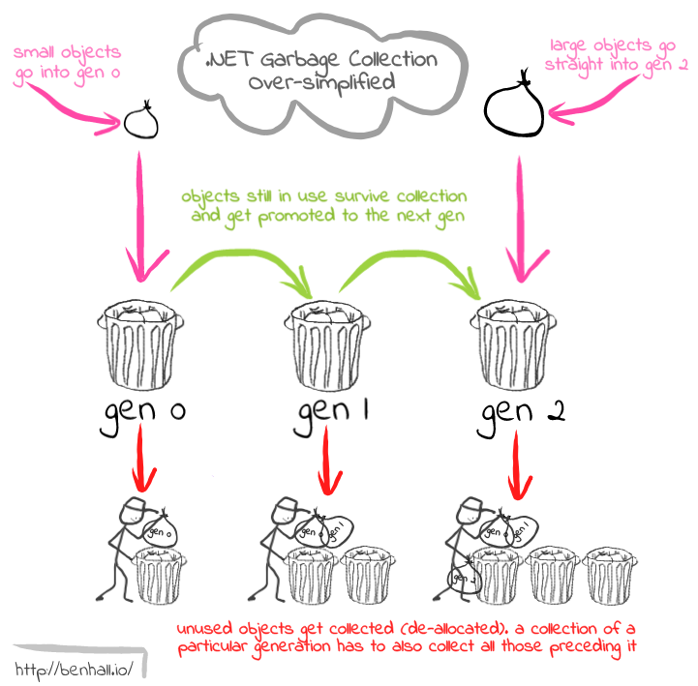
Generational Approach
The GC uses a generational approach to optimize performance.:
Generation 0:
Newly allocated objects.
Most objects are collected here because they tend to have a short lifespan.
Generation 1:
Objects that have survived one GC collection.
These objects are promoted to Generation 1.
Generation 2:
Objects that have survived multiple collections.
These are the long-lived objects, and the GC runs less frequently on this generation.

Slide 5
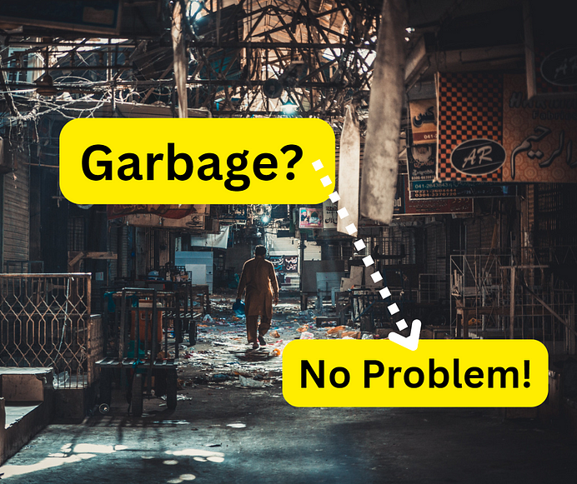
Finalization
Finalization
Is a process where an object is cleaned up before it is garbage collected.
Finalization Types:
Deterministic and non-deterministic.
Deterministic finalization
Ability to explicitly release resources (such as file handles, database connections, etc.)
at a known point in time, when you're done using an object.
Non-deterministic finalization
Automatic releasing resources by garbage collection implicitly.
We cannot predict exactly when it will happen
Due to GC behaviour Demon Thread.

Slide 6
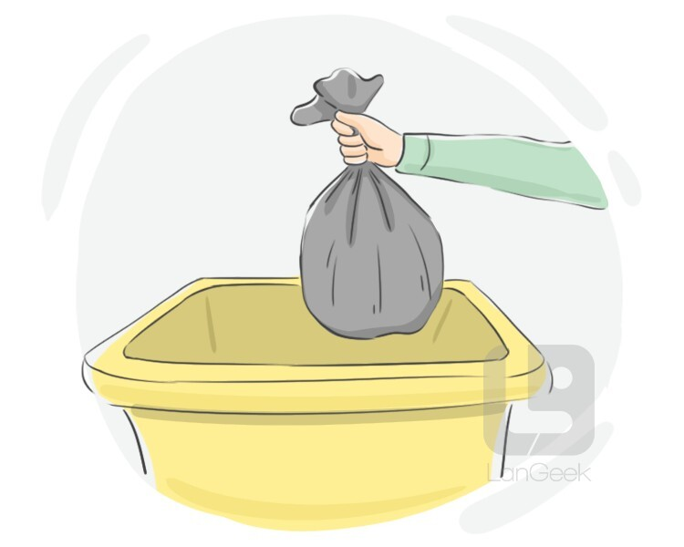
Deterministic finalization
public class DbManager : IDisposable
{
private bool disposed = false;
public void Dispose()
{
//release resources
GC.SuppressFinalize(this); }
}
~ DbManager() {
// release resources
}
//main code
Using( DbManager mgr= new DbManager)
{
…..
}

Slide 7




THANK YOU
(844) 720-6678
info@simplifyhealthcare.com
simplifyhealthcare.com
Simplify Healthcare
U.S.: 600 N Commons Drive, Suite 110, Aurora, IL 60504
India: 401/402, 4th Floor, Pentagon P-2, Magarpatta City, Pune 411013
CONNECT WITH US
LinkedIn
YouTube
X
Instagram

