Slide 1
Layered Architecture in Web Applications Pratiksha Adatkar

Slide 2
What is Layered Architecture?
Definition: Layered architecture is a software design pattern that separates an application into layers, each with a specific responsibility. This separation makes applications easier to manage, maintain, and scale.
Common Layers in Web Applications:
Presentation Layer (UI Layer): Handles user interactions and displays the UI.
Business Logic Layer (BLL): Processes user input, applies business rules, and handles data operations.
Data Access Layer (DAL): Manages interaction with the database or external data sources.
Database Layer: Stores the data and supports data queries and operations.
Presentation Layer
Business Logic Layer
Data Access Layer
Database Layer

Slide 3
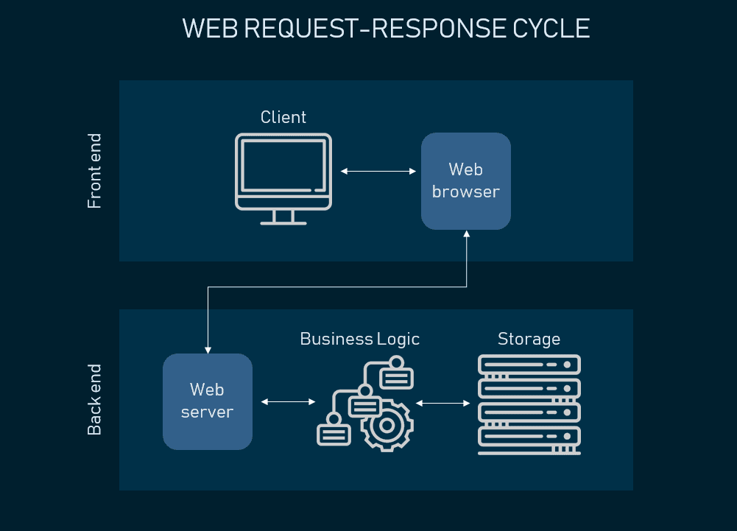
Presentation Layer and Business Logic Layer (BLL)
Presentation Layer (UI):
The first point of contact with the user.
In ASP.NET , this layer is managed through Views, Controllers, and Razor Pages.
It interacts with the BLL to fetch data, which it then displays to the user.
Business Logic Layer (BLL):
Handles the core business rules and logic of the application.
It performs data validation, calculations, and other operations needed to meet business requirements.
In ASP.NET , the BLL can be organized into Services or Managers.

Slide 4
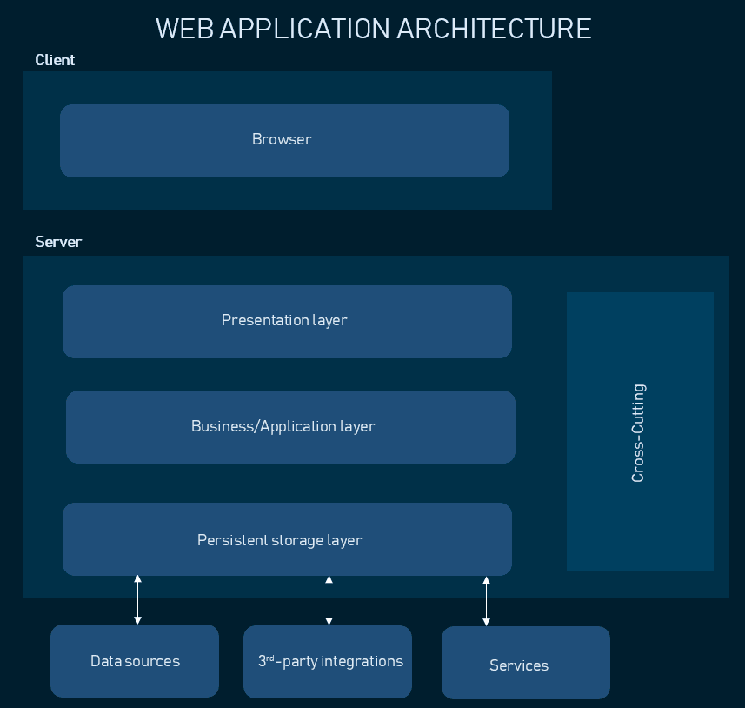
Data Access Layer (DAL) and Database Layer
Data Access Layer (DAL):
This layer is responsible for communicating with the database.
It encapsulates database access, ensuring that other layers are not tightly coupled with database-specific code.
In ASP.NET , Entity Framework is commonly used in the DAL for Object-Relational Mapping (ORM).
Database Layer:
The database layer contains the actual data. It's typically implemented using SQL databases (like SQL Server, PostgreSQL, MySQL) or NoSQL (MongoDB, etc.).
DAL queries are applied to the database using SQL or LINQ .

Slide 5
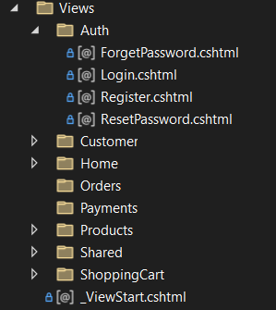
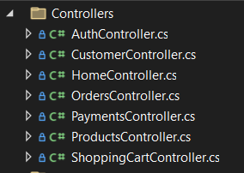
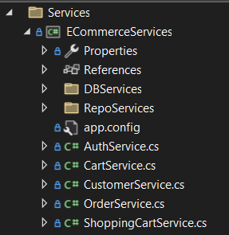
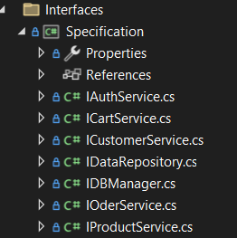
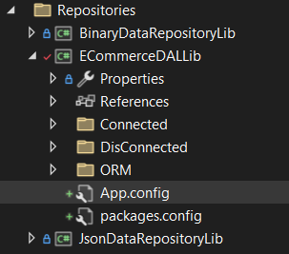
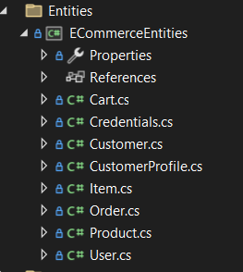
Example of Layered Architecture in Ecommerce Application
Presentation Layer
Business Logic Layer
DB
Data Access Layer
Database Layer

Slide 6
Advantages and References of Layered Architecture:
Advantages
Separation of Concerns: Each layer focuses on a specific responsibility.
Maintainability: Changes in one layer don't affect others.
Reusability: Business logic and DAL can be reused across different UI technologies.
Scalability: Layers can be scaled independently, such as increasing the database capacity.
Testability: Layers can be tested independently.
References
https://learn.microsoft.com/en-us/aspnet/core/mvc/
https://learn.microsoft.com/en-us/aspnet/core/
https://learn.microsoft.com/en-us/ef/core/

Slide 7




THANK YOU
(844) 720-6678
info@simplifyhealthcare.com
simplifyhealthcare.com
Simplify Healthcare
U.S.: 600 N Commons Drive, Suite 110, Aurora, IL 60504
India: 401/402, 4th Floor, Pentagon P-2, Magarpatta City, Pune 411013
CONNECT WITH US
LinkedIn
YouTube
X
Instagram

