Slide 1
ASP .NET Application Execution Flow Shruti Kadam

Slide 2
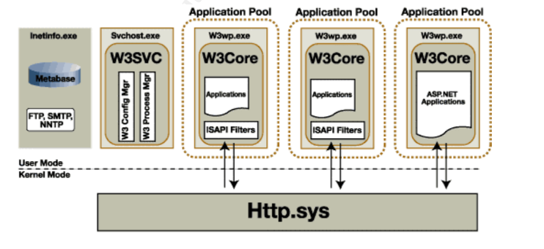
IIS as a Web Server for Web App Hosting
IIS (Internet Information Services) is a web server installed on windows server for hosting Web Application.
Remote Web user requests are received using http.sys and passed to IIS server (inetinfo.exe).
IIS consist of Virtual directory to maintain Web Applications List along with Application pool.
Application pool maintains a container of work process (w3wp.exe)
IIS forwards requests to ASP.NET for dynamic content generation based on the URL path, mapping the request to an appropriate handler (e.g., ASPX, MVC Controller, Web API) inside w3wp.exe.
Application Pools:
IIS isolates applications into separate pools to ensure that each application runs in its own process, providing better security and stability. A request for an ASP.NET application is routed to the appropriate application pool.

Slide 3
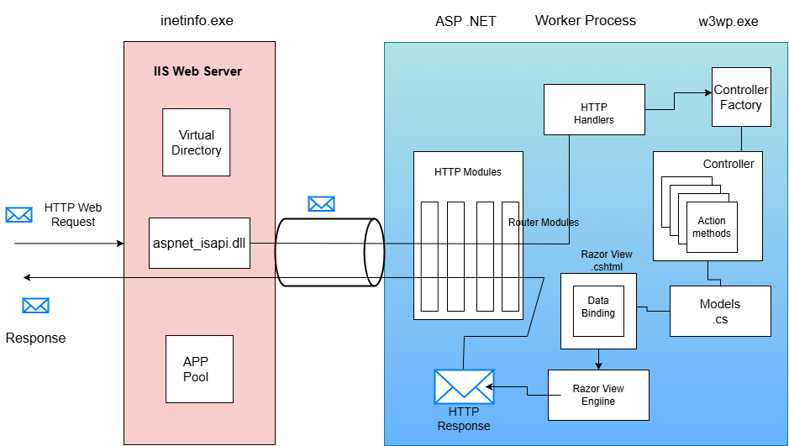
Application Execution Flow

Slide 4
COMPONENTS
Application Pool : It is the container of the worker processes. It takes the request of the specific application from the virtual directory.
Worker Process: W3WP.exe runs the ASP .NET application in IIS. Each application will a worker process and a separate w3wp.exe file.
Virtual Directory : It is a table in IIS server that stores the details about the server applications. It contains the port number , physical address and website .
HTTP Modules : They are classes that have access to the incoming request . There are some http modules like Authentication , Session , Output caching , Routing etc.
Controllers : Contains the action methods
Models
Data Binding : We can perform model binding here .
Razor View Engine : The specified view is sent to view engine for processing and sending the equivalent web response to the client through the http modules back.
Application Lifecycle: Includes initialization, handling, rendering, and cleanup.
MVC/Web Forms/Web API Handling:
For Web Forms: Page lifecycle (Init, Load, Render, Unload).
For MVC/Web API: Routing to controllers, action execution, view rendering/response generation.
Middleware (ASP.NET Core): Additional processing steps for request/response handling.

Slide 5
FINAL RESPONSE AND CLIENT INTERACTION
Response Generation: ASP.NET generates a dynamic response (HTML, JSON, etc.).
IIS Final Processing: IIS may apply additional features like caching or compression before sending the response.
Client Receives Response: The client’s browser processes the response and renders the output (HTML page, JSON, etc.).

Slide 6




THANK YOU
(844) 720-6678
info@simplifyhealthcare.com
simplifyhealthcare.com
Simplify Healthcare
U.S.: 600 N Commons Drive, Suite 110, Aurora, IL 60504
India: 401/402, 4th Floor, Pentagon P-2, Magarpatta City, Pune 411013
CONNECT WITH US
LinkedIn
YouTube
X
Instagram

