Slide 1
Command Design Pattern

Slide 2
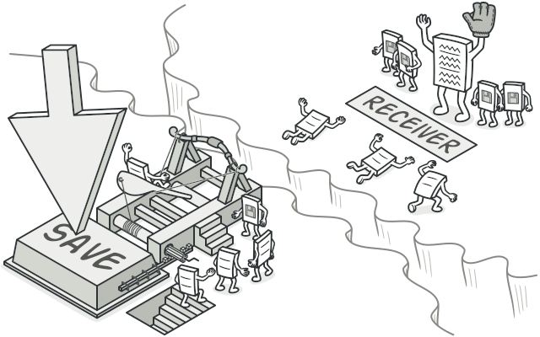
Command Design Pattern
A behavioural design pattern.
Purpose: Turns a request into a stand-alone object containing
all the request's information.
Key Features:
Pass requests as method arguments.
Delay or queue request execution.
Support undoable operations.

Slide 3
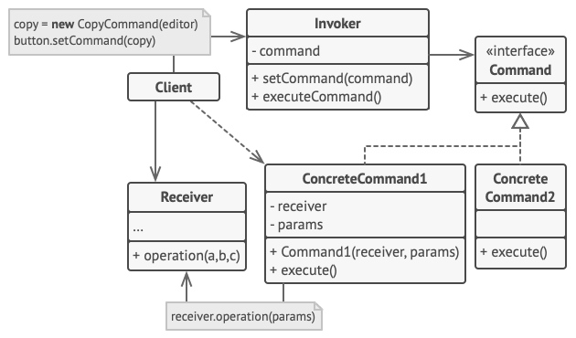
Structure of Command Pattern
Command Interface:
Declares a method for execution (e.g., Execute, Undo).
Concrete Command:
Implements the command interface.
Encapsulates the request and links it to the receiver.
Receiver:
Performs the actual work when the command is executed.
Invoker:
Holds and triggers commands. Example: Button, Menu,Shortcut.
Client:
Configures commands and assigns them to invokers.

Slide 4
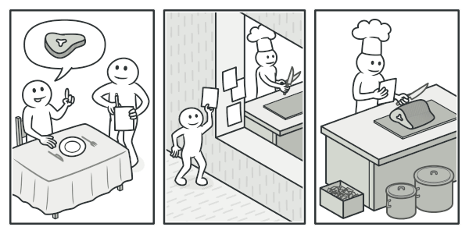
Real-World Analogy: Order in Restaurant
You (Client):
Place an order at the restaurant (request for service).
Waiter (Invoker):
Takes your order and delivers it to the kitchen. Does not prepare the food but knows how to forward the order.
Order Slip (Command):
Encapsulates all details of the request (meal, preferences).Serves as an intermediary between you and the chef.
Chef (Receiver):
Reads the order slip and prepares the meal.Executes the actual task (cooking).
Result:
You get your meal without directly interacting with the chef..

Slide 5
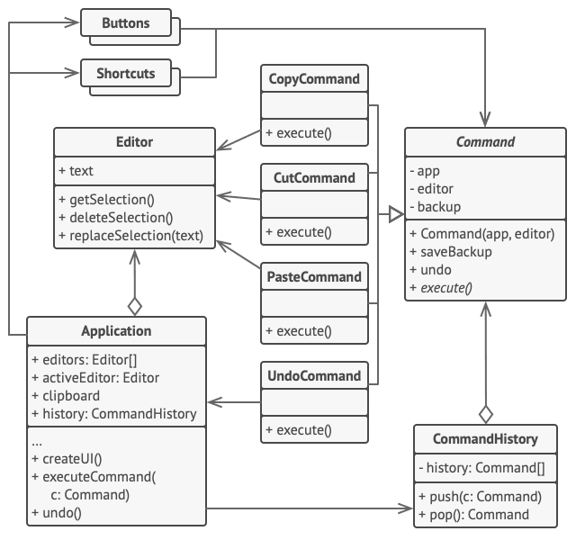
Tool Buttons Example
Problem
GUI elements (Buttons/Shortcuts) are tightly coupled with the editor's business logic.
Leads to rigid and hard-to-maintain code.
Common operations (e.g., Copy, Paste) need to be implemented in multiple places.
Adding new actions or features requires modifying multiple classes.
Difficult to implement undo/redo functionality without cluttering the code.
Solution
Encapsulate each operation as a Command object (e.g., CopyCommand, PasteCommand).
Separate GUI triggers (Buttons, Shortcuts) from the actual business logic.
Maintain a history of executed commands to enable undo functionality.
Reuse the same commands across multiple invokers (e.g., Toolbar, Menus, Shortcuts).

Slide 6
Pros and Cons
Pros
Decouples Sender and Receiver: Separates GUI elements (e.g., buttons) from the business logic.
Encapsulation: Each command object encapsulates a specific operation.
Reusability: Commands can be reused across multiple triggers (e.g., toolbar, shortcuts, menus).
Undo/Redo Support: Easy to implement undo and redo by storing commands in a history.
Scalability: Adding new commands requires minimal changes to existing code.
Flexible Queuing and Logging: Commands can be queued, delayed, or logged independently.
Cons
Increased Complexity: Introduces additional classes (commands for each operation).
Overhead: May lead to extra memory usage due to command objects and history tracking.
Learning Curve: Requires understanding of design pattern concepts, which may be challenging for new developers.
Overengineering: Might be unnecessary for simple applications.

Slide 7
When to use
Use Cases
Decoupling GUI and Business Logic:
When you need to separate user interface elements (e.g., buttons) from the underlying operations.
Undo/Redo Functionality:
Ideal for applications like text editors, where users need to revert or repeat actions.
Macro Commands:
When you want to execute multiple commands in a sequence (e.g., batch operations).
Request Queuing and Logging:
Useful when requests need to be queued, delayed, or logged for audit purposes.
Dynamic Commands:
When you need to change or configure commands at runtime.
Reusable Actions:
Commands that can be triggered from multiple sources (e.g., toolbar, context menu, shortcuts).
Complex Operations:
When the operations involve multiple steps and should be encapsulated as a single unit.

Slide 8




THANK YOU
(844) 720-6678
info@simplifyhealthcare.com
simplifyhealthcare.com
Simplify Healthcare
U.S.: 600 N Commons Drive, Suite 110, Aurora, IL 60504
India: 401/402, 4th Floor, Pentagon P-2, Magarpatta City, Pune 411013
CONNECT WITH US
LinkedIn
YouTube
X
Instagram

