Slide 1
Builder Design Pattern
Shubham K. Pakale

Slide 2
What is a Builder Design Pattern ?
The Builder Design Pattern is a creational design pattern that allows you to construct a complex object step by step
It separates the construction process of an object from its representation, making it possible to create different representations of the same type of object.
Purpose:
To simplify the construction of complex objects by allowing a more controlled and flexible construction process.
How it Works:
It separates the construction logic from the actual object.
Instead of creating an object directly through constructors, you use a builder class that constructs the object step by step.
Director: A class that constructs the object using a builder.
Builder: A class responsible for constructing the individual parts of the object.
Product: The final complex object that is being built.

Slide 3
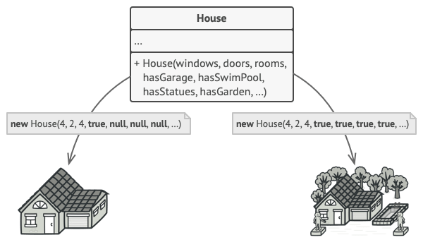
Problem:
Constructing House
Extent the base House class and create a set of subclasses to cover all combinations of the parameters.
Create a giant constructor right in base House class will all possible parameters
Solution :
The Builder pattern suggests that you extract the object construction code out of its own class and move it to separate objects called builders.

Slide 4
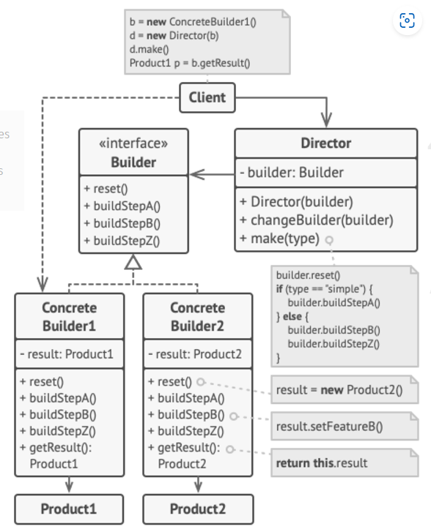
Structure:
Builder Interface: Declares common construction steps for all builders.
Concrete Builders: Provide specific implementations of construction steps and may produce different products.
Products: Resulting objects that don’t need to follow a shared class hierarchy or interface.
Director Class: Controls the construction order to create specific product configurations.
Client-Builder Association: The client associates a builder with the director, usually once.
Dynamic Builder Assignment: The client can pass a different builder to the director each time.

Slide 5
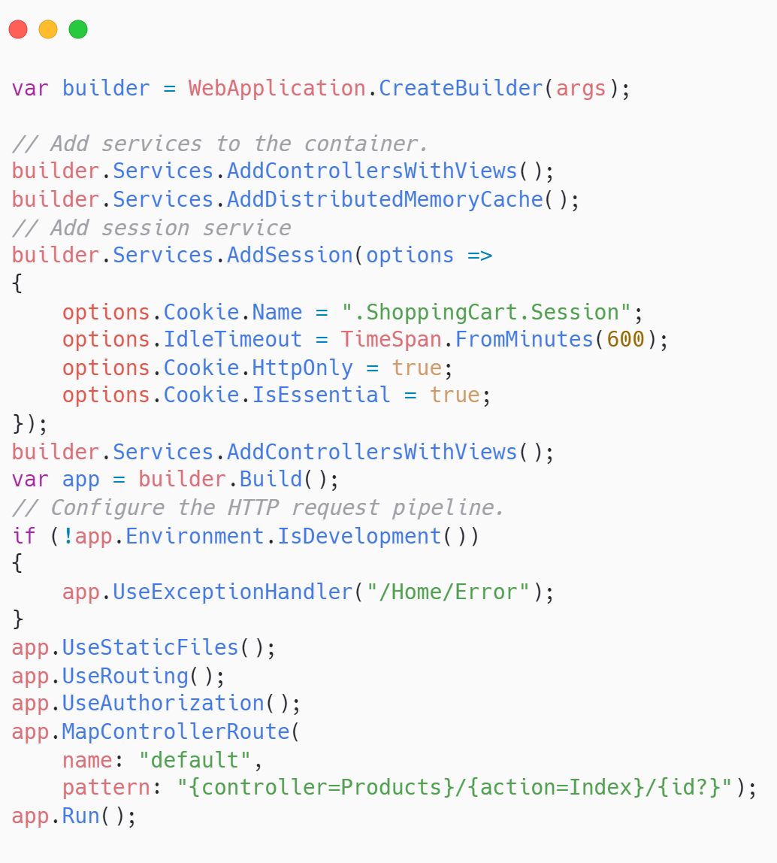
Use Case in Dot net E-commerce
Builder Initialization:
Adding Services
Building the Application (Product Creation):
Configuring the HTTP Request Pipeline (Defining the Flow):
Final Step - Running the Application:

Slide 6
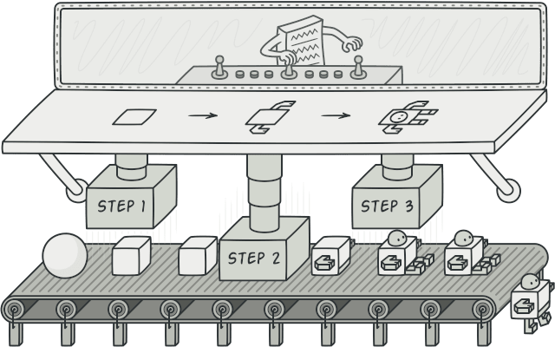
Pros and Cons of Builder Pattern
Pros:
Improves code readability and maintainability.
Provides flexibility and reusability.
Enforces immutability of objects.
Single Responsibility Principle.
Cons:
complexity of the code

Slide 7
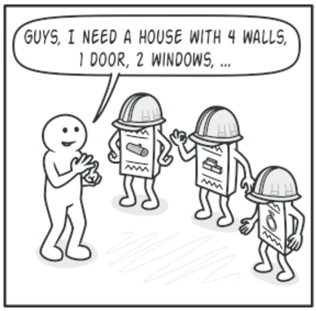
When to Use the Builder Pattern
When an object has many optional parameters
provides a cleaner and more manageable way to set optional properties without the need for multiple constructors.
When you want to separate construction from representation
Easier to create different versions of the object with the same construction process.
When you want to create immutable objects
create an object that should not be changed once created

Slide 8




THANK YOU
(844) 720-6678
info@simplifyhealthcare.com
simplifyhealthcare.com
Simplify Healthcare
U.S.: 600 N Commons Drive, Suite 110, Aurora, IL 60504
India: 401/402, 4th Floor, Pentagon P-2, Magarpatta City, Pune 411013
CONNECT WITH US
LinkedIn
YouTube
X
Instagram

