Slide 1
Design Pattern : Proxy Pratiksha Adatkar

Slide 2
Design Patterns : typical solutions to commonly occurring problems in software design. Three main groups of patterns: 1)Creational patterns provide object creation mechanisms that increase flexibility and reuse of existing code. 2)Structural patterns explain how to assemble objects and classes into larger structures, while keeping these structures flexible and efficient. 3)Behavioral patterns take care of effective communication and the assignment of responsibilities between objects.
Introduction

Slide 3
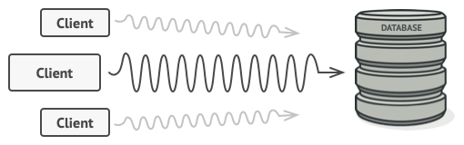
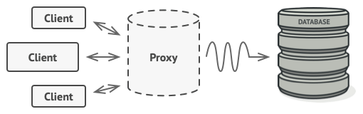
Proxy Pattern: Managing Expensive Objects Efficiently
Problem: Managing Large and Expensive Objects
Challenge: Large objects consume lots of resources (memory, time).
Need: Only create the object when it’s actually needed, but without repeating code everywhere.
Solution: Proxy Pattern
Lazy Initialization: Create the object only when needed.
Proxy as Middleman:
Checks if object exists.
Creates object if needed, or reuses existing one.
Benefits of Proxy Pattern
Resource Efficiency: Avoids creating the object until necessary.
Cleaner Code: No need for repeated initialization logic.
Works with 3rd-Party Libraries: Can manage objects from libraries you can't modify.

Slide 4
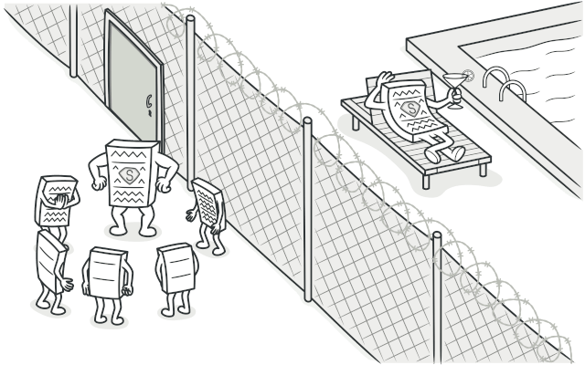
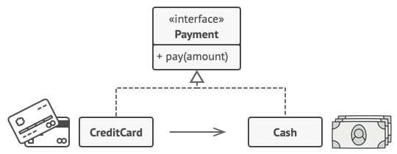
Proxy Pattern : Definition and Real-World Example
Proxy is a structural design pattern that lets you provide a substitute or placeholder for another object. A proxy controls access to the original object, allowing you to perform something either before or after the request gets through to the original object.
Real-World Analogy
Credit Card = Proxy for a Bank Account, which is a Proxy for Cash.
Shared Interface: All can be used for making payments.
Benefits:
For Consumers: No need to carry cash, easy & secure transactions.
For Shop Owners: Instant electronic payments, no risk of losing cash or getting robbed.

Slide 5
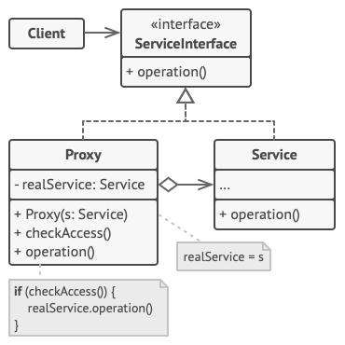
Proxy Pattern Structure
Service Interface:
Declares the common interface for both service and proxy.
Service:
Provides the actual business logic and functionality.
Proxy:
Holds a reference to the service.
Performs extra tasks (e.g., lazy initialization, logging, access control, caching) before passing requests to the service.
Client:
Works with both services and proxies using the same interface.
The proxy can be passed as if it were the service itself.

Slide 6
Proxy Pattern - Applicability & Use Cases
Popular Uses of Proxy Pattern:
Lazy Initialization (Virtual Proxy):
Delay creation of heavyweight objects until needed.
Access Control (Protection Proxy):
Restrict access to service objects based on client credentials.
Remote Service (Remote Proxy):
Pass client requests to a remote server, handling network details.
Logging (Logging Proxy):
Log requests before passing them to the service object.
Caching (Caching Proxy):
Cache results of repeated requests for efficiency.
Smart Reference:
Track service object usage and release resources when no clients are active.

Slide 7
Proxy Pattern - Implementation & Relations
How to Implement:
Interface: Create a service interface (if not already present) for interchangeable proxies and services.
Proxy Class: Stores reference to the service and manages its lifecycle.
Methods: Proxy methods delegate work to the service after performing specific tasks (e.g., logging, caching).
Lazy Initialization: Consider implementing lazy initialization.
Pros and Cons:
Pros:
Controls service object lifecycle without client knowledge.
Works even if service object isn’t available.
Follows Open/Closed Principle.
Cons:
Can introduce more complexity with many classes.
May cause delays in service response.
Relations with Other Patterns:
Adapter: Different interface to access an existing object (Proxy keeps the same interface).
Facade: Both simplify complex entities, but Proxy has the same interface as the service.
Decorator: Similar structure, but Proxy manages the service lifecycle; Decorator is client-controlled.

Slide 8




THANK YOU
(844) 720-6678
info@simplifyhealthcare.com
simplifyhealthcare.com
Simplify Healthcare
U.S.: 600 N Commons Drive, Suite 110, Aurora, IL 60504
India: 401/402, 4th Floor, Pentagon P-2, Magarpatta City, Pune 411013
CONNECT WITH US
LinkedIn
YouTube
X
Instagram

