Slide 1
Abstract Factory Design Pattern
Chinmay S. Lute

Slide 2
What is design pattern? A design pattern is a reusable solution to a common problem that occurs in software design. It provides a template or guideline for solving a particular type of problem in a specific context, making code more flexible, efficient, and easier to maintain. Different types of design patterns Creational patterns:: provide object creation mechanism that promotes flexibility and reuse of existing code. Structural patterns: explains how to assemble objects and classes into larger structures while keeping structures flexible and efficient. Behavioral patterns: take care of effective communication and assignment of the responsibilities between objects.

Slide 3
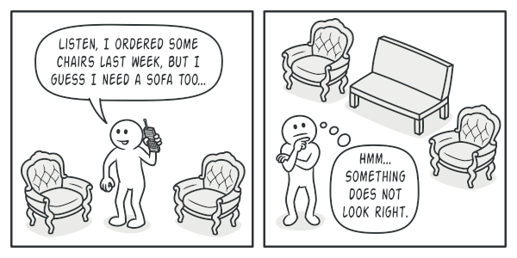
Real-World Analogy:
Analogy:
Imagine you're going to a furniture store to buy some furniture for your home. The store offers different "families" of furniture sets based on design styles:
Modern furniture
Traditional furniture

Slide 4
Why Abstract Factory?
Problem:
Imagine you want to create furniture shop simulator and your code consist classes that represent:
A family of related product let say chair + sofa + coffeetable
Several variants of this family, for e.x chair + sofa + coffeetable are available in different variants like modern and traditional.
To solve this problem you need a way to create furniture objects so that they match other objects of the same family.
Customers get quite mad when they receive non matching furniture.

Slide 5
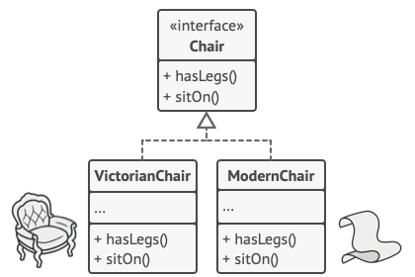
How to implement?
Abstract Factory is a creational design pattern that lets you produce families of related objects without specifying their concrete classes.
The first thing the Abstract Factory pattern suggests is to explicitly declare interfaces for each distinct product of the product family (e.g., chair, sofa or coffee table).
The next move is to declare the Abstract factory – an interface with a list of creation methods for all products that are part of product family.( e.g createChair, createSofa and createCoffeeTable)
4. For each variant of a product family, we create a separate factory class based on the AbstractFactory interface. For example ModernFurnitureFactory which can only create ModernChair, ModernSofa and ModernCoffeeTable

Slide 6
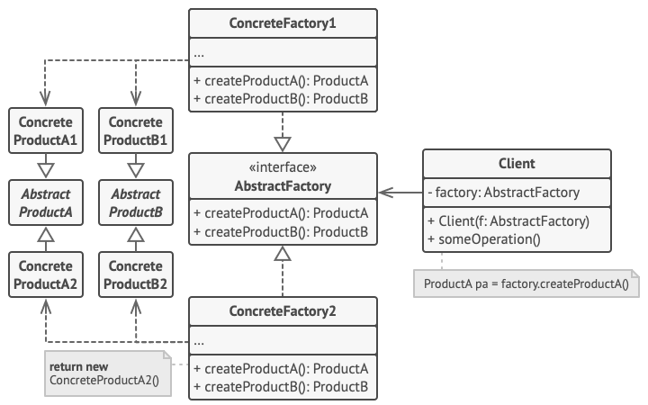
Structure

Slide 7
Pros and Cons
Pros:
You can be sure that the products you’re getting from a factory are compatible with each other.
You avoid tight coupling between concrete products and client code.
Single Responsibility Principle. You can extract the product creation code into one place, making the code easier to support.
Open/Closed Principle. You can introduce new variants of products without breaking existing client code.
Cons
The code may become more complicated than it should be, since a lot of new interfaces and classes are introduced along with the pattern.

Slide 8
Thankyou

