Slide 1
Design Pattern : Adapter Aaryan Dharmadhikari

Slide 2
Design Patterns :A design pattern is a general, reusable solution to a commonly occurring problem within a given context in software design. It is a template or description of how to solve a problem that can be adapted to various situations. A design pattern provides a standardized method of solving a problem that may arise during software development and helps improve code maintainability, scalability, and flexibility. Types of Design Patterns: 1) Creational patterns-These patterns deal with object creation mechanisms, trying to create objects in a manner suitable to the situation. They abstract the instantiation process and make it more flexible and reusable. Example- Singleton, Factory Pattern 2)Structural patterns-These patterns deal with the composition of classes or objects, focusing on simplifying the structure by identifying simple ways to realize relationships between entities. Example-Adapter,Bridge,Composite . 3) Behavioral Patterns- These patterns focus on communication between objects, addressing how objects interact and how responsibilities are delegated between them . Example-Command, Interpreter, Iterator.
Introduction

Slide 3
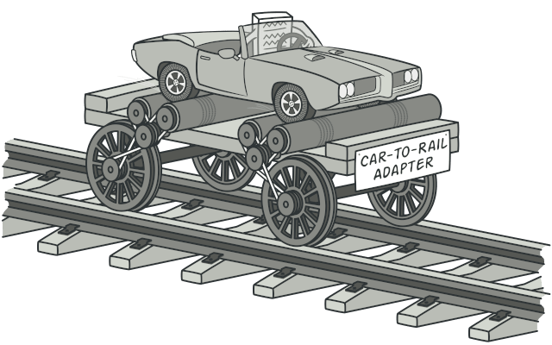
Adapter: allows objects with incompatible interfaces to collaborate.
Problem: Incompatible Interfaces
Challenge: when two classes or systems that need to work together have different interfaces, making direct communication or interaction impossible
Need : The Adapter design pattern is needed to enable collaboration between classes or systems with incompatible interfaces, allowing them to work together without modifying their existing code
Solution: Adapter
An adapter wraps one of the objects to hide the complexity of conversion happening behind the scenes. The wrapped object isn’t even aware of the adapter. For example, you can wrap an object that operates in meters and kilometers with an adapter that converts all of the data to imperial units such as feet and miles.
Adapters can not only convert data into various formats but can also help objects with different interfaces collaborate..
Benefits of Adapter
The adapter gets an interface, compatible with one of the existing objects.
Using this interface, the existing object can safely call the adapter’s methods.
Upon receiving a call, the adapter passes the request to the second object, but in a format and order that the second object expects.

Slide 4
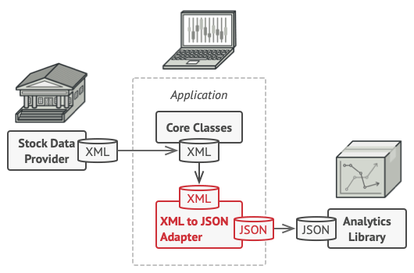
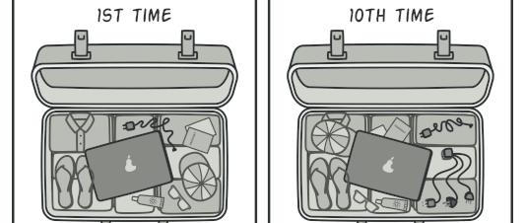
Adapter Design Pattern : Definition and Real-World Example
Example for Adapter
To solve the dilemma of incompatible formats, you can create XML-to-JSON adapters for every class of the analytics library that your code works with directly. Then you adjust your code to communicate with the library only via these adapters. When an adapter receives a call, it translates the incoming XML data into a JSON structure and passes the call to the appropriate methods of a wrapped analytics object.
Real-World Analogy
When you travel from the US to Europe for the first time, you may get a surprise when trying to charge your laptop. The power plug and sockets standards are different in different countries. That’s why your US plug won’t fit a German socket. The problem can be solved by using a power plug adapter that has the American-style socket and the European-style plug..

Slide 5
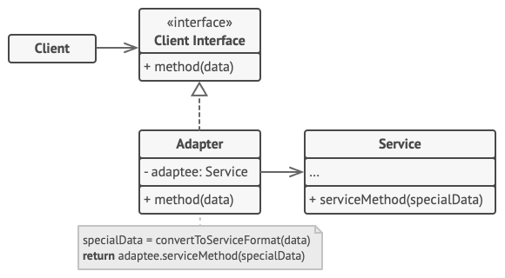
Adapter Structure
The Client is a class that contains the existing business logic of the program.
The Client Interface describes a protocol that other classes must follow to be able to collaborate with the client code
The Service is some useful class (usually 3rd-party or legacy). The client can’t use this class directly because it has an incompatible interface.
The Adapter is a class that’s able to work with both the client and the service: it implements the client interface, while wrapping the service object. The adapter receives calls from the client via the client interface and translates them into calls to the wrapped service object in a format it can understand.
The client code doesn’t get coupled to the concrete adapter class as long as it works with the adapter via the client interface. Thanks to this, you can introduce new types of adapters into the program without breaking the existing client code. This can be useful when the interface of the service class gets changed or replaced: you can just create a new adapter class without changing the client code.

Slide 6
Adapter- Applications & Use Cases
.
Popular Uses of Adapter:
1) Legacy System Integration:When integrating legacy systems with newer systems, the Adapter pattern allows the old system's interfaces to communicate with modern applications without altering the legacy code. Example: Adapting a legacy database interface to a new database management system.
2) Third-party Library Integration:If your application needs to use a third-party library or API whose interface does not match your system’s requirements, the Adapter pattern can wrap the library's interface to make it compatible. Example: Adapting an external payment gateway API to work with your existing e-commerce platform.
3) Device Communication:In scenarios where hardware devices use different communication protocols or APIs, the Adapter pattern can convert the protocols to be compatible with the system. Example: Adapting a serial communication protocol to a USB protocol for a printer.
4) UI Frameworks:In applications where you need to integrate various user interface frameworks (e.g., Swing with JavaFX), an Adapter can help unify their interfaces so they can work together. Example: Adapting a custom control in a GUI framework to be used in another GUI framework without altering the underlying

Slide 7
Adapter - Implementation & Relations
How to Implement:
Make sure that you have at least two classes with incompatible interfaces:
A useful service class, which you can’t change (often 3rd-party, legacy or with lots of existing dependencies).
One or several client classes that would benefit from using the service class.
2. Declare the client interface and describe how clients communicate with the service.
3. Create the adapter class and make it follow the client interface. Leave all the methods empty for now.
4. Add a field to the adapter class to store a reference to the service object. The common practice is to initialize this field via the constructor, but sometimes it’s more convenient to pass it to the adapter when calling its methods.
5. One by one, implement all methods of the client interface in the adapter class. The adapter should delegate most of the real work to the service object, handling only the interface or data format conversion.
6. Clients should use the adapter via the client interface. This will let you change or extend the adapters without affecting the client code.
Pros and Cons:
Pros:1)Single Responsibility Principle. You can separate the interface or data conversion code from the primary business logic of the program.
2)Open/Closed Principle. You can introduce new types of adapters into the program without breaking the existing client code, as long as they work with the adapters through the client interface.
Cons:1) The overall complexity of the code increases because you need to introduce a set of new interfaces and classes. Sometimes it’s simpler just to change the service class so that it matches the rest of your code.
Relations with Other Patterns:
Bridge is usually designed up-front, letting you develop parts of an application independently of each other. On the other hand, Adapter is commonly used with an existing app to make some otherwise-incompatible classes work together nicely.
With Adapter you access an existing object via different interface. With Proxy, the interface stays the same. With Decorator you access the object via an enhanced interface.
Facade defines a new interface for existing objects, whereas Adapter tries to make the existing interface usable. Adapter usually wraps just one object, while Facade works with an entire subsystem of objects.

Slide 8




THANK YOU
(844) 720-6678
info@simplifyhealthcare.com
simplifyhealthcare.com
Simplify Healthcare
U.S.: 600 N Commons Drive, Suite 110, Aurora, IL 60504
India: 401/402, 4th Floor, Pentagon P-2, Magarpatta City, Pune 411013
CONNECT WITH US
LinkedIn
YouTube
X
Instagram

