Slide 1
Design Pattern : Flyweight Shruti Kadam

Slide 2
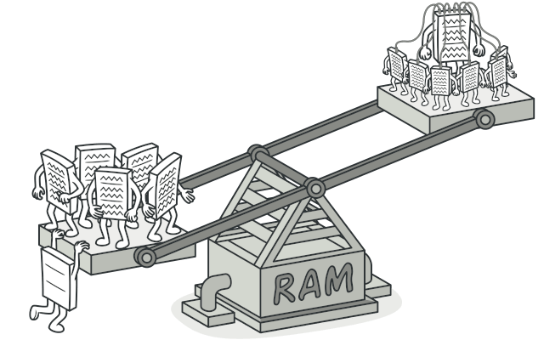
Flyweight Pattern
The Flyweight design pattern is a structural pattern that helps optimize memory usage by sharing common parts of an object's state (intrinsic state) between multiple objects, while keeping only the unique parts (extrinsic state) outside the object.
Problem:
In applications dealing with large numbers of similar objects (e.g., video games with particles like bullets or missiles), redundant storage of common data leads to high memory consumption. This can lead to crashes, especially on machines with limited RAM.
Solution:
Flyweight Object: A flyweight object only stores the intrinsic state (e.g., bullet sprite, color). It can be shared by many instances to save memory.
Context Class: The extrinsic state (e.g., position, velocity) is stored in a separate context class. This class keeps track of individual particles' dynamic data and links them to the flyweight object.
Memory Optimization: By using flyweights, you only need one instance of the intrinsic state (like a bullet sprite) even for thousands of particles, significantly reducing memory usage.

Slide 3
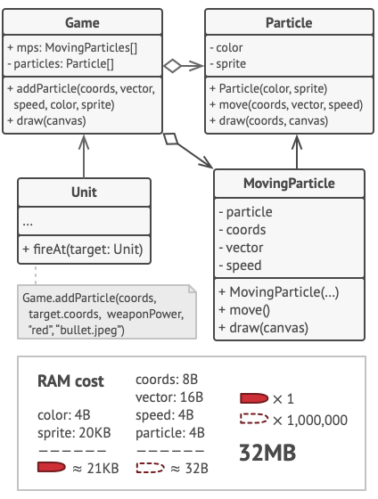
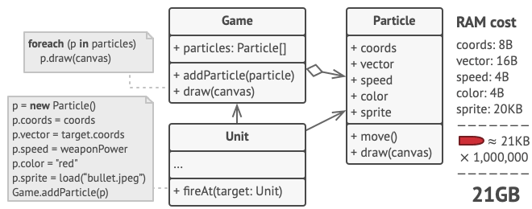
Flyweight Pattern: Real World Analogy
Context: In a game with particles like bullets, missiles, and shrapnel, each particle contains lots of data (e.g., color, sprite, position, speed).
Challenge: The shared data (color, sprite) takes up substantial memory, and as the number of particles grows, this redundancy overwhelms available RAM, causing the game to crash.
Solution Need: To reduce memory consumption, we need to store common data once and share it across particles.

Slide 4
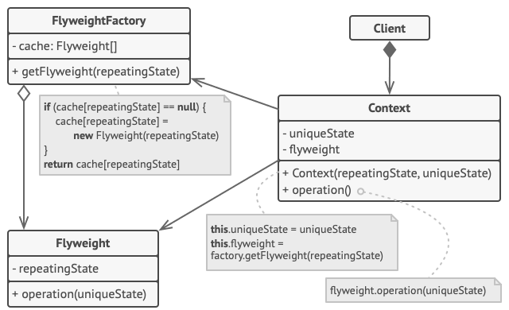
Flyweight Pattern Structure
1.Flyweight:
Contains the intrinsic state (shared data) that is common across multiple objects.
This data is immutable and cannot be modified once set.
2.Context:
Stores the extrinsic state (unique data) that changes over time, such as position, speed, or movement.
It passes the extrinsic state to the Flyweight object when needed.
3.Flyweight Factory:
Manages the creation and reuse of Flyweight objects.
Ensures that existing flyweights are reused to save memory, creating new ones only when necessary.
4.Client:
Manages the extrinsic state and passes it to the Flyweight objects when performing operations.

Slide 5
Flyweight Pattern – When to Use ?
Optimal Use Cases:
Use the Flyweight pattern only when your program must support a huge number of objects which barely fit into available RAM.
The Flyweight pattern is useful in situations where:
There are many objects with identical or similar data (e.g., particles, shapes in games, UI elements).
Memory consumption is a concern and needs optimization.
The same data needs to be reused across many objects.
Important Consideration:
Flyweight is an optimization pattern and should be used when there is an actual memory consumption issue. Before applying it, ensure that the problem can’t be solved through other means (e.g., reducing the number of objects).

Slide 6
Flyweight Pattern – How to Implement?
1.Divide the Class Fields:
Intrinsic State: Keep the fields that contain unchanging, shared data (e.g., color, sprite).
Extrinsic State: Separate out fields with unique, contextual data (e.g., position, speed).
2.Make Intrinsic State Immutable:
Store intrinsic state in the class and make it immutable (set only via constructor).
3.Modify Methods Using Extrinsic State:
For methods that use the extrinsic state, replace the class fields with parameters representing the extrinsic data.
4.Create a Factory Class (optional):
The factory manages the pool of flyweight objects.
It checks if a flyweight with the same intrinsic state already exists and reuses it, or creates a new one.
5.Client Responsibilities:
The client stores or calculates the extrinsic state (context data).
The client must pass this extrinsic state to the flyweight’s methods when calling them.
6.Context Class (optional):
To further simplify, store the extrinsic state and the reference to the flyweight object in a separate context class.

Slide 7
Flyweight Pattern – Pros, Cons & Relations
Pros and Cons:
Pros:
- You can save lots of RAM, assuming your program has tons of similar objects.
Cons:
-You might be trading RAM over CPU cycles when some of the context data needs to be recalculated each time somebody calls a flyweight method.
- The code becomes much more complicated. New team members will always be wondering why the state of an entity was separated in such a way.
Relations with Other Patterns:
You can implement shared leaf nodes of the Composite tree as Flyweights to save some RAM.
Flyweight shows how to make lots of little objects, whereas Facade shows how to make a single object that represents an entire subsystem.
Flyweight would resemble Singleton if you somehow managed to reduce all shared states of the objects to just one flyweight object. But there are two fundamental differences between these patterns:
--->There should be only one Singleton instance, whereas a Flyweight class can have multiple instances with different intrinsic states.
--->The Singleton object can be mutable. Flyweight objects are immutable.

Slide 8




THANK YOU
(844) 720-6678
info@simplifyhealthcare.com
simplifyhealthcare.com
Simplify Healthcare
U.S.: 600 N Commons Drive, Suite 110, Aurora, IL 60504
India: 401/402, 4th Floor, Pentagon P-2, Magarpatta City, Pune 411013
CONNECT WITH US
LinkedIn
YouTube
X
Instagram

