Slide 1
DECORATOR Design Pattern

Slide 2
DECORATOR DESIGN PATTERN

Slide 3
Understanding the Decorator/Wrapper Pattern
The Decorator design pattern is a structural pattern that allows behavior to be added to an object dynamically.
It helps in extending the functionality of an object without altering its structure.
Ideal for adding functionality to classes without changing their code.

Slide 4
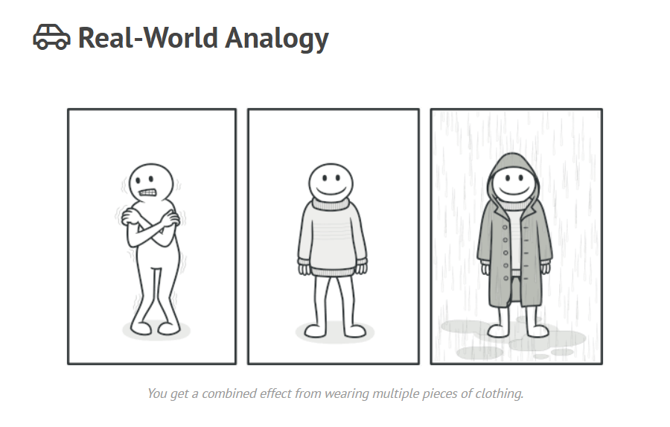
Wearing clothes is an example of using decorators. When you’re cold, you wrap yourself in a sweater. If you’re still cold with a sweater, you can wear a jacket on top. If it’s raining, you can put on a raincoat. All of these garments “extend” your basic behavior but aren’t part of you, and you can easily take off any piece of clothing whenever you don’t need it.

Slide 5
Components of the Decorator Pattern
Component: Interface or abstract class for the objects to be decorated.
Concrete Component: A class implementing the Component interface (e.g., a simple object).
Decorator: A class that implements the same interface as the Component and wraps around it.
Concrete Decorators: Specific decorators that add behavior to the object.

Slide 6
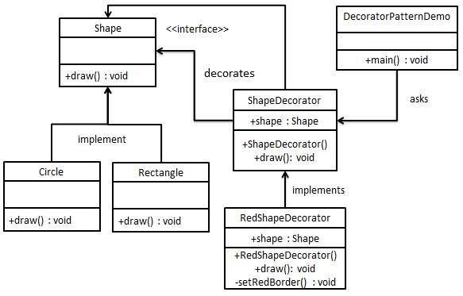
UML Diagram

Slide 7
Advantages and Disadvantages
Advantages:
Flexibility: You can mix and match different decorators.
Single Responsibility Principle: Each decorator has its own responsibility.
Open/Closed Principle: Behaviors can be added without modifying the existing code.
Disadvantages:
Complexity: Can lead to many small classes, making the code hard to follow.
Overuse: Too many decorators can make it difficult to track object behavior.

Slide 8
Real-World Use Cases
Real-World Use Cases:
GUI systems where elements need to be decorated with styles (e.g., buttons with borders, icons).
Input/Output streams where different filters (e.g., compression, encryption) are applied.
The Decorator Design Pattern allows for flexible, maintainable, and reusable object extension.
It's an excellent alternative to subclassing for enhancing object behavior dynamically.

Slide 9




THANK YOU
(844) 720-6678
info@simplifyhealthcare.com
simplifyhealthcare.com
Simplify Healthcare
U.S.: 600 N Commons Drive, Suite 110, Aurora, IL 60504
India: 401/402, 4th Floor, Pentagon P-2, Magarpatta City, Pune 411013
CONNECT WITH US
LinkedIn
YouTube
X
Instagram

