Slide 1
Observer Design Pattern
by Samrudhee Deshmukh

Slide 2
What is the Observer Design Pattern?
The pattern commonly known as the Observer Pattern is extensively utilized in software design to establish an efficient communication mechanism between objects.
By decoupling the subject from its observers, this pattern fosters a flexible and scalable architecture, enabling automatic propagation of changes across different components of the system.
Purpose:
Allows an object (publisher) to notify multiple interested objects (subscribers) about state changes without unnecessary checks or tight coupling.
Enables flexible and dynamic relationships between objects, where subscribers can join or leave notifications at runtime.
How it Works:
The publisher maintains a list of subscribers and provides methods for adding, removing, and notifying them about events.
Subscribers implement a common interface, allowing the publisher to call their notification method without needing to know their specific implementation.

Slide 3
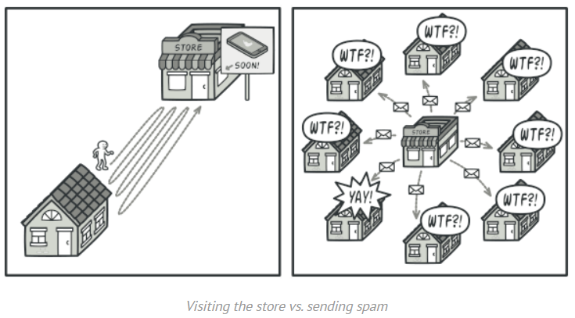
The Problem and Solution
Problem: Customers repeatedly check product availability, wasting time. Stores risk spamming all customers with unnecessary notifications.
Customers waste time repeatedly checking for updates (e.g., visiting a store for product availability).
Stores waste resources notifying all customers, even those not interested in specific updates.
Solution: A subscription mechanism to notify only interested customers (subscribers).Subscribers can join or leave the subscription list at runtime, ensuring flexibility and relevance.The publisher and subscribers communicate through a shared interface, reducing dependencies and promoting reusability.

Slide 4
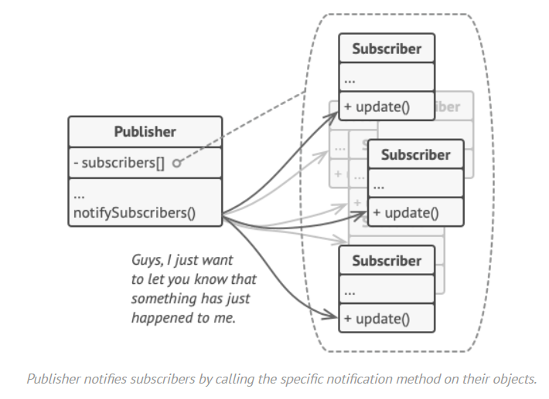
Structure of the Observer Pattern
Publisher:
Maintains a list of subscribers.
Notifies them about events (e.g., product availability).
Subscriber:
Reacts to updates from the publisher.
All subscribers implement a shared interface that defines a method (e.g., update) to handle notifications.
Each subscriber performs specific actions in response to notifications, making them decoupled and reusable across different publishers.
Dynamic Mechanism:
Add or remove subscribers at runtime.
Subscribers can dynamically subscribe to or unsubscribe from the publisher at runtime, ensuring relevance and adaptability.
Subscribers can choose to listen to specific types of events, ensuring they receive only relevant updates.

Slide 5
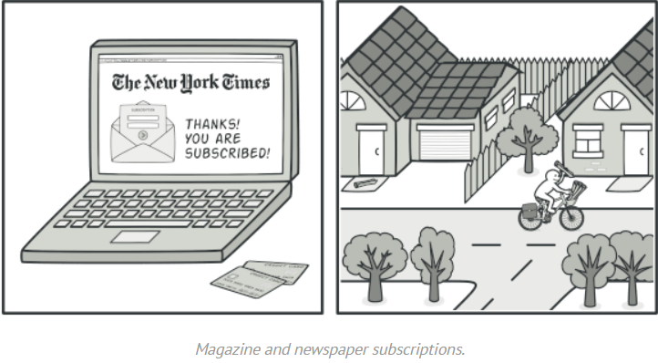
Real-World Analogy: Newspaper Subscription
Subscribe once, get issues directly in your mailbox. Unsubscribe anytime.
Publisher manages who gets which magazines.

Slide 6
Slide Applicability & Benefits
Applicability:
1)Event-Driven Systems:
GUIs where button clicks or state changes need to trigger actions (e.g., forms, dashboards).
2)Messaging Platforms:
Real-time notifications for new messages or status updates.
3)Stock Market Applications:
Notify investors when stock prices change.
Benefits:
1)Open/Closed Principle:
Add new subscribers or publishers without altering existing code.
2)Dynamic Subscription:
Subscribers can join or leave at runtime based on requirements.
3)Decoupled Components:
Publishers and subscribers operate independently via a shared interface.

Slide 7
When to Use the Observer Pattern
1)Event-Driven Scenarios:
When changes in one object need to trigger updates in other objects dynamically (e.g., UI updates in response to user actions).
2)One-to-Many Dependency:
When an object needs to notify multiple dependent objects about changes to its state.
3)Dynamic Subscriptions:
When the set of dependent objects (subscribers) is not fixed and can change at runtime.
4)Decoupled Communication:
When you want to minimize dependencies between the objects that send notifications (publishers) and those that receive them (subscribers).
5)Scenarios with Frequent Updates:
When you need to propagate state changes or events frequently and efficiently (e.g., stock price updates, live game scores).

Slide 8




THANK YOU
(844) 720-6678
info@simplifyhealthcare.com
simplifyhealthcare.com
Simplify Healthcare
U.S.: 600 N Commons Drive, Suite 110, Aurora, IL 60504
India: 401/402, 4th Floor, Pentagon P-2, Magarpatta City, Pune 411013
CONNECT WITH US
LinkedIn
YouTube
X
Instagram

