Slide 1
SOLID Design Principles Ruchita Amale

Slide 2
Software Design Principles
Definition: Design principles are fundamental guidelines or best practices that help in creating high-quality software. They are aimed at promoting maintainability, scalability, and flexibility while keeping the code clean and efficient.
Key Benefits of Design Principles:
Improve maintainability: The code is easier to understand, modify, and extend.
Promote reusability: Components of the system can be reused in different contexts.
Enhance flexibility: The software can adapt to changes in requirements or technology.
Increase readability: Well-structured code is easier to read and understand by developers.
DRY (Don't Repeat Yourself)
KISS (Keep It Simple, Stupid)
YAGNI (You Aren’t Gonna Need It)
SOLID

Slide 3
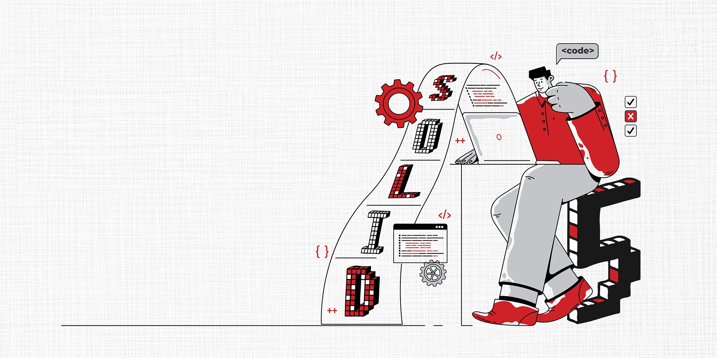
SOLID Principles
S – SINGLE RESPONSIBILITY PRINCIPLE
O – OPEN / CLOSED PRINCIPLE
L – LISKOV SUBSTITUTION PRINCIPLE
I – INTERFACE SEGREGATION PRINCIPLE
D – DEPENDENCY INVERSION PRINCIPLE

Slide 4
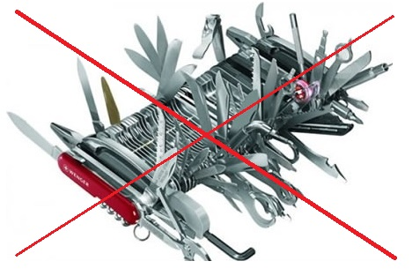
Single Responsibility Principle
Definition:
A class should have only one reason to change, meaning it should only have one job or responsibility.
Benefit:
Makes the code more maintainable by ensuring that each class has a focused responsibility and doesn't become too complex.
Example:
Separate classes for handling different tasks in the Ecommerce system.
ProductServices
OrderServices
…..Just because you can doesn’t mean you should

Slide 5
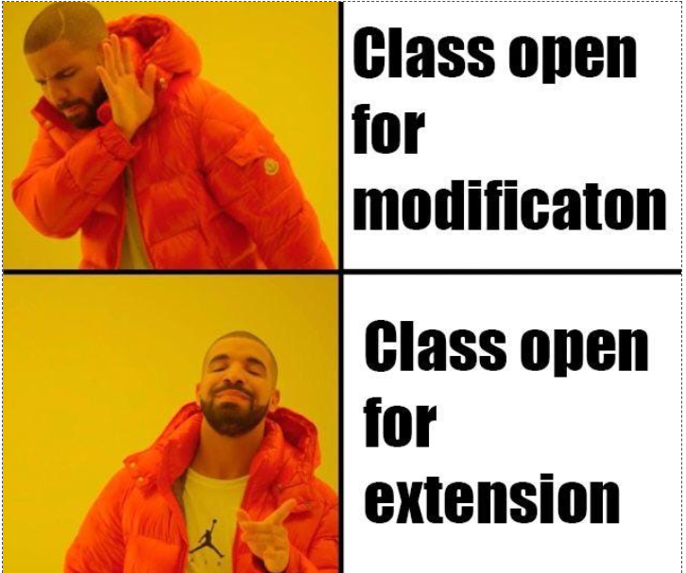
Open For Extension / Closed For Modification
Definition:
A class should be open for extension but closed for modification. New functionality should be added by extending the class, not modifying its existing code.
Benefit:
Encourages adding new features without altering existing working code, which makes systems more robust and reduces the risk of introducing bugs.
Example:
Card Services and NetBanking Services Implementing Payment Service
…जो चल रहा है उसे चलने दो.. उसे हाथ मत लगाओ !

Slide 6
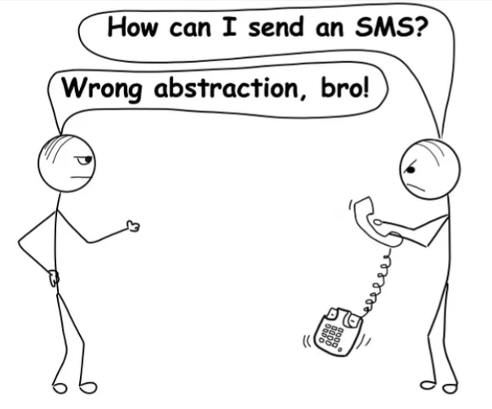
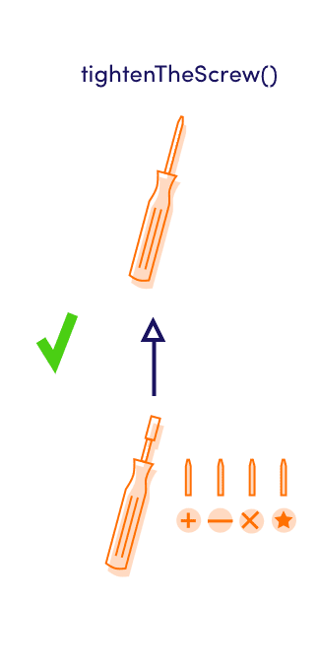
Liskov Substitution Principle (LSP)
Definition:
Objects of a superclass should be replaceable with objects of a subclass without affecting the correctness of the program.
Benefit:
Ensures that inheritance hierarchies are logically consistent, and derived classes can be used in place of their base classes without errors.
Example:
Entity Framework – Oracle MsSQL Database Connectivity
IDataRepository
Json Data Repository
Binary Data Repository
…..Replace the Experienced with Trainees

Slide 7
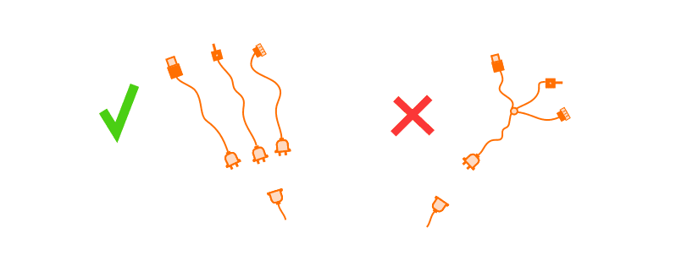
Interface Segregation Principle (ISP)
Definition:
A client should not be forced to depend on interfaces it doesn't use. Instead of one large interface, split it into smaller, more specific interfaces.
Benefit:
Improves code flexibility and makes classes and services easier to maintain.
Example:
IPaymentService and IShippingService interfaces instead of one large IECommerceService

Slide 8
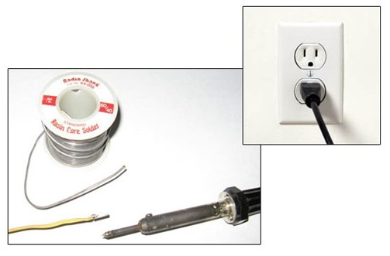
Dependency Inversion Principle (DIP)
Definition:
High-level modules should not depend on low-level modules. Both should depend on abstractions (interfaces). This helps in decoupling the application components.
Benefit:
Reduces the coupling between components, improving testability and flexibility, making it easier to swap implementations without affecting other parts of the application.
Example:
ProductsController – IProductService – ProductService
…Would You Solder A Lamp Directly To The Electrical Wiring In The Wall?

Slide 9




THANK YOU
(844) 720-6678
info@simplifyhealthcare.com
simplifyhealthcare.com
Simplify Healthcare
U.S.: 600 N Commons Drive, Suite 110, Aurora, IL 60504
India: 401/402, 4th Floor, Pentagon P-2, Magarpatta City, Pune 411013
CONNECT WITH US
LinkedIn
YouTube
X
Instagram

