Slide 1
Facade Design Pattern
Rutuja Yadav Patil

Slide 2
What is a Facade?
A Facade is a structural design pattern that provides a simplified, unified interface to a complex subsystem of classes or components.
It hides the internal workings of the subsystem and exposes only the necessary functionality to the client.
Purpose:
To simplify client interaction with a complex system.
To decouple the client code from the subsystem's details.
How it Works:
The facade class knows where to direct the client’s requests and how to coordinate operations between various subsystems.
The client interacts only with the facade, without needing to understand the complexity of the underlying subsystem.

Slide 3
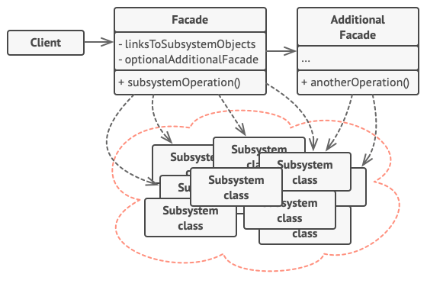
Structure of the Facade Pattern
Facade: Provides a simplified interface to the subsystem, directing requests and managing interactions between complex components.
Additional Facades: Used to prevent a single facade from becoming too complex by breaking down features into multiple, specialized facades.
Complex Subsystem: Composed of multiple objects, requiring deep knowledge of their interactions, initialization, and data handling.
Subsystems: Unaware of the facade, they interact with each other directly.
Client: Interacts with the facade, not the subsystem classes directly, simplifying the client’s code.

Slide 4
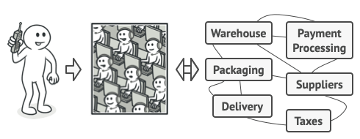
Real-World Analogy: Phone Order
Phone Order Analogy:
You (Client): Want to place an order.
Operator (Facade): Provides a simplified interface to a complex set of services (ordering system, payment gateways, delivery services).
Result: You don’t need to know the details of how the system works; you interact only with the operator.

Slide 5
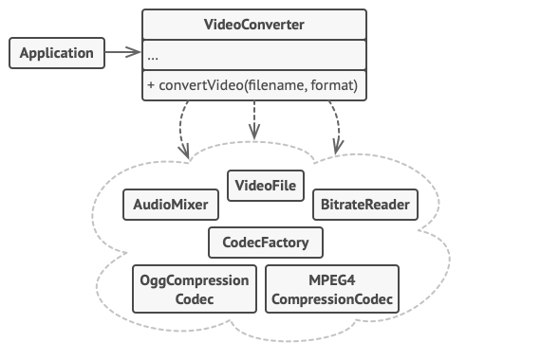
Video Conversion System
Problem:
Direct interaction with a complex video conversion framework requires handling multiple classes (e.g., VideoFile, CodecFactory, BitrateReader, AudioMixer).
The client must manage dependencies, formats, and conversions manually.
Facade Solution:
The VideoConverter class acts as a facade, providing a simple interface to convert videos.
The client only needs to call convert(filename, format) without dealing with the complexities of the framework.
Benefits:
Simplifies client interaction with the system.
Hides the complexity of the video conversion framework behind a unified interface.

Slide 6
Pros and Cons of Facade Pattern
Pros:
Isolates client code from subsystem complexity.
Makes code easier to maintain and upgrade.
Cons:
Facade can become too complex if it tries to cover too many functionalities.
Risk of "god object" syndrome if not carefully managed
.

Slide 7
When to Use the Facade Pattern
When dealing with complex subsystems:
Subsystems grow more complex over time, making it difficult for clients to interact with them.
When you want to create a simpler interface:
Expose only the most commonly used functionality.
To organize subsystems into layers:
Define facades for each layer and reduce interdependencies.

Slide 8




THANK YOU
(844) 720-6678
info@simplifyhealthcare.com
simplifyhealthcare.com
Simplify Healthcare
U.S.: 600 N Commons Drive, Suite 110, Aurora, IL 60504
India: 401/402, 4th Floor, Pentagon P-2, Magarpatta City, Pune 411013
CONNECT WITH US
LinkedIn
YouTube
X
Instagram

