Slide 1
Design Pattern

Slide 2
STATE Design Pattern

Slide 3
What it is & When to Use ?
What it is ?
Definition:
A behavioural design pattern that allows an object to alter its behaviour when its internal state changes. It makes an object appear to change its class.
Purpose:
To simplify managing different states of an object without complex conditionals.
Supports state transitions without modifying the context class each time.
When To Use ?
Complex behaviour: When the behaviour of an object depends on its state
Multiple states: When an object can exist in many states, and each state has specific behavior.
Avoid conditionals: When complex conditional logic needs to be avoided in the context class.

Slide 4
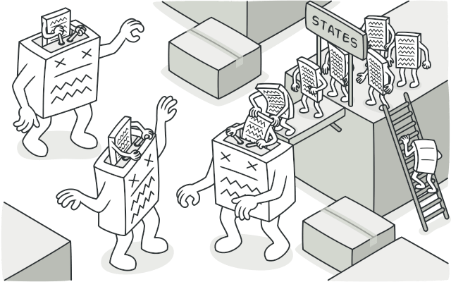
Structure and Example
Structure
Context
Maintains a Reference to the current State.
Delegates the behaviour to the current state.
State Interface
Defines common method for Concrete States
Concrete States
Implement state-specific behaviour and transitions
Example
Scenario
A traffic light system with 3 states: Green, Yellow, and Red.
State Transition
Green -> Yellow -> Red -> Green
State Behaviour
Each state has specific behaviour and triggers a transition to the next state.

Slide 5
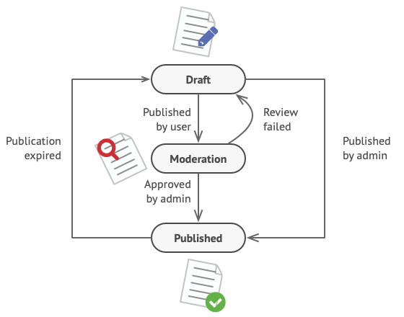
Problem
In Draft, it moves the document to moderation.
In Moderation, it makes the document public, but only if the current user is an administrator
In Published, it doesn’t do anything at all.

Slide 6
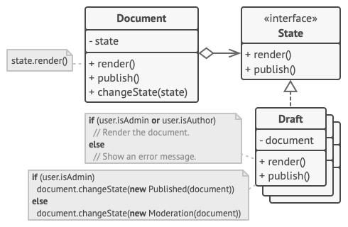
Solution

Slide 7
Code
// Concrete States
public class GreenState : ITrafficLightState
{
public void Change(TrafficLight context)
{
Console.WriteLine("Traffic light is green.");
context.SetState(new YellowState());
}
}
public class YellowState : ITrafficLightState
{
public void Change(TrafficLight context)
{
Console.WriteLine("Traffic light is yellow.");
context.SetState(new RedState());
}
}
// State Interface
public interface ITrafficLightState
{
void Change(TrafficLight context);
}

Slide 8
Code
// Context
public class TrafficLight
{
private ITrafficLightState _currentState;
public TrafficLight(ITrafficLightState initialState)
{
_currentState = initialState;
}
public void SetState(ITrafficLightState newState)
{
_currentState = newState;
}
public void ChangeLight()
{
_currentState.Change(this);
}
}
public class RedState : ITrafficLightState
{
public void Change(TrafficLight context)
{
Console.WriteLine("Traffic light is red.");
context.SetState(new GreenState());
}
}

Slide 9
Code
// Usage
public class Program
{
public static void Main()
{
TrafficLight light = new TrafficLight(new GreenState());
// Simulating traffic light changes
light.ChangeLight(); // Green -> Yellow
light.ChangeLight(); // Yellow -> Red
light.ChangeLight(); // Red -> Green
}
}

Slide 10
Benefits & Real-World Use Cases
Benefits
Simplifies code: Removes complex conditional logic.
Improves flexibility: Each state can be changed independently.
Enhances maintainability: Adding new states does not require changes to existing states or context class
Encapsulation of behaviours: States encapsulate specific behaviour, leading to better-organized code.
Use Cases
Game development: Handling different states of a game character (Idle, Running, Jumping).
UI components: Managing UI states (e.g., Button – Enabled, Disabled, Hovered)
Workflow systems: Transitioning between different stages of a process (Order Received, Processing, Shipped).

Slide 11




THANK YOU
(844) 720-6678
info@simplifyhealthcare.com
simplifyhealthcare.com
Simplify Healthcare
U.S.: 600 N Commons Drive, Suite 110, Aurora, IL 60504
India: 401/402, 4th Floor, Pentagon P-2, Magarpatta City, Pune 411013
CONNECT WITH US
LinkedIn
YouTube
X
Instagram

