Slide 1
Design Pattern : Composite Yash Valvi

Slide 2
Structural patterns are design patterns in object-oriented software development that deal with how objects and classes are composed to form larger structures. Definition of Structural Patterns: Structural patterns are concerned with the composition of classes and objects to form larger structures. They focus on how to assemble classes and objects in a way that the system becomes more flexible, reusable, and scalable. Objective: The main Objective is to learn composite design pattern which is a subset of structural patterns.
Introduction

Slide 3
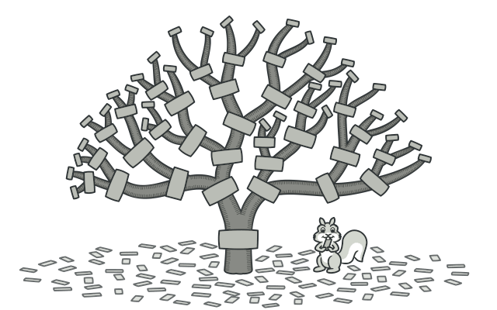
Composite Pattern: Managing Hierarchical Structure
Problem: Managing Hierarchical structures
Challenge: Hierarchical structures are difficult to manage if there is no standard way to treat them.
Need: When working with such hierarchical structures, one of the major challenges is treating individual objects and groups of objects uniformly, so that the client code doesn’t need to know the difference between the two.
Solution: Composite Pattern
The Composite pattern ensures that both leaf and composite objects implement a common interface (or abstract class). This allows the client code to treat them uniformly, without having to distinguish between the two types.
Benefits of Proxy Pattern
Uniformity of Interface: The primary benefit is the ability to treat individual objects (leaf) and groups of objects (composite) uniformly.
Flexibility : The Composite Pattern makes it easy to add new types of components to the structure without affecting the existing code
Extensibility: The pattern supports extending the object structure easily. New leaf objects or composite objects can be added with minimal impact on the existing system.

Slide 4
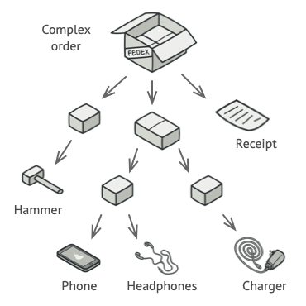
Proxy Pattern : Definition and Real-World Example
Composite allows you to compose objects into tree-like structures to represent part-whole hierarchies.
Real-World Analogy
File Systems: Directories and files treated uniformly in a file explorer.
Graphics Systems: Shapes (circle, square) and groups of shapes treated uniformly.
Organization Structures: Employees and departments treated the same way in an organizational chart.
Document Structure: Pages, paragraphs, and sections in a document editor.

Slide 5
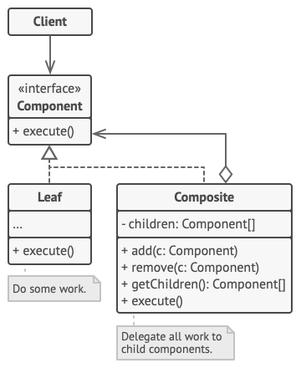
Composite Pattern Structure
Component:
The Component interface describes operations that are common to both simple and complex elements of the tree.
Leaf:
The Leaf is a basic element of a tree that doesn’t have sub-elements.
2. Usually, leaf components end up doing most of the real work, since they don’t have anyone to delegate the work to.
Composite:
The Container (aka composite) is an element that has sub-elements: leaves or other containers. A container doesn’t know the concrete classes of its children. It works with all sub-elements only via the component interface.
Client:
The Client works with all elements through the component interface. As a result, the client can work in the same way with both simple or complex elements of the tree.

Slide 6
Composite Pattern - Applicability & Use Cases
Popular Uses of Composite Pattern:
Hierarchical Tree Structures:
When your system requires you to model hierarchical structures, such as trees, where objects can be organized in part-whole relationships.
Uniform Treatment of Leaf and Composite Objects:
When you need to perform operations on objects in a structure (leaf or composite) in a uniform way, allowing recursive operations like add(), remove(), or display() to be applied uniformly.
Flexible and Extensible Systems
When the system needs to be easily extended by adding new types of components (leaf or composite) without modifying existing code.
Avoiding Code Duplication
When there is a need to avoid writing different logic for leaf objects and composite objects that perform the same operations
Complex Structures with Recursive Relationships
When objects in the system are nested or composed of other objects of the same type, recursive relationships are natural. The Composite pattern provides a way to handle such recursive structures seamlessly.

Slide 7




THANK YOU
(844) 720-6678
info@simplifyhealthcare.com
simplifyhealthcare.com
Simplify Healthcare
U.S.: 600 N Commons Drive, Suite 110, Aurora, IL 60504
India: 401/402, 4th Floor, Pentagon P-2, Magarpatta City, Pune 411013
CONNECT WITH US
LinkedIn
YouTube
X
Instagram

