Slide 1

Walk Tracker
Client:
Dr. Rhonda Beemer
Group C

Slide 2
Agenda
Problem Statement
Project Description
Benefits of WALK TRACKER
Core Team Members
Project Requirements Specifications
Project Management Plan
UI Sketches of WALK TRACKER
Outcomes of the Project

Slide 3

Problem Statement
Between 2017 and 2018, the National Health and Nutrition Examination Survey observes 1 out of every 4 children are suffering from Obesity, also obesity is linked to more than 60 chronic diseases and there is epidemic of obesity around the world.
In the U.S., childhood obesity alone is estimated to cost $14 billion annually in direct health expenses. Unhealthy lifestyle and eating habits has direct impact on physical health causing damage to metabolism, which has impact on mental well-being too.

Slide 4
Project Description
WalkTracker is a digital technology to help people eat better, get fitter and lose weight. The primary solution is delivered via a smartphone app (iOS, Android, PC) with a team of qualified diet/ fitness expert’s available in-app.
Our application will help users to:
Track users health and wellness progress using user activity
Developing AI and ML interface, to service fitness suggestions (healthy alternative food and task recommendations)
Providing points based on the steps count (Rewarded points used to buy products like Our University T-Shirts, Caps)
Optional Integration with various tracking wearables

Slide 5
Benefits of WALK TRACKER
Some of the benefits of using WalkTracker:
Provide various exercise programs and guidance for workouts.
Ability to set personal goals
Communication features, such as a forum for sharing users’ experiences, recipes, etc.
The user statistical data can be used to predict users health prior to attack.

Slide 6
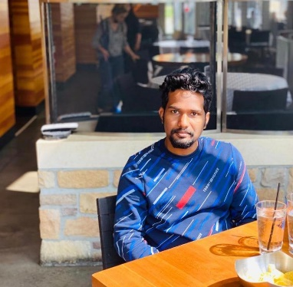
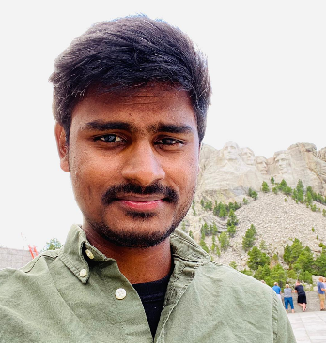
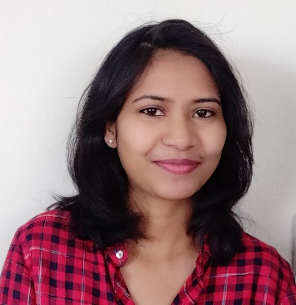
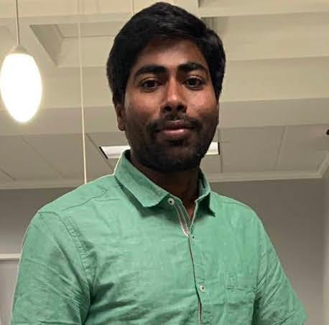
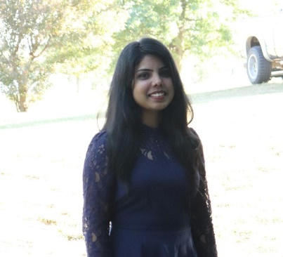
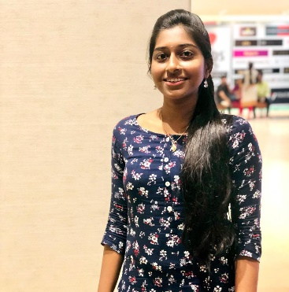
Core Team Members
Ravi Teja Pagidoju
Project Manager
Bhanu Prakash Thota
Quality Assurance Specialist
Soujanya Janapatla
Team Lead
Gopichand Bhandarupalli
Database Administrator
Sindhu Rani
Front-end Developer
Navya Devineni
Back-end Developer

Slide 7
Project Requirements Specifications
The Functional Requirements include:
Step count
Hydration level
Amount of sleep
Servings of fruit consumed
Servings of vegetables consumed
Number of calories consumed
Heart Rate etc

Slide 8
Project Management Plan
The planning stage and particularly the project management plan are commonly part of the correct execution, monitoring, and closure of a project.
Project Life Cycle
Terms and Techniques
Schedule Management
Cost Estimation
Communication Management
Risk Management

Slide 9
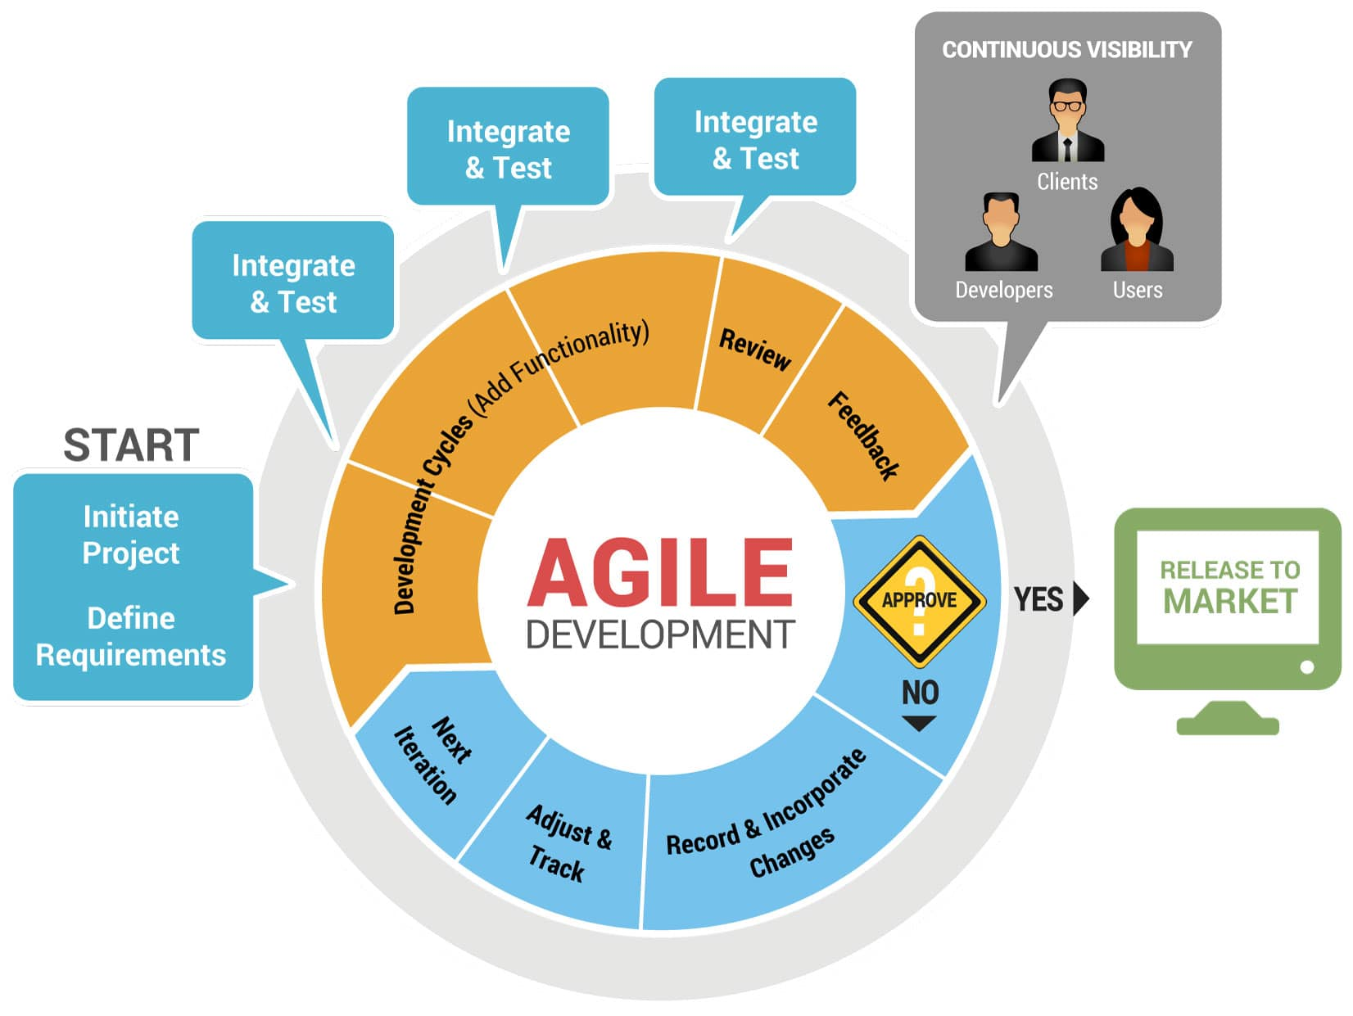
Agile - Software Development Methodology

Slide 10









Terms and Techniques
Here are a set of front-end and back-end tools used for developing the application:

Slide 11
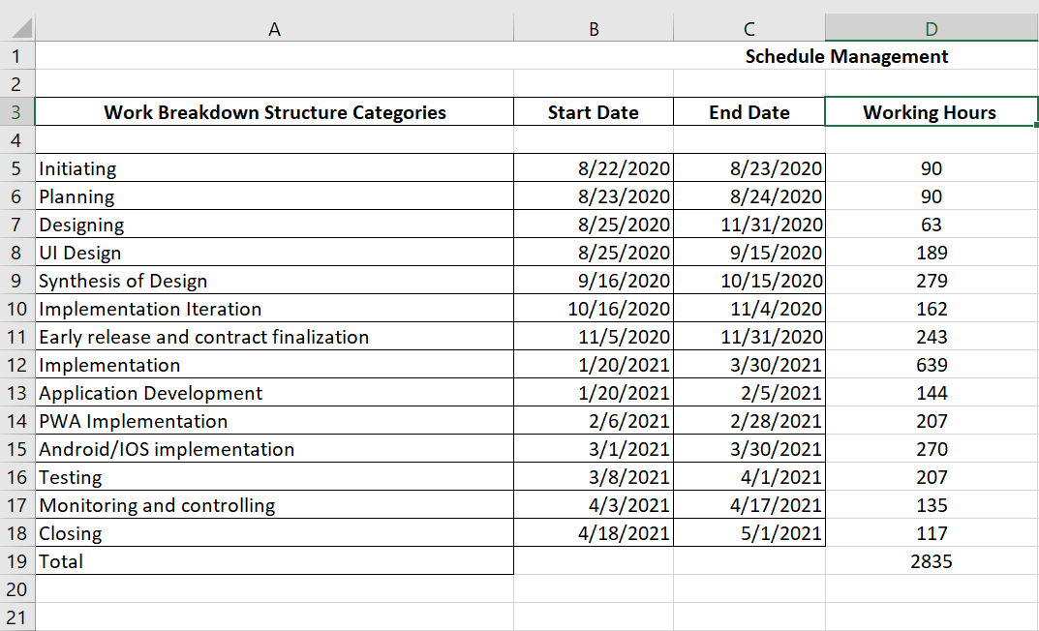
Schedule Management

Slide 12
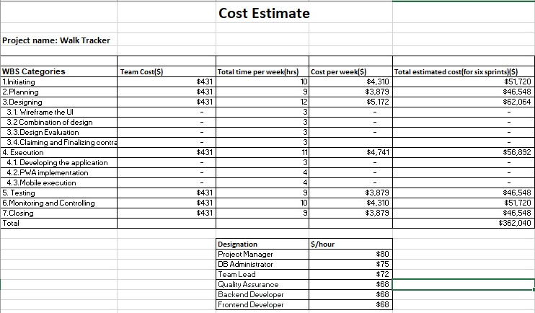
Cost Estimation

Slide 13
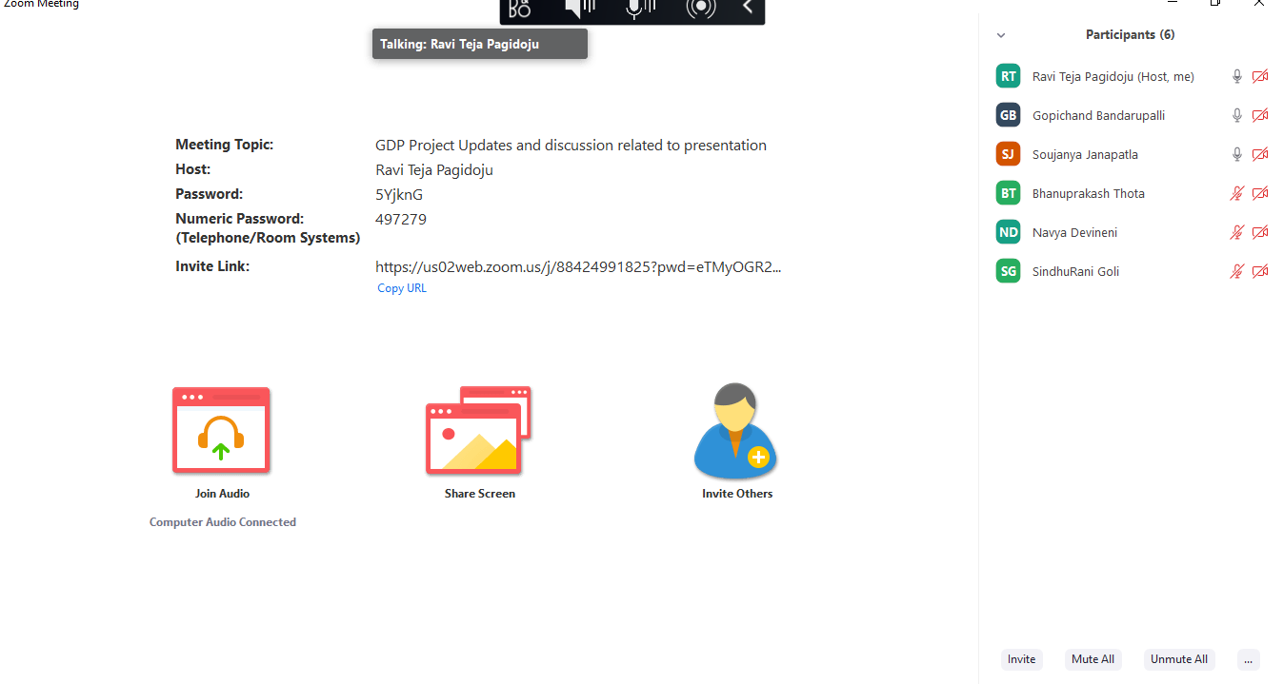
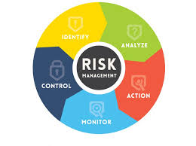
Project Management Plan(Cnt..)
Communication Management
Risk Management

Slide 14
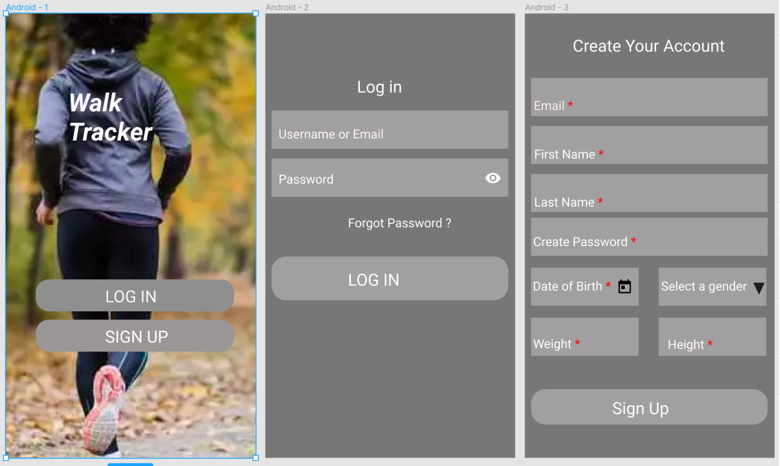

Slide 15
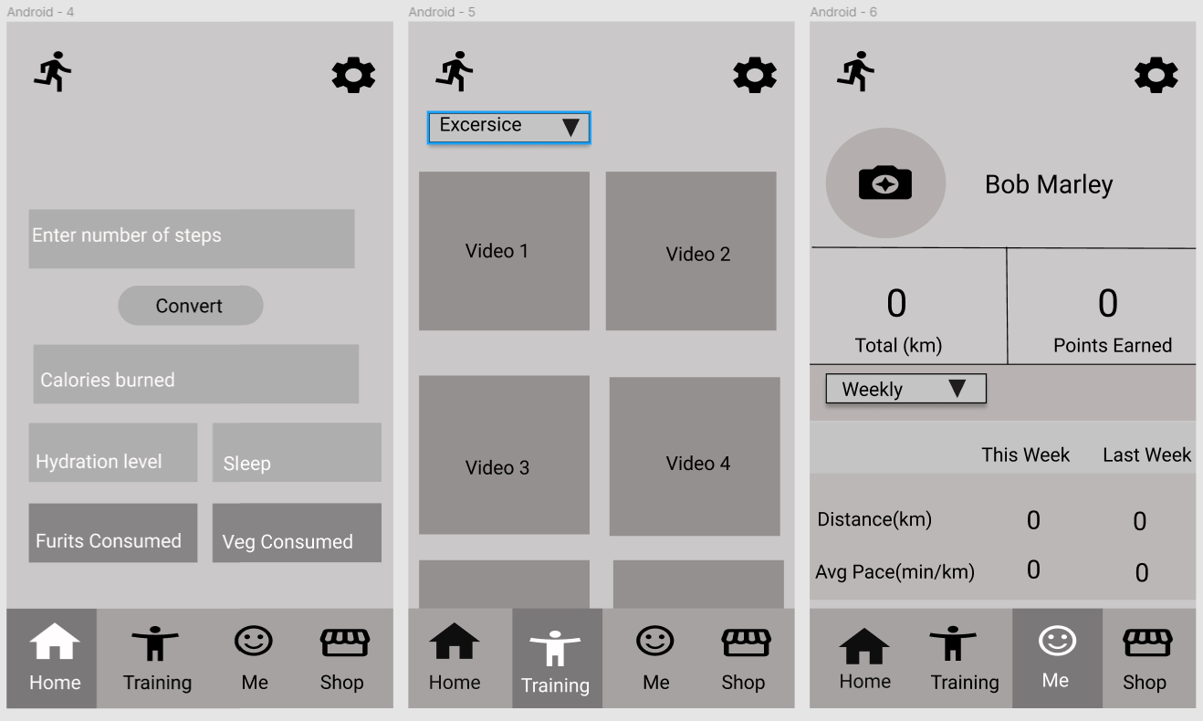

Slide 16
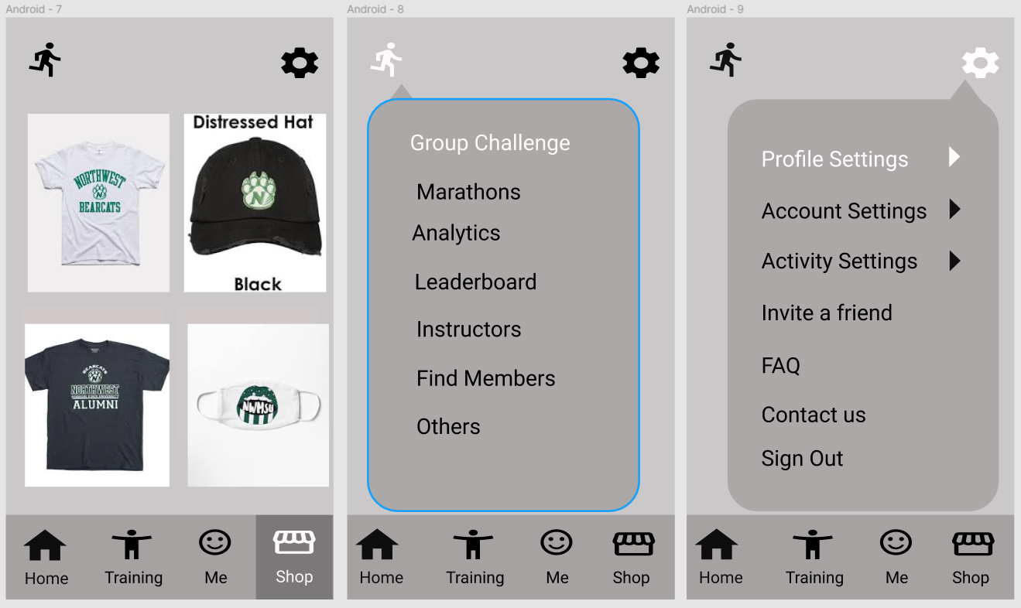

Slide 17
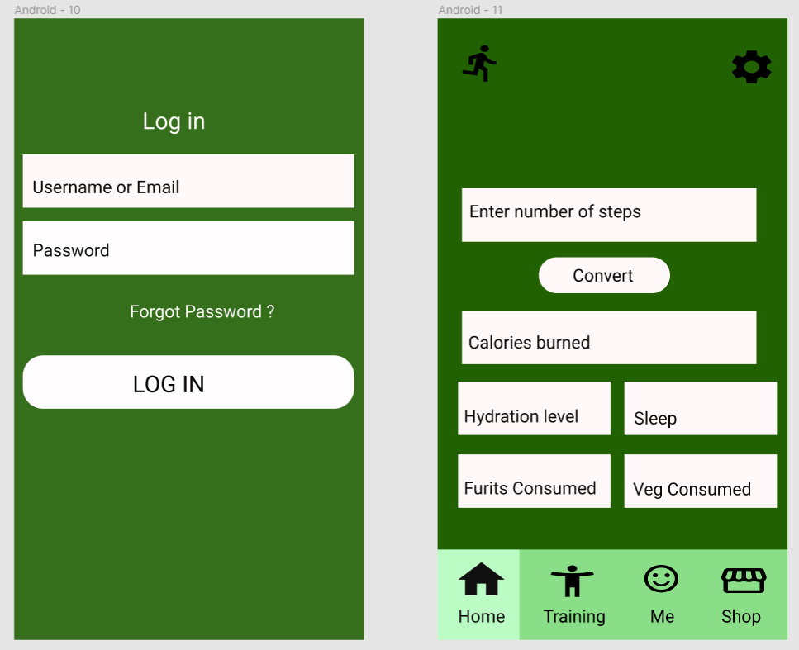

Slide 18

Make your idea success
https://github.com/RaviTeja444/health-wellness

Slide 19


