Slide 1
Assembly Language Compiler
PRESENTED BY :K. Ravi Teja

Slide 2
OUTLINE
INTRODUCTION
SYSTEM REQUIREMENTS
MODULES
IMPLEMENTATIONS
UML DIAGRAM(CLASS)
RESULTS
REFERENCES

Slide 3
INTRODUCTION
A compiler is a program that converts instructions into a machine-code or lower-level form so that they can be read and executed by a computer. The instruction set of the language is predefined and the datasheet corresponding to the instructions is as follows:
There are 8 registers namely:
AX, BX, CX, DX, EX, FX, GX, HX
Any arithmetic operation can be done only using registers.
There are two input/output instruction.
Supported Arithmetic operators are ADD, SUB, MUL ,DIV.
Logic operations IF THEN ELSE are supported.
JUMP instruction is used to jump to the corresponding label in the program
Program execution starts with the keyword START and ends with the keyword END

Slide 4
SYSTEM REQUIREMENTS
SOFTWARE REQUIREMENTS:
Operating system : WINDOWS
Language : C
IDE : Visual Studio

Slide 5
MODULES
Compilation Module
Execution Module
Compilation Module:
First we check whether the file provided by the user is with .asm extension or not and then we parse the assembly code line by line.
Intermediate Language, Symbol Table, Block Address Table and Memory Table are generated and stored in an .obj file.
The instructions present in the assembly code are converted to their corresponding opcodes.
Execution Module:
The Intermediate Language generated and stored in the form of a table in the Compilation module is used to execute the Operation Codes(opcodes) and finally the output is generated in this module.

Slide 6
IMPLEMENTATION

Slide 7
DATA SHEET
Specifications for the assembler/simulator is code sheet/datasheet for the assemble language.
The instruction set of the language is predefined and the datasheet corresponding to the instructions is as follows:
There are 8 registers namely:
AX, BX, CX, DX, EX, FX, GX, HX
Any arithmetic operation can be done only using registers. Example :
DATA A : This will be allocating 4 bytes for A
CONST C =5 : This will make constant 5 assigned to C
MOV instruction is used to move values between registers or between register and variables. Example:
MOV AX, C : Now AX has value of C
MOV C, AX : Value of AX moves into C
MOV AX, DX : Value of DX moves to AX

Slide 8
There are two input/output instructions in addition to these
READ AX : Value read and assigned to the register
PRINT AX : To print the values of AX
Supported Arithmetic operators are ADD, SUB, MUL ,DIV
ADD DX, AX, BX : DX= AX + BX
SUB EX, DX, CX : EX = DX - CX
MUL EX, DX, CX : EX = DX * CX
DIV EX, DX, CX : EX = DX / CX
Logic operations IF THEN ELSE are supported. Example:
IF condition THEN
Block of statements terminated with a semi colon;
ELSE
Block of statements terminated with a semi colon;
Condition checks supported are:
GT : Greater than.
LT : Less than.
EQ : Equal to.
GTEQ : Greater than equal to
LTEQ : Less than equal to.
Where condition can be between operators and registers only.

Slide 9
JMP instruction is used to jump to the corresponding label in the program.
X:
MOV AX, C
JMP X : Will jump the program execution to X
Program execution starts with the keyword START and ends with the keyword END.
START : Program execution starts here
END : Program execution ending.

Slide 10
INSTRUCTION SET
REGISTERS | AX,BX,CX,DX,EF,FX,GX,HX
DECLARATION / INITIALIZATION | DATA,CONSTANT
ARITHEMATIC | ADD,SUB,MUL,DIV
CONDITIONAL | IF THEN ELSE
UNCONDITIONAL JUMP | JMP
INPUT / OUTPUT | READ,PRINT
DATA PROCESSING | MOV
CONDITION CHECKS | GT, LT ,EQ ,GTEQ , LTEQ
OTHER KEYWORDS | START,END, <label>:

Slide 11
OP CODES FOR INSTRUCTIONS
Instruction | Op code
MOV(Register to Mem) | 1
MOV(Mem to Register) | 2
ADD | 3
SUB | 4
MUL | 5
JUMP/ ELSE | 6
IF | 7
EQ | 8
LT | 9
GT | 10
LTEQ | 11
GTEQ | 12
PRINT | 13
READ | 14

Slide 12
Sample Assembly Code
DATA B
DATA A
DATA C[4]
DATA D
CONST E = 8
START:
READ AX
READ BX
MOV A, AX
MOV B, BX
ADD CX, AX, BX
MOV DX, E
X:
IF CX EQ DX THEN
MOV C[0], CX
MOV D, CX
ELSE
MOV C[1], CX
ENDIF
JUMP X
END

Slide 13
DATA A
DATA C[4]
DATA D
CONST E = 0
START:
READ AX
READ BX
MOV A, AX
MOV B, BX
ADD CX, AX, BX
MOV DX, E
X:
IF CX EQ DX THEN
MOV C[0], CX
MOV D, CX
ELSE
MOV C[1], CX
ENDIF
JUMP X
END
DATA B

Slide 14
DATA B
MEMORY CURRENT ADDRESS = 8
REGISTER CODES
AX | BX | CX | DX | EX | FX | GX | HX
0 | 1 | 2 | 3 | 4 | 5 | 6 | 7
BLOCK ADDRESSES
Block name | Address
INTERMEDIATE LANGUAGE
MEMORY
SYMBOL TABLE
Name | Address | Size
B | 8 | 1

Slide 15
DATA B
DATA C[4]
DATA D
CONST E = 0
START:
READ AX
READ BX
MOV A, AX
MOV B, BX
ADD CX, AX, BX
MOV DX, E
X:
IF CX EQ DX THEN
MOV C[0], CX
MOV D, CX
ELSE
MOV C[1], CX
ENDIF
JUMP X
END
DATA A

Slide 16
DATA A
MEMORY CURRENT ADDRESS = 9
REGISTER CODES
AX | BX | CX | DX | EX | FX | GX | HX
0 | 1 | 2 | 3 | 4 | 5 | 6 | 7
BLOCK ADDRESSES
Block name | Address
INTERMEDIATE LANGUAGE
MEMORY
SYMBOL TABLE
Name | Address | Size
B | 8 | 1
A | 9 | 1

Slide 17
DATA B
DATA A
DATA D
CONST E = 0
START:
READ AX
READ BX
MOV A, AX
MOV B, BX
ADD CX, AX, BX
MOV DX, E
X:
IF CX EQ DX THEN
MOV C[0], CX
MOV D, CX
ELSE
MOV C[1], CX
ENDIF
JUMP X
END
DATA C[4]

Slide 18
DATA C[4]
MEMORY CURRENT ADDRESS = 10
REGISTER CODES
AX | BX | CX | DX | EX | FX | GX | HX
0 | 1 | 2 | 3 | 4 | 5 | 6 | 7
BLOCK ADDRESSES
Block name | Address
INTERMEDIATE LANGUAGE
MEMORY
SYMBOL TABLE
Name | Address | Size
B | 8 | 1
A | 9 | 1
C | 10 | 4

Slide 19
DATA B
DATA A
DATA C[4]
CONST E = 0
START:
READ AX
READ BX
MOV A, AX
MOV B, BX
ADD CX, AX, BX
MOV DX, E
X:
IF CX EQ DX THEN
MOV C[0], CX
MOV D, CX
ELSE
MOV C[1], CX
ENDIF
JUMP X
END
DATA D

Slide 20
DATA D
MEMORY CURRENT ADDRESS = 14
REGISTER CODES
AX | BX | CX | DX | EX | FX | GX | HX
0 | 1 | 2 | 3 | 4 | 5 | 6 | 7
BLOCK ADDRESSES
Block name | Address
INTERMEDIATE LANGUAGE
MEMORY
SYMBOL TABLE
Name | Address | Size
B | 8 | 1
A | 9 | 1
C | 10 | 4
D | 14 | 1

Slide 21
DATA B
DATA A
DATA C[4]
DATA D
START:
READ AX
READ BX
MOV A, AX
MOV B, BX
ADD CX, AX, BX
MOV DX, E
X:
IF CX EQ DX THEN
MOV C[0], CX
MOV D, CX
ELSE
MOV C[1], CX
ENDIF
JUMP X
END
CONST E=0

Slide 22
CONST E = 0
MEMORY CURRENT ADDRESS = 15
REGISTER CODES
AX | BX | CX | DX | EX | FX | GX | HX
0 | 1 | 2 | 3 | 4 | 5 | 6 | 7
BLOCK ADDRESSES
Block name | Address
INTERMEDIATE LANGUAGE
MEMORY
 |  |  |  |  |  | 0
SYMBOL TABLE
Name | Address | Size
B | 8 | 1
A | 9 | 1
C | 10 | 4
D | 14 | 1
E | 15 | 0
Here constant size is specified as 0 to indicate it as a constant (given spec specifies that constant is always 1 byte and we store it in the respective memory location)

Slide 23
START
Till this point all the declarations are done.
From this point parse the code and generate intermediate code

Slide 24
DATA B
DATA A
DATA C[4]
DATA D
CONST E = 0
START:
READ BX
MOV A, AX
MOV B, BX
ADD CX, AX, BX
MOV DX, E
X:
IF CX EQ DX THEN
MOV C[0], CX
MOV D, CX
ELSE
MOV C[1], CX
ENDIF
JUMP X
END
READ AX

Slide 25
1. READ AX
MEMORY CURRENT ADDRESS = 15
REGISTER CODES
AX | BX | CX | DX | EX | FX | GX | HX
0 | 1 | 2 | 3 | 4 | 5 | 6 | 7
BLOCK ADDRESSES
Block name | Address
INTERMEDIATE LANGUAGE
In No | Op code | PARAMETERS
1 | 14 | 0
MEMORY
 |  |  |  |  |  | 0
SYMBOL TABLE
Name | Address | Size
B | 8 | 1
A | 9 | 1
C | 10 | 4
D | 14 | 1
E | 15 | 0

Slide 26
DATA B
DATA A
DATA C[4]
DATA D
CONST E = 0
START:
READ AX
READ BX
MOV A, AX
MOV B, BX
ADD CX, AX, BX
MOV DX, E
X:
MOV C[0], CX
MOV D, CX
ELSE
MOV C[1], CX
ENDIF
JUMP X
END
IF CX EQ DX THEN

Slide 27
7. IF CX EQ DX THEN
REGISTER CODES
AX | BX | CX | DX | EX | FX | GX | HX
0 | 1 | 2 | 3 | 4 | 5 | 6 | 7
LABEL TABLE
Block name | Address
X | 7
INTERMEDIATE LANGUAGE
In No | Op code | PARAMETERS
1 | 14 | 0
2 | 14 | 1
3 | 2 | 1 | 0
4 | 2 | 0 | 1
5 | 3 | 2 | 0 | 1
6 | 1 | 3 | 7
7 | 7 | 2 | 3 | 8 | *
STACK
7
MEMORY
 |  |  |  |  |  | 0
SYMBOL TABLE
Name | Address | Size
B | 8 | 1
A | 9 | 1
C | 10 | 4
D | 14 | 1
E | 15 | 0

Slide 28
DATA B
DATA A
DATA C[4]
DATA D
CONST E = 0
START:
READ AX
READ BX
MOV A, AX
MOV B, BX
ADD CX, AX, BX
MOV DX, E
X:
IF CX EQ DX THEN
MOV C[0], CX
MOV D, CX
MOV C[1], CX
ENDIF
JUMP X
END
ELSE

Slide 29
10. ELSE
REGISTER CODES
AX | BX | CX | DX | EX | FX | GX | HX
0 | 1 | 2 | 3 | 4 | 5 | 6 | 7
LABEL TABLE
Block name | Address
X | 7
INTERMEDIATE LANGUAGE
In No | Op code | PARAMETERS
1 | 14 | 0
2 | 14 | 1
3 | 2 | 1 | 0
4 | 2 | 0 | 1
5 | 3 | 2 | 0 | 1
6 | 1 | 3 | 7
7 | 7 | 2 | 3 | 8 | *
8 | 1 | 10 | 2
9 | 1 | 14 | 2
10 | 6 | *
STACK
10
7
MEMORY
 |  |  |  |  |  | 0
SYMBOL TABLE
Name | Address | Size
B | 8 | 1
A | 9 | 1
C | 10 | 4
D | 14 | 1
E | 15 | 0

Slide 30
DATA B
DATA A
DATA C[4]
DATA D
CONST E = 0
START:
READ AX
READ BX
MOV A, AX
MOV B, BX
ADD CX, AX, BX
MOV DX, E
X:
IF CX EQ DX THEN
MOV C[0], CX
MOV D, CX
ELSE
MOV C[1], CX
JUMP X
END
ENDIF

Slide 31
11. MOV C[1], CX
REGISTER CODES
AX | BX | CX | DX | EX | FX | GX | HX
0 | 1 | 2 | 3 | 4 | 5 | 6 | 7
LABEL TABLE
Block name | Address
X | 7
INTERMEDIATE LANGUAGE
In No | Op code | PARAMETERS
1 | 14 | 0
2 | 14 | 1
3 | 2 | 1 | 0
4 | 2 | 0 | 1
5 | 3 | 2 | 0 | 1
6 | 1 | 3 | 7
7 | 7 | 2 | 3 | 8 | *
8 | 2 | 10 | 2
9 | 2 | 14 | 2
10 | 6 | *
11 | 2 | 11 | 2
STACK
10
7
MEMORY
 |  |  |  |  |  | 0
SYMBOL TABLE
Name | Address | Size
B | 8 | 1
A | 9 | 1
C | 10 | 4
D | 14 | 1
E | 15 | 0

Slide 32
11. MOV C[1], CX
REGISTER CODES
AX | BX | CX | DX | EX | FX | GX | HX
0 | 1 | 2 | 3 | 4 | 5 | 6 | 7
LABEL TABLE
Block name | Address
X | 7
INTERMEDIATE LANGUAGE
In No | Op code | PARAMETERS
1 | 14 | 0
2 | 14 | 1
3 | 2 | 1 | 0
4 | 2 | 0 | 1
5 | 3 | 2 | 0 | 1
6 | 1 | 3 | 7
7 | 7 | 2 | 3 | 8 | *
8 | 2 | 10 | 2
9 | 2 | 14 | 2
10 | 6 | 12
11 | 2 | 11 | 2
STACK
7
MEMORY
 |  |  |  |  |  | 0
When we encounter “ENDIF” we pop the stack and store that value in a temporary variable. We move to that Instruction in Intermediate Language and replace the * with current Instruction Number
SYMBOL TABLE
Name | Address | Size
B | 8 | 1
A | 9 | 1
C | 10 | 4
D | 14 | 1
E | 15 | 0

Slide 33
11. MOV C[1], CX
REGISTER CODES
AX | BX | CX | DX | EX | FX | GX | HX
0 | 1 | 2 | 3 | 4 | 5 | 6 | 7
LABEL TABLE
Block name | Address
X | 7
INTERMEDIATE LANGUAGE
In No | Op code | PARAMETERS
1 | 14 | 0
2 | 14 | 1
3 | 2 | 1 | 0
4 | 2 | 0 | 1
5 | 3 | 2 | 0 | 1
6 | 1 | 3 | 7
7 | 7 | 2 | 3 | 8 | 11
8 | 2 | 10 | 2
9 | 2 | 14 | 2
10 | 6 | 12
11 | 2 | 11 | 2
STACK
MEMORY
 |  |  |  |  |  | 0
We pop the stack again and we move to that Instruction in Intermediate Language and replace the * with previously popped value (i.e. which is stored in the temporary variable) + 1
SYMBOL TABLE
Name | Address | Size
B | 8 | 1
A | 9 | 1
C | 10 | 4
D | 14 | 1
E | 15 | 0

Slide 34
DATA B
DATA A
DATA C[4]
DATA D
CONST E = 0
START:
READ AX
READ BX
MOV A, AX
MOV B, BX
ADD CX, AX, BX
MOV DX, E
X:
IF CX EQ DX THEN
MOV C[0], CX
MOV D, CX
ELSE
MOV C[1], CX
ENDIF
END
JUMP X

Slide 35
12. JUMP X
REGISTER CODES
AX | BX | CX | DX | EX | FX | GX | HX
0 | 1 | 2 | 3 | 4 | 5 | 6 | 7
LABEL TABLE
Block name | Address
X | 7
INTERMEDIATE LANGUAGE
In No | Op code | PARAMETERS
1 | 14 | 0
2 | 14 | 1
3 | 2 | 1 | 0
4 | 2 | 0 | 1
5 | 3 | 2 | 0 | 1
6 | 1 | 3 | 7
7 | 7 | 2 | 3 | 8 | 11
8 | 2 | 10 | 2
9 | 2 | 14 | 2
10 | 6 | 12
11 | 2 | 11 | 2
12 | 6 | 7
STACK
MEMORY
 |  |  |  |  |  | 0
SYMBOL TABLE
Name | Address | Size
B | 8 | 1
A | 9 | 1
C | 10 | 4
D | 14 | 1
E | 15 | 0

Slide 36
DATA B
DATA A
DATA C[4]
DATA D
CONST E = 0
START:
READ AX
READ BX
MOV A, AX
MOV B, BX
ADD CX, AX, BX
MOV DX, E
X:
IF CX EQ DX THEN
MOV C[0], CX
MOV D, CX
ELSE
MOV C[1], CX
ENDIF
JUMP X
END

Slide 37
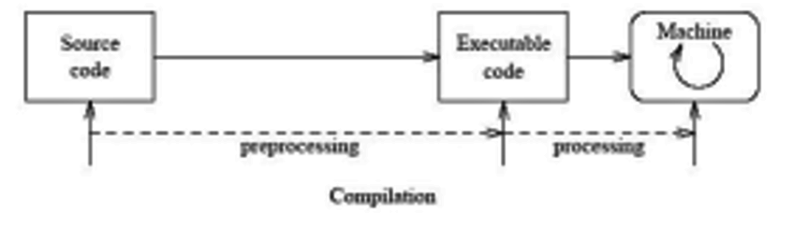
UML DIAGRAM

Slide 38
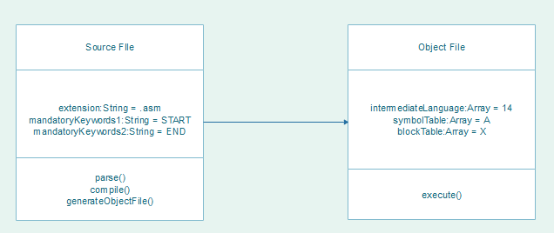
UML CLASS DIAGRAM

Slide 39
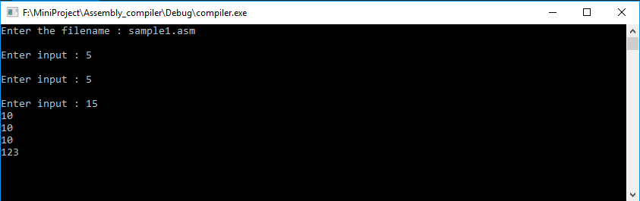
OUTPUT

Slide 40
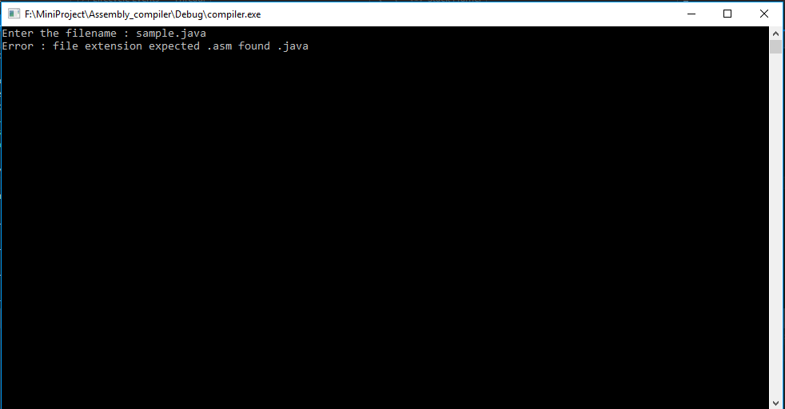
ERROR OUTPUT

Slide 41
Sample Object File(.obj)
---------------Symbol Table is----------
B 8 1
A 9 1
C 10 4
D 14 1
E 15 0
--------------Block Table is----------
X 6
---------------Instruction Table is----------
1 14 0
2 14 1
3 1 12 0
4 1 8 1
5 3 2 0 1
6 14 0
7 4 3 0 1
8 13 3
9 13 2
10 7 2 3 8 14
11 1 10 2
12 13 10
13 6 17
14 1 11 3
15 13 11
16 6 6
17 13 15

Slide 42
REFERENCES
Compiler Design Concepts : https://www.tutorialspoint.com/compiler_design/
Alfred V Aho, Ravi Sethi, Jeffrey D.Ullman, “Compilers-Principles Techniques and Tools”, 2nd Edition, Pearson Education,2008..
Kenneth C.Louden, “Compiler Construction-Principles and Practice”, 2nd Edition, Cengage, 2010
C in Depth by Deepali Srivastava (Author), S. K. Srivastava

Slide 43
ANY QUERIES??

Slide 44
THANK YOU

