Slide 1

Module EN 4202 : Project RISC-V BASE-ISA PROCESSOR Supervisor : Dr. Ajith Pasqual
Department of Electronics and Telecommunication Engineering University of Moratuwa
5th APRIL 2017

Slide 2
GROUP MEMBERS
H.M.N. Perera 120465X
D.M.Y.N. Senaviratne 120602R
M. Thilakasiri 120660P
H.A.R.T. Wijesekara 120715P

Slide 3
INTRODUCTION
In the current processor industry following problems can be identified,
Processor manufacturing giants like Intel and AMD have proprietary or closed processor designs.
Integrating a ARM processor core in a design is expensive due to high licensing fees.
MicroBlaze by Xilinx and Nios by Altera can only be used in their own hardware platforms.
Primary Objectives
Design a high performance processor using RISC V ISA.
Soft processor core optimized for performance.

Slide 4
EXPECTED DELIVERABLES
RISC–V Base ISA processor
Design for optimal performance, and for portability
Demonstrate in FPGA, but extendable to ASIC implementations
Compare with existing designs and implementations
Extendable to include multiplication and/or division

Slide 5
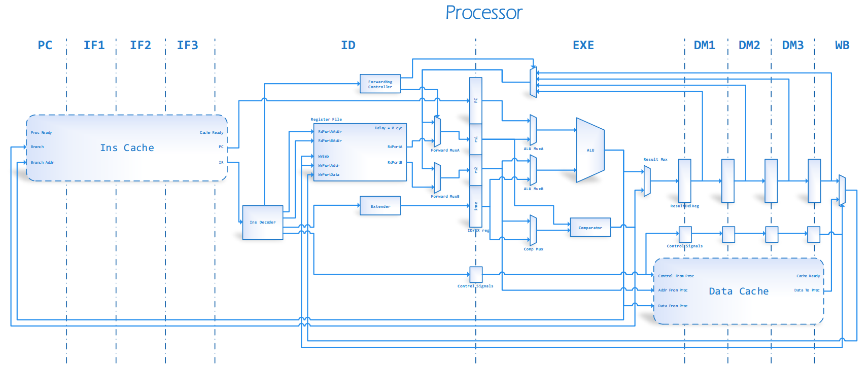
ARCHITECTURE

Slide 6
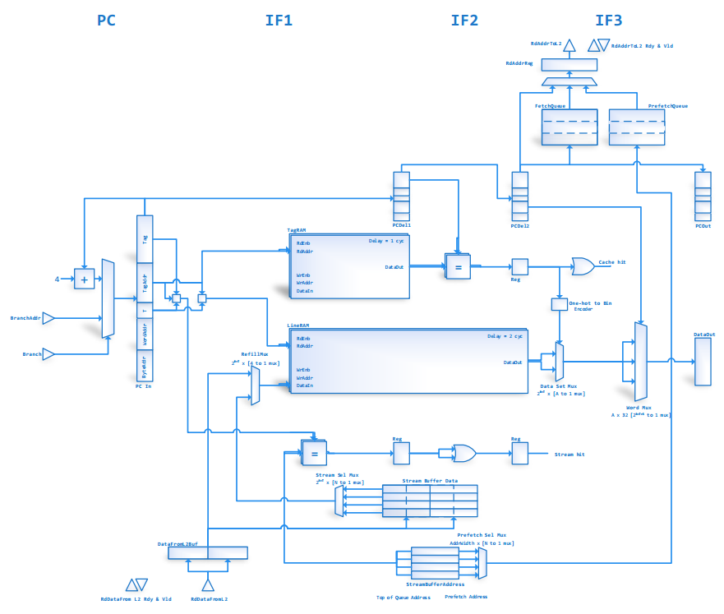
INSTRUCTION CACHE

Slide 7
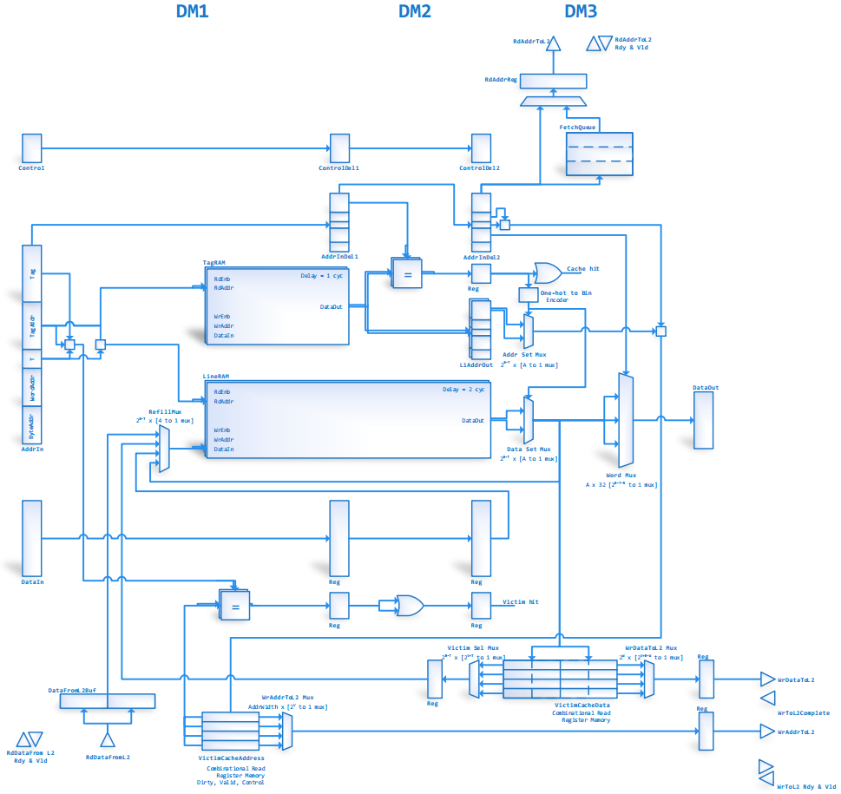
DATA CACHE

Slide 8
Features
Implements 32I RISC V ISA
Optimized 10 stage pipeline
Data and instruction cache support -Parameterizable size, associativity, cache line width etc. -Optional victim caches, stream buffers -AXI4 MM capable memory interfaces
120MHz clock frequency
Utilization at 16KB caches
 | Resource Utilization
Slice LUTs | 5966
Slice Registers | 3948
Block RAM Tiles(36Kb) | 18

Slide 9
Strategies for high performance
10 stage deep pipeline for maximizing instruction level parallelism.
3 stage L1 cache, for high frequency operation
Wide AXI4 MM bus (128 bit or higher) towards lower memory levels
Width to depth translation of line memory
Write-back caches, early restart and critical word first fetching
Stream buffers and victim caches to further reduce cache miss penalties
Ability to miss under miss (capability of handling multiple misses in parallel)
Result forwarding to deal with consecutive dependent instructions
Relocating logic from EX stage to ID stage for reducing critical paths
Architecture supports extension for multi cycle multiply/divide units

Slide 10
Implementation & Verification
The processor was implemented on Zynq-7 (ZedBoard) and Artix-7 (AC701) at 120MHz and 140MHz respectively.
A special test setup was created, to use existing ARM core to provide the necessary environment for RISC V core to function
Several test programs were run in hardware using the ZedBoard. Test programs included
Array bubble sorting
Histogram/ basic statistic calculation
Convolution filtering
Matrix multiplication
Function calls and return

Slide 11
Comparison
Compared with ‘SHAKTHI’ cores developed by IIT Madras
Utilization / frequency comparison
 | Our design at 64KB caches | Shakthi class c
Slice LUTs | 6681 | 16246
Slice Registers | 3947 | 5874
BRAM tiles (36Kb) | 32 | 44.5
DSPs | 0 | 7
Frequency | 120MHz | 40MHz

Slide 12
Conclusions
‘SHAKTHI’ core has implemented multiplication and floating point operations. Therefore resource comparisons cannot be taken directly.
But we do not expect LUT count to exceed 10,000 even when we add above functionality.
Further more our implementation has better timing performance.
This difference in efficiency can be attributed to HLS tool flow (Bluespec) vs Verilog tool flow
It can be concluded that compared with existing work, our work has taken the extra step towards realizing actual hardware implementation of RISC V architecture.

Slide 13
Future Plans & Improvements
Extensions toward floating point, multiplication and division
Further subdividing the execution stage will potentially increase the frequency to +200MHz
Adding a more complex branch prediction scheme will significantly decrease wasted cycles
Addition of virtual memory and memory management units.

Slide 14
THANK YOU

