Slide 1

Module EN 4202 : Project RISC V BASE ISA PROCESSOR Supervisor : Dr. Ajith Pasqual
Department of Electronics and Telecommunication Engineering University of Moratuwa
22nd July 2016

Slide 2
GROUP MEMBERS
H.A.R.T. Wijesekara 120715P
D.M.Y.N. Senaviratne 120602R
M.M.G.U.M. Thilakasiri 120660P
H.M.N. Perera 120465X

Slide 3
PROBLEM STATEMENT
In the current processor industry following problems can be identified
Processor manufacturing giants like Intel and AMD have proprietary and secret processor designs.
Integrating a ARM processor core in a design is expensive due to high licensing fees.
MicroBlaze by Xilinx and Nios by Altera can only be used in their own hardware platforms.
Therefore the need for a low cost, multi platform open source processor is eminent.
RISC-V ISA was developed by University of California as a solution to this problem
But actual implementations of the ISA need to be developed
Notes:
What the problem?
Intel AMD proprietary and secret
ARM expensive
MicroBlaze Nios can be ASICed without license
open source processors neeeded

Slide 4
PRIMARY OBJECTIVES
Design a high performance processor using RISC V ISA
Soft processor core optimized for performance
Achieve equivalent or superior performance to similar processors such as Xilinx MicroBlaze and Altera Nios II
Notes:
RISCV
outperform on which platform?

Slide 5
SCOPE
We have limited ourselves to the following scope,
RISC-V Base ISA with only integer operations
Optional multiplication and division extensions (if time permits)
Design for optimal performance, and for portability
Implement in FPGA, but extendable to ASIC implementation
Compare with existing designs and implementations
Notes:
base ISA, integer operations
implement base isa
try multiplication, division if possible
implement in fpga board and compare with existing designs
optimise for performance

Slide 6
BENEFITS AND BENEFICIARIES
Benefits
Processor compatible with wide range of applications
High level programmability
Parameterizable architecture for better performance/user requirement
Portable to many different platforms
Beneficiaries
Developers who do not have access to expensive/licensed processor cores
Undergraduates & Researchers
Department of Electronic and Telecommunication Engineering, UoM
Group members (Experience, Knowledge)
Notes:
benifits - proceseor with wide range of applications
high level programmerbility
reconfigurable architecture for better performance or user requirements
beneficiaries - developers who do not have access to licensed processor cores
undergraduates
researchers
electronic and telecommunication engineering department, university of moratuwa
group members - gain experience, knowlegde

Slide 7
LITERATURE REVIEW
RISC V architecture specifications
RISC-V ISA Manual, Volume I-II, A.Waterman et al, University of California
Design of RISC-V ISA, A.Waterman, University of California
Processor design and implementation (text books)
Computer Organization and Design, 4th Ed, D.A.Patterson, J.L.Hennesey
Computer Architecture, 5th Ed, D.A.Patterson, J.L.Hennesey
Other ISA specifications and implementations
Intel 64 and IA-32 Architectures Developer’s Manual
MicroBlaze Processor Reference Guide, Xilinx Inc.
Other RISC-V implementations
Rocket Chip, K.Asanovic et al, University of California
Pulpino, Andreas Traber et al, University of Bologna
Processor and cache specific papers
Design of high performance L1 cache for RISC processors, T.V.K.U.Kumar et al,Bharath Univ.
Bus and Cache Organizations for Multiprocessors, D.C.Winsor, University of Michigan

Slide 8
ARCHITECTURE

Slide 9
ALTERNATIVE STRATEGIES
Using a 3 stage pipeline in place of a 5 stage pipeline.
Can’t go up to the clock speed we require
Using one level of cache without using two levels of cache.
Negative effect on performance
Use of out of order execution in place of in order execution.
Exceedingly complex, for the development time we have
Using Matlab based simulations in place of C based simulations.
Already available toolchains, developed by UoC
Notes:
In terms of hardware….
pipeline stages
cache levels
out of order execution
using altera
why chisel
c based

Slide 10
RISKS AND PLANS
Technical risk factors
Can we compete with the major processor families like ARM and Intel?
Good structure and expert design in the ISA already gives us a certain edge.
Innovation needed in the implementation.
Can we exhaustively test the processor within the project period?
Start only with the basic ISA
Additional capabilities introduced only if time permits
Sustainability risk factors
Can we support the processor 5-6 years to the future?
Plan to continue the project within the ENTC for the next few years also
Can the processor compete in the future market?
Use the most recent design and optimization strategies
Make the design modular, parameterizable and extendable
Financial risk factors
Can we sell this processor?

Slide 11

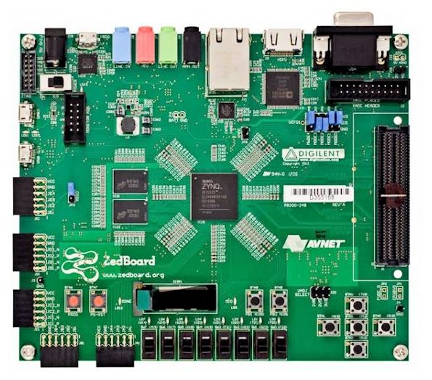

RESOURCE REQUIREMENTS
Licensed tools
Matlab
Xilinx Vivado
ModelSim
Hardware tools
Virtex 7 development board
Notes:
licenced tools
Matlab
Xilinx vivado
ModelSim
Hardware
Virtex 7 development board

Slide 12
BUDGET AND FUNDING
At our scope of the project, we do not want any external funding as we will not have any expenditure.
Resources needed for the project (eg : Software licences, FPGA Board) is available at the department

Slide 13
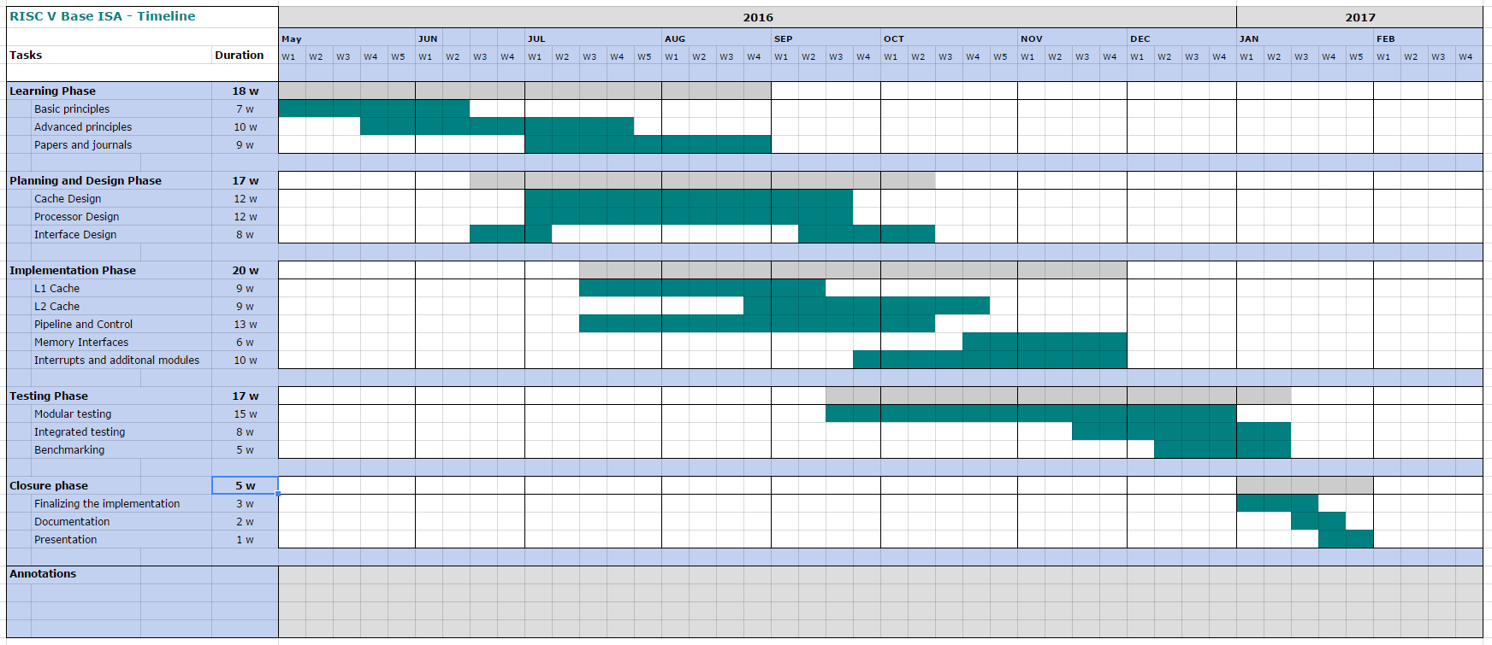
TIMELINE
Notes:
Learning phase
Planing and design phase
Implementing phase
Testing phase
Closure phase

Slide 14
TASK DELEGATION
 | Ravi | Yasas | Nimashini | Mojith
Study | Cache | Benchmarking Prog, DDR3 | Microblaze | Base ISA
Cache design | ✓ |  | ✓
Pipeline and Control |  | ✓ |  | ✓
Memory controller | ✓ |  | ✓
RAM Interface | ✓ |  | ✓
IO Interface |  | ✓ |  | ✓
Interrupts & other modules |  | ✓ |  | ✓
Compilers and toolchains |  | ✓ |  | ✓
ISA simulator |  |  | ✓ | ✓
Test and verification | ✓ | ✓ | ✓ | ✓
Benchmarking | ✓ | ✓
Analysis | ✓ | ✓ | ✓ | ✓
Notes:
pipeline
cache
memorey controler
ram interface
IO interfaces
testing
bechmarks
convertion to assembley
toolchain
ISA simulator
testing
Analysis
Yasas
Benchmarking programs
SPEC
Studying DDR3 MMU generation in Xilinx
Studying how to convert hiigh level code into assembly using RISCV tool chain
Pipeline design and implementation
currently ALU
Mojith
Detailed study of the ISA
Pipeline design and implementation
currently ALU
Nimashini
Studying microblaze for benchmarking
Cache design and implementation
Ravi
Cache design and implementation

Slide 15
PROGRESS
We have studied RISC V ISA, benchmarking methodologies, similar architectures which are present in the literature
We have started designing and implementing the pipeline architecture and cache architecture.
Notes:
progress

Slide 16
THANK YOU

