Slide 1
float* solanum

Slide 2
float* solanum
float* solanum

Slide 3
SECTION 1

Slide 4
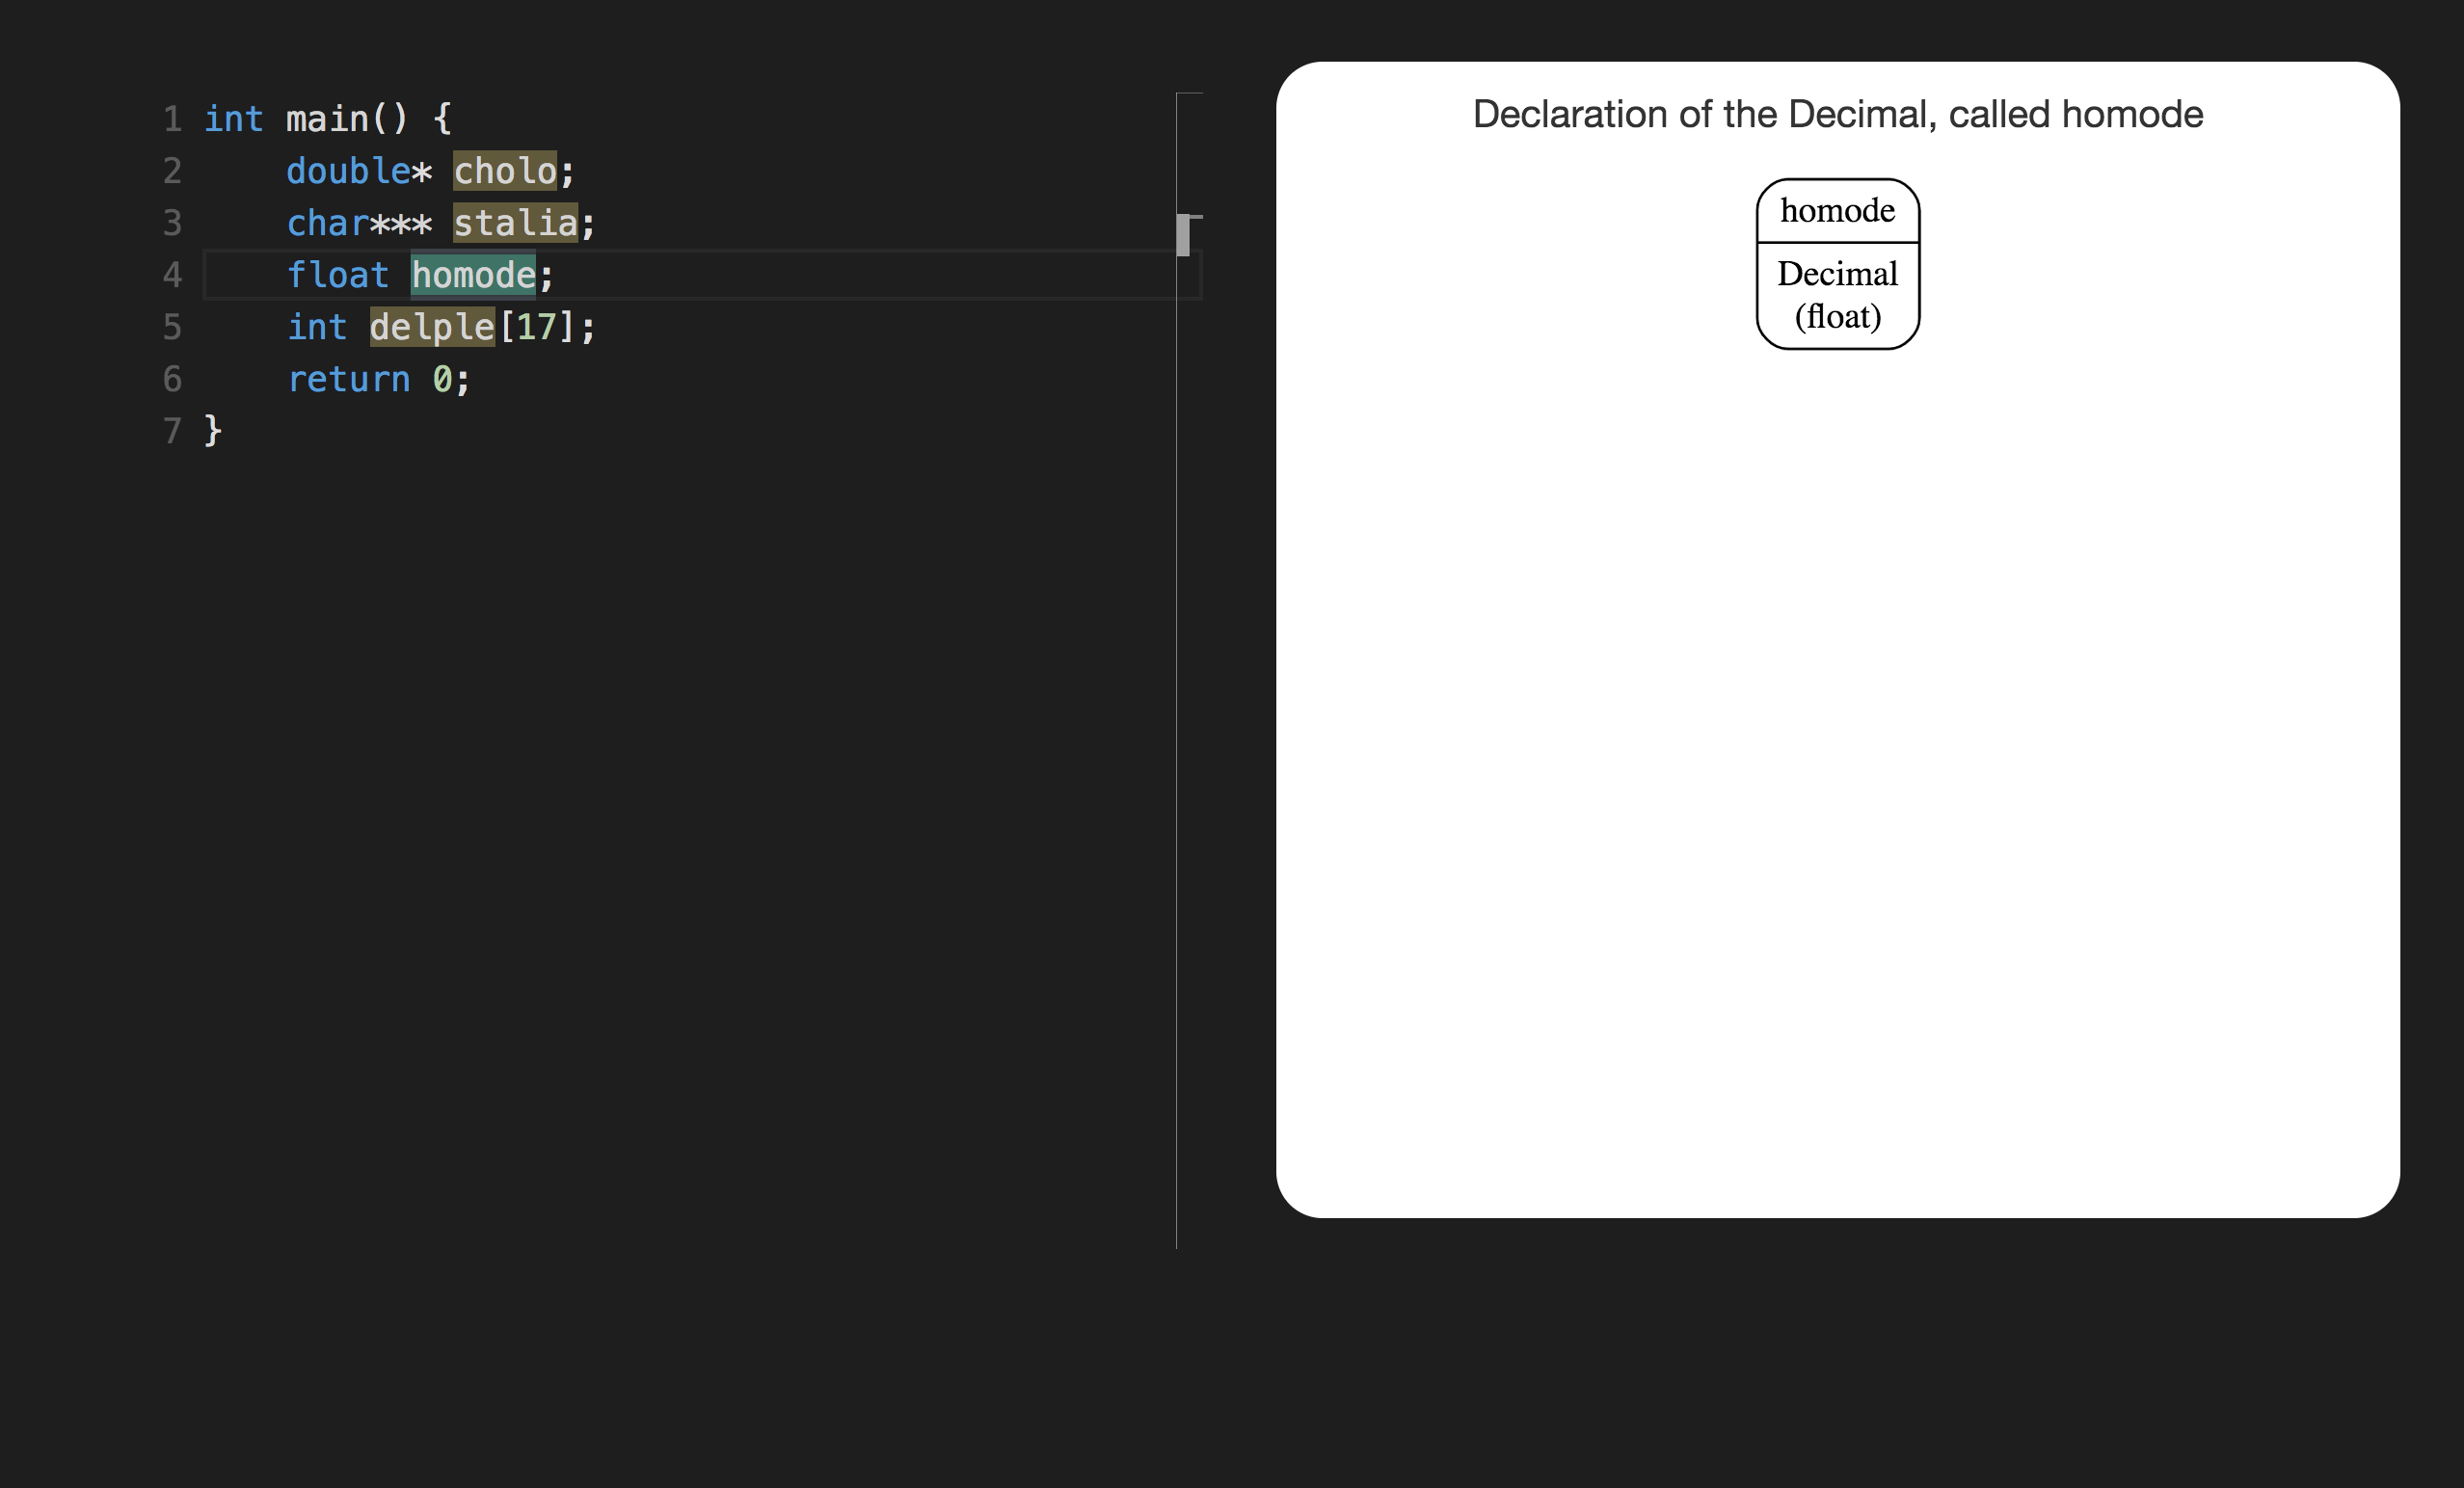

Slide 5
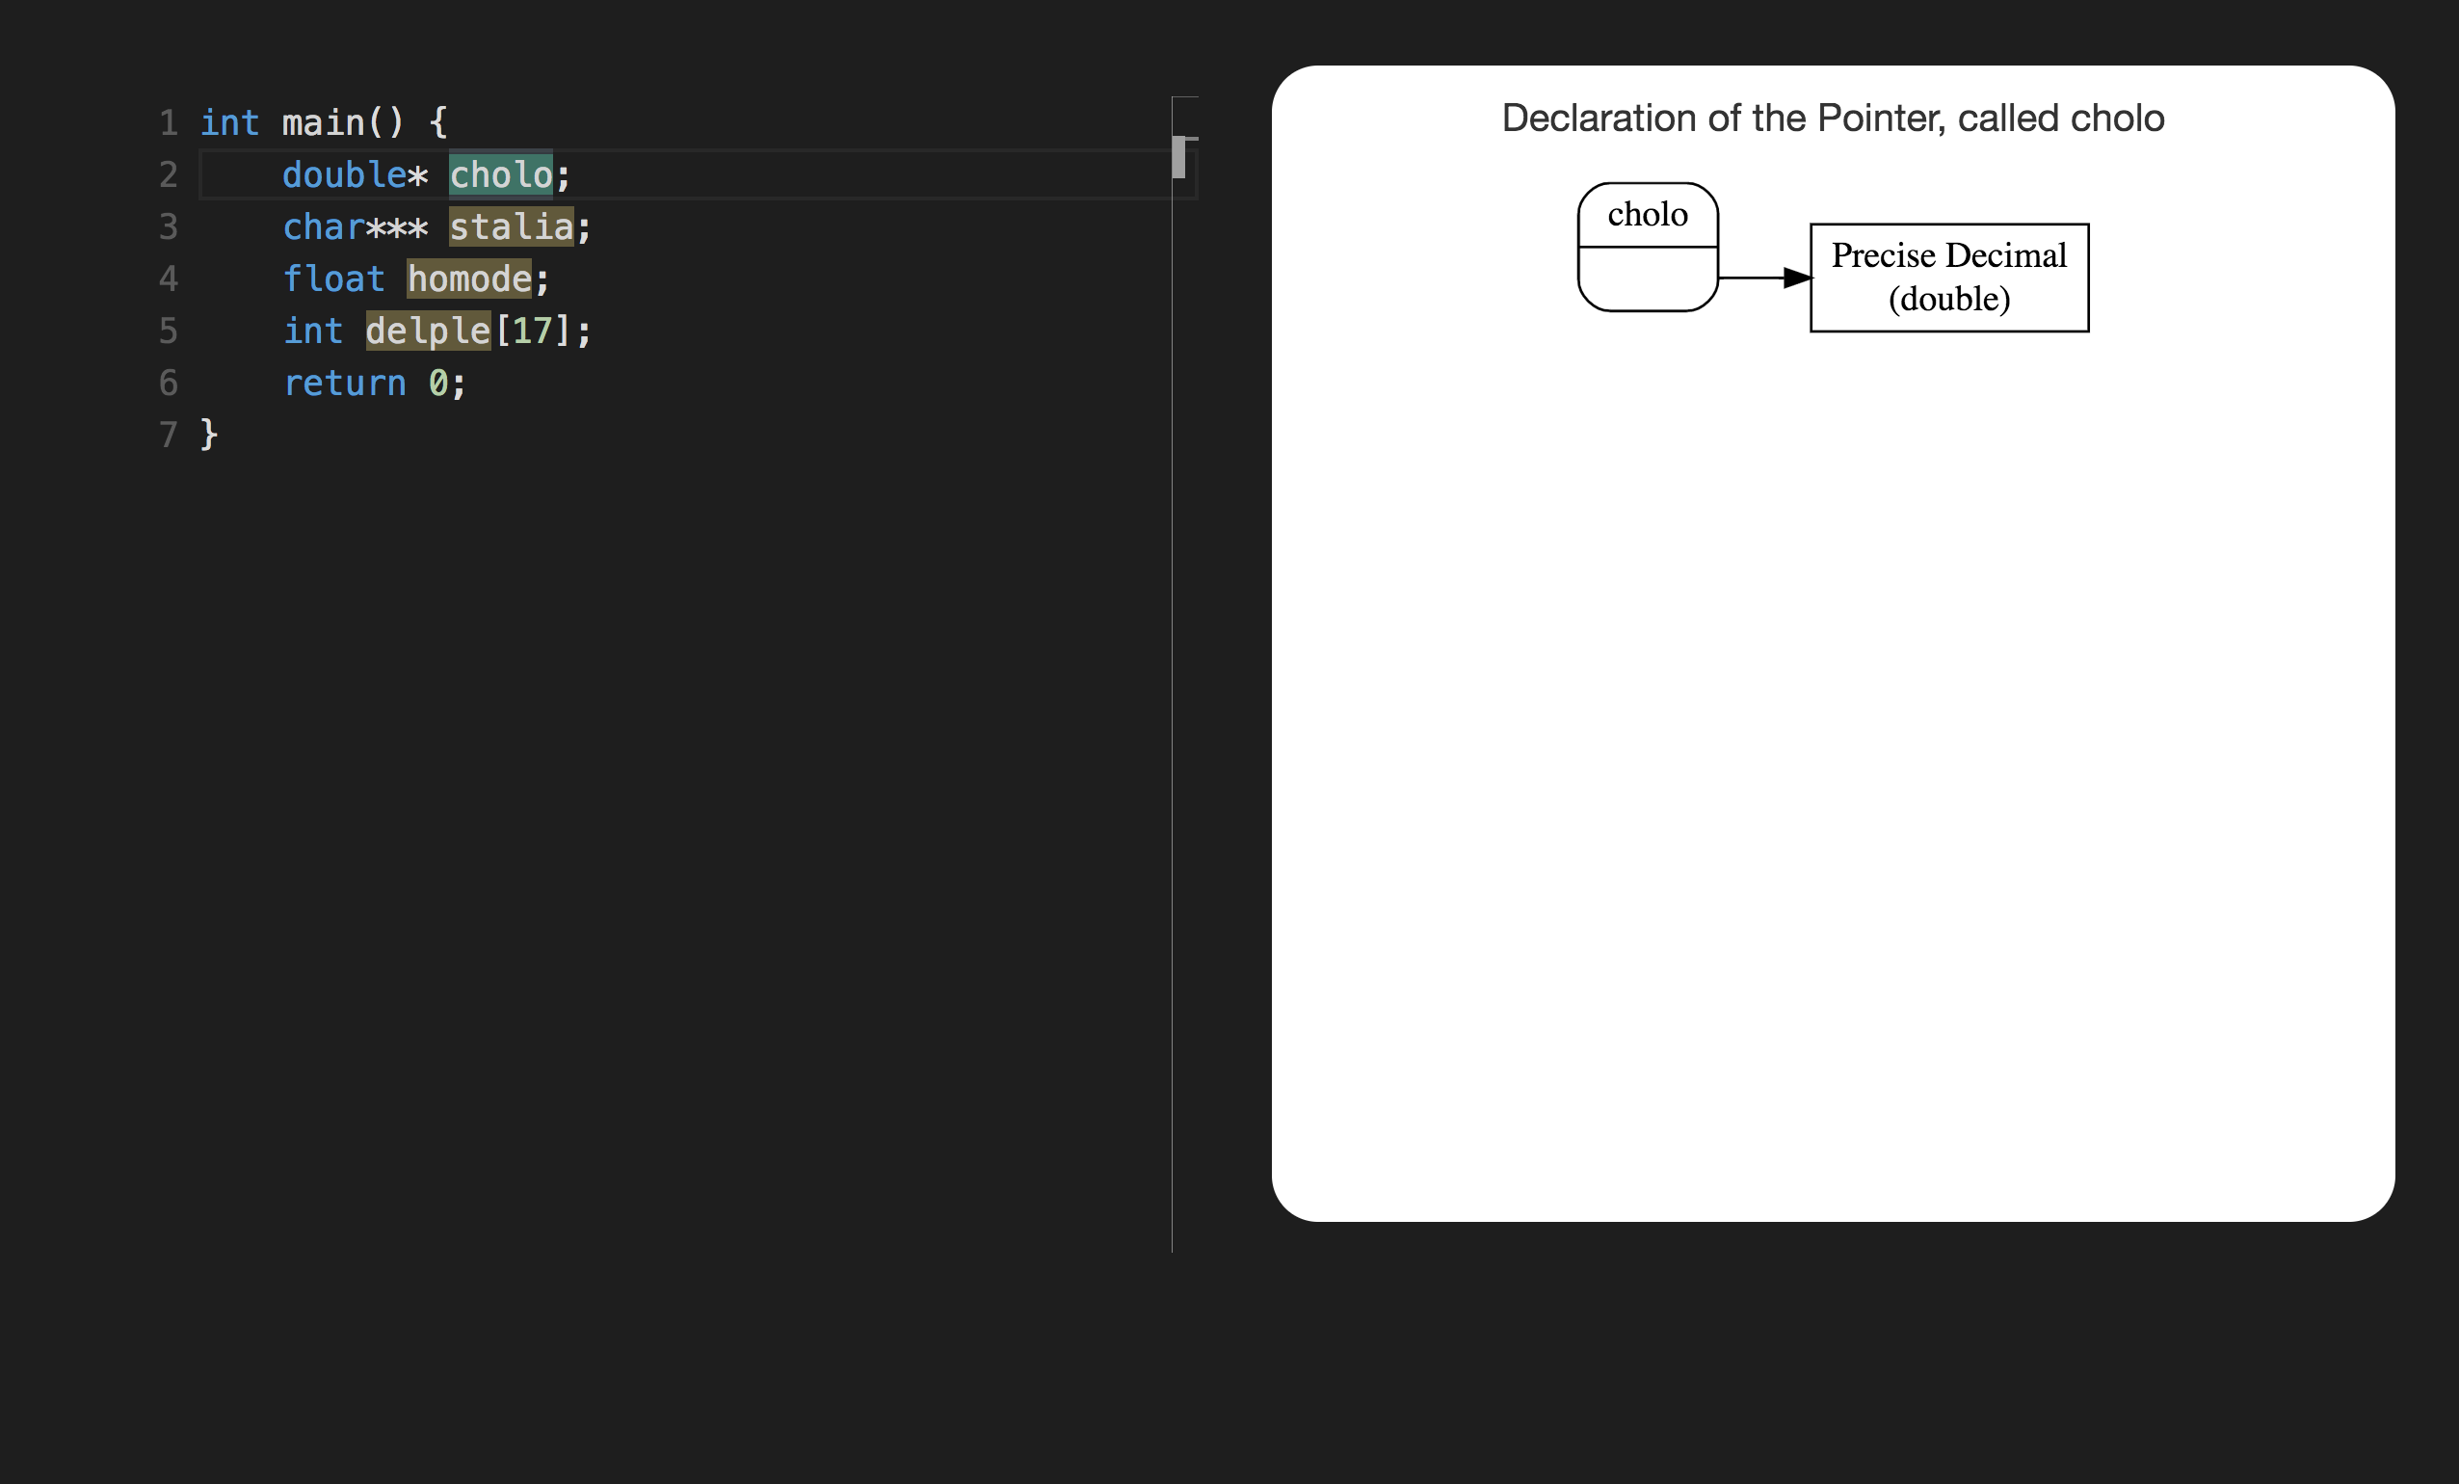

Slide 6
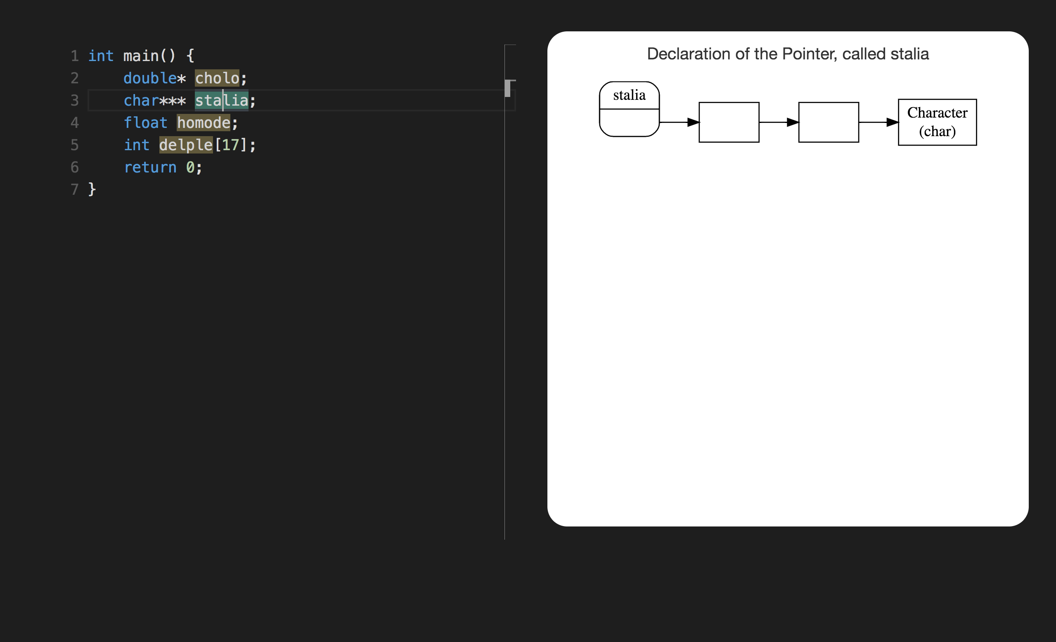

Slide 7
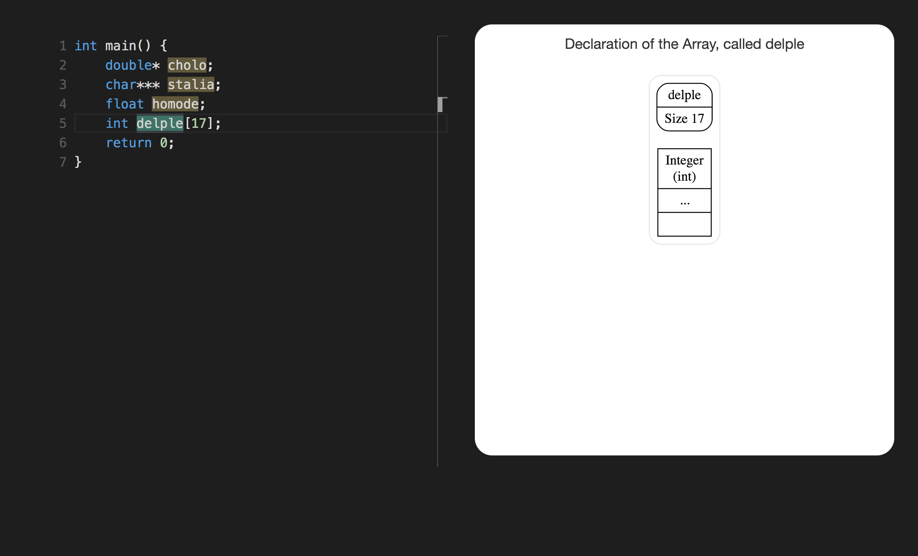

Slide 8
SECTION 2

Slide 9
void para(int*)

Slide 10
char* aspa(float)

Slide 11
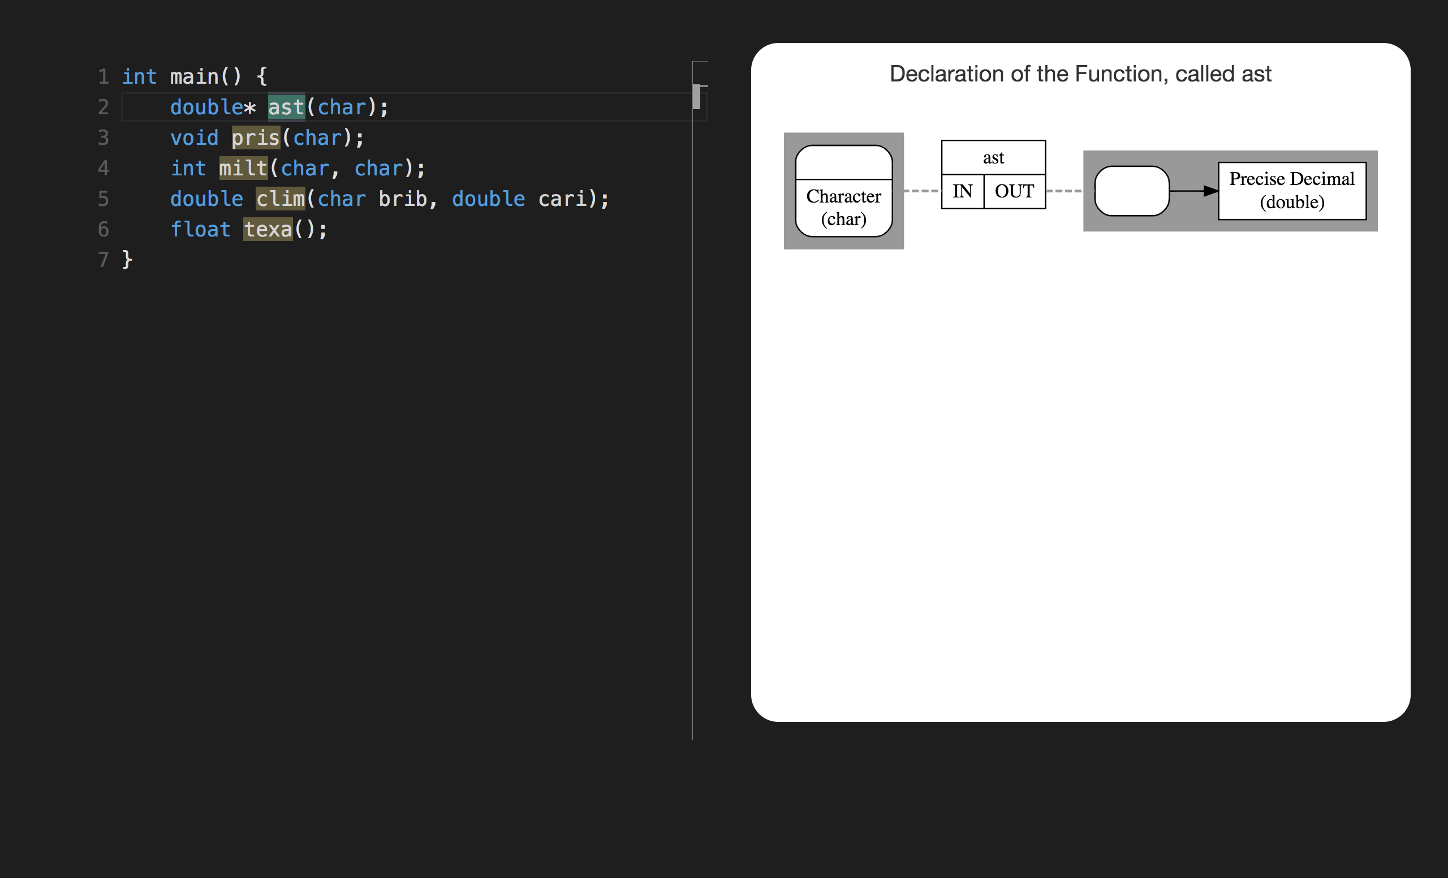

Slide 12
int indo(int*)
declare indo as
function (int) returning pointer to int

Slide 13
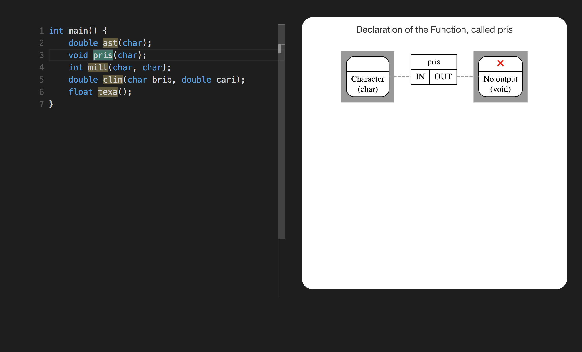
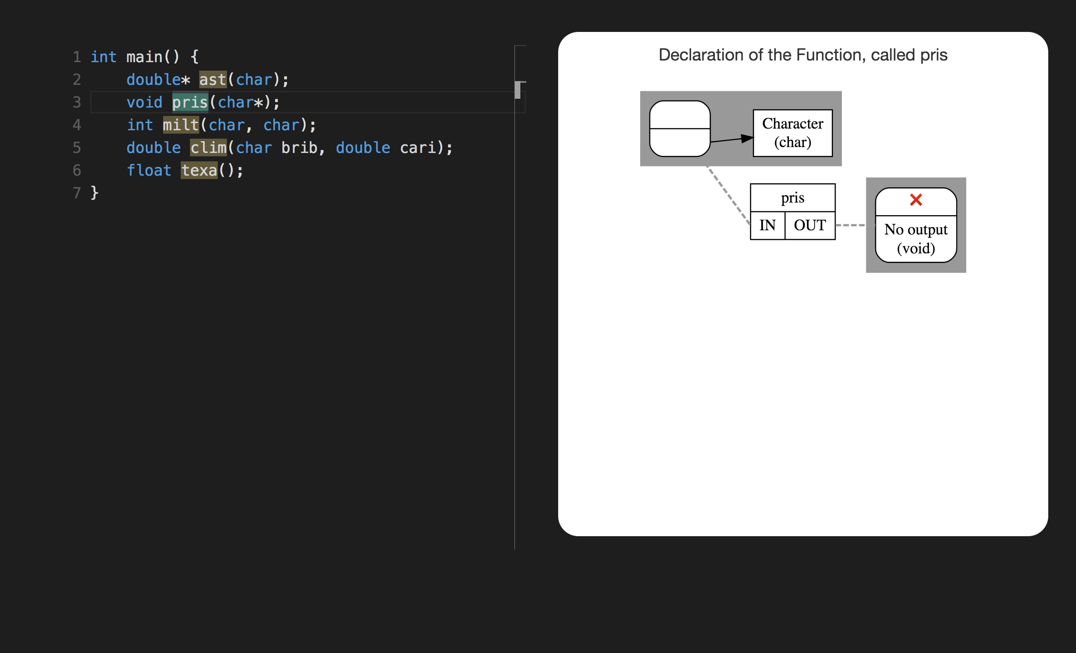

Slide 14
SECTION 3

Slide 15
char *trom[7]

Slide 16
int (*rota)(float, double, int)

Slide 17
char const ** const gera

Slide 18
int (*ster)[4]
declare ster as
pointer to array 4 of int

Slide 19
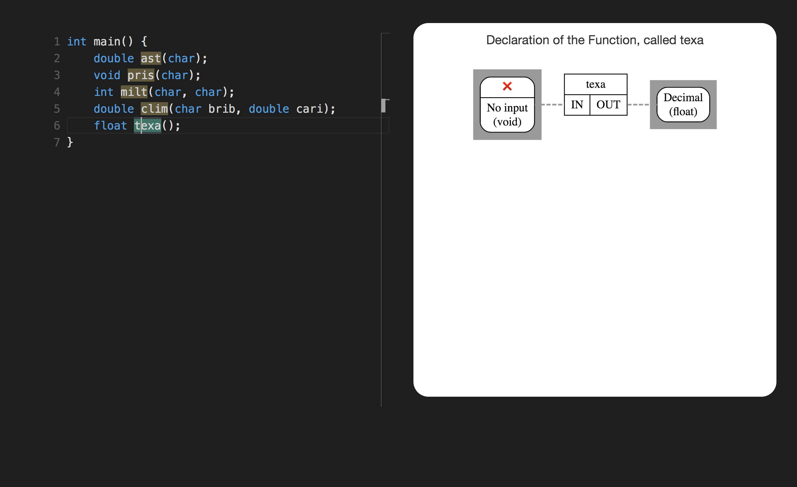
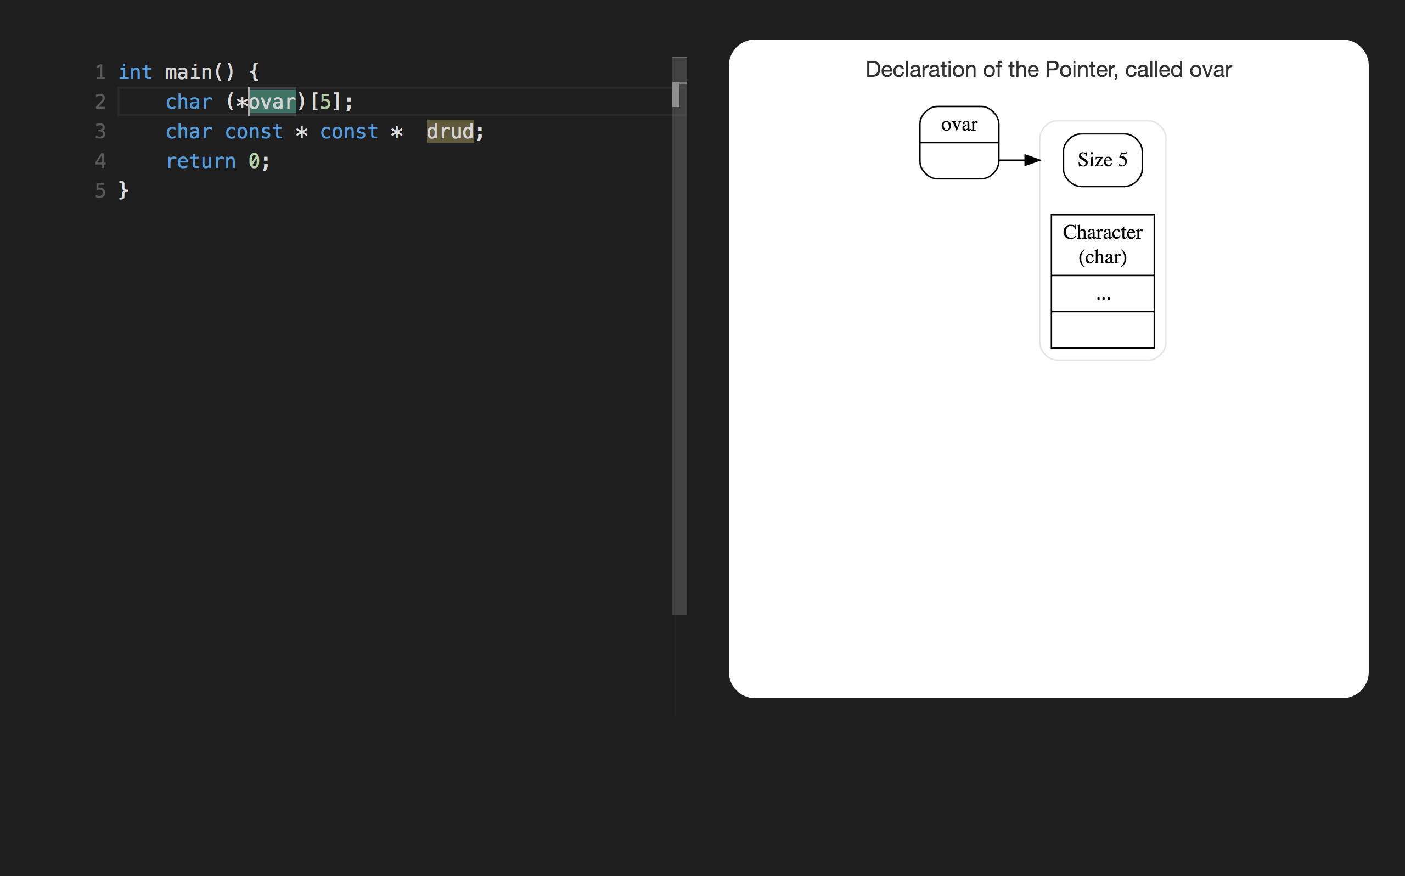

Slide 20
char (*blin)(int)
declare blin as pointer to function (int) returning char

Slide 21
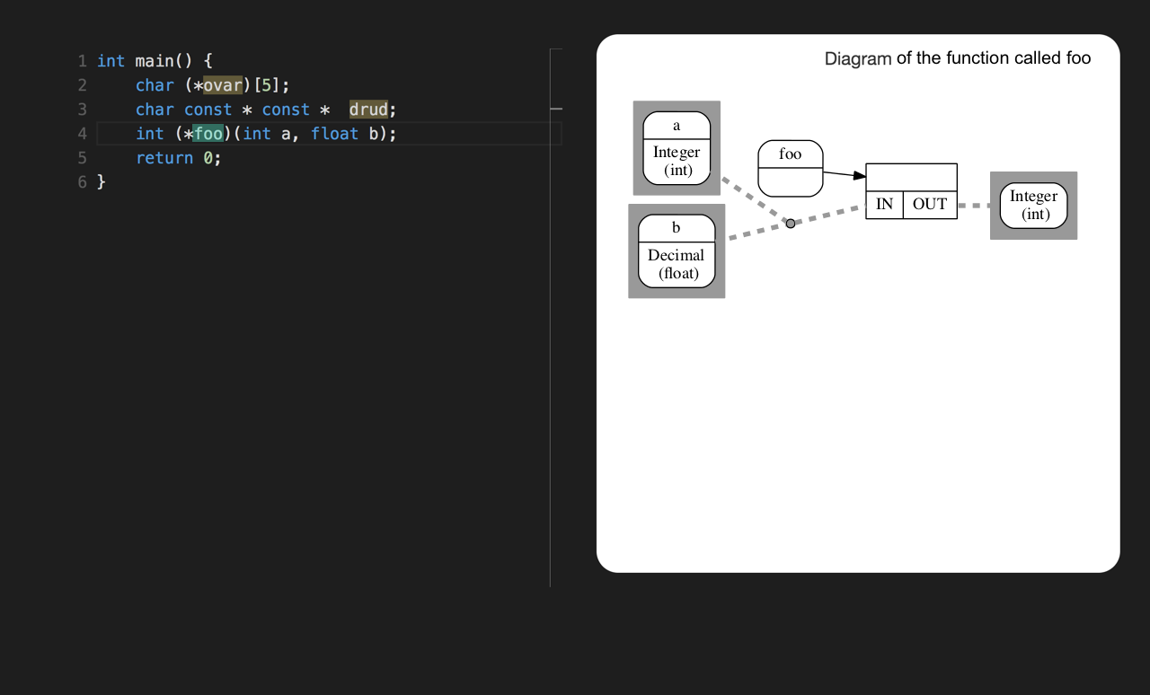
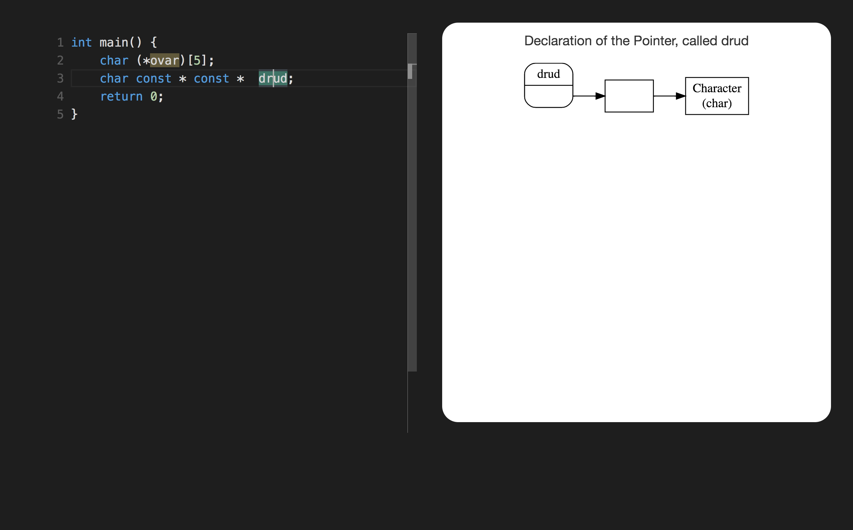

Slide 22
SECTION 4

Slide 23
char const ** const gera

Slide 24
char slin(int, int(*nort)())

Slide 25
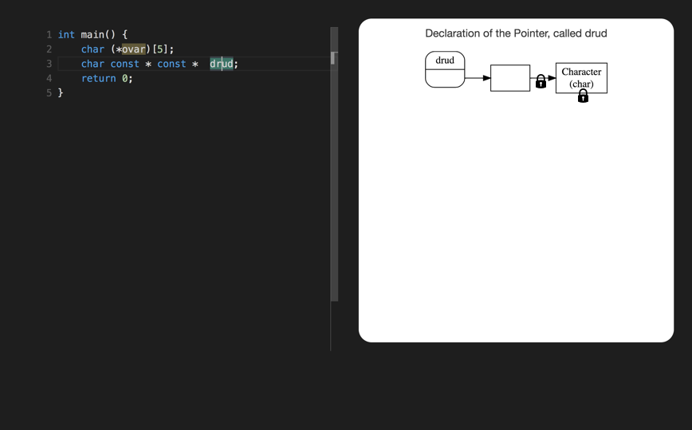

Slide 26
char * const * stic
declare stic as pointer to const pointer to char

Slide 27
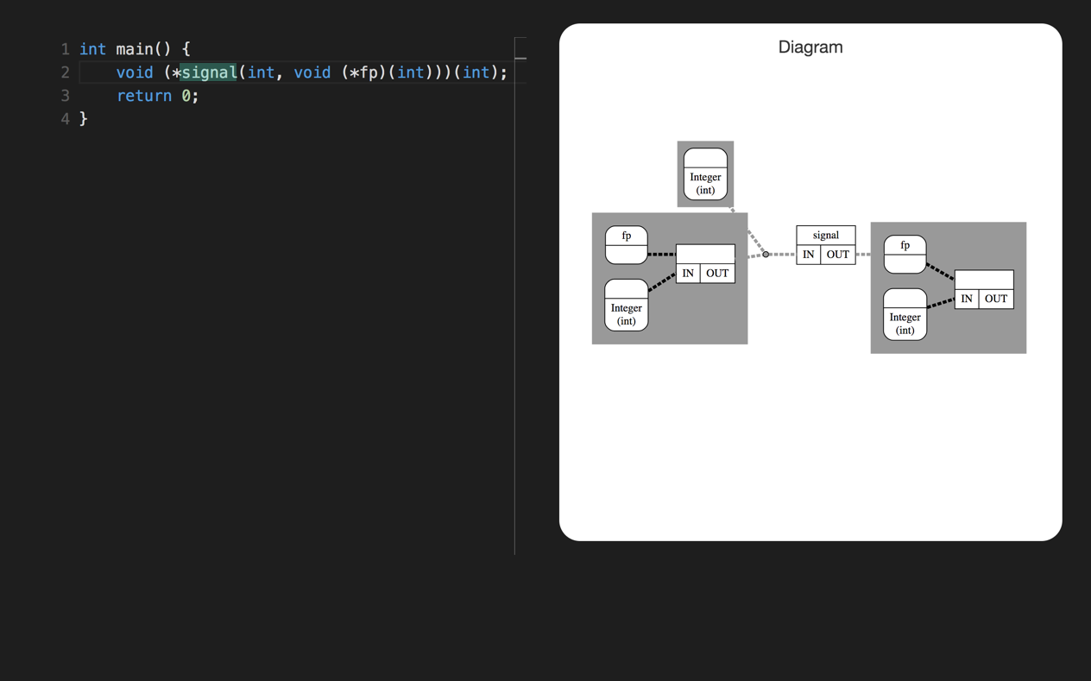

Slide 28
int (*holl(float))(char)
declare holl as function (float) returning pointer to function (char) returning int

